Slide 1

Professor Catherine Calderwood
University of Strathclyde, Glasgow
Consultant Obstetrician, Edinburgh
Former Chief Medical Officer for Scotland
Chair: Royal College of Obstetricians & Gynaecologists Patient safety Committee
X THE PLACE OF USEFUL LEARNING

Slide 2
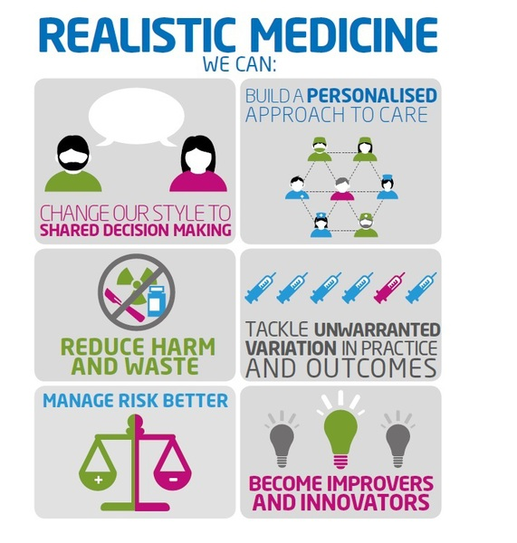

Slide 3


Slide 4


Slide 5


Slide 6


Slide 7


Slide 8
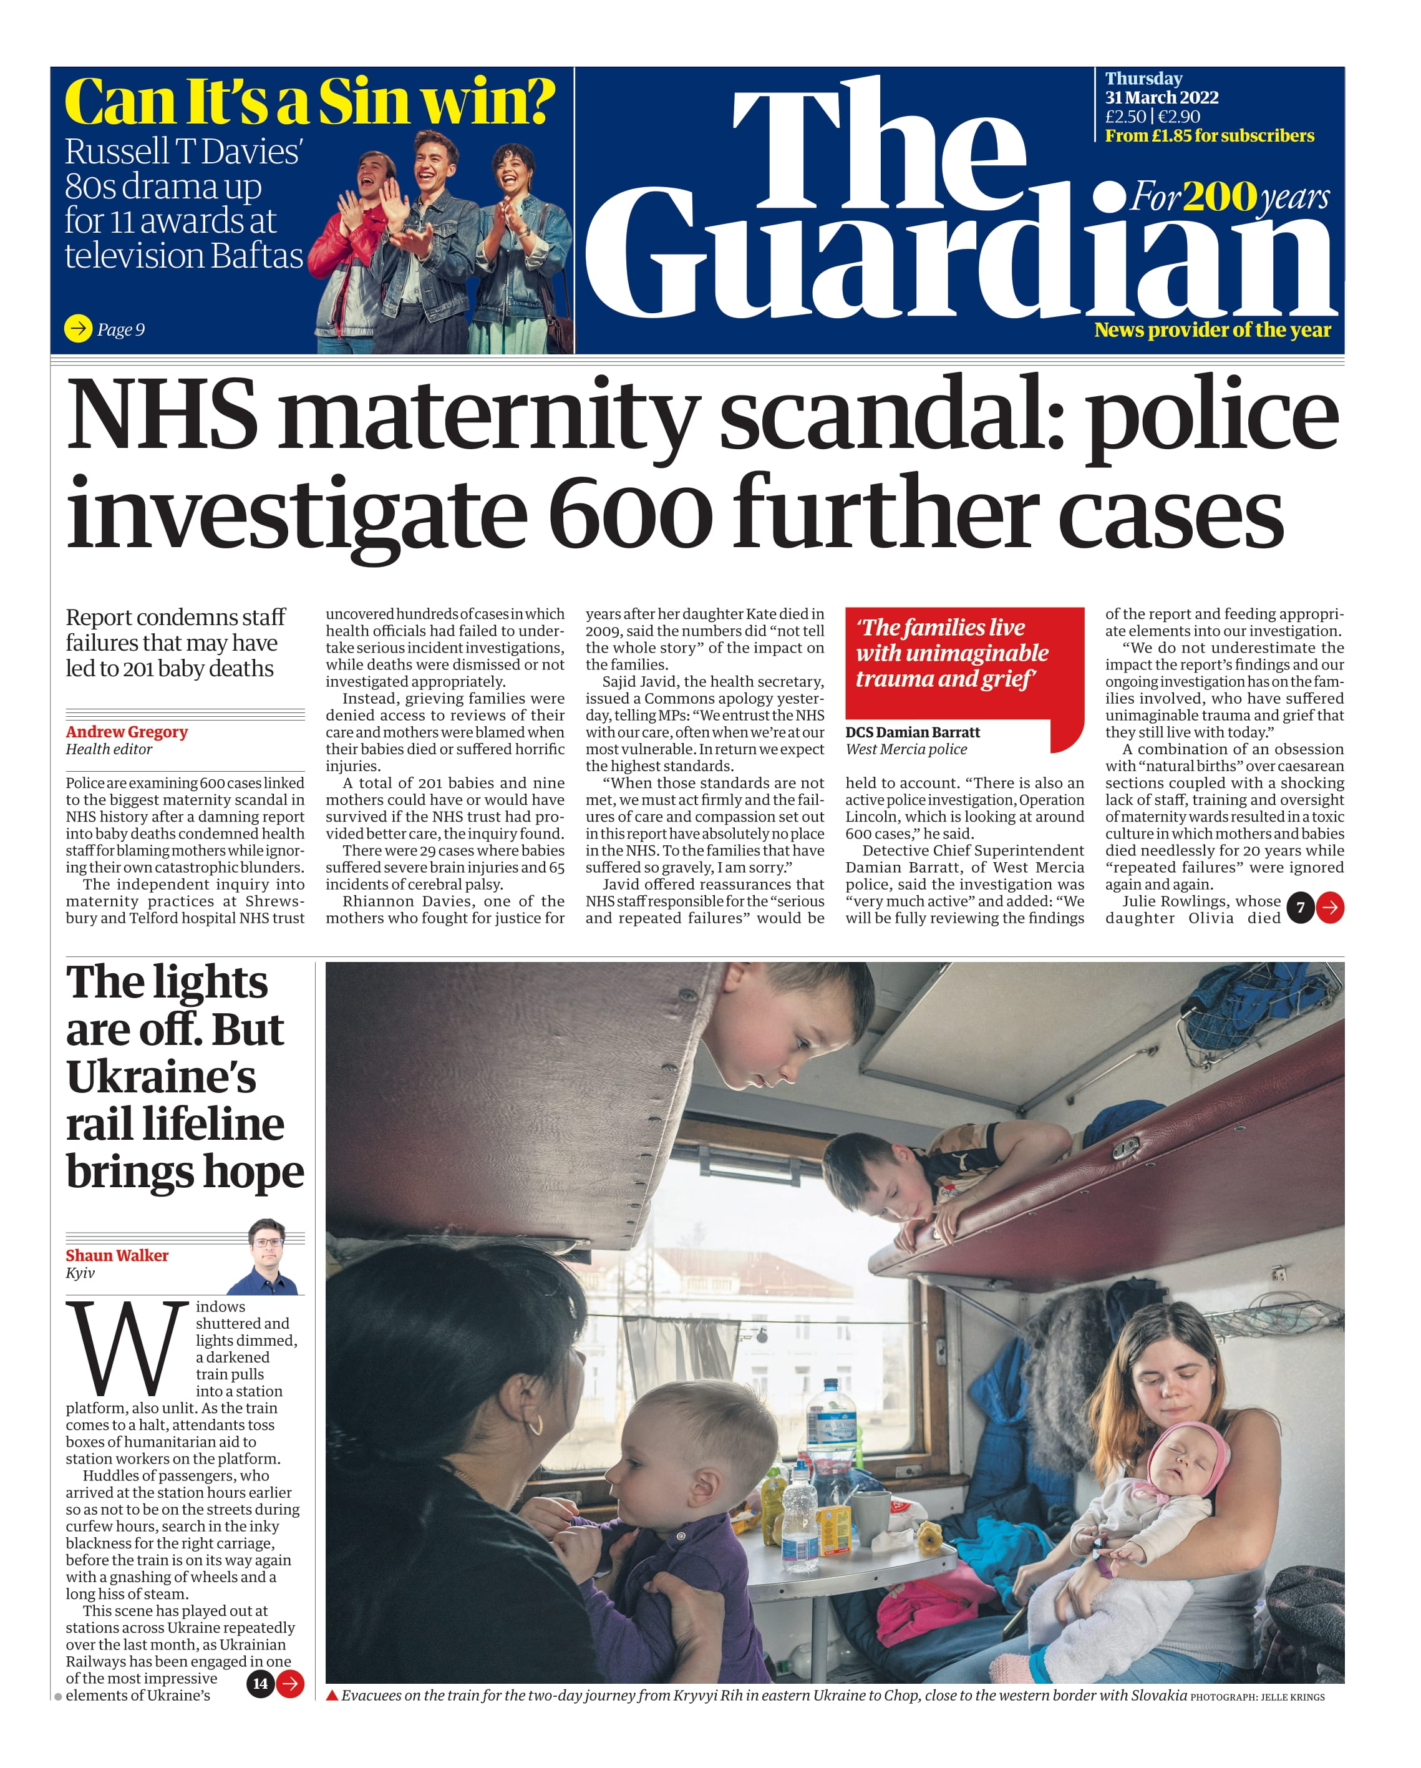

Slide 9


Slide 10


Slide 11
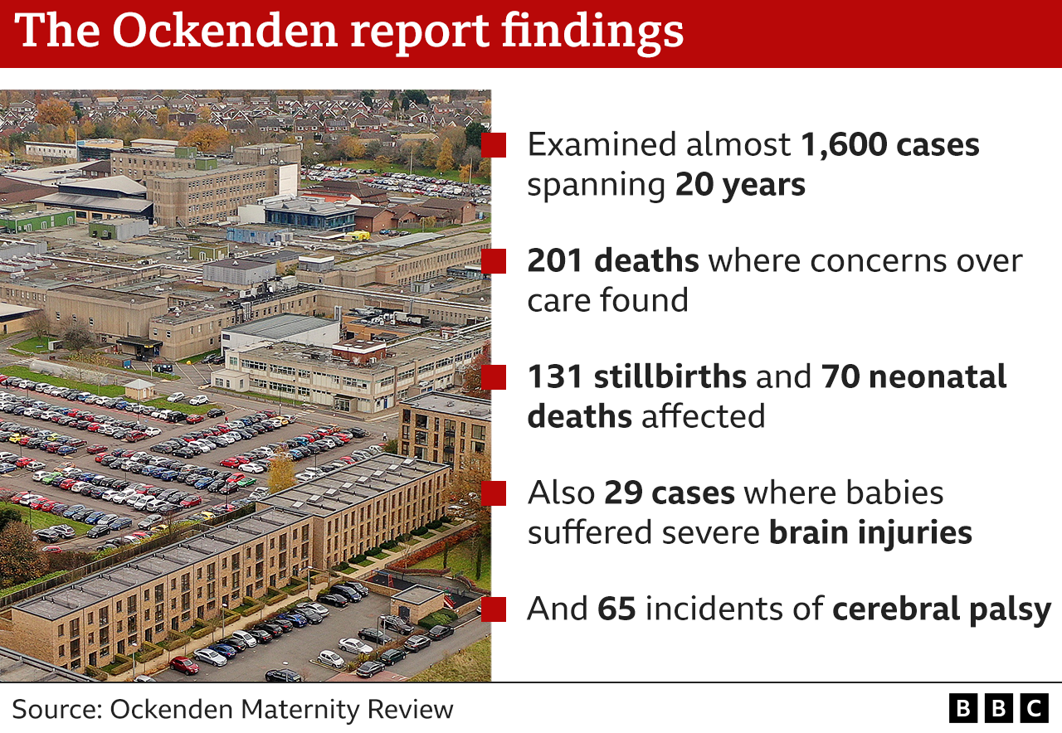

Slide 12
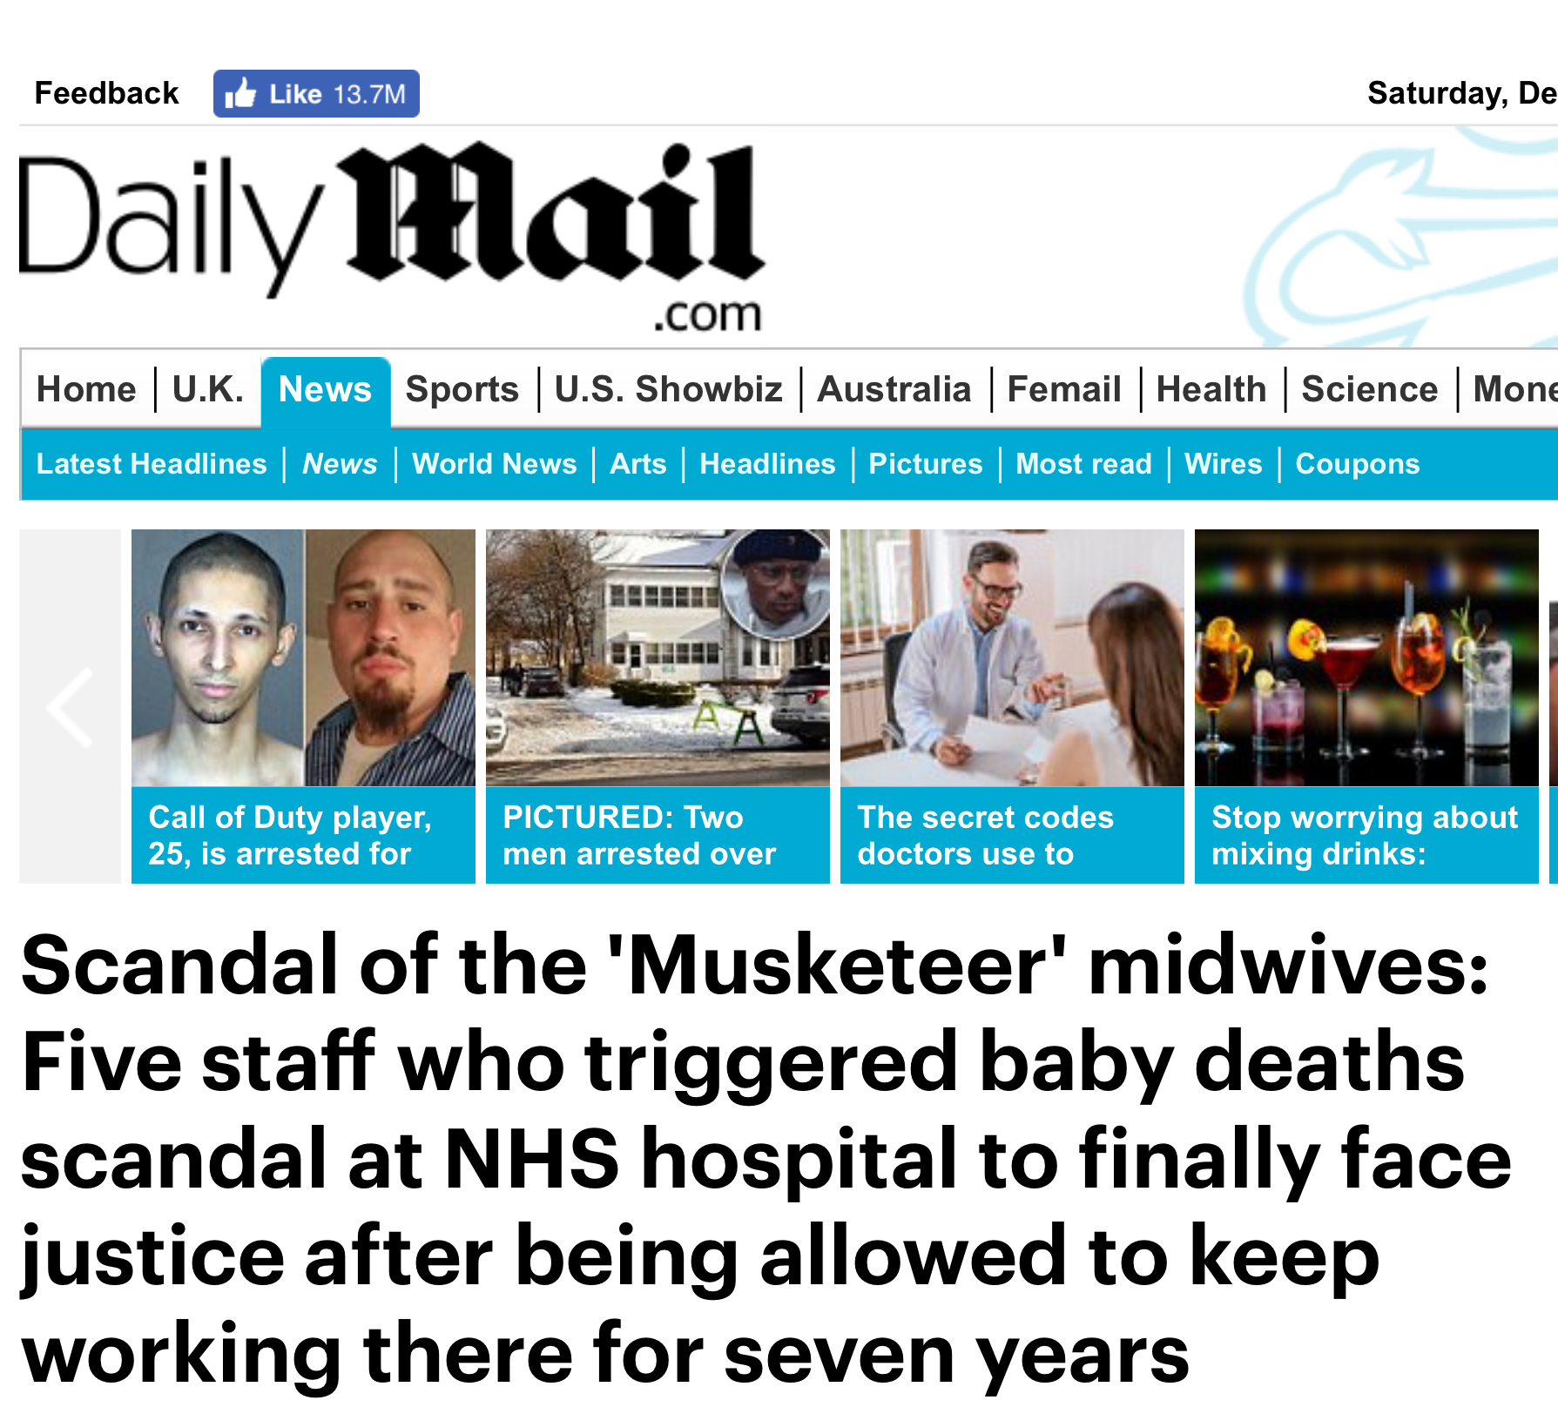
The problems within the Trust fell into five problem areas, which resulted in the service being described as seriously dysfunctional. These were:
Clinical competence of a proportion of staff fell significantly below the standard required for a safe, effective service
Working relationships between different groups of staff were extremely poor
Midwifery care in the unit became strongly influenced by a small number of dominant individuals
Advice to mothers that it was appropriate to consider delivery at FGH was significantly compromised by a failure to assess the risks properly
A grossly deficient response from unit clinicians to serious incidents with repeated failure to investigate properly and learn lessons

Slide 13



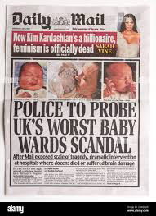


Slide 14
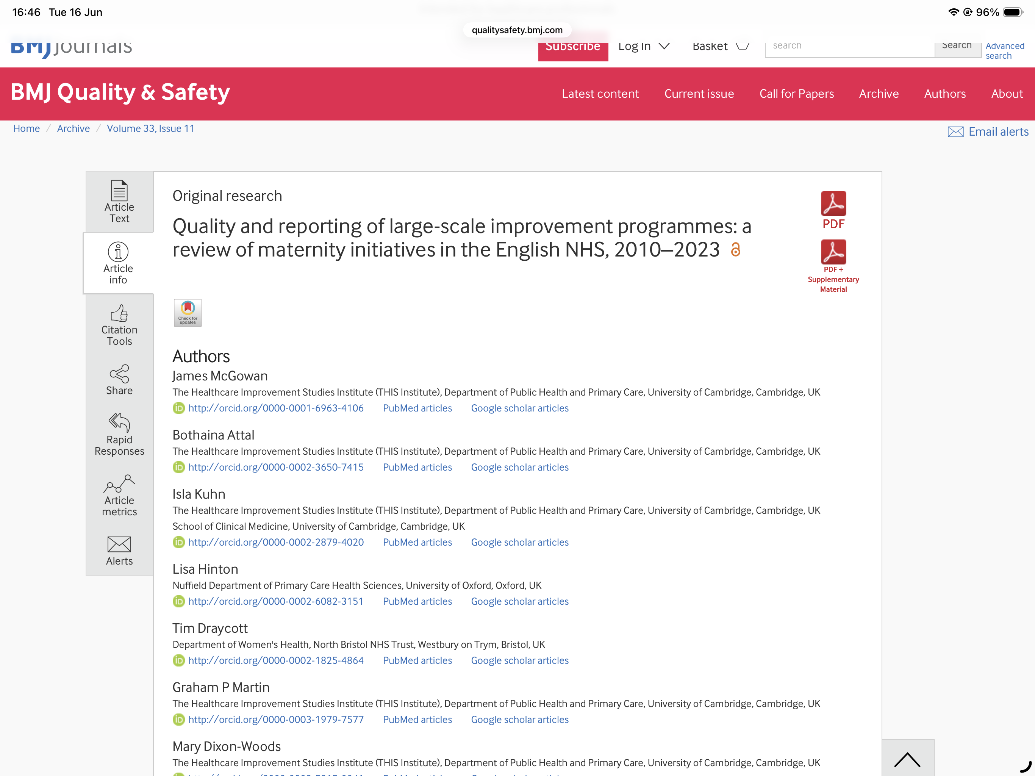

Slide 15
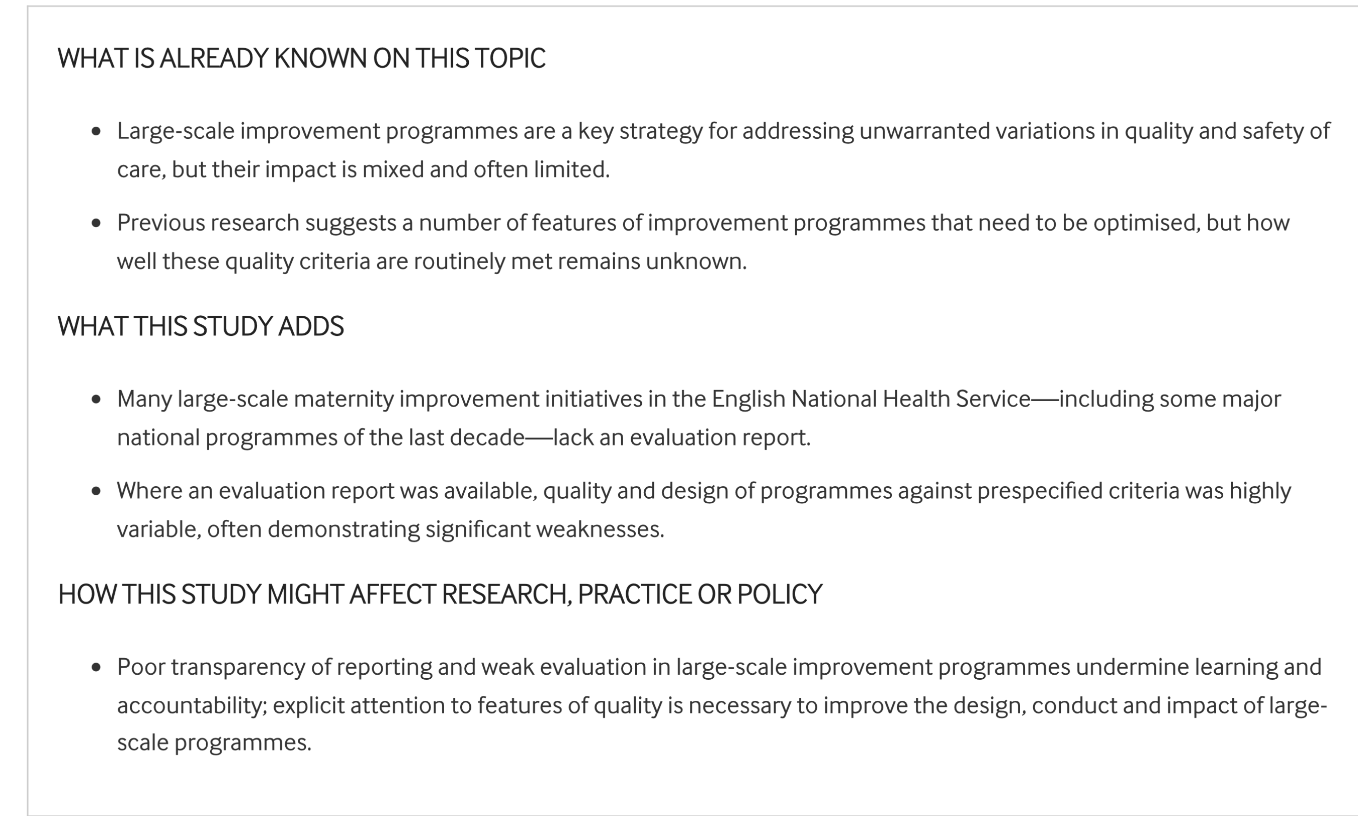

Slide 16
Clinical Safety & Workforce Transformation
Systemic Reform: Clinical Safety and Workforce Standards
Consolidated actionable directives from UK maternity inquiries (2015–2026)
Clinical & Safety Overhaul
Immediate Escalation: Mandatory senior obstetric review for complex, high-risk cases.
Fetal Monitoring: Standardized, centralized CTG systems to prevent undetected distress.
Independent Oversight: External clinical reviews and fully independent safety investigations.
Cross-hospital Audits: Regular peer reviews to enforce uniform clinical guidelines.

Slide 17
Workforce & Resources
Safe Ratios: Guarantee minimum staffing; end critical gaps on postnatal wards.
Joint Training: Enforce multi-professional team training to eliminate working in silos.
Outcome Metrics: Deploy unified, transparent data to catch failing units early.
Compassionate Care: Embed defined dignity and care metrics into daily operations.

Slide 18
Culture, Inequality, & Patient Advocacy
Cultural Overhaul: Accountability and Patient-Centered Care
Shifting from institutional protection to transparency and equity
Culture & Accountability
Statutory Candour: Legally enforce the "Hillsborough Law" duty of absolute truthfulness.
Eradicate Blame: Eliminate reputation-first "cover-up" cultures and denial tactics.
Zero Tolerance: Actively root out workplace bullying and intimidating behaviors.
Family Engagement: Involve bereaved parents in safety investigations from day one.

Slide 19
Care Equity & Choice
Target Disparities: Eradicate structural biases affecting Black and Asian mothers.
Co-Production: Build personalized care plans reflecting individual health choices.
Funded Flexibility: Scale Personal Maternity Care Budgets to grant women autonomy.
Unified Advocacy: Standardize localized family feedback channels to elevate patient voices.

Slide 20
Issues identified in numerous reports
Standards and guidelines
Communication
Extension of roles beyond training
Tolerance of exception
Unacceptable becomes acceptable
Lack of care and compassion

Slide 21
Lessons for regulators
Remember the staff continuing to go to work to deliver care in increasingly pressured system. Scrutiny, social media, own trauma, feelings, anxieties
Read what has gone before. What has been done here or in other areas/regions which can be learned from
What is realistic?
Who is responsible for actioning the recommendations?
How can staff be supported

Slide 22


