Slide 1
AI in Regulation
Julie Stanborough
Director of Data & Insight / Chief Analyst
Care Quality Commission, UK

Slide 2
AI Vision
Enhance Efficiency: Automate routine tasks to free up resources for more complex activities
Support Regulatory Decision-Making and Identification of Risk: Utilise AI to analyse large datasets, identify trends, and provide insights that support evidence-based decision-making
People's Experience: Synthesise a wholistic view of user-driven information to guide our strategic direction and our shaping of the sector

Slide 3
AI at CQC
We have three core areas of work exploring AI and its impact at CQC:
Our internal development of bespoke AI to drive our strategic goals as an organisation
The onboarding of 'off the shelf’ AI-driven tools, either in existing software or new tooling
Our external position as a regulator where health and social care services are using AI

Slide 4
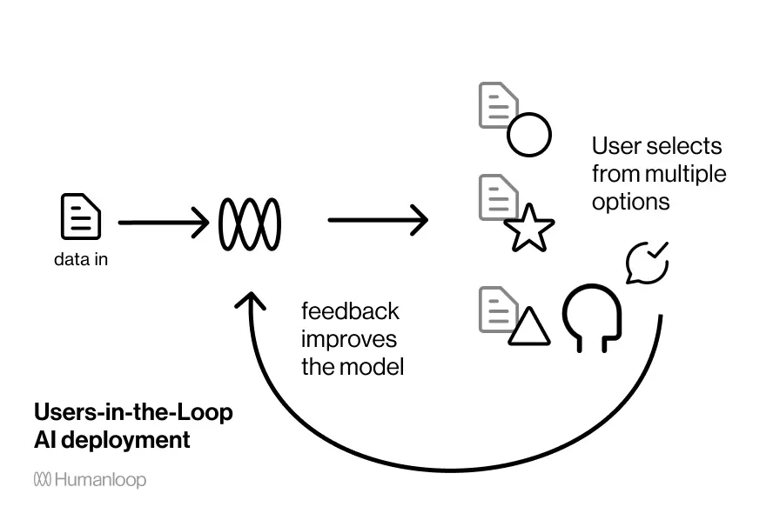
AI as a Support Tool – Keeping Humans in the Loop
“AI in CQC is not about replacing human judgment - it’s about enhancing decision-making with better insights. Our AI solutions are designed as tools to support, not replace, the expertise of our teams.”
How We Ensure AI Supports, Not Replaces:
Human-in-the-loop approach – AI highlights risks, but inspectors make final decisions.
Embedded into existing dashboards – AI insights appear within the platforms teams already use.
Enhancing workflow & user experience – AI reduces manual effort while keeping users in control.
Transparent & explainable AI – Ensuring AI outputs can be understood and trusted.

Slide 5
Bespoke AI

Slide 6
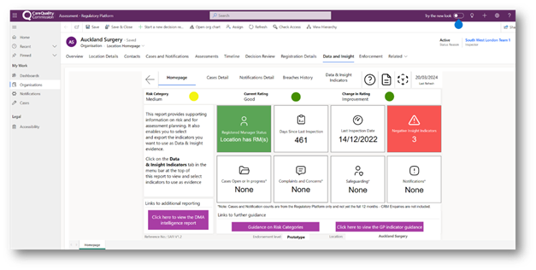




Machine Learning at CQC
Machine learning helps us analyse large volumes of data more quickly and consistently than manual review, supporting prioritisation and decision‑making.
Current Initiatives using Machine Learning
Predictive & Prescriptive methods
Adult Social Care Risk Score
Use of internal and external data sources to predict changes in the
quality of care to inform prioritisation of inspections.
Descriptive & Predictive methods
Serious Injury Classification
Using AI on notifications data to group serious incidents into categories. e.g. burns & scalds, choking, Falls, Pressure Ulcers.
DESCRIPTIVE | DIAGNOSTIC | PREDICTIVE | PRESCRIPTIVE
What’s happening? | Why is it happening? | What’s likely to happen? | What do I need to do?

Slide 7
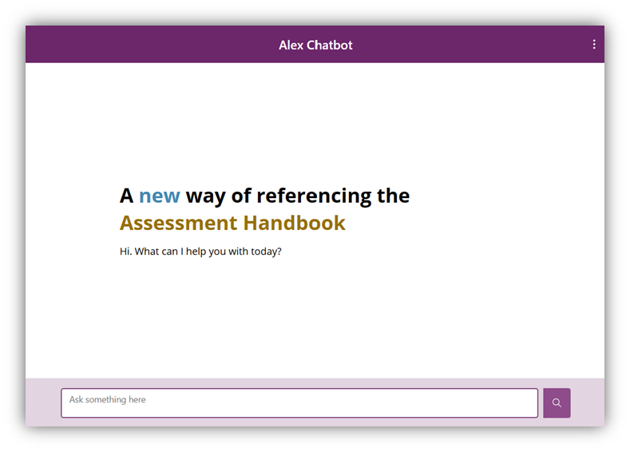
AI Assistants at CQC: Alex Chatbot
We are exploring how AI and large language models can help colleagues more quickly find and use regulatory guidance.
Alex Chatbot Pilot
A retrieval-based AI assistant designed to support inspectors in accessing operational guidance
Challenge
~2,000 documents across our knowledge bank
Guidance is detailed and frequently updated
Keyword search can be slow and inconsistent
What we are testing
Using AI to understand questions in natural language
Retrieving relevant guidance and highlighting key points
Making it easier to navigate and use detailed guidance
Why this matters for regulation
Faster access to relevant information
Supporting inspectors to work with complex guidance more efficiently
Making better use of guidance across large volumes of material

Slide 8
Using AI to Turn Regulatory Signals into Actionable Insight
We hold large volumes of unstructured information about care, including feedback, incident reports and inspection evidence. We are starting to explore how AI can help us use this data more effectively, with early discovery and prototyping underway.
Areas we are exploring
Service user feedback → identify themes in experiences of care
Notifiable incidents → detect emerging safety signals earlier
Inspection evidence → summarise large volumes of material
Published reports → identify patterns of good practice and innovation
Our approach
Early discovery and prototyping to test value and feasibility
Human oversight remains central to regulatory decision-making
Strong focus on data protection, governance and safe use
Designed to support inspectors, not replace judgement

Slide 9
AI-Enabled Software

Slide 10
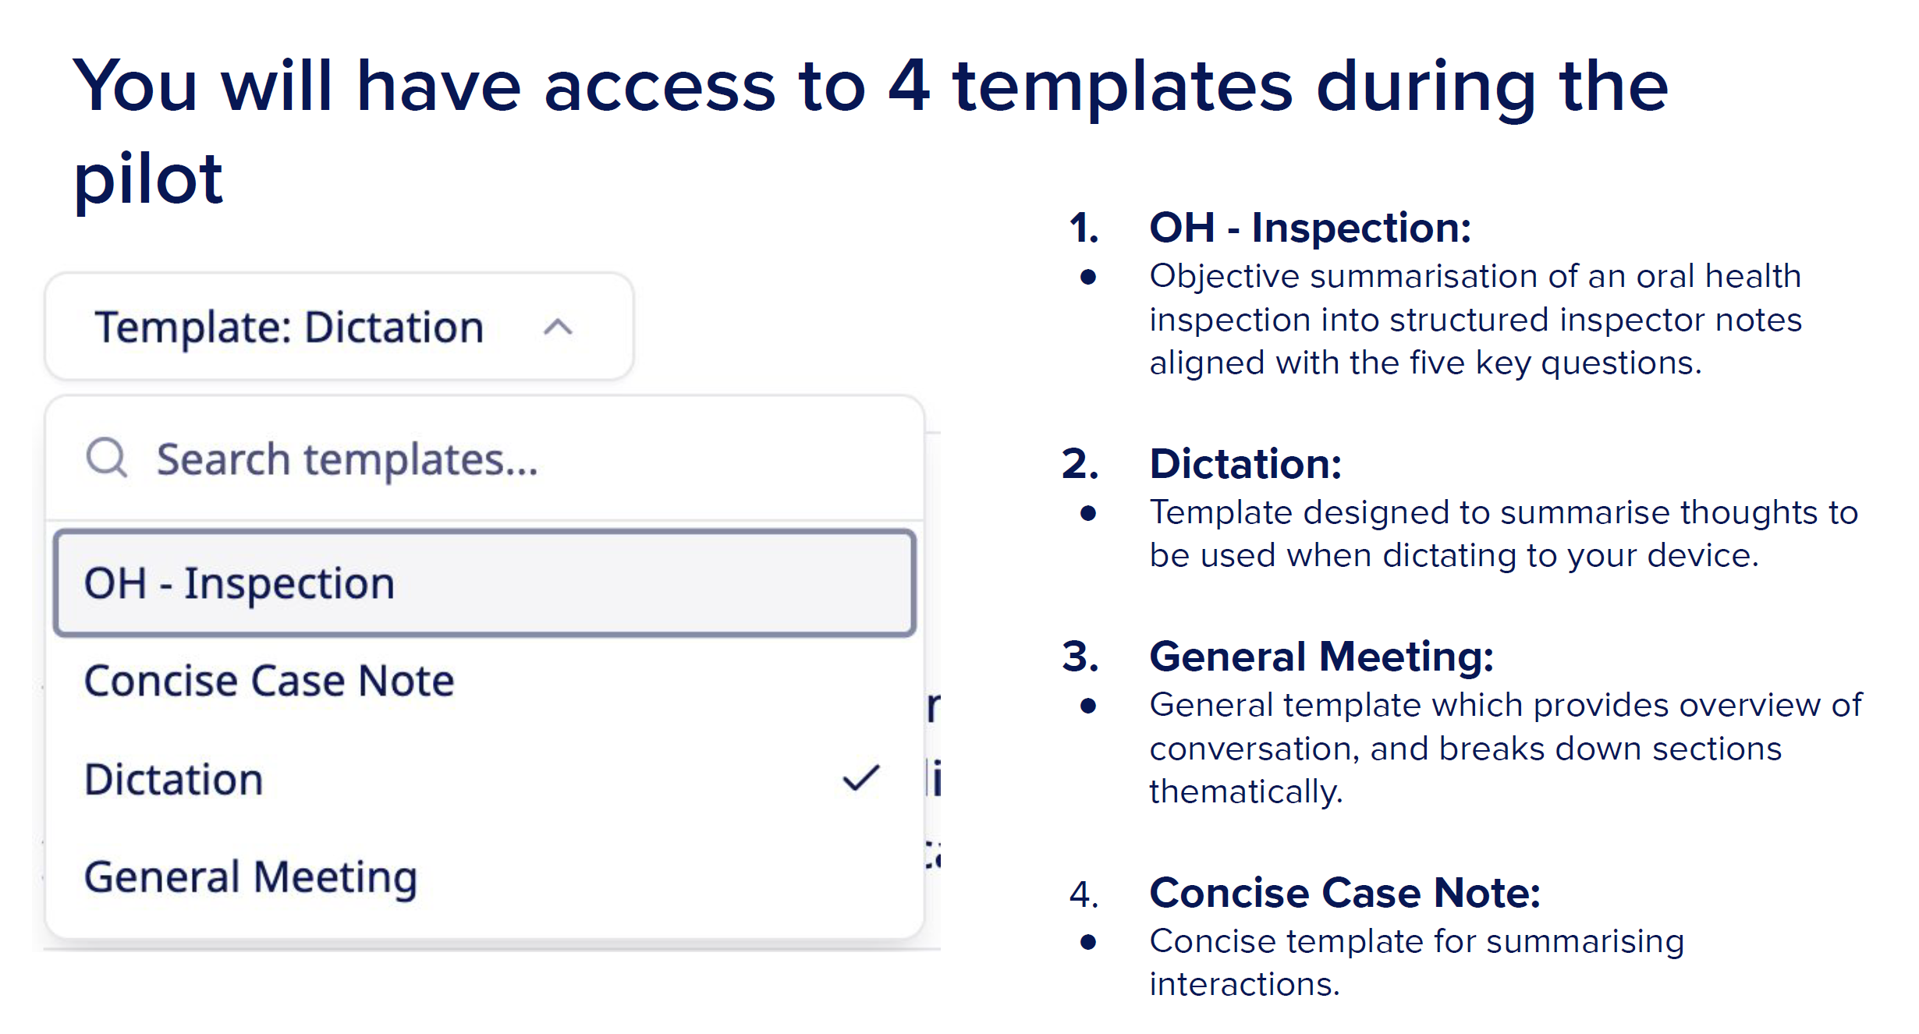
CQC AI Prototypes: AVT for Inspection
Learn
Adapt
Test
Ambient Voice Technology (AVT) uses AI to listen to conversations, automatically transcribing them into structured, real-time notes, reducing typing and administrative burden, allowing more focus on the conversation.
At CQC, we want to observe, evaluate and learn what value Ambient Voice Technology can bring to assessments at CQC.
Evaluate
We are piloting with one service provider, and in three sectors – PCC, Oral Health and Hospitals.
The project runs from October 2025 – July 2026. The pilot has just concluded, and the team is writing up their findings in June and July, with the final report out this summer.
AVT Interface, which allows inspectors to choose the template for their interview

Slide 11
CQC AI Prototypes: AVT for Inspection
What have we learned so far?
Feasibility: AVT shows promise in inspection settings, but requires early adaptation to existing templates and workflows.
Efficiency: Does AVT reduce note-taking burden without compromising regulatory quality?
Early feedback loops suggest a reduction in conversation-heavy inspections; there are limited gains in observation-led visits.
Consistency & Quality: Can AVT improve the completeness and consistency of inspection evidence?
The endline evaluation is ongoing, and inspectors still need to review outputs carefully for accuracy – hallucinations/ errors. However, there have been limited early reports of hallucinations and occasional hallucinations or errors.
Wellbeing & Acceptability: What are the effects on inspector experience, inclusivity, and confidence to use the tool?
Feedback loops have revealed that the tool is easy to use, improves the experience for newer inspectors, and supports reasonable adjustments.
Provider Relationships: Provider response has been largely positive, though a small number declined consent due to discomfort or unfamiliarity with the tool.

Slide 12

Microsoft 365 Copilot
Could Copilot help a regulator work better, without weakening judgement?
To answer this, we ran a Microsoft 365 Copilot trial with 250 colleagues across multiple directorates over 12 months.
We focused on real work, not laboratory scenarios. Drafting and redrafting written outputs, summarising large volumes of material, preparing for operational activity, improving accessibility, and reducing repetitive administrative effort.
The trial included use cases in Adult Social Care, other Inspectorates, and select corporate teams. Helping us test value in different operational contexts.
From the outset, Copilot was positioned as a productivity and drafting aid, not an autonomous decision-maker. Regulatory judgement, evidential weighting, sign-off and accountability remained with CQC colleagues throughout.

Slide 13

Microsoft 365 Copilot
The trial showed clear value, but the biggest lesson wasn’t the technology
The strongest value came from reducing “work about work”. Copilot helped colleagues create first drafts more quickly, summarise and synthesise material more effectively, prepare and turn notes into clearer, better-structured outputs.
Across the trial, internal reporting recorded over 38 minutes saved per user daily and referenced an average of 3,500 Copilot-assisted hours per four-week period across the 250-user trial group.
The benefits went beyond speed. We saw improvements in clarity, consistency, wellbeing and confidence, with particularly strong benefits for colleagues who need the most support.
The trial also highlighted an important organisational lesson, namely licences alone do not create value. Our assessment stressed that adoption, coaching, skills and change support are essential if organisations want sustained results.

Slide 14
AI Capability & CQC Rebuild

Slide 15
Building our Regulatory Services Programme
We are building our Enterprise Data Platform in Microsoft Fabric
Fabric is an AI first data platform, offering significant capabilities:
For developers / analysts
Copilot in every development experience:
For end users
Data Agents – “Chat with your Data”
Text Analysis
Pipelines
Notebooks
Power BI
At CQC, text (qualitative) data is particularly significant. Large amounts of free text are generated from notifications, cases and regulatory meetings.
AI in Fabric will help to classify and extract structured data from free text.

Slide 16
Building our Regulatory Services Programme
The Discovery Proof of Concept (PoC) showed AI solutions to address current challenges for users
Registrations Data Agent
Natural language conversations - users can ask questions about registrations of regulated organisations
Free Text Analysis
Qualitative (text) data is critical for effective regulation
Agent provides references, reasoning and even code it used
Agent’s behaviour was closely controlled, ensuring it stayed “on topic” and followed CQC policies and used CQC language.
Our PoC reviewed thousands of meeting minutes, and extracted structured information for further reporting
We generated sentiment, summaries and classified meetings by their main topics
AI Use Cases
“How many GP practices were registered in Sunderland in 2025 vs 2024?”
“How many approved registrations had meetings related to them with negative sentiment?”
Example Questions AI Helps Us Answer
“How long on average does it take to approve a new registration for a dental practice?”
“How long do our meetings about registrations typically last?”
“Why have care home registrations been slower than usual in the North-West of England in Q4?”
“What proportion of our registration meetings lead to a clear outcome?”

