Slide 1

Data Analytics, BI
and AI tools in ZVA
16.06.2026, Valletta, Malta
Jēkabs Balodis
Expert – Data analyst

Slide 2
Agenda
Introduction
  Who is the State Agency of Medicines?
BI and Data Analytics
  Our BI infrastructure and processes
Artificial Intelligence
  Current use and future plans

Slide 3




National regulator
Purpose
State Agency of
Medicines, operating
under the Ministry of
Health
To ensure safe and
effective use and
regulation of medicines
and related healthcare
substances
Who
we are
Self-financed
Since 2013, funded
entirely by service fees
Core functions
Medicine registration &
quality evaluation,
pharmacovigilance,
inspections, monitoring
import/export, clinical
trials, and many more

Slide 4



BI tools we use
Microsoft SQL Server
SQL Server Integration
Services (SSIS)
Power BI Report Server
Core of our BI infrastructure.
Includes Data Warehouse as
the central database for
aggregated operational data
and hosts/schedules ETL
pipeline execution.
Hosts interactive dashboards
& reports for expert analysis
and decision-making.
Creating automated ETL
pipelines for data extraction,
transformation and loading.

Slide 5
Report examples
Drug sales data
  Comprehensive report that shows info
  about medicines sold over time
Local manufacturers
  Report displaying information about
  drugs whose manufacturer responsible
  for batch release is located in Latvia
Drug price reform
  Quickly compare price changes for
  medication before and after the reform.

Slide 6
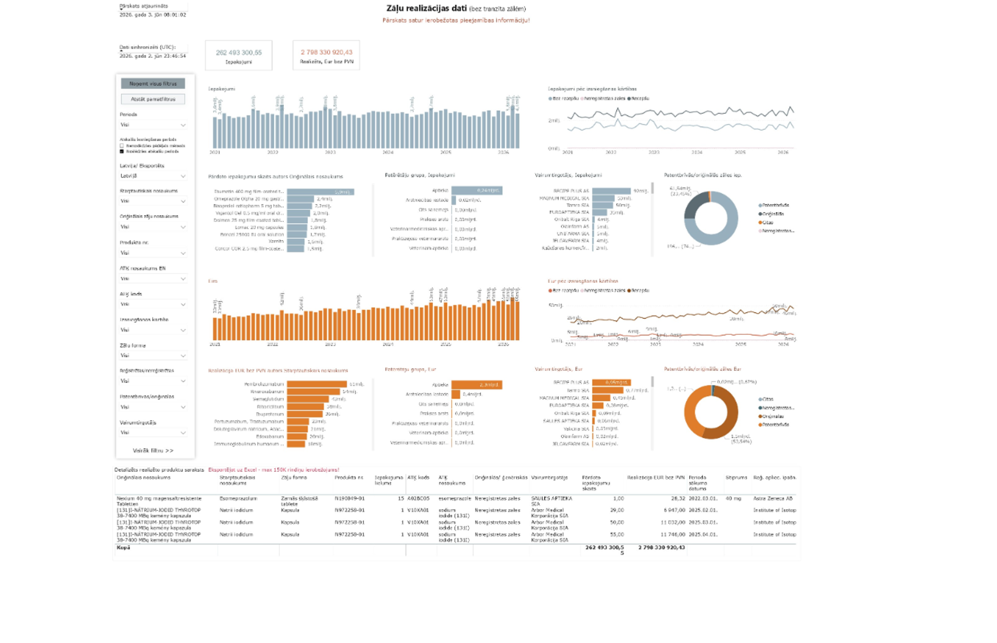

Slide 7
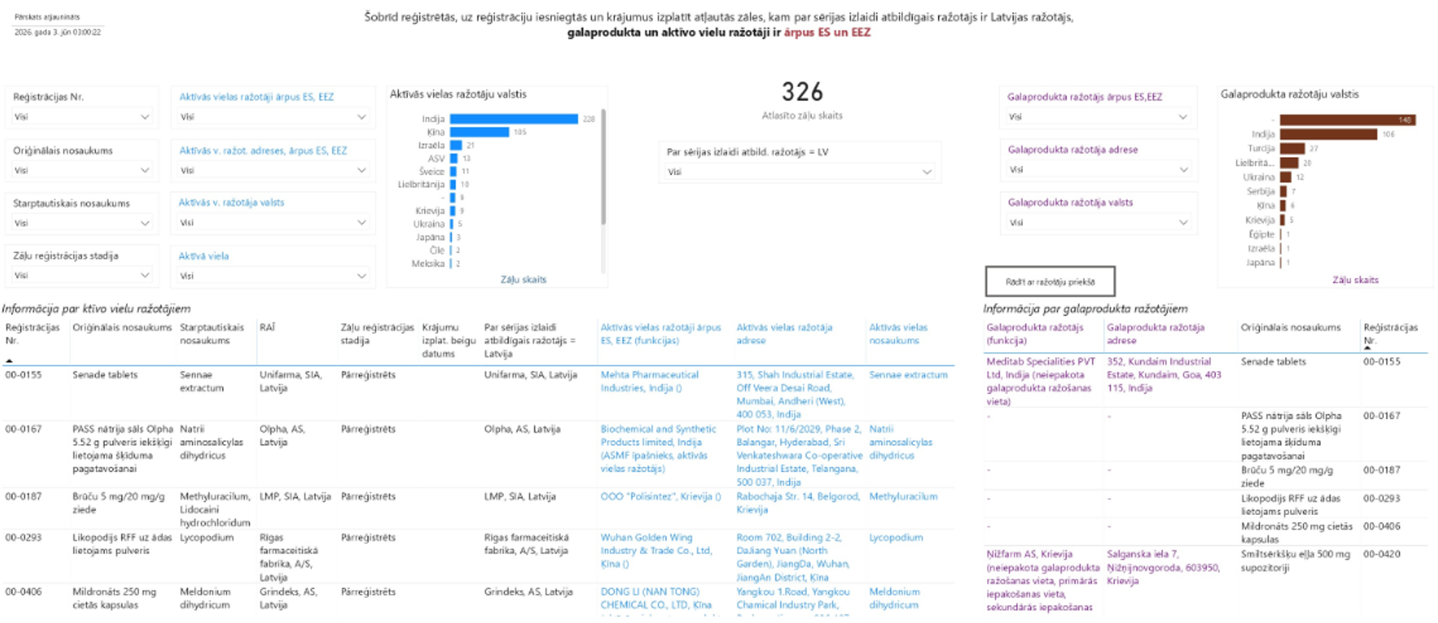

Slide 8
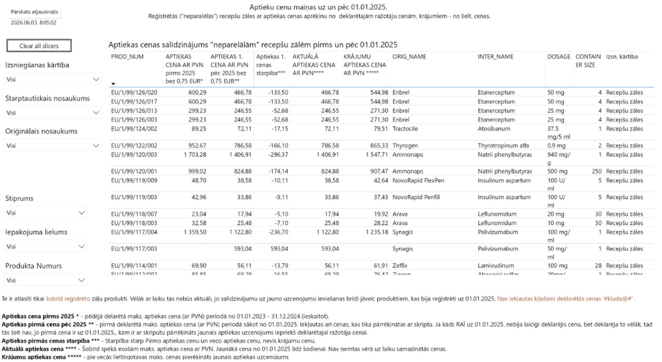

Slide 9
Report examples
Drug sales data
  Comprehensive report that shows info
  about medicines sold over time
Local manufacturers
  Report displaying information about
  drugs whose manufacturer responsible
  for batch release is located in Latvia
Drug price reform
  Quickly compare price changes for
  medication before and after the reform.

Slide 10
Benefits of BI Tools
Data aggregation
Automatic updates
of reports
Efficiency
Using SSIS we aggregate
data from multiple
sources into one
destination – DWH
Automating ETL Pipelines
ensures consistent and
up-to-date data
Reports are updated on a
schedule ensuring most
recent data

Slide 11

AI Tools already in use
AI@MPA
EMA Scientific
Explorer
Internal guidelines
Suite of AI services for
medicines regulation
provided by Swedish
Medical Products Agency
Principles for safe and
responsible use of AI Tools
Search engine that
incorporates AI
techniques to retrieve
regulatory and scientific
information

Slide 12
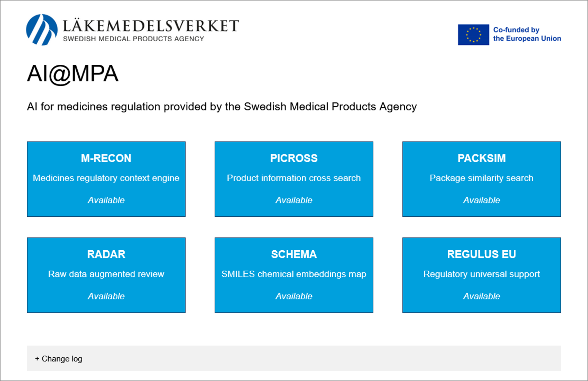

Slide 13


Slide 14
AI Tools already in use
AI@MPA
EMA Scientific
Explorer
Internal guidelines
Suite of AI services for
medicines regulation
provided by Swedish
Medical Products Agency
Principles for safe and
responsible use of AI Tools
Search engine that
incorporates AI
techniques to retrieve
regulatory and scientific
information

Slide 15
Future plans for AI use
Linguistic analysis
Terminology control
Analyse Summary of product
characteristics
Ensure correct use of terms
Structured & Unstructured data
Secure environment
Consolidate both categories of data
Allow prompting with sensitive data
without exposing it to outside

Slide 16



Benefits from AI and
in-house solutions
Precise regulatory
search
Linguistic quality
Secure and compliant
operation
Goal is to analyse SmPC
translations faster and easier
AI powered search engine
allows efficient lookup of
scientific information
Running models on-premise
allows to process sensitive
data

Slide 17
Jēkabs Balodis
jekabs.balodis@zva.gov.lv
16.06.2026
Valletta, Malta

