Slide 1


Deploying Artificial Intelligence
in Public Administration
Comparative analysis, challenges and conditions for success
Fabienne Bartoli
Juliette Berthe June 2026
Presented by IGAS EPSO Seminar, Malta Tuesday 16th June 2026

Slide 2
Data and the use of AI
How is AI used in France (IGAS)?

Slide 3
AI at IGAS
AI offers many opportunities
In the data area
  Improves the targeting of inspections (eg.nursing homes)
  Supports the evaluation process
  Identifying network connections
  Sentiment analysis and topic modelling
Inspectors
  Use of Generative AI solutions for routine tasks (summarization, writing, etc.);
  Establishment of a prompt library by a dedicated IGAS working group

Slide 4
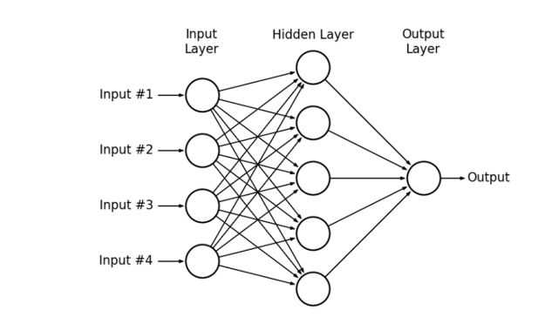
Targeting Nursing Home Inspections
Context
Cases of resident abuse in nursing homes homes
Objective
Identify nursing homes with the highest probability of non conformity
72 Variable input
Non-conformity score
Findings
A neural network model trained on the results of previous investigations doubles the probability of identifying nursing homes with deviant practices.

Slide 5
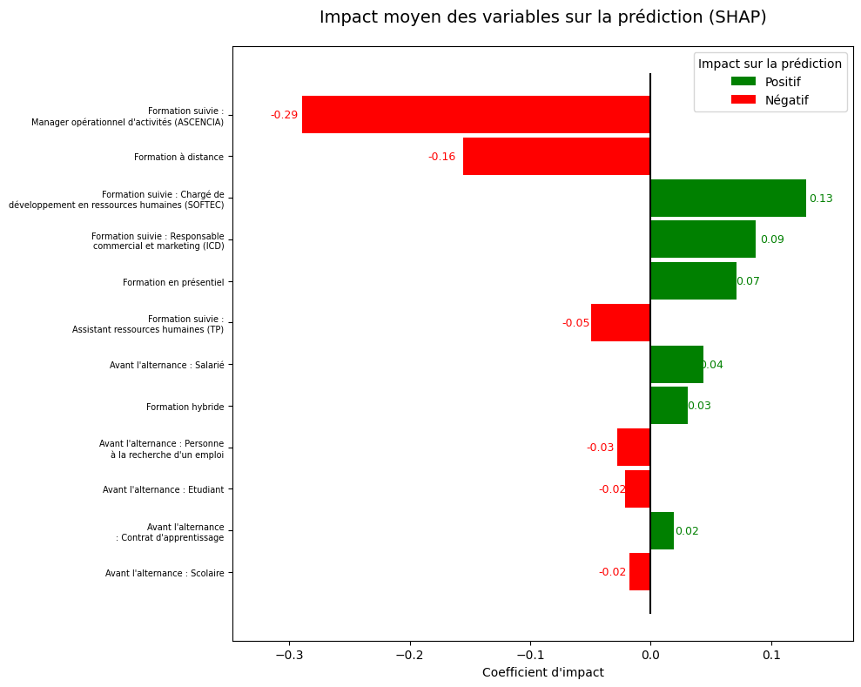
Audit Mission: ISCOD (2024)
100% online Apprenticeship Training Centre
Context
An apprenticeship training provider offering an innovative fully online learning model, attracting a large and diverse audience.
Objective
To assess the training provider and identify the factors associated with successful labor market integration.
Findings
Labor market integration is less favorable following fully online programs and for certain training pathways.
Individuals with prior work experience before starting their apprenticeship achieve better employment outcomes.

Slide 6
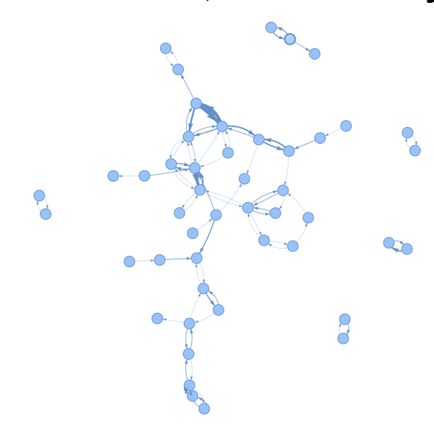
Thematic Audit of Child Welfare Services (ASE)
Children Placed Outside Their Home District
Children network in non-authorized structure SNA outside the district
Context
To assess the extent and drivers of out-of-district placements of children under the responsibility of Child Welfare Services (ASE).
Objective
To identify network relationships among child welfare service providers.
Findings
The analysis revealed preferential networks between out-of-district providers, characterised by atypical patterns of interaction.
Source : local information system

Slide 7
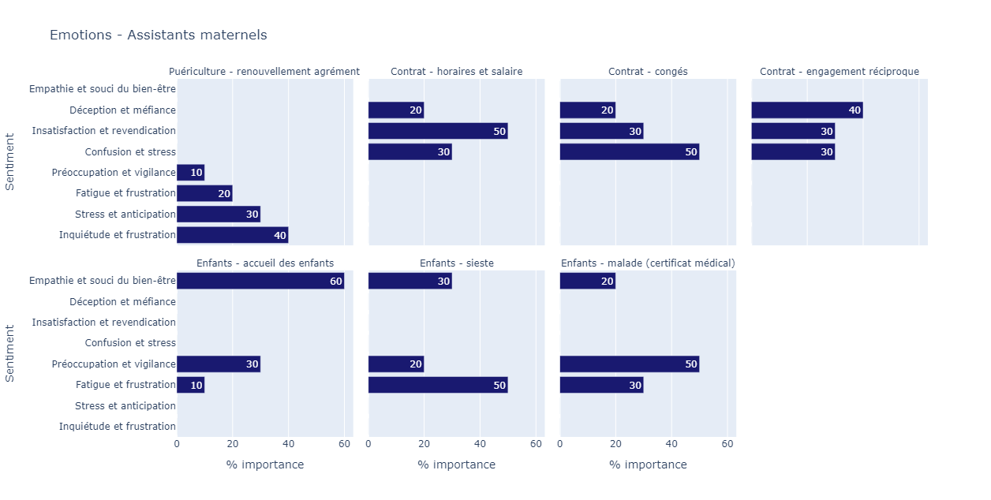
Evaluation Mission: The Attractiveness of the Childminder Profession
Context
A profession under considerable pressure
Objective
To identify the main sources of dissatisfaction in order to inform policy improvements.
Findings
Contract-related issues generate substantial stress, dissatisfaction and disappointment.
The licence renewal process is frequently associated with stress and frustration.
While caring for children is the primary source of job satisfaction and fulfilment, it is also a source of concern and stress for many childminders.

Slide 8
AI across public administration
Comparative analysis (private public sector and foreign administrations) · challenges · conditions for success
Drawing on the joint IGF-IGAS-IGA inspections · April 2026, still confidential

Slide 9
A major shift and how others are deploying it
What makes AI different
Private sector
Functional autonomy
learns from data and generates content on its own.
Inference
produces contextualised predictions and content.
A long trajectory
now entering a new phase: from generative to agentic AI.
Deploys first on support functions and client relations. Leaders place AI at the core of strategy and accept deferred returns on investment.
Foreign administrations
Combine centralised strategy with operational decentralisation. Singapore’s secured “Pair”; the UK’s “Humphrey / Minute” suite. Gains are real but measured in a fragmented way.
Inspection Générale des Affaires Sociales
EPSO Seminar · Malta · 2026
Notes:
l'IA comme bascule majeure et évolutive (génératif → agentique) ; comment le privé (fonctions supports, relation client, ROI différé) et les administrations étrangères les plus avancées déploient (Singapour « Pair », UK « Humphrey/Minute » ; stratégie centralisée + décentralisation opérationnelle).

Slide 10
France: a sudden, sprawling and uneven adoption
~40%
0 – 74
90% / 85%
of agents already use AI informally — “shadow AI”
AI tools per ministry — sharp heterogeneity across the State
of metropolises / regions engaged, while small communes lag — a size effect
Three families of use cases are emerging
1
Generalist
2
Support functions
3
Métier (domain)
Cross-cutting accelerators: search, summary, minutes, translation.
Legal affairs, procurement, HR, finance — still little pooled.
Targeted tools co-built with teams and integrated into information systems — the most promising.
Inspection Générale des Affaires Sociales
EPSO Seminar · Malta · 2026

Slide 11

How exposed are public jobs to AI?
20% · Significantly exposed (gradients 1–4)
23% · Lightly exposed (moderate automation potential)
47% · Mostly non-exposed tasks
3% · Armed forces (not in ILO study)
7% · Not in the job nomenclature
≈ 1 in 5 public jobs is significantly exposed (ILO, 30,000-task reference).
Exposure is not a gain in itself: AI tends to intensify work more than it cuts headcount (HBR, 2026). Regimes range from substitution to complementarity and augmentation.
Public jobs by AI-exposure regime — ILO task model applied to French public employment.
Inspection Générale des Affaires Sociales
EPSO Seminar · Malta · 2026

Slide 12
Gains: real — but conditional, diffuse and deferred
Beyond time saved: faster and more personalised responses, better targeting and control, and stronger attractiveness and quality of work life.
CNAV (pensions)
UK — “Extract”
Support functions
20–30%
1–2 h → 3 min
+20–40%
Time saved on short, low-value tasks for 9,000 agents using Copilot Chat.
Processing time for planning-permission files.
Potential time saving (BCG) from generative AI — up to +5–20 pts more with full process redesign.
The catch. Gains are diffuse and deferred, and materialise only after a learning phase. Value must be assessed net of direct and indirect costs, risks and externalities — which an updated evaluation method (MAREVA) must capture.
Inspection Générale des Affaires Sociales
EPSO Seminar · Malta · 2026

Slide 13
Mastering the risks — the regulator’s responsibility
Public decision-making cannot be delegated. Risk mastery is even more critical in administration than in the private sector and must be built in from design.
1
Human oversight, by design
2
Sovereignty & resilience
Systematic, non-delegable supervision of every AI-supported decision — with a clear map of human responsibility per processing.
Service continuity, version/lifecycle control, cybersecurity — failures erode the trust of agents and users alike.
3
Learning from failures
4
Test, then contract
Documented breakdowns abroad (Netherlands, Australia, US, Spain) show the cost of biased, unmastered systems.
Structured adversarial testing in regulatory sandboxes; deployer duties — documentation, auditability, reversibility, traceability.
Inspection Générale des Affaires Sociales
EPSO Seminar · Malta · 2026

Slide 14
Conditions for success
Scaling beyond the “graveyard of proofs of concept” (70–95% of POCs fail) takes more than technology.
1
Pool the commons
2
Govern the data
Share infrastructure and reusable bricks to overcome capacity and budget limits.
Quality, accessibility, interoperability; sovereign environments for sensitive uses.
3
Start from real work
4
Frame & delegate
Co-build with agents around actual irritants — the surest route to scaling.
Transverse national framing plus métier subsidiarity and change management.
5
Social dialogue
6
Skills & supervision
Continuous, technology-aware dialogue with staff representatives.
Workforce planning (GPEC), tiered training, and continuous lifecycle monitoring.
The key issue is no longer adoption — already under way — but turning AI into a durable capability for the public service, its agents and its users.
Inspection Générale des Affaires Sociales
EPSO Seminar · Malta · 2026

