Slide 1
Regulatory Reporting using AI POC
Mr. John Farrelly
EPSO Conference
MALTA

Slide 2
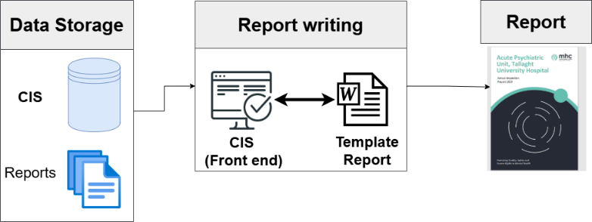
Background
The objective of the Regulatory Reporting using AI PoC was to evaluate the appropriateness of AI for the regulatory report drafting process using Microsoft Copilot 365
In the coming years, the number of inspections will increase significantly in response to the Mental Health Bill 2024. To deal effectively with this increased demand, AI report drafting offers the potential scale the inspection process by leveraging technology while maintaining human oversight.
Current High-Level Process
When conducting an inspection on an approved centre, the inspectors input details and information on CIS.
Report writers access inspection data through the CIS front-end application and commence drafting of the report.
Frequent tab switching across multiple views and screens to retrieve all the information required and to compile the report draft in Word using CIS data.
Process repeated for all regulations in a report. This is time-consuming and typically takes several days to complete a report draft.
If an issue is tagged as critical, an Immediate Action Notice is drafted, based on data across multiple CIS locations, and sent to the approved centre.

Slide 3
Project Scope
The AI PoC focused on immediate action notices and selected sections of annual inspection reports
In-Scope
End-to-end automation of producing final formatted report.
Full-scale production deployment.
Integration with live systems or databases.
Not In-Scope
Annual Inspection Reports
11 different approved centres (all acute hospitals) with the following regulations were targeted for this PoC:
  Regulation 15: Individual Care Plan
  Regulation 16: Therapeutic Services and Programmes
  Regulation 23: Ordering, Prescribing, Storing and Administration of medicines
  Regulation 32: Risk Management Procedures
Immediate Action Notices (IANs)
13 approved centres used for the development of the IAN solution, with eye-test on all centres and extensive mathematical measurements focused on three centres:
  St. Michael’s
  St. Catherine’s
  St. Anne’s
Agreed list of areas within annual inspection reports, as well as select immediate action reports were targeted for replication in the POC.
Automated content creation for prioritised report sections using historical data from approved centres.
Evaluated appropriateness of MS Copilot 365 for producing the necessary report areas.
Target Outcomes of Project
Determine if AI-powered draft reports can perform well in replicating inspection reports and IANs.
Assess potential reductions in time and effort for technical writers.
Develop a clear understanding of production potential and feasibility of technology.

Slide 4
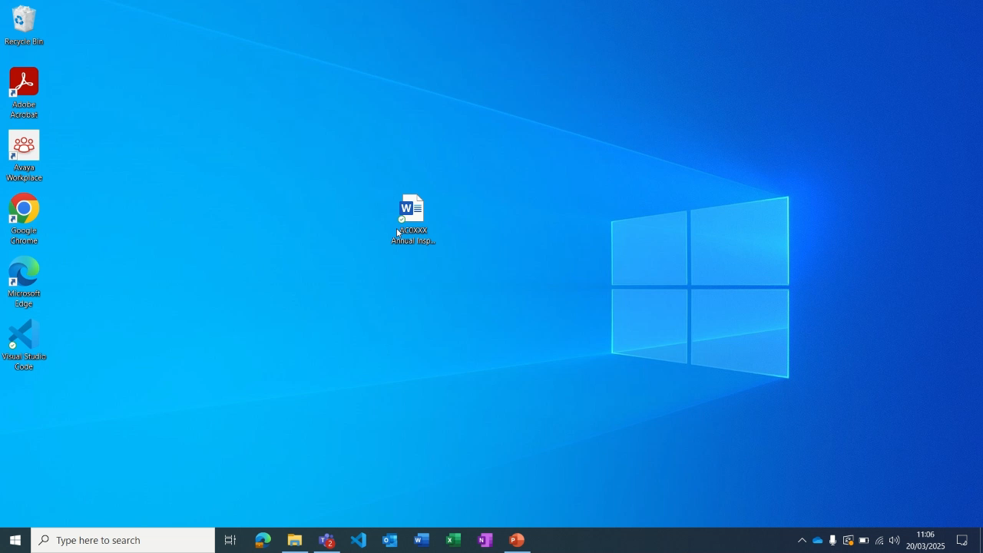

Slide 5

Key
Compliant Information
Non - Compliant Information
Conclusion
Regulation 15: Individual Care Plan – St. Vincent’s Hospital
The registered proprietor shall ensure that each resident has an individual care plan…
Ten individual care plans (ICPs) were reviewed on inspection. All ICPs were a composite set of documents. Specific sections were allocated for needs, goals, treatment, care, resources required, as well as space for reviews. The ICPs were stored within the clinical file, were identifiable and uninterrupted and were not amalgamated with progress notes. The ICPs were developed by the multi-disciplinary team (MDT) following a comprehensive assessment within seven days of admission. Nine of the ICPs were discussed, agreed where practicable, and drawn up with the participation of the resident and their representative, family and next of kin, as appropriate. One ICP did not contain evidence of such a discussion having taken place. Four ICPs did not contain appropriate goals for the resident. Four ICPs did not identify the care and treatment required to meet the goals and the responsibilities required for implementing the care and treatment. Seven of the ten ICPs did not identify the resources required to provide the care and treatment identified. All ICPs were reviewed by the MDT in consultation with the resident, weekly in an acute setting, and at least every six months for residents in a continuing care facility. All ICPs were updated following review, as indicated by the resident’s changing needs, conditions, circumstances and goals. The approved centre was non-compliant with this regulation for the following reasons: a) There was no documentary evidence that one ICP had been drawn up and discussed with the participation of the resident and their representative, family or next of kin, as appropriate. b) Four individual care plans did not identify appropriate goals for the resident. c) Four individual care plans did not identify the care and treatment required to meet resident goals. d) Seven individual care plans did not identify the resources required to provide the care and treatment identified.
Copilot – Regulation 15: Individual Care Plan – St. Vincent’s
Hospital
The approved centre developed an Individual Care Plan (ICP) by the Multi-Disciplinary Team (MDT) following a comprehensive assessment within seven days of admission. The ICP was identifiable and uninterrupted, stored within the clinical file, and included allocated spaces for goals, treatment, care, resources required, and reviews. It was not amalgamated with progress notes. The ICP was reviewed by the MDT in consultation with the resident, weekly in an acute setting and at least every six months for residents in a continuing care facility. The ICP was updated following review, as indicated by the resident’s changing needs, condition, circumstances, and goals. The ICP was a composite set of documents.
However, the facility was non-compliant in several areas. Four out of ten ICPs did not identify appropriate goals for the resident. Four out of ten ICPs did not identify the care and treatment required to meet the goals identified, including the frequency and responsibilities for implementing the care and treatment. Seven out of ten ICPs did not identify the resources required to provide the care and treatment identified. There was no documentary evidence that one ICP had been drawn up and discussed with the participation of the resident and their representative, family, or next of kin, as appropriate.
The facility was non-compliant with Regulation 15 Individual Care Plan. The reasons for non-compliance are as follows:
- Four individual care plans did not identify appropriate goals for the resident.
- Four individual care plans did not identify the care and treatment required to meet resident goals.
- Seven individual care plans did not identify the resources required to provide the care and treatment identified.
- There was no documentary evidence that one ICP had been drawn up and discussed with the participation of the resident and their representative, family, or next of kin, as appropriate.

Slide 6
Main findings
The POC successfully demonstrated that leveraging AI via Microsoft Copilot 365 represents a viable and secure approach to improving efficiency by reducing the workload associated with drafting Annual Inspection Reports and Immediate Action Notices.
AI is effective at drafting - Leveraging Microsoft Copilot within Word provides an effective solution for automating regulatory report drafting, accurately retrieving content from CIS and resembling current reports.
Accuracy and consistency - Outputs generated by AI for both compliant and non-compliant regulations were found to be equally accurate and consistent with drafts prepared by report writers, effectively interpreting input data from CIS.
Reduction in manual effort - The new solution significantly reduces the manual effort required by report writers, streamlining the drafting process by bringing source data into a regulation/IAN draft with a few clicks.
Agent development & custom prompts - The creation of a specialised Agent, coupled with custom-curated prompts, resulted in consistently high-quality outputs and guided use. CoPilot agents do not currently support programmatic interaction (i.e. interacting with the model in a fully automated way, without human input).
Prompt segmentation - Utilising separate prompts for compliant regulations, non-compliant regulations, and Immediate Action Notices (IANs) produced superior results compared to longer, more detailed prompts.

