Slide 1

Beyond model accuracy: enabling AI-driven adverse drug reaction surveillance with electronic health records
40th EPSO, 2026
Sreemanee Raaj Dorajoo, BSc (Pharm) Hons. PhD
Health Sciences Authority, Singapore

Slide 2
Agenda
Challenge: Delayed safety signal detection
Opportunity: Leveraging electronic health records and contemporary analytical methods
Moving from capability to regulatory insight
Considerations for implementation at scale and impact

Slide 3
Delayed safety signal detection
At the time of market authorization, our understanding of a medicine’s safety profile is provisional ^{[1]}
Pharmacovigilance needed to detect, validate and mitigate risks in the post-market setting
However, current tools to detect signals have key limitations (e.g., underreporting in spontaneous reporting databases)
Availability of electronic health records(EHRs) + Large Language Models (LLMs) to parse and capture relevant information in EHRs offer an opportunity to augment pharmacovigilance surveillance systems
[1] Pinnow et al., Clinical Pharmacology & Therapeutics 2018: 70.1% of FDA-approved NME labels studied had at least one safety-related update, with updates occurring from 160 days after approval and throughout follow-up

Slide 4

Access to EHRs in Singapore
The Singapore public healthcare system comprises three main clusters, providing over 80% of inpatient care.
HSA has access to the de-identified electronic health records of the public healthcare system.
Individuals have a unique identification number that allows linking EHRs. Data elements include:
  Diagnoses records
  Laboratory tests
  Medication dispensing records
  Procedure records
  Unstructured clinical notes (e.g. discharge summaries / Emergency Department Notes)
Aggregated EMR database
knowledge.csc.gov.sg

Slide 5
Unstructured electronic health records (EHRs)
Inpatient discharge summary excerpt for illustration
Unstructured EHR data contain valuable information about adverse events(AEs) attributed to drugs
HOSPITAL COURSE AND TREATMENT:
74-year-old male adm for syncope.
PMH
RE Cataract s/p IOL insertion cx endophthalmitis 2011
Non-smoker, non-drinker
CC
Syncope. 2◌ to cerebral ischemia/atrial fibrillation/hypotension…
== issues and progress ==
AF
Started on warfarin (target INR 2-3), 5mg, 5mg, 3mg. but family counselling – dg prefers dOACs.
Started on rivaroxaban at 20mg OM but soon developed anxiety and insomnia.
Rivaroxaban switched to apixaban with nil complains. D/C with apixaban 5mg BD.
4. Gout. Allopurinol 100mg OM. There were no acute issues regarding gout.
Causal link implied between drug and adverse event
Further corroborating evidence. Resolution of AE following a de-challenge
Notes:
Point 1 elaboration: This is something structured EHRs do not readily capture. Hence there is interest in harnessing signals embedded within these free-text clinical notes such as inpatient discharge summaries.
In the example provided here, the treating physician has clearly documented the onset of anxiety and insomnia following the use of rivaroxaban which appears to have abated on switching to an alternative agent. Automating the extraction of statements like this using algorithms is of interest to address the problem of underreporting with spontaneous databases and this has been the topic of investigation by our team.

Slide 6
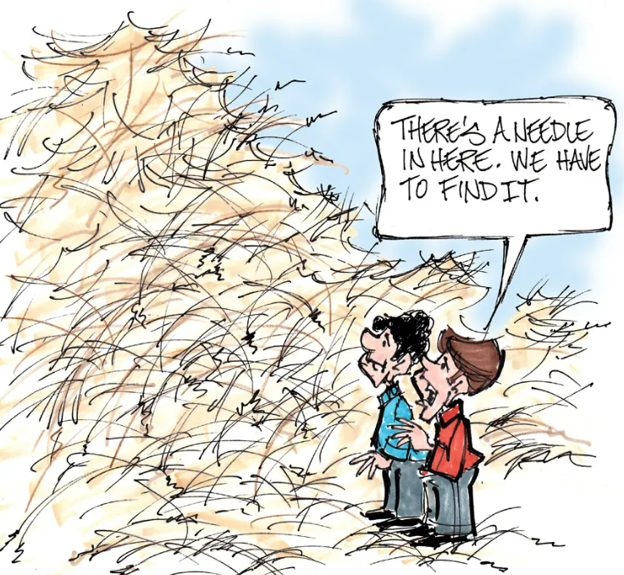

Objective
To develop an automated tool capable of detecting causally related drug-adverse event pairs in discharge summaries
“…started on rivaroxaban at 20mg ON but developed anxiety and insomnia.”

Slide 7
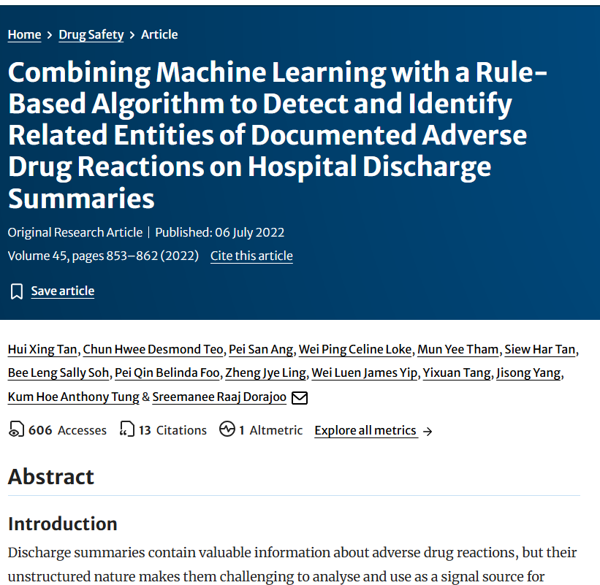
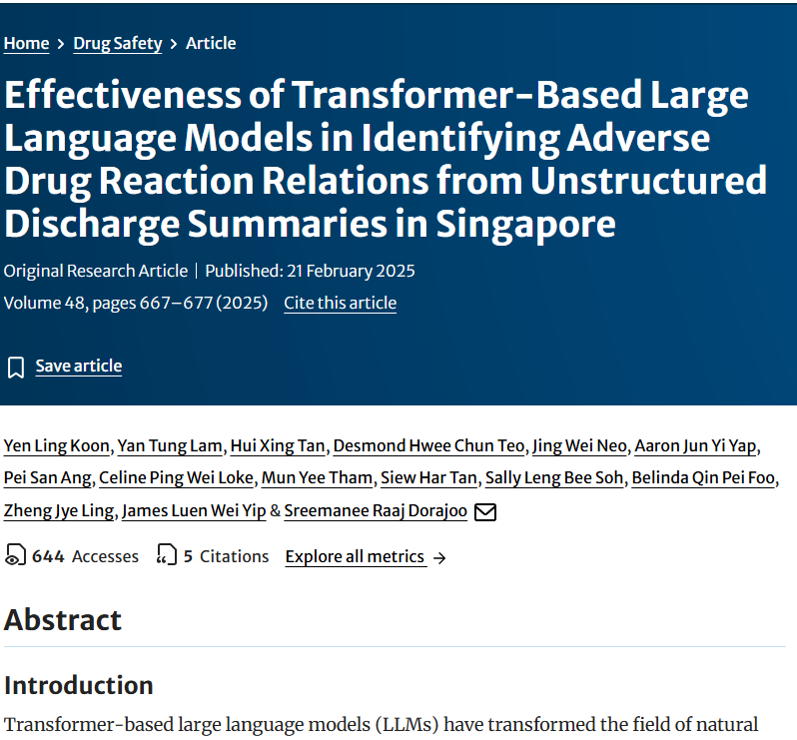
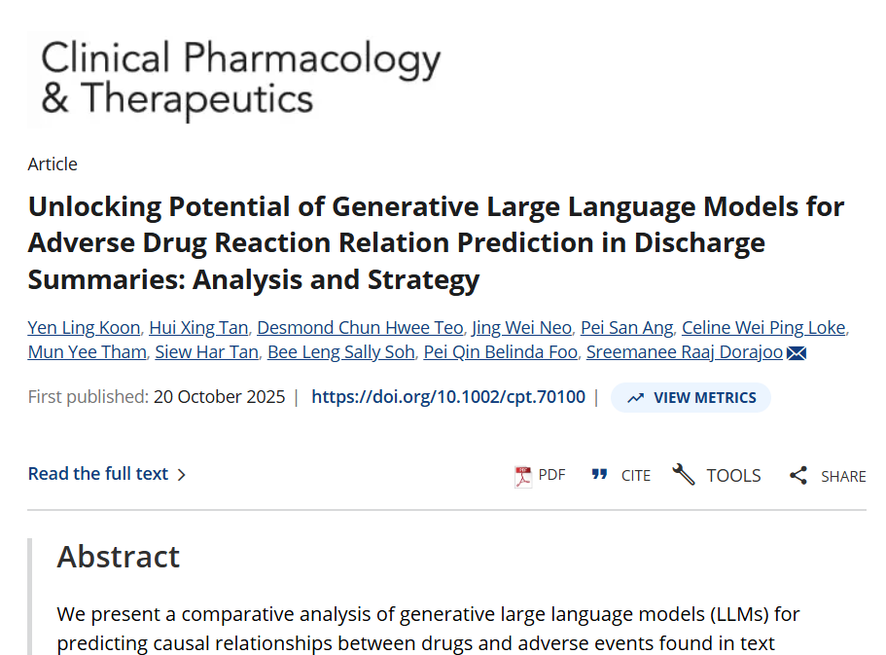
Machine learning algorithms (e.g. Naïve Bayes, Support Vector Machine, Random Forest):
Identify text segments containing drug and AE terms within close proximity
Machine learning to predict probability of causal r’ship between drug and AE within text segment
~65% accuracy
Encoder (i.e. task-specific)
language models (e.g. SciBERT, BioBERT):
Identify text segments containing drug and AE terms within close proximity
Encoder language models (BERT) to predict probability of causal r’ship between drug and AE within text segment
~75% accuracy
Decoder (i.e. generative) language models (e.g. GPT, Gemini, llama, Claude):
Identify text segments containing drug and AE terms within close proximity
Large language models to predict probability of causal r’ship between drug and AE within text segment
~85% accuracy

Slide 8
Leveraging large language models (LLMs) to parse unstructured clinical text
LLMs can connect scattered clues across a given document
  Drug exposure, event, temporality, dechallenge/rechallenge, contributing factors, and clinical uncertainty
LLMs can be tasked to estimate whether the narrative supports a drug–event relationship.
  Model outputs a probability of causal relatedness between drug and event
  Drug X + Event Y + supportive clinical context → candidate ADR (Drug X possibly led to Event Y)
Ability to decode clinical shorthand that are indicative of incident ADRs
  “↑LFTs after augmentin Rx by GP for URTI 1/12 prior”
  “NSAID + ACEI + AMG → AKI , ± dehydration”
  “atypical femur # 2° bisphosphonate (long term)”

Slide 9
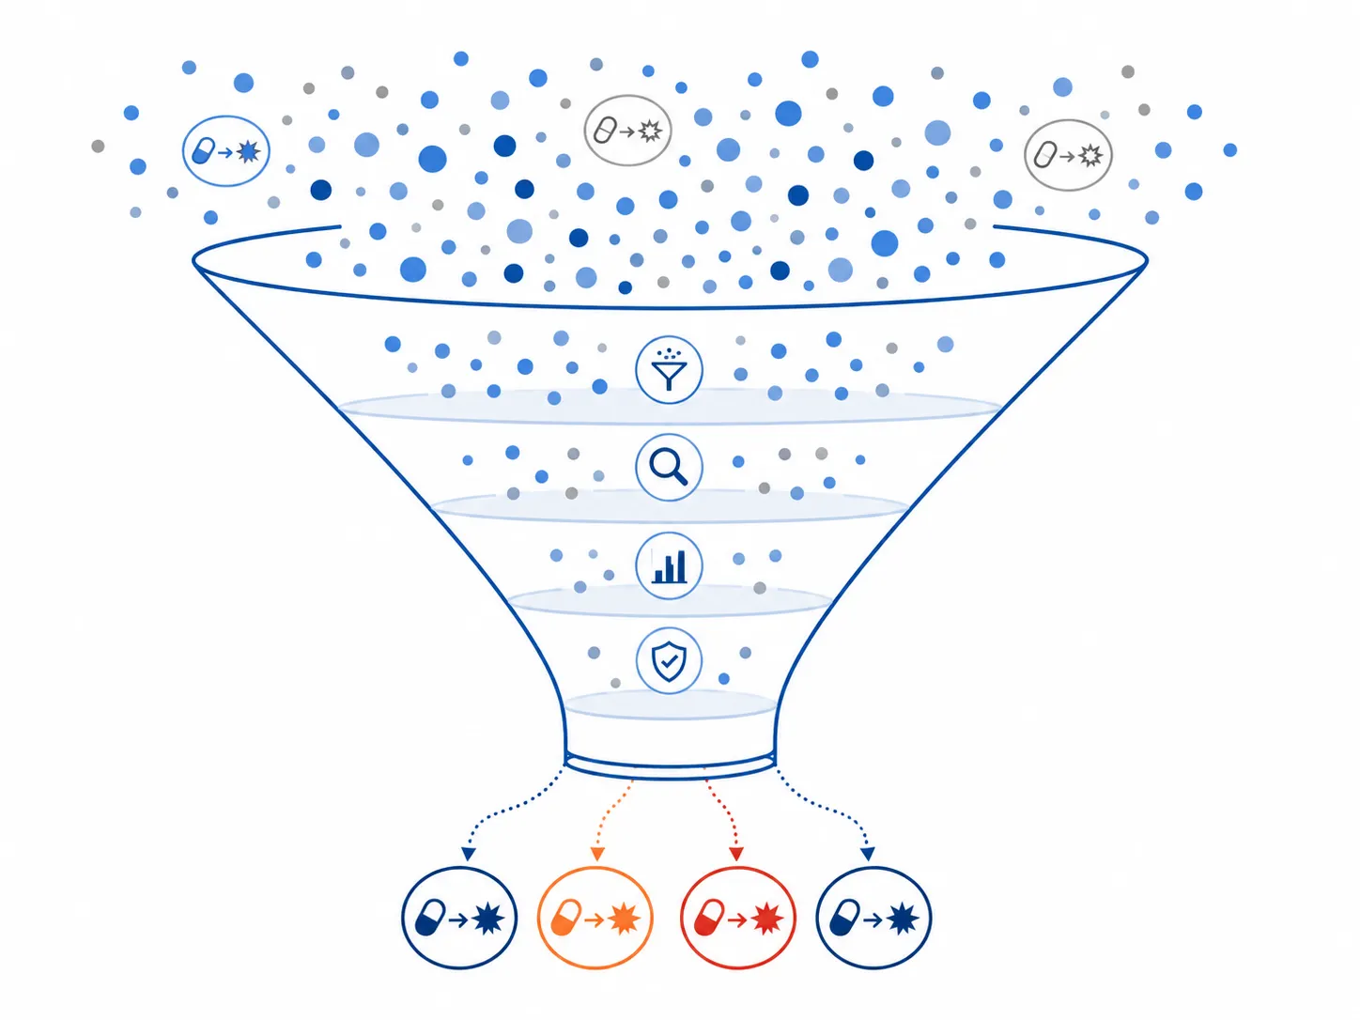
Moving from proof-of-concept to proof-of-value
Each day, ~1500 patients discharged from Singapore public hospitals
1500 discharge summaries => many drug-event pairs with high probability of relatedness
However, most detected pairs are not of regulatory interest
Many will be known ADRs (e.g. opioid => constipation)
Allergy documentation (e.g. penicillin allergy)
Expected pharmacology (anticoagulant => bleeding)
Treatment indications misread as adverse events (e.g. anti-microbials => pneumonia)
Duplicate mentions across admissions (i.e. historical events)
Significant filtering needed to identify signals of regulatory relevance

Slide 10
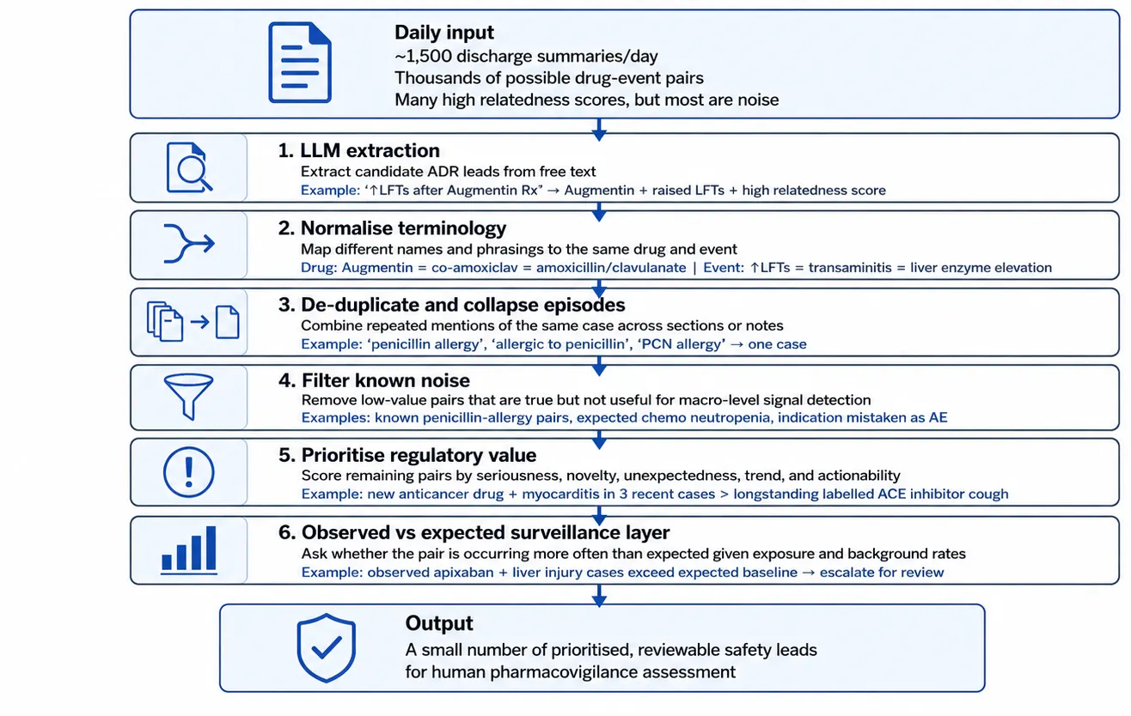
From Data to Detection: Translating EHR leads into regulatory insights

Slide 11
Lessons learnt
Unstructured clinical narratives can be a valuable complementary source of signals for drug safety surveillance
  Contains rich information that is unavailable in structured EMR data (causal associations)
  LLMs can extract causally related drug-AE pairs
However, accurate extraction is only the first step; regulatory value requires filtering, prioritization, observed-versus-expected analytics, and human review
  Optimizing each step requires a non-trivial amount of experimentation / iteration
Broader lesson: AI can help expand regulatory visibility, but various other features must be deliberately engineered to build a fit-for-purpose tool

Slide 12
Key considerations
Current approach still requires clinical suspicion of drug-adverse event to be documented in a patient’s chart
  Documentation circularity: once a drug safety concern is communicated, clinicians are likely to document it more often
Computational cost and sustainability
  Proof-of-concept performance based on large frontier models, but routine surveillance needs secure, affordable models that can run at scale
  Strategies include: using small open-weight models: MedGemma, trim text length before model sees it (reduce token size)
AI tool’s impact on regulatory decisions needs to be continually evaluated
  Possible unanticipated consequences can negate anticipated benefits on routine integration into existing workflows
Implementation hygiene (access controls, audit trials, software maintenance)

Slide 13

sreemanee_dorajoo@hsa.gov.sg
End-of-Presentation

Slide 14
Annex

Slide 15
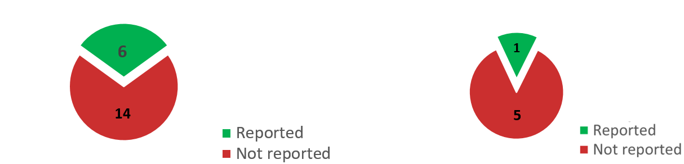
How we detect safety signals
Main tool: Adverse event (AE) reporting by Doctors and Pharmacists.
But, AE reporting suffers from considerable underreporting.
Empirical evidence of underreporting
Severe muscle toxicity from statins
(cholesterol-lowering drugs)
→ 14 / 20 not reported [70%]¹
Diabetic ketoacidosis from gliflozins
(glucose-lowering drugs)
→ 5 / 6 not reported [85%]²
Underreporting of AEs potentially delays safety signal detection (and assessment and prevention).
However, instances of serious AEs are captured in electronic medical records (EMR), particularly in unstructured EMRs.

Slide 16
Hospital discharge summary excerpt
HOSPITAL COURSE AND TREATMENT:
44-year-old male adm for syncope.
Nil PMH
Non-smoker, non-drinker
Syncope. 2◌ to cerebral ischemia/atrial fibrillation
--issues and progress--
HTN
Prev on Diltiazem SR 90 mg TDS -> Biso 5mg OM
AF
Started on warfarin (target INR 2-3), 5mg, 5mg, 3mg. but family counselling – dg prefers NOACs.
Started on rivaroxaban at 20mg ON but soon developed anxiety and insomnia.
Rivaroxaban switched to apixaban with nil complains. D/C with apixaban 5mg BD.
4. Gout. Allopurinol 100mg OM. There were no acute issues regarding gout. Standby colchicine given.
5. Prophylaxis. The patient was on Protonix and TEDs.
…
Key features
Information dense
Frequent use of short-hand, abbreviations and symbols
But contain clear representation of causal relationships between drugs and adverse events
Casual relationship between
drug (rivaroxaban) and
adverse events (anxiety and insomnia)

Slide 17
Efforts to capture causally related drug-adverse event pairs
In 2018/2019:
Developed various rule-based algorithms on anonymized, local discharge summaries from 2011
No | Relation Rule Group | Connecting words | Example
1 | Drug Cause AE | Cause: {caused, induced, resulted in, …} | Isoniazid induced DILI
2 | AE AttributeTo drug | AttributeTo: {attributed to, due to, secondary to…} | Hypoglycemia due to glimepiride
Tang Y et al. Detecting adverse drug reactions in discharge summaries of electronic medical records using Readpeer Int. J. Med. Infor. 2019

Slide 18
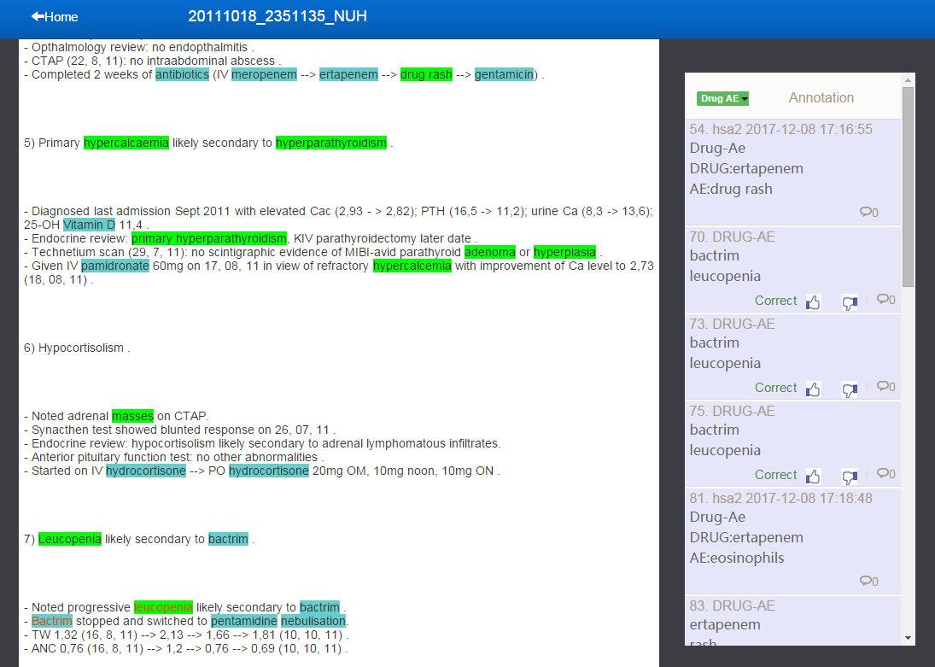
Relation rules implemented in ReadPeer
Missed
Labelling done using ReadPeer
Detected
Nature of causal expressions often intra-sentential and sometimes implicit (esp. for well known adverse effects of drugs)

Slide 19
Efforts to capture causally related drug-adverse event pairs
In 2018/2019:
Developed various rule-based algorithms
No | Relation Rule Group | Connecting words | Example
1 | Drug Cause AE | Cause: {caused, induced, resulted in, …} | Isoniazid induced DILI
2 | AE AttributeTo drug | AttributeTo: {attributed to, due to, secondary to…} | Hypoglycemia due to glimepiride
Rule development: iteratively tweaked rules over 6 cycles (120 segments used each time).
Rule validation: Final set of rules applied on 600 held-out text segments:
Recall: 45%
Precision: 76%
Tang Y et al. Detecting adverse drug reactions in discharge summaries of electronic medical records using Readpeer Int. J. Med. Infor. 2019

Slide 20
Efforts to capture causally related drug-adverse event pairs
In 2020/2021:
Applied rule-based algo + ensemble of traditional machine learning methods
Datasets expanded to allow temporal and geographical validation
Source | Year | Extraction method | No. of text segments | True drug-AE relations (%)
NUH | 2011 | Specific rule-based extraction + annotator detected entry (ReadPeer) | 1,326 | 66
NUH | 2010 | (.……Trigger…….…Drug.………AE………) Trigger and AE ± 100 char from Drug | 321 | 22
NUH | 2009 | (.……Trigger…….…Drug.………AE………) | 5,277 | 16
MIMIC-III | 2001-2012 | (.……Trigger…….…Drug.………AE………) | 1,342 | 13
MIMIC-III, unrestricted | 2001-2012 | (.……Trigger…….…Drug.………AE………) + annotator detected entry | 3,058 | 30
Use
Validation
Validation
Development
Validation
Validation

Slide 21


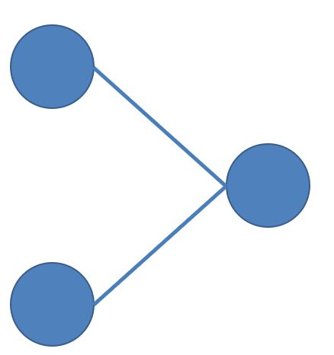
Summarized methods
Rule to identify drug and adverse event terms within close proximity
Drug | Adverse event | Text segment
Metformin | Diabetes | Metformin dosed at 500mg BD for Diabetes
Ibuprofen | GI bleeding | Developed GI bleeding after taking ibuprofen
Linagliptin | Rash | Linagliptin switched to dapagliflozin due to Rash
… | … | …
Label
0
1
1
…
Manual annotation done to indicate if drug had caused the
adverse event
Discharge summaries
Text segment | Predicted | Actual
.. | 1 | 1
.. | 1 | 1
… | 0 | 1
… | … | …
Machine learning to train a model to predict label, given context
Further validation and processing
(work in progress)
Machine learning model developed using a combination of algorithms
New discharge summaries
Over 10,000 text segments used for model development and testing

Slide 22
Efforts to capture causally related drug-adverse event pairs
In 2020/2021:
Applied rule-based algo + ensemble of traditional machine learning methods
Datasets expanded to allow for temporal and geographical validation
Source | Year | Extraction method | No. of text segments | True drug-AE relations (%)
NUH | 2011 | Specific rule-based extraction + annotator detected entry (ReadPeer) | 1,326 | 66
NUH | 2010 | (.……Trigger…….…Drug.………AE………) Trigger and AE ± 100 char from Drug | 321 | 22
NUH | 2009 | (.……Trigger…….…Drug.………AE………) | 5,277 | 16
MIMIC-III | 2001-2012 | (.……Trigger…….…Drug.………AE………) | 1,342 | 13
MIMIC-III, unrestricted | 2001-2012 | (.……Trigger…….…Drug.………AE………) + annotator detected entry | 3,058 | 30
Precision (%)
79
54
45
61
Recall (%)
68
80
76
62

Slide 23
Efforts to capture causally related drug-adverse event pairs
In 2022:
Applied rule-based algo + ensemble of traditional machine learning methods Bi-LSTM and BERT
(some preliminary findings)
Source | Year | Extraction method | No. of text segments | True drug-AE relations (%)
NUH | 2011 | Specific rule-based extraction + annotator detected entry (ReadPeer) | 1,326 | 66
NUH | 2010 | (.……Trigger…….…Drug.………AE………) Trigger and AE ± 100 char from Drug | 321 | 22
NUH | 2009 | (.……Trigger…….…Drug.………AE………) | 5,277 | 16
MIMIC-III | 2001-2012 | (.……Trigger…….…Drug.………AE………) | 1,342 | 13
MIMIC-III, unrestricted | 2001-2012 | (.……Trigger…….…Drug.………AE………) + annotator detected entry | 3,058 | 30
Precision (%)
+4 to 6
+3 to 5
+ 12 to 17
+8 to 10
Recall (%)
0
+3
-4 to -1
+1 to 3

Slide 24
Importance of submitting an AE report (e.g. myocarditis post-vaccination)
Likelihood of Dr submitting an AE report
Time
Time of vaccine approval
Suspicion raised
Safety signal confirmed

Slide 25
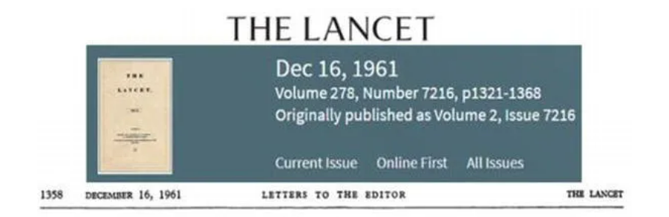
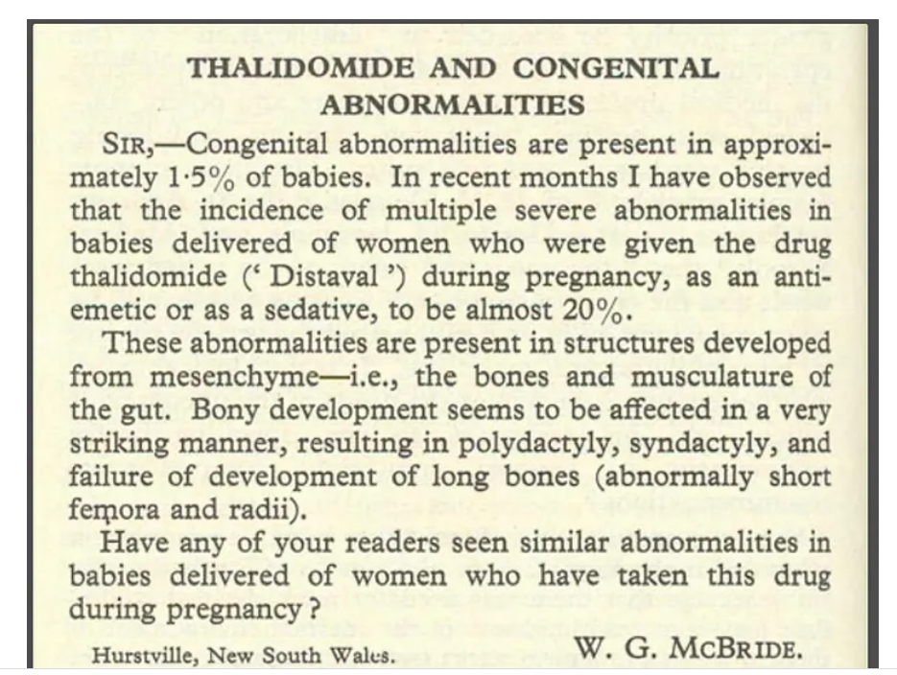
An early message of suspicion can often be more valuable than a late message of confirmation

Slide 26
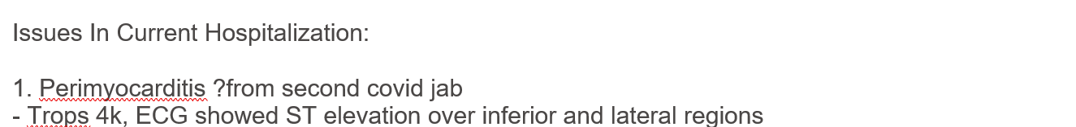
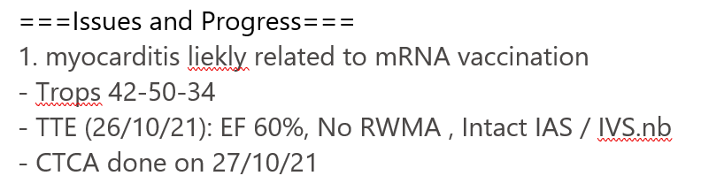
Cautious attribution of causality

