Slide 1

Data Infrastructure for Health – an ongoing worldwide challenge for many countries
Niek Klazinga MD PhD
Professor Emeritus Social Medicine Amsterdam UMC/University of Amsterdam
Advisor Health Care Quality and Outcomes Program OECD, Paris
Deze foto van Onbekende auteur is gelicentieerd onder CC BY-NC

Slide 2
Performance measurement Health Systems & Health Data Infrastructure
Measurement
- HSPA frameworks (OECD, EU countries, Canada/Australia et al)
resilience/complex system approach
Focus on outcomes (EU policies cancer, cardiovascular care )
Focus on Value (PROMS, safety, equity)
Data Infrastructure
Data sources (registries, administrative, EHR, surveys)
Data Linkage (use unique person identifiers)
EU European Health Data Space, secundary data use for policy making and monitoring
Policy and AI,
European Health Data Space (secondary data use for monitoring)
AI policies (OECD)

Slide 3

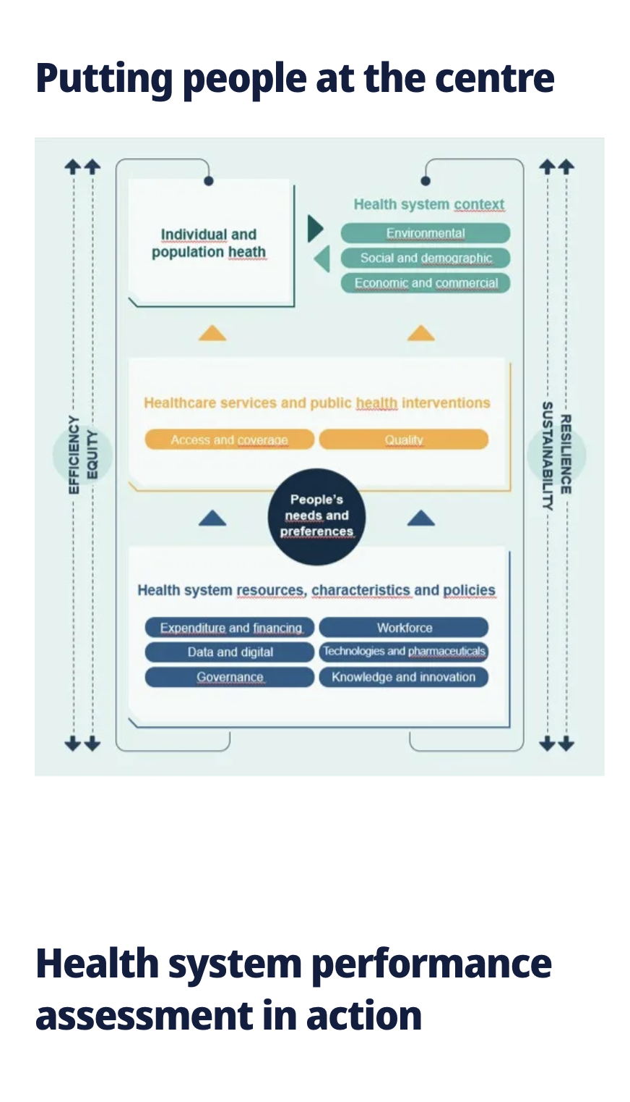




.

Slide 4
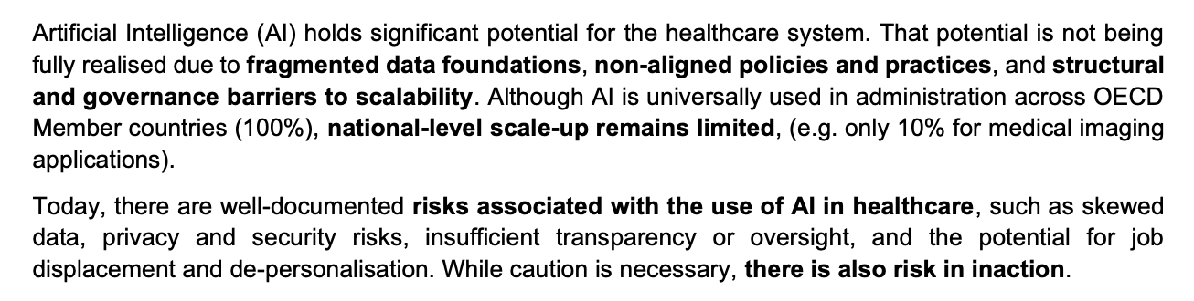

OECD April 2026

Slide 5
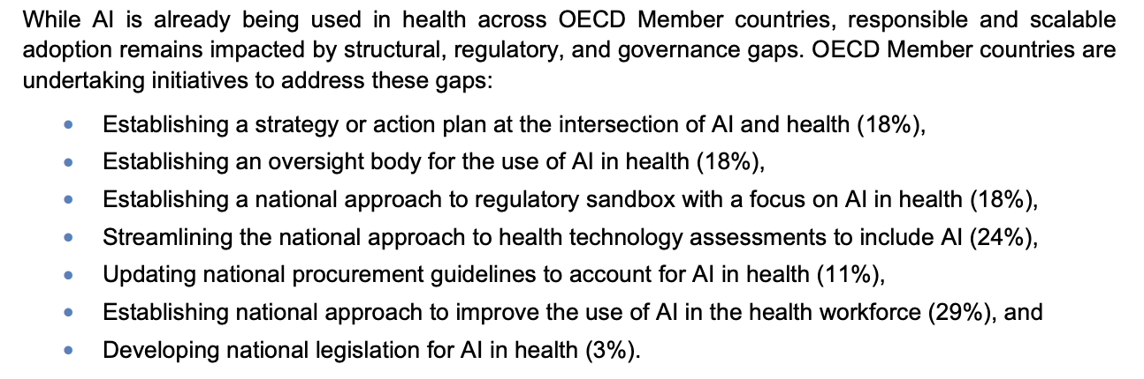
OECD April 2026

Slide 6
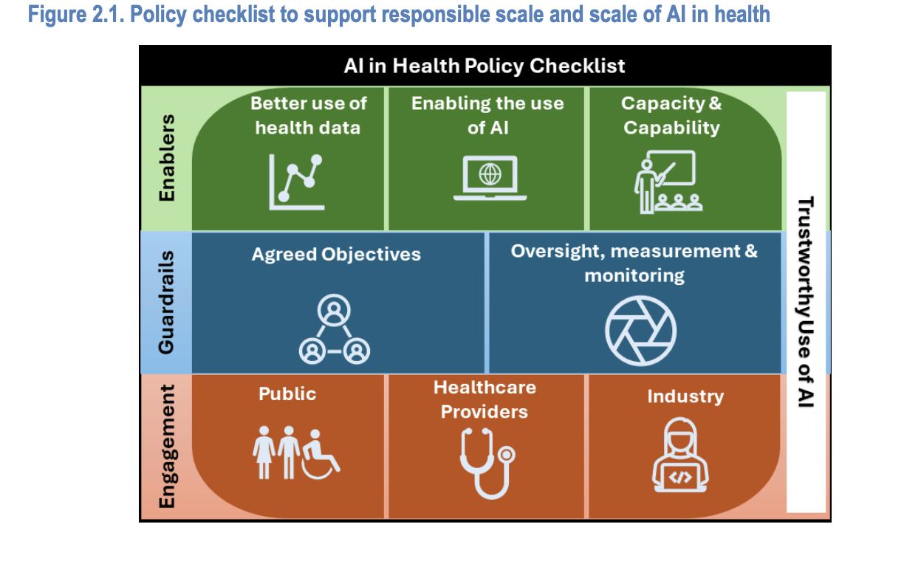
.

Slide 7
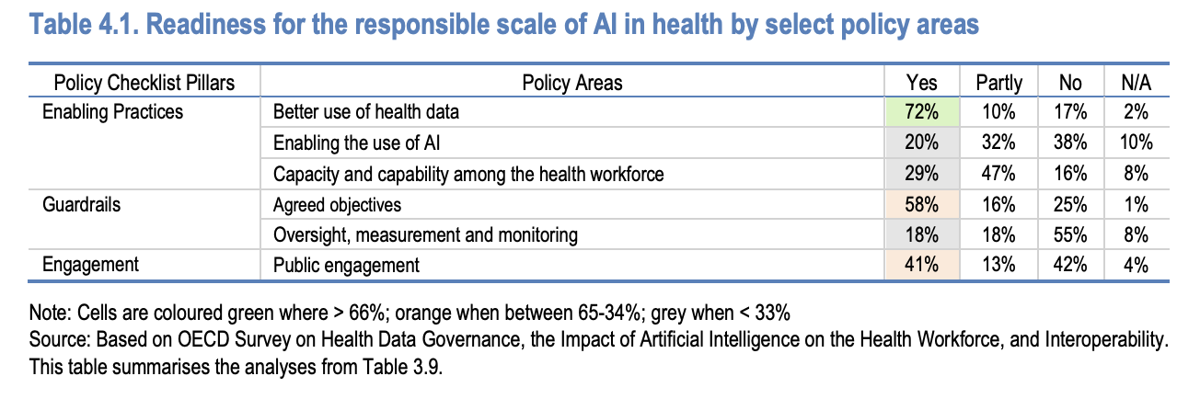
.

Slide 8

Reflections
The role of regulators in Health Care Systems
Optimal use of existing data sources
Awareness and influence on national policy making (i.e. EHDS, AI, etc)
Balancing focus on safety with continuous learning and improvement

