Slide 1

Changes and developments in the regulation of elderly and long-term care in England
June 2026
Rowenna Marshall
Deputy Director of Policy – Local Authority Assessment and Adult Social Care
Credit: Disabled And Here

Slide 2
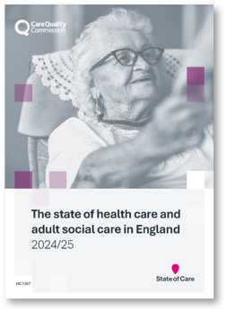
Our vision, our purpose
Why does CQC exist and what impact will we have?
Our vision
Everyone receives safe, effective and compassionate care.
Our purpose
We regulate health and adult social care, we work together with the public, systems and providers of care to protect people, and to promote and improve quality of care.

Slide 3


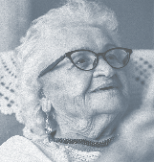


Our unique oversight of care
30,387 Adult social care services
136 NHS acute hospital trusts
10 NHS ambulance trusts
287 Independent ambulance providers
217 Hospice services
47 NHS mental health trusts
292 Independent mental health locations
11,877 Dental practices
6,330 GP practices
1,675 Independent acute locations
291 NHS or independent community health providers
268 Out of hours and urgent care
31 Slimming clinics
172 Prison healthcare locations
153 Local Authorities

Slide 4
State of care 2025: Adult social care
In adult social care, demand continues to rise.
Staff vacancies in adult social care remain three times that of the wider job market and vacancy rates in homecare are more than double that of care homes.
The end of new care worker visas is likely to put further pressure on recruitment, making it more important than ever that a sector-wide workforce strategy is agreed and the fair pay agreement has an impact.
To help people stay in their own homes longer, there need to be more community services – but we have identified factors that could limit the growth of the homecare sector.
Our local authority assurance work has found delays for people in getting access to homecare due to shortages of both homecare staff and in the workforce delivering care to people recovering at home after hospitals stays.

Slide 5
The Case for Change
The Policy context:
  Dr Penny Dash reports
  Professor Mike Richards’ report
  Care Provider Alliance report
  NHS 10 Year Plan
  Independent IT review
Feedback from the sector, the public and colleagues

Slide 6
CQC - Adult social care priorities
1
2
3
4
Our expert teams
Our inspections
Our ability to drive change
Our methodology
Build a strong, cohesive team
Supporting training, development and recruiting more expertise into our inspectorate
Strengthening sector leadership
Increasing volume, consistency and quality of inspections
Developing a balanced inspection scheduling approach
Scheduling to include aged ratings, services registered but not rated
Streamline systems and processes
Using test and learn pilots to develop new and innovative ways to understand quality of care
Sharing innovative, and best practice
Using our powers and processes to drive down health inequalities
An assessment framework designed for adult social care
Engaging and piloting our methodology

Slide 7
Vision for adult social care - becoming a collaborative regulator
Inspecting more frequently – rethinking risk
How CQC in adult social care will work:
  Engagement and co-production
  Re-build relationships between local CQC teams and providers to help spot problems early
  Embedding sector-expertise
  Data and insights gathered through relationships should drive improvement in our sector
A strong and credible advocate for social care nationally and locally
To help them improve and innovate.
We work with care providers and systems to improve quality and equity. We set clear, evidence-based expectations, identify risks early, and support innovation through strong relationships and data-driven insight.

Slide 8

Strengthening our assessment frameworks
Re-introducing sector-specific assessment frameworks
Re-introducing clear descriptions of what each rating means in practice
Fewer quality statements, reframed into key lines of enquiry (KLOEs)
Reducing duplication
User voice included throughout
Rating at key question level
Continuing to adopt the ‘I statements’

Slide 9
Draft adult social care framework
34 to 24
SAFE
Safety culture
Safe systems, pathways and transitions
EFFECTIVE
Assessing needs
Evidence-based care and equitable outcomes
CARING
Kindness, compassion and dignity
RESPONSIVE
Care provision, integration and continuity
WELL-LED
Strategic direction
Workforce equity and culture
Capable and compassionate leaders
Governance and management
Partnerships and communities
Improvement, innovation and learning
Listening to and involving people
Timely and equitable access
Equity in experiences
Person-centred care
Independence, choice and control
Consent to care and treatment
Safe environments and infection prevention and control
Safe staffing
Safe medicines and treatments
Safeguarding
Supporting people to live healthier lives
Managing risks during care and treatment

Slide 10
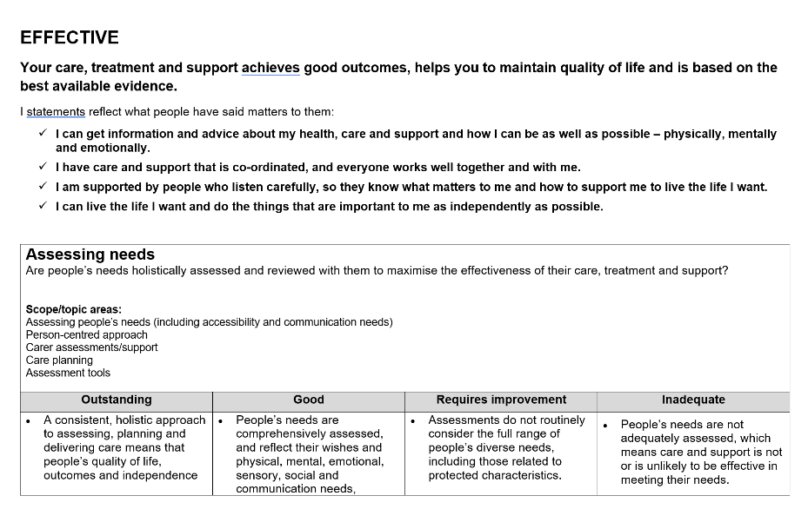
What does it look like in adult social care
Key question
I statement
KLOE
Ratings characteristics

Slide 11
Examples of current activity
Return to Good
Piloting a different approach to inspecting services that are already rated as good, with the focus being people's experiences and outcomes.
To test ways of streamlining the current approach to enable inspectors to assess more services whilst not compromising on quality.
Short reports
Developing and testing a simplified inspection report format for the CQC to present findings more clearly and support faster action from providers.
To improve report quality and accessibility while reducing inspector time spent writing, in response to staff feedback and independent reviews.
We have restructured our teams back into sector specific inspection teams​.
Across all sectors colleagues are starting to re-introduce portfolio owners in a phased rollout.
Portfolio Management
Use of Artificial Intelligence
Testing how artificial intelligence can support report drafting and evidence analysis, using consent-based pilots where inspectors review and approve AI generated drafts.
Improving productivity, consistency, and decision making, while enabling more timely, modern, technology enabled regulation.

Slide 12
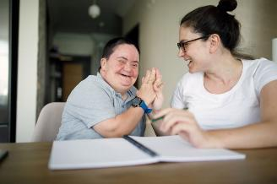
Our inspections and visits
Personalisation and safety are key
Looking for good
Empathetic and robust
Focus on interaction with people who use services
and staff is absolutely central
Balance of observation with review of paperwork
An improvement approach with immediate
learning
Engagement from providers

Slide 13


Key themes from Outstanding providers
Person centred excellence
Services consistently “go the extra mile” and exceed quality statements.
Strong empowerment of people and staff; creative methods of coproduction.
Innovative practice with demonstrable outcomes
Technology used in a way that clearly improves outcomes (e.g., PainChek).
Research involvement or self driven research to improve care provision.
Specialist training delivered by/with people, relatives or staff.
Strong external partnerships
Robust collaborative relationships with health, community, academic or voluntary sector partners that result in better experiences for people.
Reducing inequalities
Targeted work addressing poor outcomes for people with complex or advanced needs (pain, fluids, sleep, distress, inequalities).
Recognition and accreditation
Awards and external validation such as Stirling Gold for dementia friendly environments.

Slide 14
Themes from local authority assessments
The Health and Care Act gives CQC a duty to assess how local authorities are meeting their social care duties under part 1 of the Care Act
Supports us to look more effectively at how care provided in a local system is improving outcomes and reducing inequalities
Overall, local authorities performing well in face of significant challenges
Updated approach from April 2026
Key themes:
More support is needed for unpaid carers
Equity of experiences – consistently low scoring
Increased emphasis needed in supporting prevention
Data is used inconsistently making it harder to plan and monitor services and measure outcomes
Continued impact of recruitment pressures
Transitions for young people becoming adults is an area of challenge
Inconsistent practice in safeguarding
Increasing reliance on voluntary sector around prevention and better outcomes where there is strong partnership working

Slide 15





Any questions?
cqc.org.uk
linkedin.com/company/care-quality-commission
facebook.com/CareQualityCommission
https://medium.com/@CareQualityComm
cqc.govocal.com/en-GB/

