Slide 1



Regulation of Quality, Safety, and Leadership in Elderly and long-term care
EPSO 16 - 17 June 2026

Slide 2
Singapore Population | Regulatory Landscape | NHS Requirements | Regulatory Approach
1
Singapore Population
2
Singapore’s Regulatory Landscape
3
Nursing Home Service (NHS) Requirements
4
Regulatory Approach
2

Slide 3
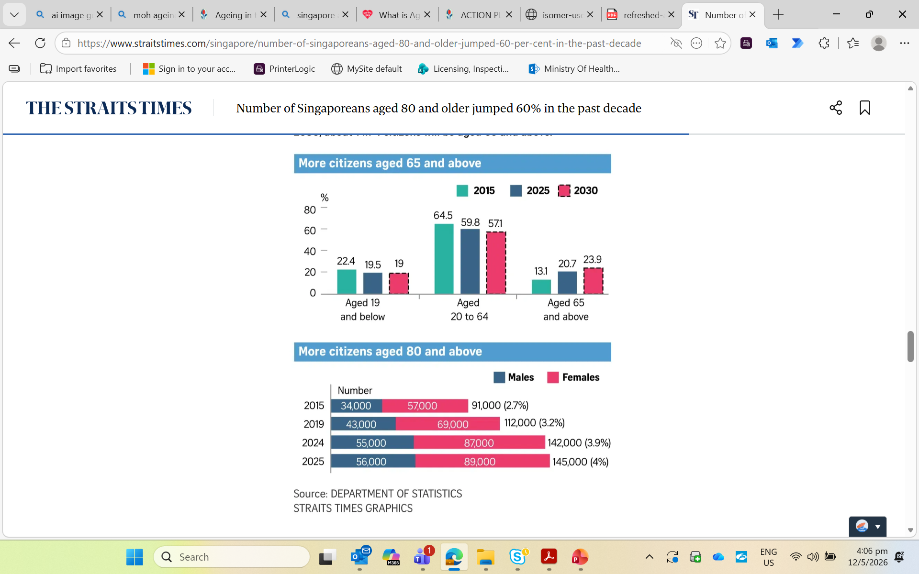


Singapore Population | Regulatory Landscape | NHS Requirements | Regulatory Approach
Singapore’s society profile is changing, alongside the healthcare regulatory context
AGEING POPULATION
INCREASED HEALTHCARE RESOURCE UTLISATION
The proportion of Singaporeans aged 65 and above increased from 13.1%(2015) to 20.7%(2025). By 2030, 1 in 4 Singaporeans will be 65 years or older.
Utilisation of healthcare services is expected to surge, with the expected increased prevalence of chronic diseases and age-related conditions.
Disease Policy and Strategy Division, and Health Analytics Division, Ministry of Health Policy, Research & Surveillance Group, Health Promotion Board, Singapore
ADVANCING MEDICAL TECHNOLOGIES
Personalised medicine via genetics and Precision Medicine, with novel therapies change the trajectory of medical conditions
  CONTINUED RISE OF HEALTHCARE CONSUMERISM
With high mobile penetration rates, Singaporeans are increasingly becoming more digitalised. Consumers are getting more involved in their healthcare.
Chan, G., & Tan, T. (2025, September 29). Number of Singaporeans aged 80 and older jumped 60% in the past decade. The Straits Times. https://www.straitstimes.com/singapore/number-of-singaporeans-aged-80-and-older-jumped-60-per-cent-in-the-past-decade
3

Slide 4
Singapore Population | Regulatory Landscape | NHS Requirements | Regulatory Approach
To manage these changes, Singapore’s healthcare landscape needs to transform
Healthcare 2020
Beyond Healthcare 2020
ACCESSIBILITY
Beyond Healthcare to Health
Help and support Singaporeans to lead healthier lives
We will receive healthcare when we need it
Beyond Hospital to Community
Enable Singaporeans to receive appropriate care in the community and closer to home
QUALITY
AFFORDABILITY
Our healthcare services will be effective and of good quality
We will be able to afford such services
Beyond Quality to Value
Give every Singaporean best value, while keeping our system sustainable
Singaporeans should have the assurance that they will be able to afford quality care appropriate to their needs.
Then-Minister for Health Gan Kim Yong, 2012
…doing more of the same cannot be the solution. We need a paradigm shift in our approach to ageing and health.
Then-Minister for Health Gan Kim Yong, 2016
4

Slide 5








Singapore Population | Regulatory Landscape | NHS Requirements | Regulatory Approach
At present, Singapore’s healthcare regulatory ecosystem is currently segregated into four domains governed by three regulatory agencies.
Health Services
and Data
Health Products
Health Professionals
(Healthcare Services Act, Health Information Act)
To safeguard patient safety and welfare. Data is an emerging regulatory domain that is expected to grow and evolve with time.
(Health Products Act)
To ensure standards of safety, quality and efficacy throughout the product life cycle are met.
(Various professional registration acts e.g. Medical Registration Act)
To uphold standards on professional conduct and ethics, supported by the Secretariat of Healthcare Professional Boards (SPB).
5

Slide 6

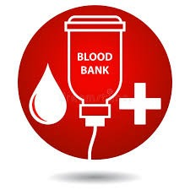

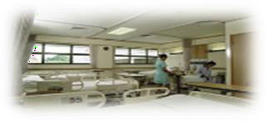







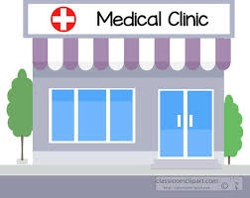


Singapore Population | Regulatory Landscape | NHS Requirements | Regulatory Approach
To address the evolving healthcare landscape, a more versatile regulatory regime is also required
Private Hospitals and Medical Clinics Act (PHMCA)
Premises-based
Licensable Premises
Healthcare Services Act (HCSA)
Services-based
17 Licensable Healthcare Services
Hospitals
Healthcare Establishments
Acute Hospital Service
Blood Banking Service
Radiological Service
Community Hospital Service
Clinical Laboratory Service
Nursing Home Service
Ambulatory Surgical Service
Outpatient Medical Service
Medical Clinics
Clinical Laboratories
Assisted Reproduction Service
Outpatient Dental Service
The HCSA replaces the Private Hospital and Medical Clinics Act (PHMCA) and sets out a services-based approach to the licensing and regulation of health services.
Better safeguard patient safety and well-being in the changing healthcare environment; and
Enable the development of new and innovative healthcare services.
6

Slide 7
Singapore Population | Regulatory Landscape | NHS Requirements | Regulatory Approach
The structure of the Healthcare Services Act & Regulations allows more flexibility
The Act
Sets out broad requirements and obligations.
Regulations
Sets out requirements to be met when providing licensable healthcare services.
General Regulations
Advertisement Regulations
General requirements applicable to all licensees.
Fees Regulations
Appeals Regulations
Requirements unique to each licensable healthcare service (LHS).
Service Specific Regulations
Licence Conditions
Sets out specific technical requirements for each LHS + provides more flexibility than Regulations.
Code of Practice (COP)
(e.g. COP for Key Office Holders)
Provides guidance to licensees on minimum standards.
*FAQs/Guidance carry illustrations of good practices to help licensees interpret and meet the requirements in the Regulations and LCs and are not enforceable.
7

Slide 8
Singapore Population | Regulatory Landscape | NHS Requirements | Regulatory Approach
Four Modes of Service Delivery (MOSDs) is also offered under HCSA
Rationale: To better cater for emerging models of care and to futureproof HCSA, four different modes of service delivery are available for each LHS.
4 Modes of Service Delivery
Permanent premises
e.g. brick-and-mortar premises such as GP or dental clinics
Conveyances
where the LHS is delivered from a vehicle
e.g. medical transport
Temporary premises
no permanent premises
e.g. treating patients at home (home medical)
Remote
through virtual platforms or applications
e.g. virtual GP consultation
Licensees need to obtain MOH’s approval for the applicable MOSDs for each LHS.
Not all MOSDs are allowed for every LHS.
  For example, based on the current and emerging models of care, the nursing home is operated out of a permanent premises, hence the only MOSD allowed is permanent premises for nursing home service.
It is an offence to provide a LHS via MOSDs without prior approval from MOH.
8

Slide 9
Singapore Population | Regulatory Landscape | NHS Requirements | Regulatory Approach
Nursing Home Service (NHS) definition under HCSA
  “nursing home service” means —
  (a) any of the following healthcare services that is provided to an inpatient who is an elderly or a disabled person, or is labouring under a life‑limiting condition or illness, and requires continuous nursing care but does not require continuous onsite supervision by a medical practitioner:
    (i) the examination of the inpatient’s body or mind;
    (ii) the assessment of the inpatient’s health;
    (iii) the observation and diagnosis of, and intervention in, the inpatient’s health condition;
    (iv) the treatment of the inpatient for any condition, disability, disease, disorder or injury;
    (v) the provision of medical care to the inpatient while the inpatient is being accommodated to receive that care;
    (vi) the rehabilitation of an inpatient for the purpose of slowing down the disabling effects of the inpatient’s health condition and functional abilities;
    (vii) the provision of palliative care to an inpatient; and
  (b) any other healthcare service that is incidental to the provision of a healthcare service mentioned in paragraph (a)(i) to (v), including —
    (i) the conduct of any simple in vitro diagnostic test on the inpatient; and
    (ii) the conduct of any ultrasound imaging on the inpatient,
  but excludes the following:
  (c) the provision of any dental care, treatment or procedure to an inpatient, other than assisting the inpatient in cleaning his or her teeth or mouth to ensure the oral hygiene of the inpatient;
  (d) any specialised treatment given to an inpatient who is acutely unwell and requires critical medical care;
  (e) the conduct of any surgical procedure, other than a minor surgical procedure;
  (f) the provision of any treatment or conduct of any procedure on an inpatient that requires the inpatient to be in a state of general anaesthesia;
  (g) the administration of any anaesthetic to cause general anaesthesia in an inpatient
9

Slide 10
Singapore Population | Regulatory Landscape | NHS Requirements | Regulatory Approach
To better safeguard patient safety and welfare, HCSA has enhanced numerous aspects within its regulatory framework
  Licensing Matters
  Governance of Licensees
    Roles and responsibilities of licensee, Key Appointment Holders, Principal Officer, Clinical Governance Officer
  Personnel
    Suitability of personnel engaged or employed by the licensee for providing the nursing home service
  Appointment of the Quality Assurance Committee (QAC)
    Evaluate and monitor the quality and clinical appropriateness of the nursing home service provided to residents including those of incident management such as Serious Reportable Events and emergency preparedness
  Premises, Conveyances and Equipment
    To ensure sanitation and safety aspects, and that premises, conveyances and equipment are fit-for-purpose.
  Medical Products and Health Products
    Standards for purchase, prescription, preparation, storage, disposal, delivery and transportation of medicinal products and health products.
  Specimens
    Safe and proper handling of specimens
    Specimen collection for testing purposes
  Service standards
    Requirements to protect patient safety and welfare
    Communication with patients
    Management of patient health records
    Continuity and transfer of care
  Infection Control
    Infection prevention and control (IPC):
      Lead personnel appointment
      Implementation of an IPC Programme
  Miscellaneous
    Restrictions on use of names
    Penalties
10

Slide 11
Singapore Population | Regulatory Landscape | NHS Requirements | Regulatory Approach
A) Detailed roles and responsibilities of each leadership appointment under HCSA [1/3]
The enhanced governance framework under HCSA ensures greater oversight of the NHS
Licensee
Responsible and accountable for overall service compliance with HCSA
Appoints suitable individuals for other key roles
Key Appointment Holder
Responsible for strategic leadership and general management oversight
Principal Officer
Assists the licensee in ensuring overall operational compliance with HCSA
Oversees day-to-day management of the service
11

Slide 12
Singapore Population | Regulatory Landscape | NHS Requirements | Regulatory Approach
NHS-specific leadership requirements [2/3]
Clinical Governance Officer
Oversees the delivery, co-ordination and evaluation of clinical aspects of the NHS to ensure safe and quality care
NHS criteria:
  Fully registered Doctor:
    Registered as a specialist in any branch of medicine OR is registered as a family physician; AND
    Had previously been deployed as a medical practitioner for 5 years.
  Fully registered Nurse:
    A nursing degree OR post-registration academic qualification^; AND
    5 years working and supervisory experience in an inpatient setting* before their appointment.
Responsibilities:
  Supervises and guides the NH care staff in the delivery of care
  Advocates a culture of safety and quality (e.g. developing and conducting quality assurance activities and audits)
  Works closely with respective healthcare professionals to design and develop clinical pathways, protocols and guidelines
  Reviews complaints and feedback, identifies the gaps and rectifies them with appropriate escalation to licensee
^ The post-basic academic qualification can include but is not limited to: Medical-surgical, Community Health, Palliative Care, Gerontology, Chronic Disease Management, ICU, Orthopaedic, Psychiatry, Oncology
* Any inpatient ward of a hospital or nursing home, whether in or outside Singapore
12

Slide 13
Singapore Population | Regulatory Landscape | NHS Requirements | Regulatory Approach
NHS-specific leadership requirements [3/3]
Head of Nursing
Assists the licensee and CGO in the day-to-day clinical nursing operations of services
NHS criteria:
  Registered Nurse:
    A nursing degree OR post-registration academic qualification^; AND
    5 years working and aggregated supervisory experience in an inpatient setting* before their appointment.
Responsibilities:
  Supervise and guides the nursing personnel on the delivery of care;
  Oversees the induction, training and development of nursing personnel;
  Assist in -
    Establishing, implementing and regularly reviewing written policies and procedures related to the nursing service to provide guidance;
    Ensuring the nursing service adheres to the above policies and procedures and the approved standards of nursing practice; and
    Ensuring the licensee complies with programmes stipulated in the HCSA (e.g. IPC and QAC).
^ The post-basic academic qualification can include but is not limited to: Medical-surgical, Community Health, Palliative Care, Gerontology, Chronic Disease Management, ICU, Orthopaedic, Psychiatry, Oncology
* Any inpatient ward of a hospital or nursing home, whether in or outside Singapore
13

Slide 14
Singapore Population | Regulatory Landscape | NHS Requirements | Regulatory Approach
B) Background screening of prospective personnel engaged/employed by licensee
Due to patients’ profile and long-stay in inpatient settings, Nursing Home Service (NHS) residents are deemed to be more vulnerable and at higher risks of abuse
As a result, mandatory background screening will be implemented for all prospective personnel employed or engaged by the licensee under HCSA
Individuals with determined prescribed offences will require the Director General of Health’s (DGH) permission to be deployed within the premise.
14

Slide 15
Singapore Population | Regulatory Landscape | NHS Requirements | Regulatory Approach
C) Appointment of Quality Assurance Committee (QAC) as part of service upskilling
Led by a QAC supervisor, the QAC functions to develop and maintain a quality assurance programme for evaluation and monitoring of the quality and clinical appropriateness of the NHS the licensee provides
Their duties include:
  Forming recommendations to the licensee to improve the NHS quality;
  Reviewing and managing safety incidents, including Serious Reportable Events (SRE), and monitoring implemented solutions to rectify and prevent the recurrence of such incidents; and
  Ensuring that directives issued by MOH in relation to quality assurance activities are complied with.
15

Slide 16
Singapore Population | Regulatory Landscape | NHS Requirements | Regulatory Approach
D) Crystalising infection control requirements as part of ensuring a clean environment for both residents and staff
Mandatory implementation of an infection and prevention (IPC) programme
Led by an appointed IPC lead and committee to assist the licensee in establishing, implementing and regularly reviewing the IPC programme:
  Regular IPC meetings and activities carried out at the Home
  Surveillance protocols, clear monitoring indicators and reporting mechanisms to management
16

Slide 17
Singapore Population | Regulatory Landscape | NHS Requirements | Regulatory Approach
Requirements enforcement
  A) Inspections
  NHS are inspected on a 2-yearly basis to ensure their compliance with HCSA
    Announced
    Accompanied by an NHS expert
    General HCSA scope
  Ad-hoc inspections
    Unannounced
    Focused scope
  B) Audits
  Periodically, the team also conducts a themed audit on selected NHS
    Most recent audit was focused on understanding baseline care and IPC standards after NHS onboarded HCSA
17

Slide 18
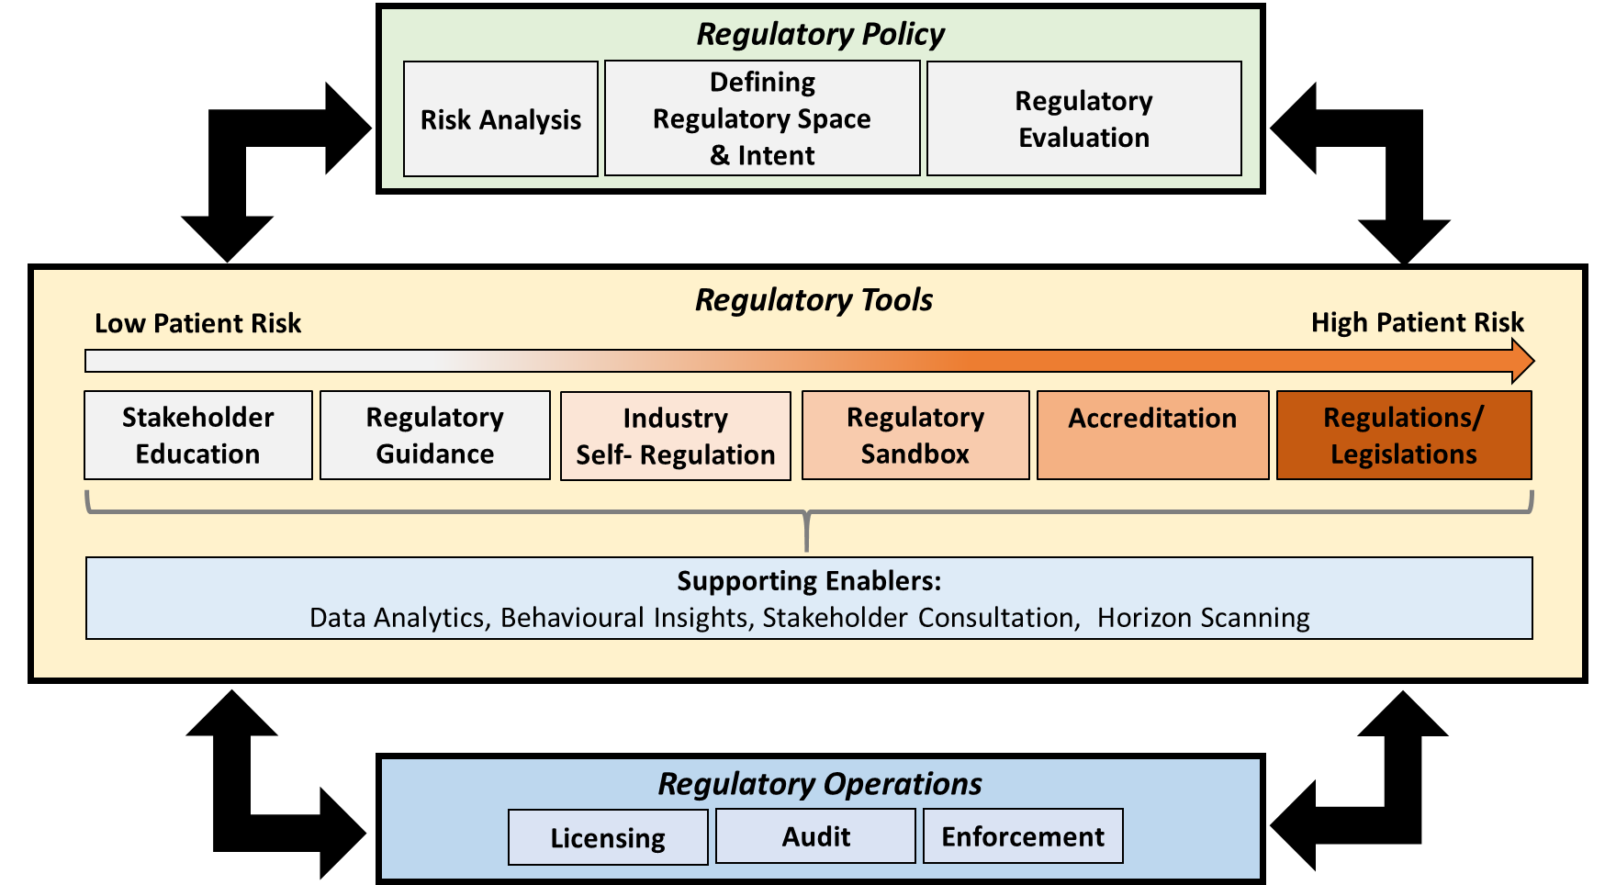
Singapore Population | Regulatory Landscape | NHS Requirements | Regulatory Approach
Singapore takes a risk-based approach in deciding the regulatory need of service models, and may deploy other levers available issues via our “Regulatory Toolkit”
Regulatory Policy
Regulatory Design
Regulatory Review
Regulatory Tools
Low Compliance Burden
Regulatory Tools
High Compliance Burden
Low Compliance Burden
High Compliance Burden
Consumer Education
Stakeholder Education
Guidelines / Standards
Industry
Self-Regulation
Regulatory
Sandbox
Regulations/
Legislations
Accreditation
Supporting Enablers :
Data Analytics, Behavioural Insights, Stakeholder Consultation, Horizon Scanning
Regulatory Operations
Licensing
Audit
Enforcement
18

Slide 19

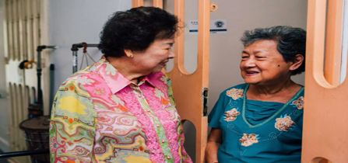
Singapore Population | Regulatory Landscape | NHS Requirements | Regulatory Approach
During our regulatory review of community-based healthcare models, two major care models of concern emerged: SCS and HN
Stay-in Shared Caregiving (SCS)
Home Nursing (HN)
Assisted living variant which provides appropriate and high quality of care for senior clients by laypersons
A sandbox was created for participating providers to experiment with different care permutations
Current residential options include public housing estates as well as private residential areas, with great demand seen within the sandbox
Mobile nurses who provide nursing care at homes of frail and home-bound elderly
Steady increase in service utilisation, with expected demand to surge with the ageing population
19

Slide 20
Singapore Population | Regulatory Landscape | NHS Requirements | Regulatory Approach
After reviewing both care models, the following regulation approach was devised
SCS
HN
Licensing not required
Responsibility of the public/consumer in choosing an appropriate service provider most suited to their needs
Licensing required under HCSA
Regulatory Tools
Regulatory Tools
Consumer Education
Stakeholder Education
Guidelines / Standards
Guidelines / Standards
Regulations/ Legislation
Eventual aim of regulating the sector once appropriate mode has been determined
20

Slide 21
Singapore Population | Regulatory Landscape | NHS Requirements | Regulatory Approach
For Discussion
From our years of regulating NHS and reviewing the community care models, the team has found this sector to be challenging due to a) the mixed profile of players, and b) the overlap in healthcare and social concerns. Thus, we would like to find out:
  How are NHS regulations enforced in your country?
  Are community care models regulated in your country? Why or why not?
  What are some considerations when contemplating whether a new or evolving community care model should be regulated?
21

Slide 22

Thank you.
Singapore Population | Regulatory Landscape | NHS Requirements | Regulatory Approach

