Slide 1




Regulation of Quality, Safety, and Leadership in Elderly care in the EU-challenges and consequences of handling this at a local level.
EPSO Conference Malta, 2026
SIRI WIIG
Centre Director & Professor of Quality and Safety in Healthcare Systems, University of Stavanger, Norway
Adjunct Professor, Western Norway University of Applied Sciences, Norway
Senior Adviser, Stavanger University Hospital, Norway
Honorary Professor, Australian Institute of Health Innovation, Macquarie University, Australia
Honorary Professor, University of Wollongong, Australia
NAME, title

Slide 2


Acknowledgements
PhD students, postdocs, collaborators, mentors, leaders, co-researchers, and colleagues
Support4Resilience EU-project, colleagues and partners
Resilience in Healthcare Research Programme, colleagues, and partners
Safe-Lead project, colleagues, and partners
Research Council of Norway
European Union

Slide 3


Background
Patient safety as a learning process
  Learning from successful outcomes and processes to be repeated
  Learning from unsuccessful outcomes to avoid reoccurrence
Reflection is key for learning individually and in organizations
(Felder et al 2026; Wiig et al 2024; DoH 2000; IOM 2000; Gherardi 2002; Donaldson 2002; Braithwaite et al 2015; Vincent & Amalberti 2016)

Slide 4
Background
Europe faces challenges in elderly care
  Workforce shortages, stress, burnout, competence and capacity demands
Regulators face challenges across countries:
  Complexity, resource constraints, fast changing technology
What is the role of regulators and leaders in promoting quality and safety in healthcare? For whom?
  Patients, staff, next of kin?
(Felder al 2026; Wiig et al 2024; DoH 2000; IOM 2000; Gherardi 2002; Donaldson 2002; Braithwaite et al 2015; Vincent & Amalberti 2016)

Slide 5

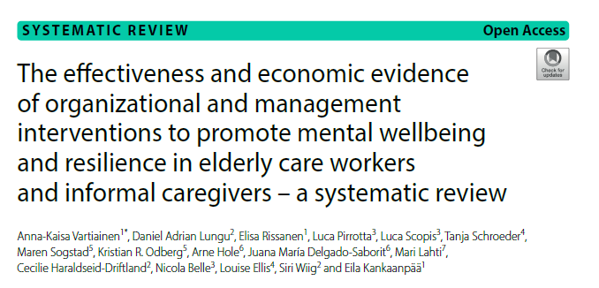
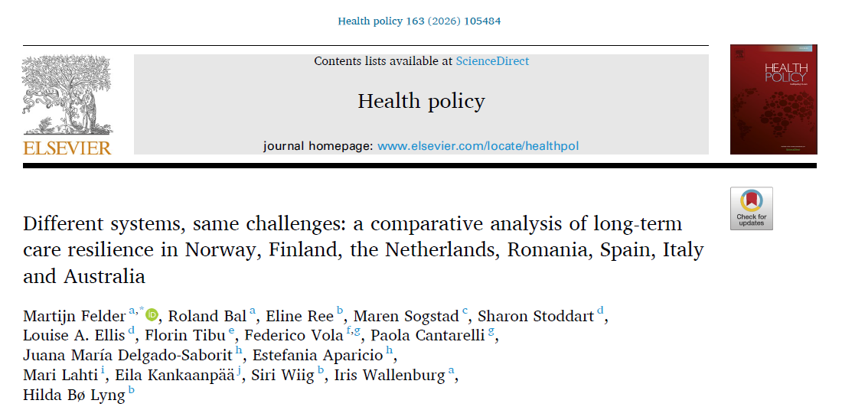
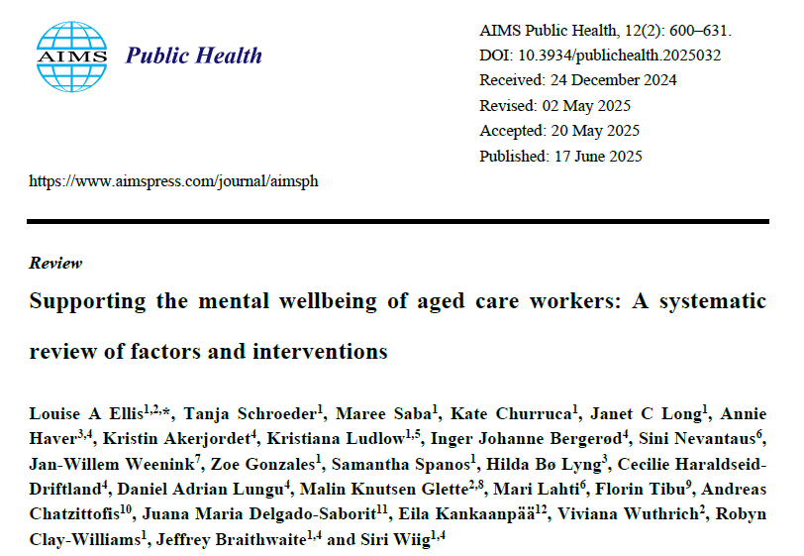
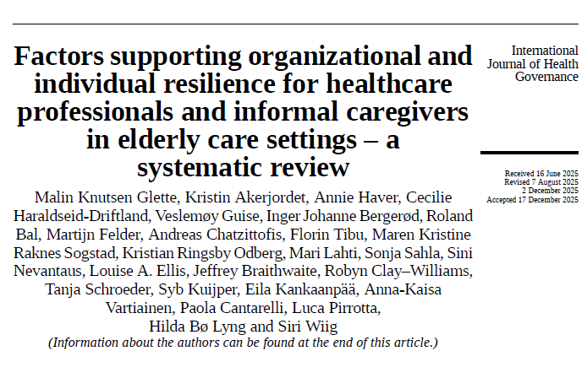

What does the research say about this. And what is the role of leaders and regulators?

Slide 6

Working environment and safety for all – A leader responsibility

Slide 7
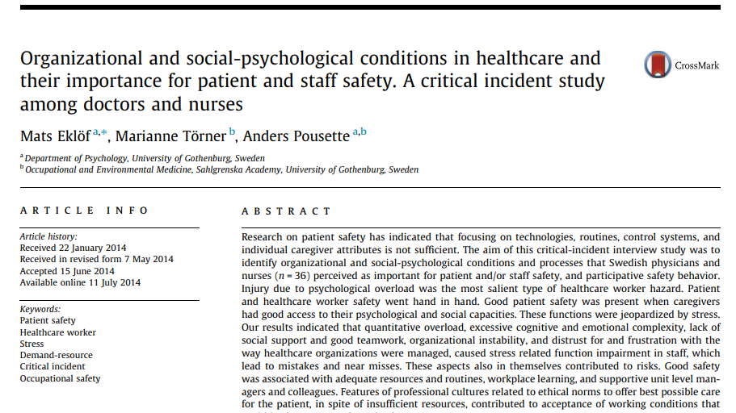

From a separate to joint understanding

Slide 8
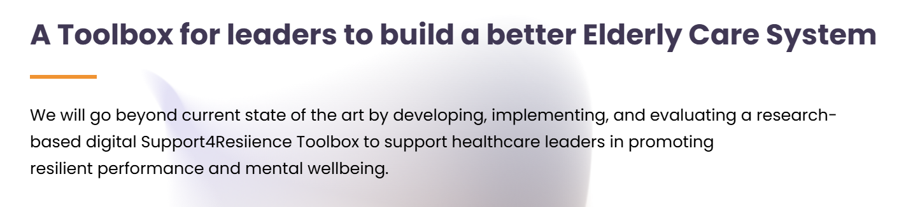
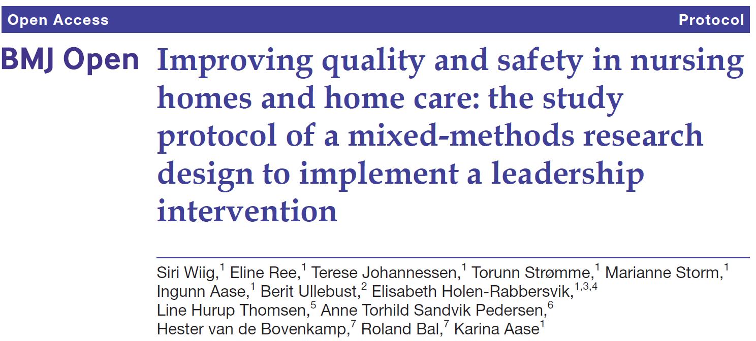
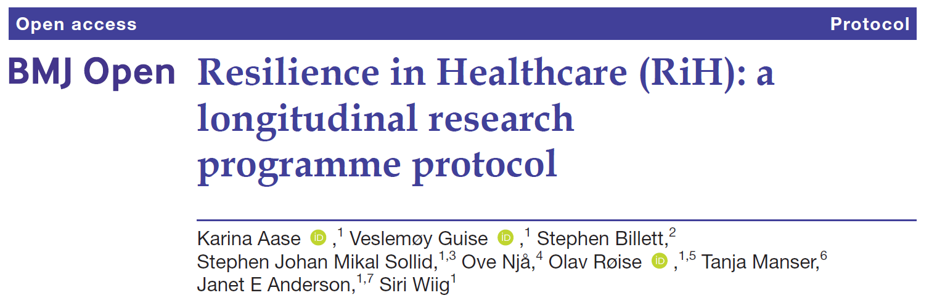
Key Projects
Support4Resilience (S4R): Strengthening resilience and mental wellbeing through the Support4Resilience toolbox for leaders in elderly care (2024-2028)
Resilience in Healthcare – developing, implementing, and evaluating a theoretical and practical resilience in healthcare framework (2018-2024)
SAFE-LEAD - Leadership intervention in nursing homes and homecare (2016-2023)

Slide 9
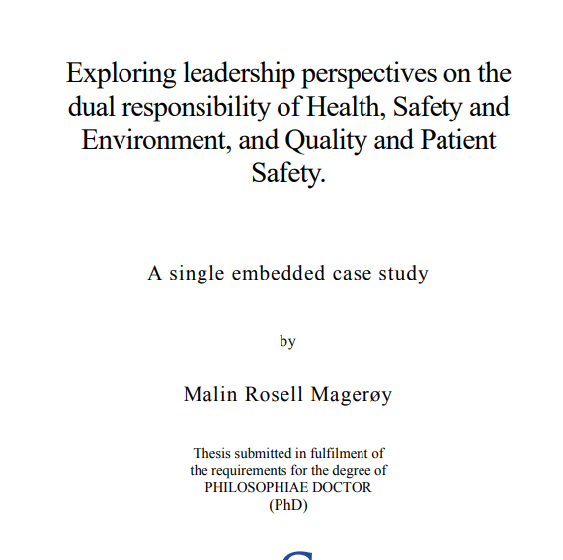
PhD project Malin Magerøy
Exploring leadership perspectives on the dual responsibility of Health, Safety and Environment, and Quality and Patient Safety: A single embedded case study (2024)

Slide 10
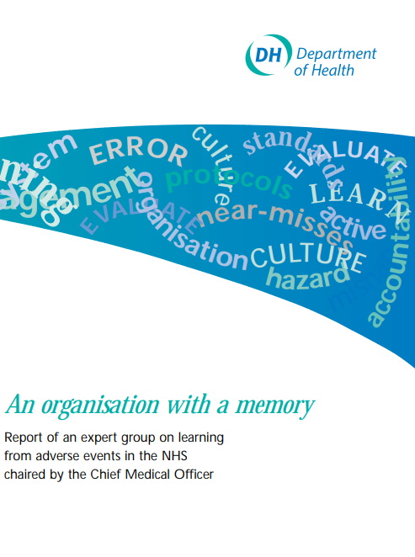
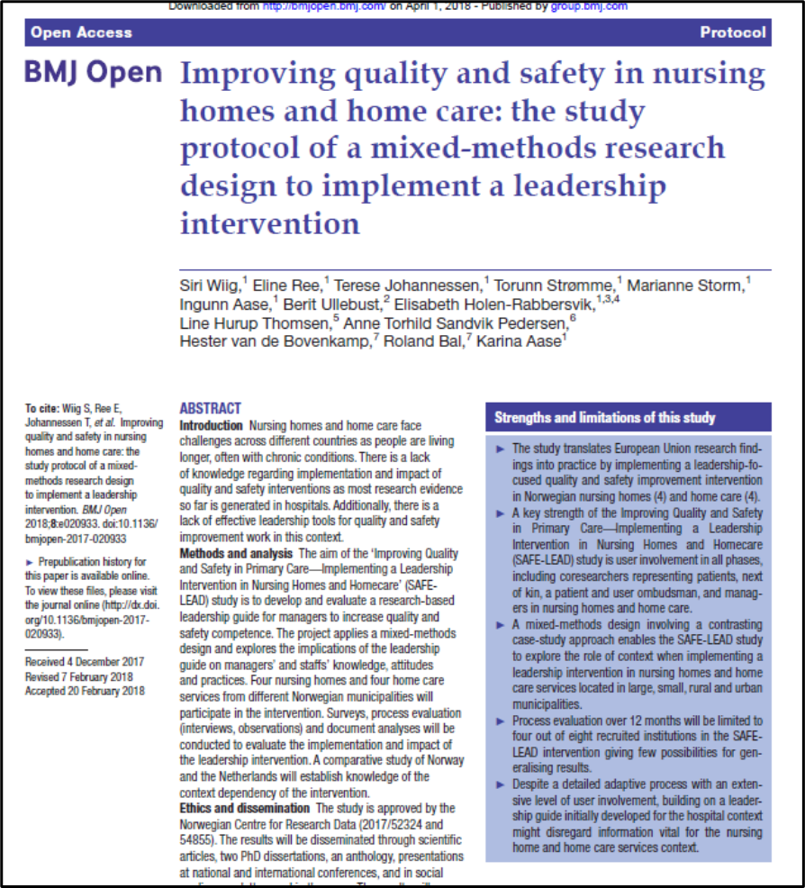
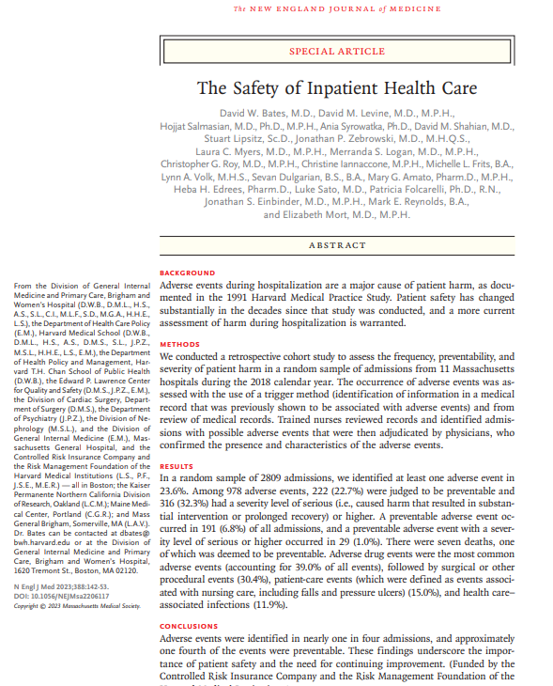
Progress in the field?

Slide 11

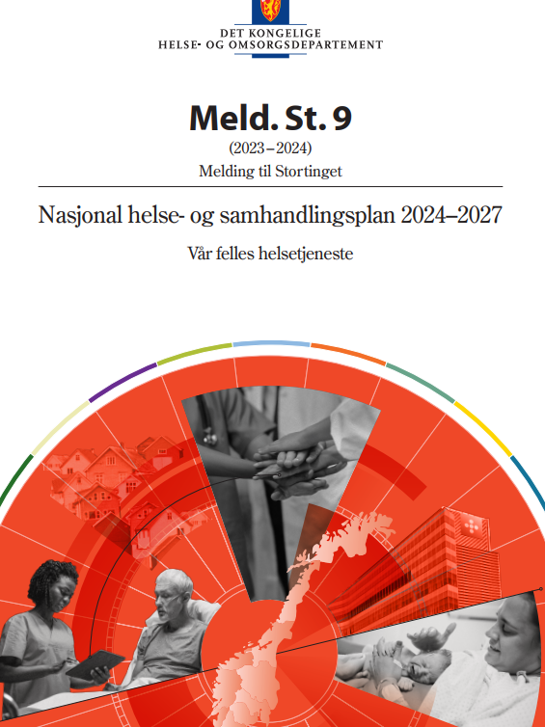
Leadership - National state of patient safety perspective
Vision:
  «Health and care services avoid harm that is preventable and identifies new risk factors» (p. 94)
Aims:
  Fewer patient harm
  Systematic learning and improvement – good systems for monitoring and learning from adverse events and good practice
  Safe to report – employees shoud experience that it is safet to report adverse events and suggestions for improvement

Slide 12
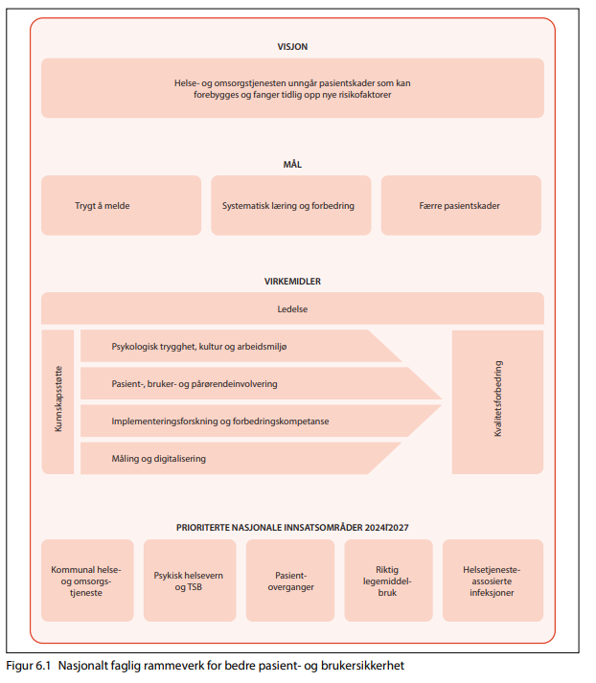
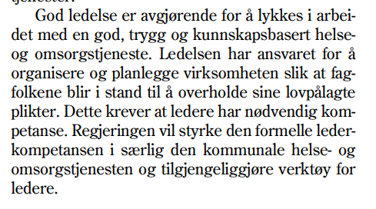
How to get there?
National framework
  Leadership
  Psychological safety
  Patient and family involvement
  Implementation research and improvement competence
  Measurement and digitalisation

Slide 13
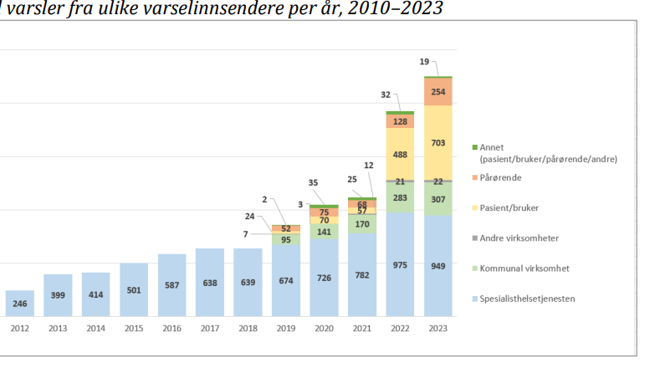
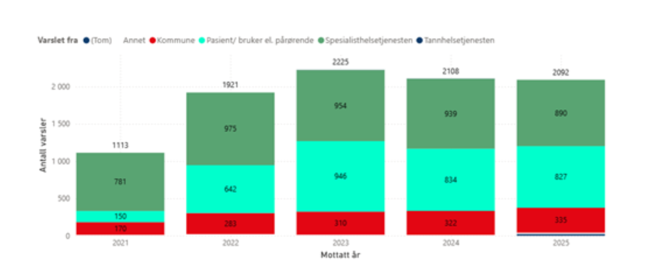

Tilsynsmelding 2023 - varsel

Slide 14

What are the challenges for leaders?

Slide 15

Key elements
Continuity is challenged due to sick leave and change processes
Workload and lack of resources
External demands challenge engagement and culture
Challenges were similar across contexts
The importance of contextual factors
Understanding of quality
Understanding of the dual responsibility for quality and safety for employees, patients, and users
(Glette et al 2026; Felder et al 2026; Aase et al 2021; Johannessen et al 2019;2021; Ree et al 2020; Magerøy et al 2023;2024)

Slide 16
Conceptualising quality
  Profession-related: more than firefighting
  Professional pride and competence
  Patient-centered approach: more than meeting basic needs “Dignity” and “continuity”
  Quality should include the softer dimensions of professional pride, dignity, and a patient-centered approach
  This must be valued in everyday work and in improvement activities

Slide 17

The need for tools and reflexive spaces

Slide 18
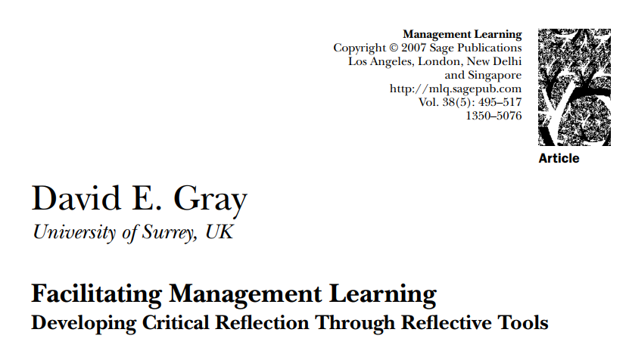
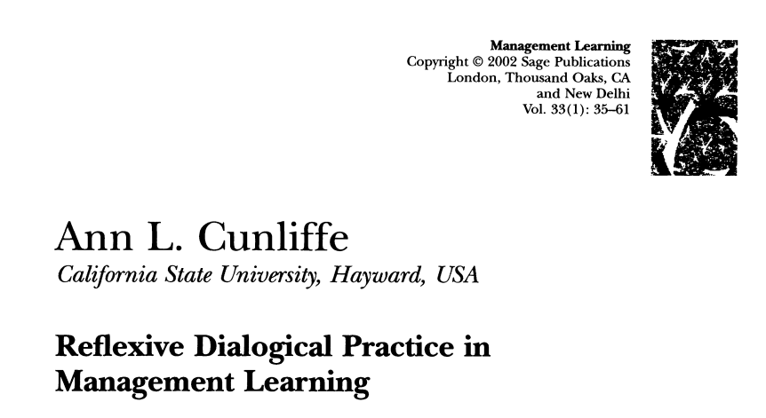
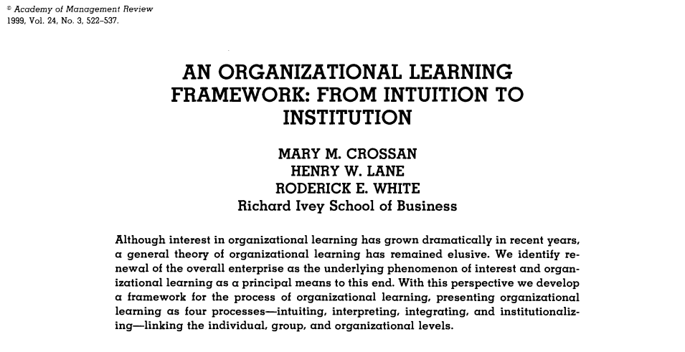
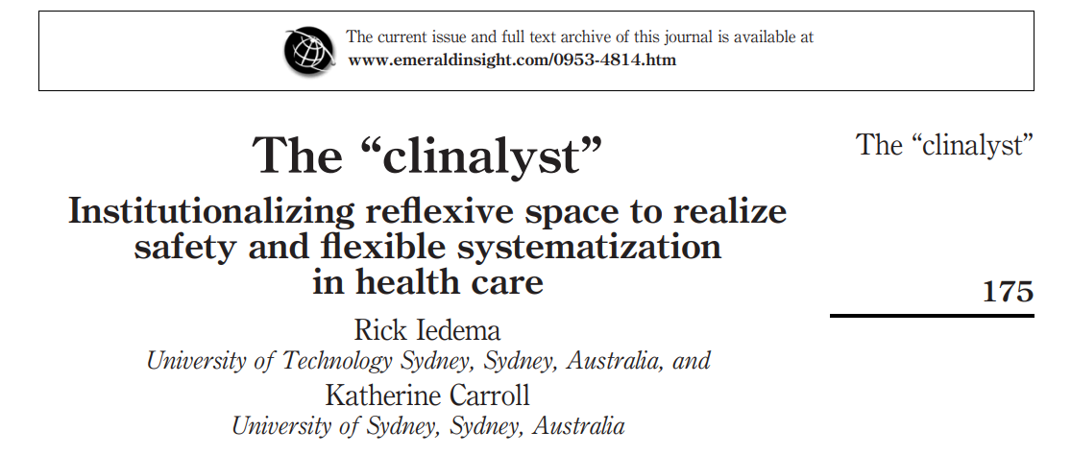

Slide 20

Reflexive spaces
Physical or virtual platforms in which reflexive dialogical practice occurs between people.
The reflexive dialogical practice is key in learning processes, because it bridges tacit and explicit knowledge.
(Cunliffe 2002; Gray 2007; Wiig et al 2020; Seljemo 2025)

Slide 21

Reflexive spaces
Can bring people together to reflect on current challenges, adaptations, and needs in work practice.
Are forums inviting accountability and feedback on concrete practices and effects.
Are collective and mobilize experiences of relevant actors.
(Jerak-Zuiderent, 2015; Gray 2007; Cunliffe 2002; Wiig et al 2020)

Slide 22

How are reflexive spaces created?
Formally and informally
Tools, processes, and structured arenas

Slide 23
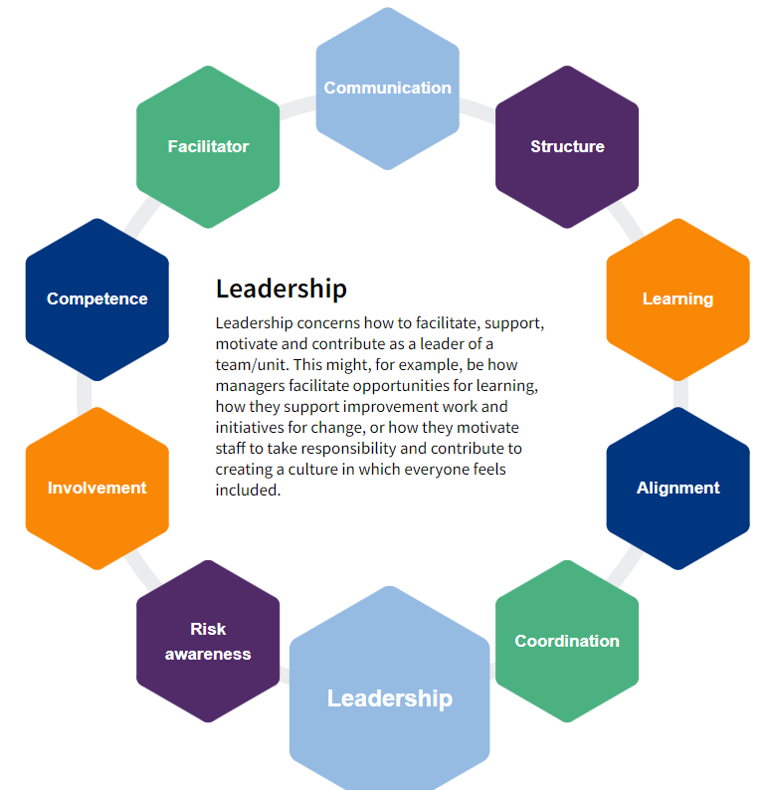
Resilience capacities
(Lyng et al 2022)

Slide 24
Learning tools’ principles and logic models

Slide 25
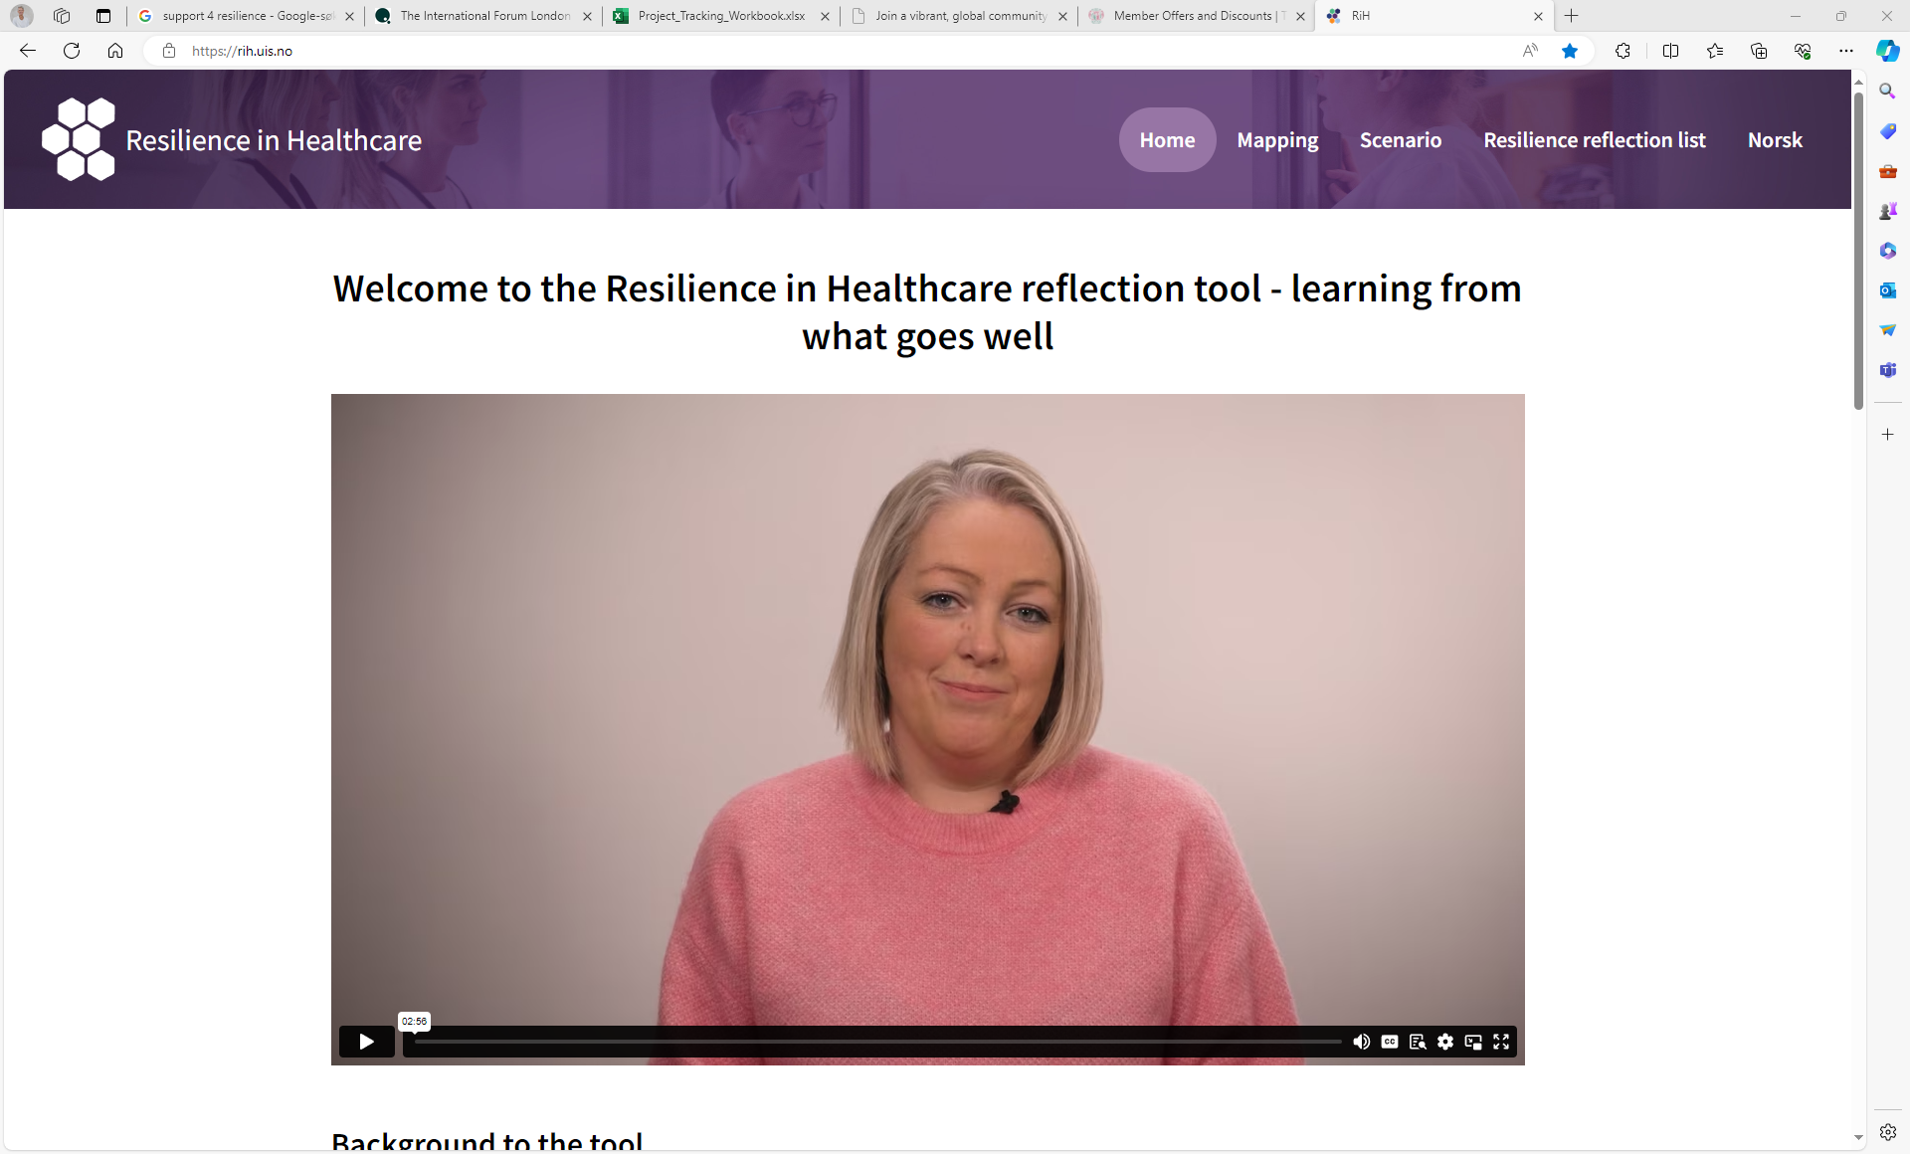


Slide 26
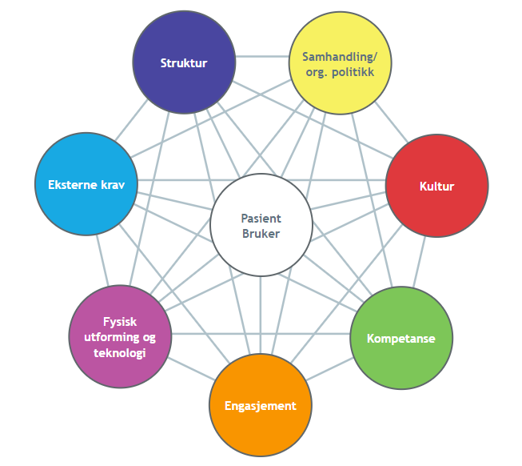
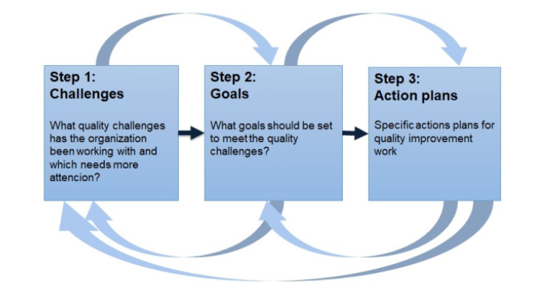
Safe-Lead Guide

Slide 27
Safe-Lead logic model emphasising reflexive spaces in work practice
Safe lead guide
Understanding of quality improvement challenges in own organisation
Suggest and prioritize areas of improvement suited to own organization
Collective reflection on practice, barriers, and facilitators
Implement action plans adapted to organizational setting and context
Monitoring and evaluating improvement and adjust to identified challenges
(Johannessen et al 2019)

Slide 29

Reflexive spaces created through tools establish structures and meeting arenas, and foster understanding of work practice
Bring people together
Talk about system safety
Boundary objects
Translate theory into practice
Creates collective understanding of safety concepts and practices
(Johannessen et al 2021; Lyng et al 2024; Haraldseid-Driftland et al 2024)

Slide 30

Who, why, and how
Employees
Leaders
Regulators
Policy makers
Patients
Unions
Professional associations
Health systems
…

Slide 31

Creating reflexive spaces between regulators and the regulated
Responsive regulation adjusting methods to promote reflection
Use incident investigation to generate team reflection
Regulate user invovlement processes, structures, and meeting arenas
Use soft signals as part of regulatory logic
(Kok 2021; Kok et al 2020; Øyri et al 2024; Wiig et al 2020;2024)

Slide 32

Creating reflexive spaces between workers, leaders, patients and families
Dialogue-based arenas
Use checklists and indicators as foundations for reflexive spaces
Encourage storytelling, reflexive conversations, metaphors, critical incident analysis, reflective journals, and focus groups.
(Kok et al 2020; Kok 2021; Wiig et al 2020; Seljemo et al 2023; 2024)

Slide 33
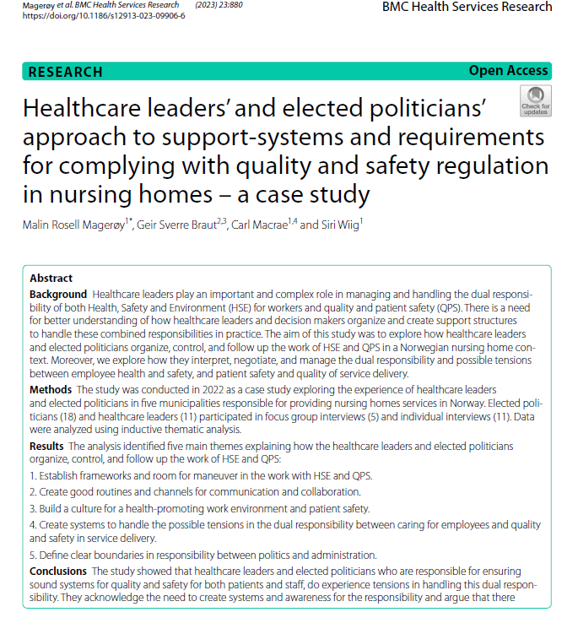
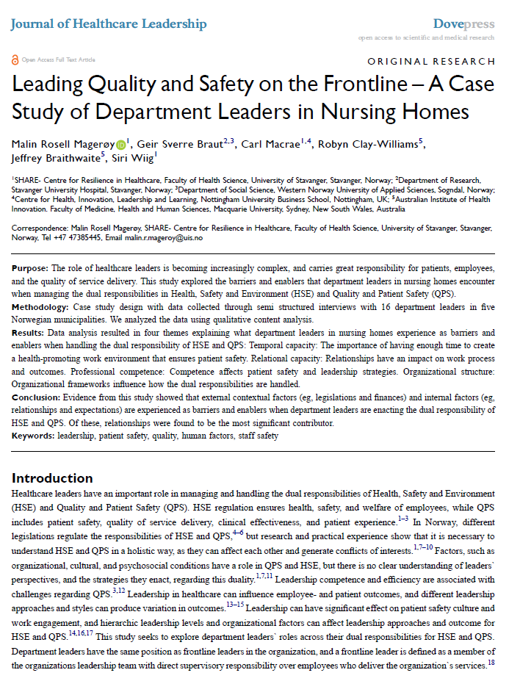
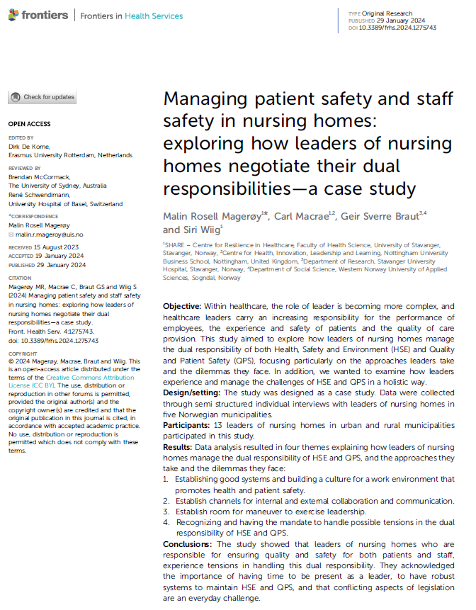
How to handle the dual responsibility??
FamilyID=Office_ArchiveTorn

Slide 34

Key elements
Goal conflicts at all levels – create room to maneuver
Build good routines for communication
Build working promoting health and patient safety
The role of relations cross cutting all levels
(Magerøy 2024; Magerøy et al 2023;2024a,b)

Slide 35

Success criteria?
Trust, dialog, respect, and a psychologically safe atmosphere.
(Gray 2007; Cunliffe 2002; Wiig et al 2020; Wahl et al 2022; Jacobsen et al 2024)

Slide 36


Reflective Learning Health Systems?

Slide 37
For those leading
Make reflexive spaces relevant and integral to work
Promote continuity in management positions
Ensure support and open climate
Use tools to structure and guide reflection
Build a working environment that emphasizes both patient safety and working environment factors which are central to safety for everyone!
(Cunliffe 2002; Gray 2007; Idema & Caroll 2011; Wahl et al 2022; Jacobsen et al 2024; Øyri et al 2024; Wiig et al 2020; Johannessen et al 2021; Haraldseid-Driftland et al 2023; Lyng et al 2024; Seljemo et al 2023;2024)

Slide 38

Conclusion
Creating different constellations of reflexive spaces is a foundation for promoting conditions that may cultivate quality and safety improvement
New leadership and regulatory approaches can stimulate, rather than curb, reflexive learning
Improvement processes could benefit from acknowledging reflexive spaces where people within and across organizations meet, share experiences, and create opportunities for learning.

