Slide 1

Loneliness among the adult population in Ireland and associations with mental health
John Farrelly
Chief Executive

Slide 2
Loneliness and Public Health
Strong links with
lack of social connectedness
poorer wellbeing, mental and physical health,
increased healthcare utilisation and associated economic costs.
Confluence of this growing evidence base and the acute experience of loneliness and social isolation during the COVID 19 pandemic has spurred greater policy attention in Ireland, with loneliness now recognised as a critical public health issue.

Slide 3
Irish Research into Loneliness
Concentrated on specific groups, such as older people and, to a lesser degree, adolescents.
A notable lack of understanding regarding loneliness within the broader adult population.
More Recently ESRI researched:
Who experiences loneliness in Ireland today?
Does loneliness affect mental health and quality of life?

Slide 4
DATA AND METHODS
Data from 2021 and 2023 of Healthy Ireland, a nationally representative telephone survey of the Irish population aged 15 and over.
Regression analysis to investigate potential predictors of loneliness
- demographic (gender, age group, country of birth, region of residence),
- socio-economic (marital status, responsibility for children under 18, educational attainment, employment status)
- health and disability status, participation in social groups, whether respondents report having few people to rely on, and the presence of a mental health problem.

Slide 5
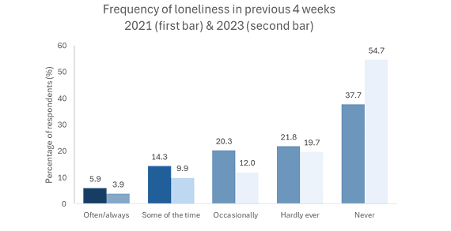
Prevalence of Loneliness

Slide 6
Results
Frequent loneliness (often or always) saw a decrease from 5.9% in 2021 to 3.9% in 2023.
Proportion of Irish people experiencing loneliness at least some of the time also fell, from 20.2% to 13.5%.
The elevated levels of loneliness observed in 2021 were likely a consequence of the COVID-19 government mandated lockdown restrictions that were in effect. As these restrictions were lifted and daily life gradually returned to a normal state, loneliness levels declined by 2023.
13.7% showed indicators of a probable mental health problem, while the majority (80.1%) of respondents reported a good quality of life.
Social connectedness, 31.4% stated they belonged to a club or group, and 26.0% indicated having few close confidants.

Slide 7
Mental Health
Strong association between having few people to rely on, probable mental health issues, and acute loneliness (feeling lonely often or always).
Marriage, compared to being single, was linked to a lower likelihood of experiencing loneliness, whereas unemployment and homemaking were associated with a higher likelihood.
Older age groups (50-64 and 65+) were less likely to report loneliness than younger respondents (15-29).
Individuals frequently experiencing loneliness had a 35.6 percentage point higher probability of having mental health problems compared to those less frequently lonely.
Loneliness was negatively associated with reported quality of life, with frequent loneliness showing a stronger negative correlation.

