Slide 1
Social Isolation and Loneliness
A major public health priority
Evidence from IGAS inspection reports
European comparative perspective – EPSO

Slide 2
A systemic public policy challenge
Rapid population ageing across Europe
Rising mental health needs and pressure on care systems
IGAS hypothesis: social isolation is partly produced by policy design

Slide 3
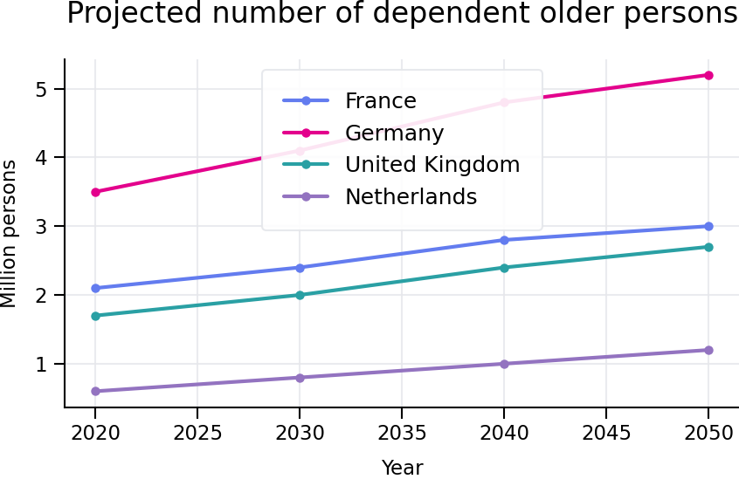
Ageing and dependency: comparative projections
France: +40–46% dependent persons by 2050
Germany: already high levels (~6% of population)
Common dynamics, differentiated pressure

Slide 4
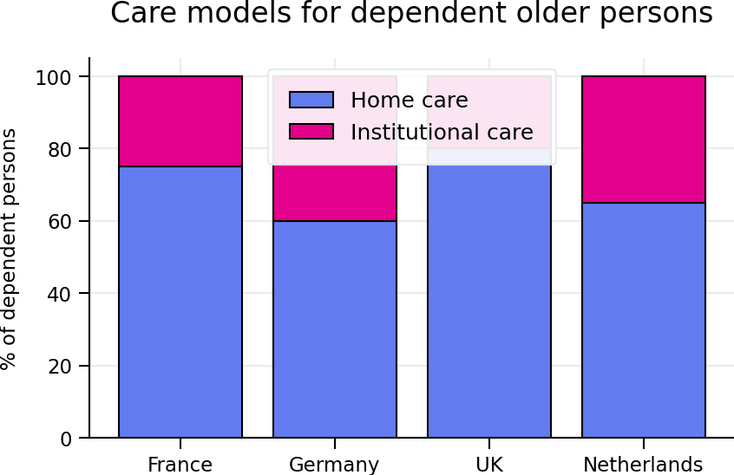
Organisation of long-term care systems
France: more than 75% cared for at home
Highly contrasted European care models
Home-based care as a structural policy choice

Slide 5
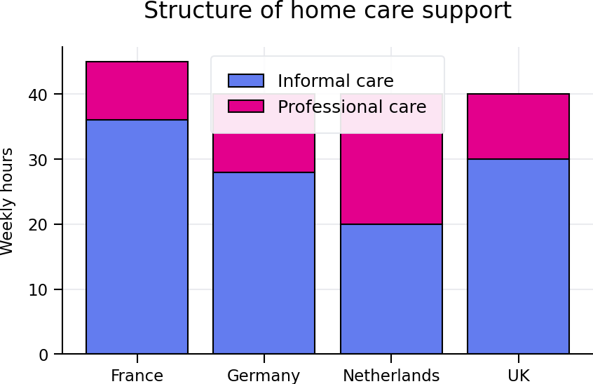
Strong reliance on informal caregivers
France: informal/professional ratio ≈ 4
Netherlands: near balance
Structural vulnerability of the French model

Slide 6
IGAS analysis: home care and invisible isolation
Low visibility of social isolation at home
High burden on family caregivers
Strong territorial inequalities in service availability

Slide 7
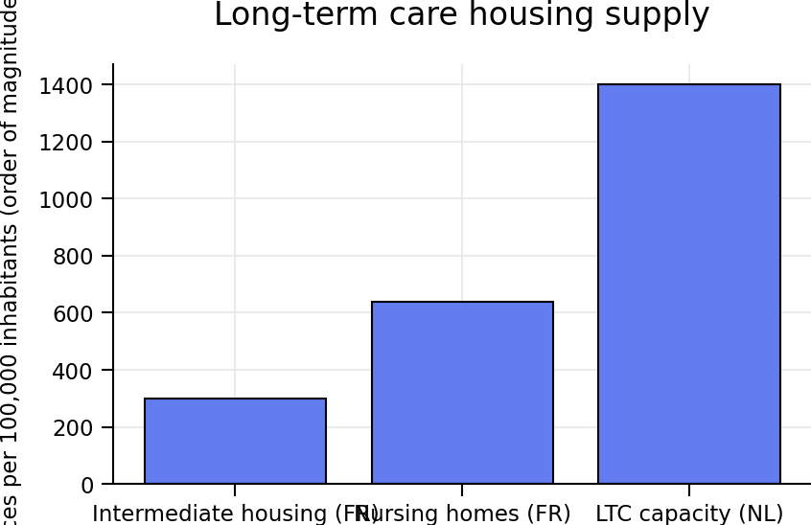
Housing supply and intermediate solutions
France: structural deficit of intermediate housing
Netherlands: dense long-term care supply
Mechanical effect: prolonged stay at home

Slide 8
Igas made a special report forcasting facilities need
Mission inter-inspections relative aux diverses formes d’habitat partagé adapté au vieillissement | Igas (share home for older people)

Slide 9
Special tool developed for local authorities
For this report, we made a special tool for helping local authorities to forecast future facilities for older persons
Three kind of facilities :
Residential nursing homes (long term care facilities; (Etablissement pour Personnes Handicapées Agées et Dépendantes, EPHAD in French);
Autonomy résidences for older adults (résidence autonomie in french);
Living at home (with home‑based care when applicable).

Slide 10
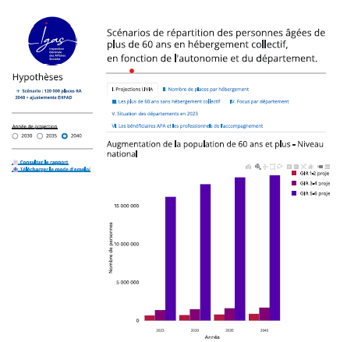
Online tool

Slide 11
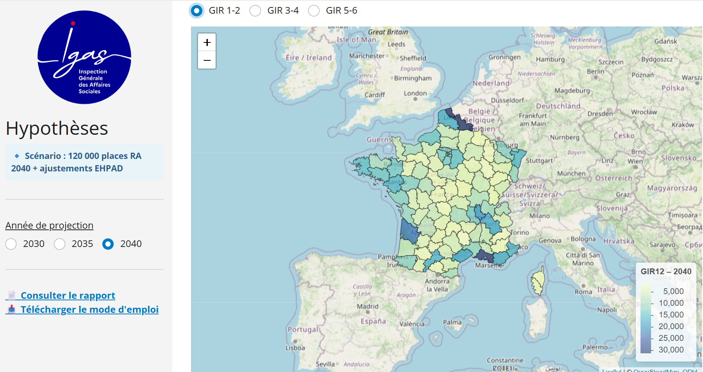
scenariospa.shinyapps.io/simple_app/

Slide 12
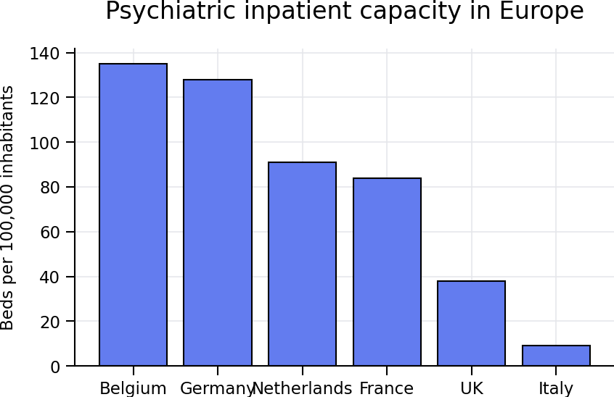
Mental health systems: contrasted European models
Gap of 1 to 14 between countries
France: intermediate position
Organisation of care directly shapes isolation risks

Slide 13
Cross-cutting comparative insights
Comparable demographic pressures
But very different policy responses
IGAS conclusion: isolation is largely system-driven

Slide 14
Conclusion – Key message
Social isolation affects all ages
It is not a demographic inevitability
Inspection bodies play a key role in identifying and transforming policies
You can find our reports here in english Reports in English | Igas

