Slide 1



Loneliness and Social Isolation
A research perspective from dementia and care
Session 1.3
X THE PLACE OF USEFUL LEARNING
Dr Kieren Egan,
Principal Research Fellow,
Digital Health and Wellness Research Group and Living Lab Co-lead
Dept of Computer and Information Sciences,
University of Strathclyde

Slide 2
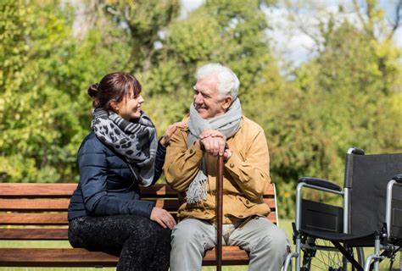
Starting with a scenario….
Two people in a house.
One has dementia. One cares for them as a family member
Neither has spoken to anyone outside for days.
The regulatory/inspectorate question: who is your responsibility?
X THE PLACE OF USEFUL LEARNING
The answer is both: but most systems are designed to see only one
Over the past decade at Strathclyde, across dementia care, digital health, and social interventions, our work has consistently shown:
  Social connection is central to living well with dementia
  Informal carers often become/lonely socially isolated as the caring role progresses
  Loneliness/social isolation is not consistently recognised (or delivered) within care systems

Slide 3
Todays talk: How could Regulation / Inspection
  How could Regulation / Inspection…
    Become more aware of the persistent challenge of loneliness in dementia and carer communities?
    Make better use of evidence and intervention models that reduce isolation and strengthen social participation?
    Pay attention to and discuss the role of co designed digital health supports and carer pathways?
    Explore social connection as a measurable, accountable component of quality and safety for older people?
X THE PLACE OF USEFUL LEARNING

Slide 4
Q1: How could Regulation / Inspection Become more aware of the persistent challenge of loneliness in dementia and carer communities?
X THE PLACE OF USEFUL LEARNING

Slide 5
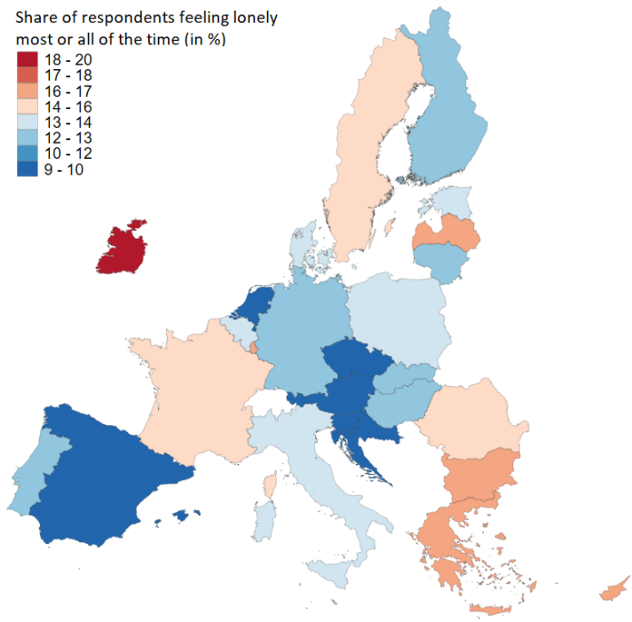
Prevalence of loneliness/social isolation
The first ever EU-wide survey on loneliness, EU-LS 2022 finds that on average, 13% of respondents report feeling lonely most or all of the time over the past four weeks, while 35% report being lonely at least some of the time.
Loneliness prevalence differs across countries.
This can be explained by cultural differences but also by demographic differences and, possibly, sampling differences.
According to EU-LS 2022 loneliness is most prevalent in Ireland with over 20% of respondents reporting feeling lonely. Luxemburg, Bulgaria and Greece follow.
The lowest levels are observed in the Netherlands, Czech Republic, Croatia and Austria (all below 10%).
X THE PLACE OF USEFUL LEARNING
Loneliness prevalence in the EU - Joint Research Centre

Slide 6
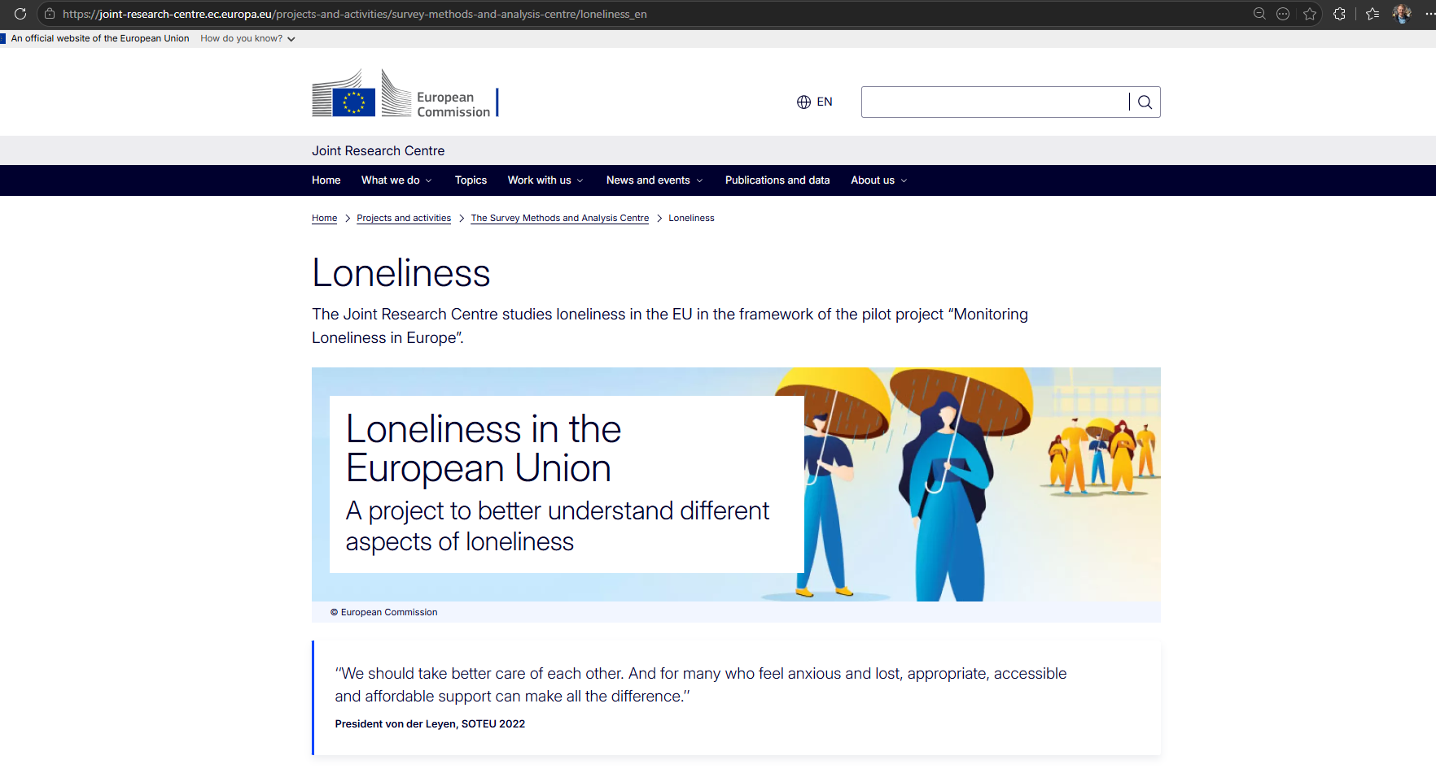
Awareness and impact of loneliness/social isolation
European Union policy reflects substantial evidence and awareness of loneliness, supported by large cross-national datasets (25,656 respondents recruited from established consumer panels)
Despite this, loneliness is not systematically embedded in inspection frameworks or regulatory standards
This creates a policy–practice gap between recognition and enforcement
X THE PLACE OF USEFUL LEARNING
Loneliness - Joint Research Centre - European Commission

Slide 7
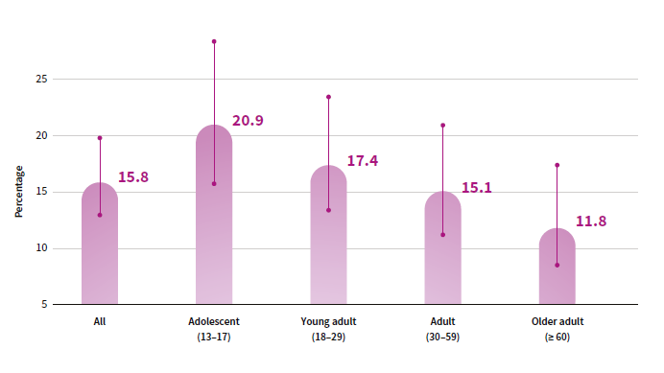

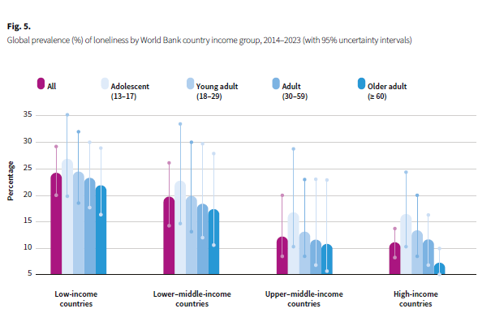
Awareness and impact of loneliness/social isolation
X THE PLACE OF USEFUL LEARNING

Slide 8
Current knowledge, public policy and practice
Loneliness is not routinely assessed, recorded, or reviewed within care systems: resulting in inconsistent visibility in everyday care.
Two scales widely used:
  University of California, Los Angeles (UCLA) Loneliness Scale (20, 3) and;
  The De Jong-Gierveld Loneliness Scale (11,6)
Can we not just start measuring it? Yes but…..
It’s subjective
Stigma limits reporting
It's episodic and context dependent
No Universal measurement or threshold
Pragmatism
Indirectness: inactivity, decline low engagement
X THE PLACE OF USEFUL LEARNING
Loneliness is associated with many consequences including
    Mortality
    poor physical health (e.g. heart disease, high blood pressure, stroke risk, weakened immune system)
    mental health (e.g. depression, anxiety, low self worth hopelessness)
    Cognitive decline
    Social and economic disadvantage (cause or effect?)
    Hospital use?
WHO Commission on Social Connection

Slide 9
Q2: How could Regulation / Inspection Make better use of evidence and intervention models that reduce isolation and strengthen social participation?
X THE PLACE OF USEFUL LEARNING

Slide 10
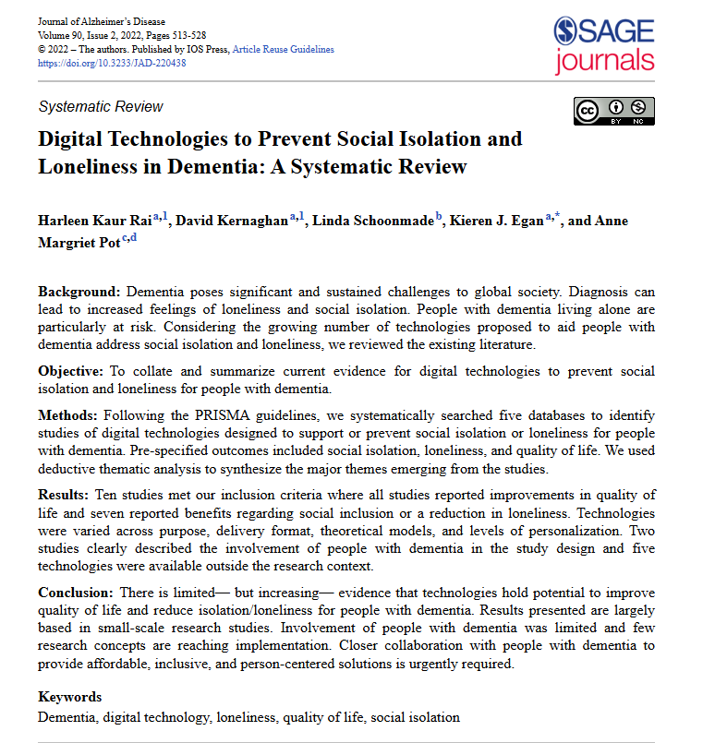
Q2: Make better use of evidence and intervention models that reduce isolation and strengthen social participation?
We have led research into social isolation and digital loneliness in dementia as a systematic review
We were seeking to collate and summarise current evidence for digital technologies to prevent social isolation and loneliness for people with dementia
10 studies met our inclusion criteria where all studies reported improvements in quality of life and seven reported benefits in social inclusion/reduction of loneliness
Lots of small-scale studies, some high cost, large staff involvement role limited, involvement of people with dementia and few research concepts are reaching widespread implementation.
X THE PLACE OF USEFUL LEARNING
Key take home: Closer collaboration with people with dementia (and those who support them) to provide affordable, inclusive and person centered solutions is urgently required

Slide 11
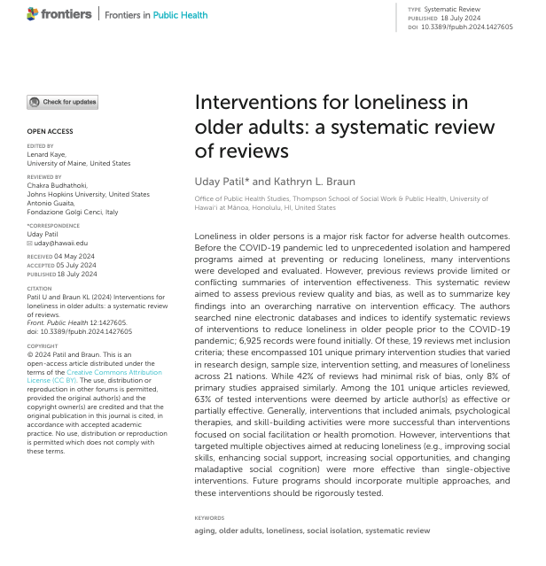
Q2: Make better use of evidence and intervention models that reduce isolation and strengthen social participation?
This systematic review aimed to collate and summarise key findings on interventions for loneliness as a systematic review of reviews.
19 reviews met inclusion criteria; these encompassed 101 unique primary intervention studies that varied in research design, sample size, intervention setting, and measures of loneliness across 21 nations.
63% of all interventions were effective or possibly effective at combatting loneliness.
Recommendations
First, allied health professions should develop broad interventions. A multi-objective approach aptly targets the multi-dimensional issue of loneliness
interventions should become more purpose-driven to stem the losses of identity many lonely older adults feel
Third, specific types of interventions proved to be more promising than others. Psychotherapeutic interventions utilized the highly effective strategy of modifying maladaptive social cognition
X THE PLACE OF USEFUL LEARNING
Key take home: Lots of different intervention ideas work to improve loneliness: multi dimensional, holistic support for loneliness is favoured from review evidence.
Patil U and Braun KL (2024) Interventions for loneliness in older adults: a systematic review of reviews. Front. Public Health 12:1427605. doi: 10.3389/fpubh.2024.1427605

Slide 12
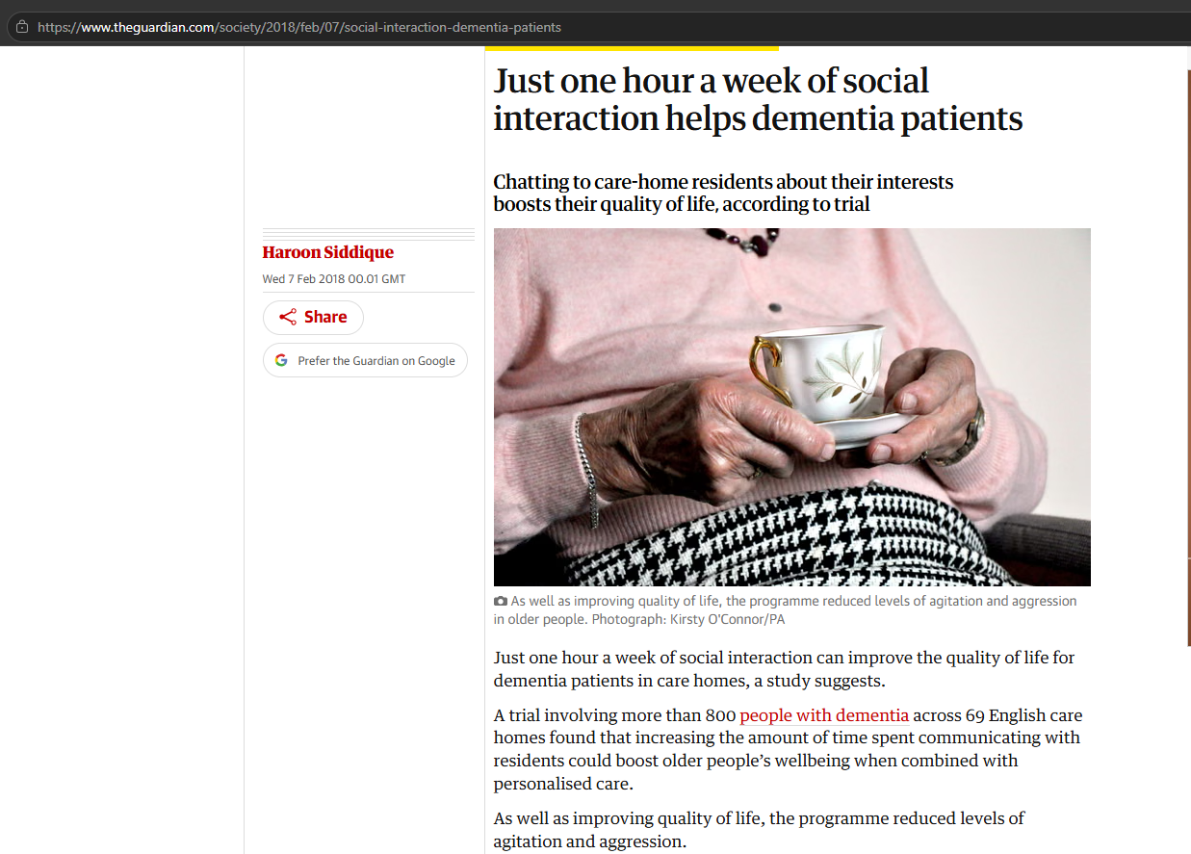
Q2: Make better use of evidence and intervention models that reduce isolation and strengthen social participation?
Previous research has found that in many care homes, residents have as little as two minutes of social interaction per day.
Since 2018 the (Well-being and Health for people with Dementia (WHELD) has been building knowledge about what could work in care home settings.
The primary study, involved a trial of more than 800 people with dementia across 69 care homes in South London, North London and Buckinghamshire.
Two ‘care staff champions’ at each home were trained over four day-long sessions, to deliver more personalised care and structured social activities.
Intervention involves simple measures such as talking to residents about their interests and involving them in decisions around their own care.
X THE PLACE OF USEFUL LEARNING
Outcome:
improved quality of life and reduced agitation (including aggression).
Increased engagement
Key ref: Ballard, C., Corbett, A., Orrell, M., et al. (2018).Impact of person‑centred care training and person‑centred activities on quality of life, agitation, and antipsychotic use in people with dementia living in nursing homes: A cluster‑randomised controlled trial.

Slide 13
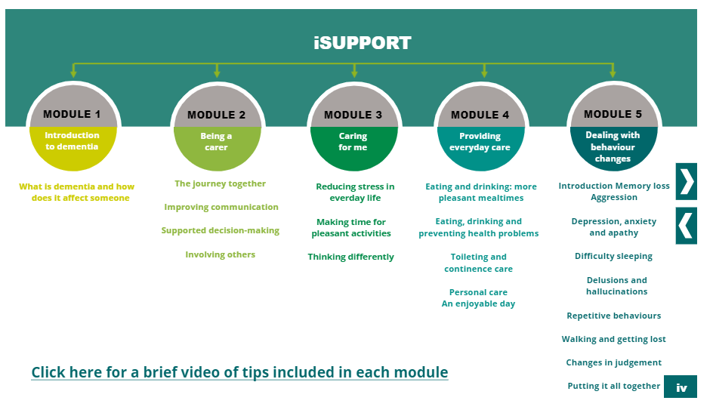
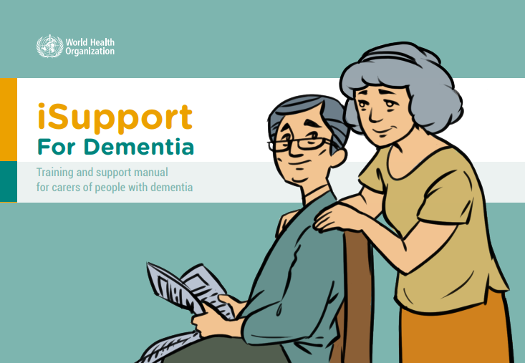




Build networks of collaboration and adaptation of evidence-based interventions
The content of iSupport is based on the ground-breaking Kitwood’s model, in which the personhood of someone with dementia is central, and in which care is essentially thought of as interaction, according to each individual’s needs, personality and ability.
The behaviour of people with dementia is not only a reflection of the functioning of their brain, but also a result of their:
X THE PLACE OF USEFUL LEARNING
  Health status
  Social and physical environment
  Personality and coping
  Life history
Source: iSupport: a WHO global online intervention for informal caregivers of people with dementia (wiley.com)

Slide 14
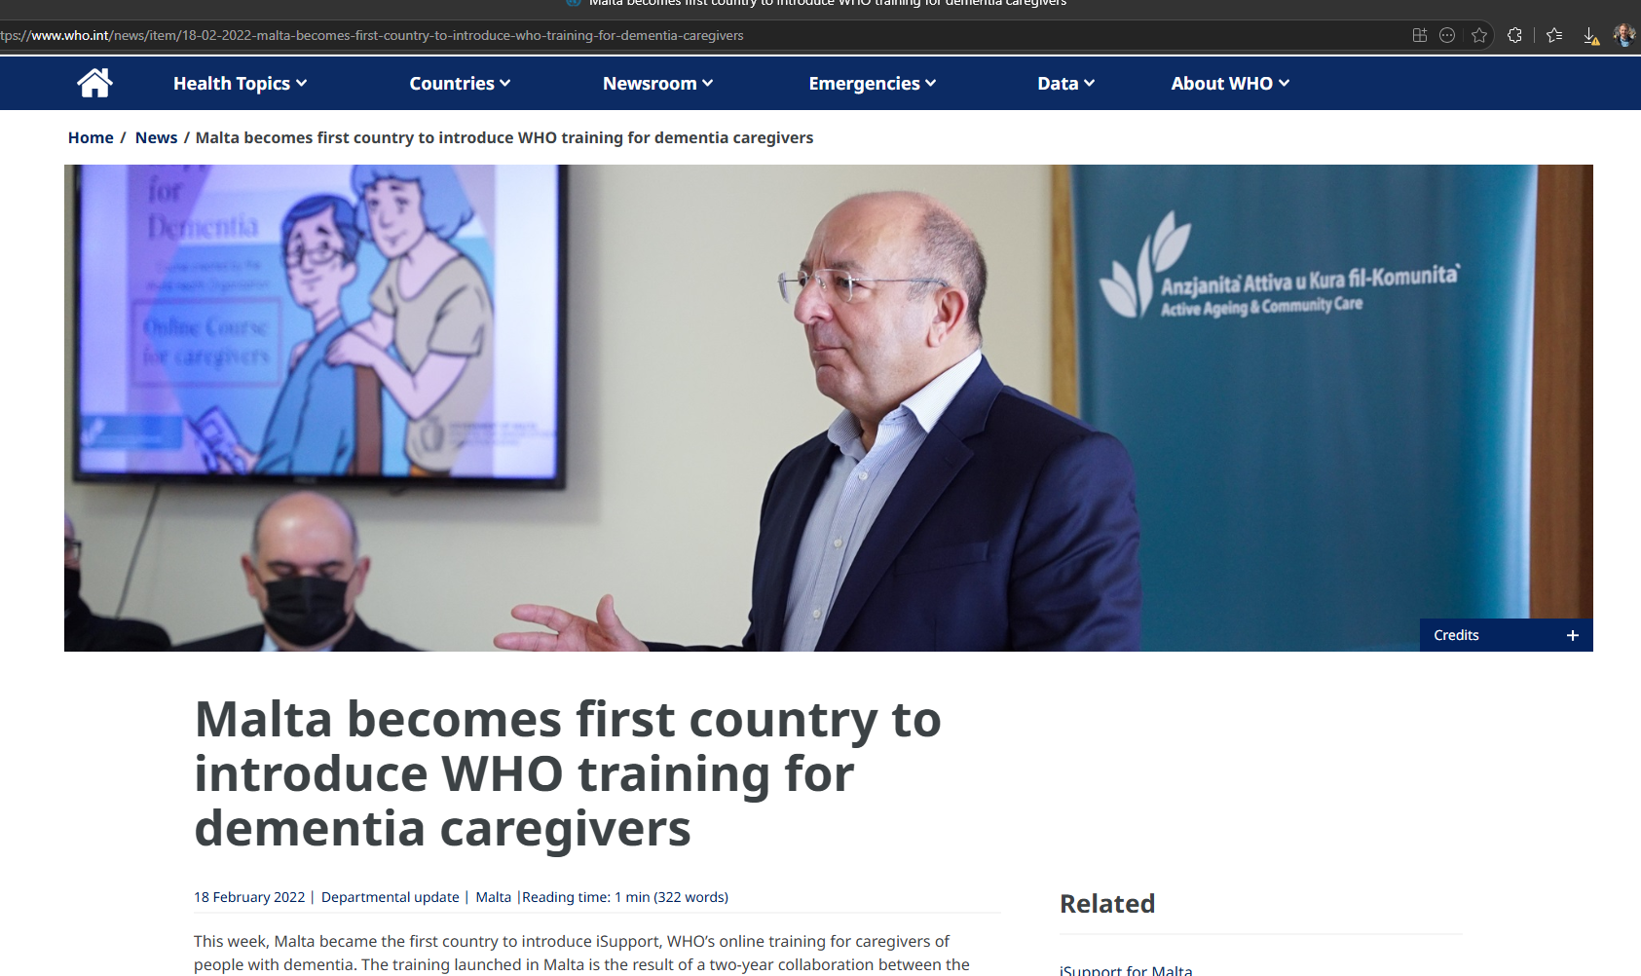
Build networks of collaboration and adaptation of evidence-based interventions
X THE PLACE OF USEFUL LEARNING
https://sparqtools.org/wp-content/uploads/2018/06/UCLA-Loneliness-Scale-Version-3.pdf

Slide 15
iSupport Methods for UK based study
A pragmatic randomised controlled trial was conducted in three centres.
Adult carers (18+) living in the community were recruited in England, Wales and Scotland and randomly assigned (1:1) through a web-based system to iSupport or usual care.
Outcome assessors were masked to allocation.
The primary outcomes assessed the difference in distress and depression between baseline and six-months.
The target sample size was 350 to enable 90% power, significance at 2.5% including 25% attrition (262 completers) on either outcome.
Analysis followed the intention-to-treat (ITT) principle. The trial was registered with ISRCTN registry (17420703).
X THE PLACE OF USEFUL LEARNING

Slide 16
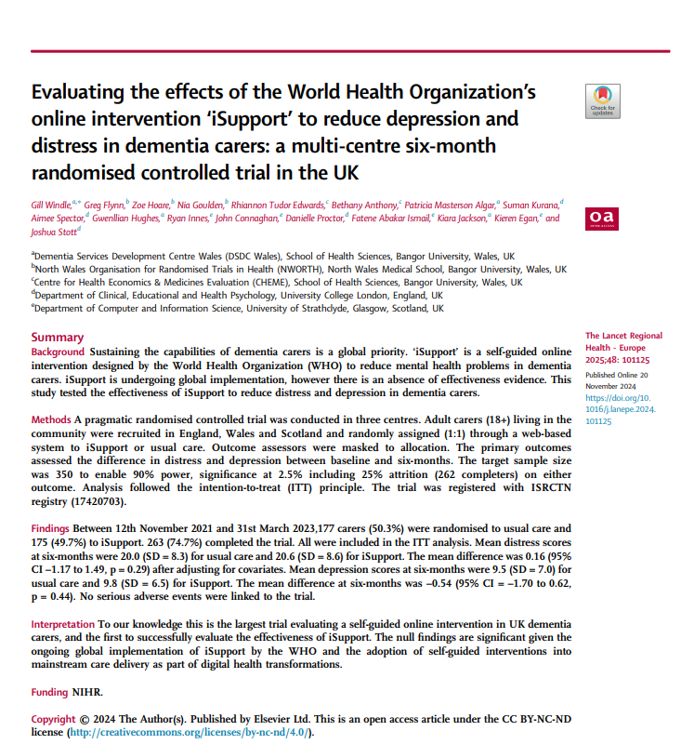
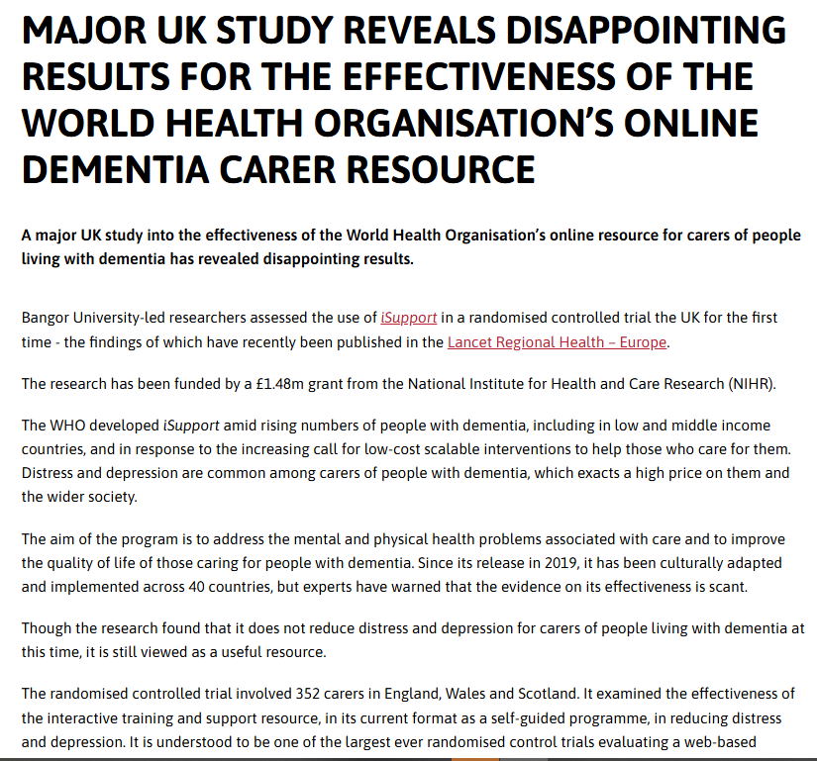
Build models for international adaptation of evidence-based interventions
X THE PLACE OF USEFUL LEARNING
Key take home:
Self guided intervention did not improve depression and distress as anticipated: contributes strongly to international knowledge

Slide 17
Q3: How could regulation/inspection pay attention to and discuss co-designed digital health supports and carer pathways?
X THE PLACE OF USEFUL LEARNING

Slide 18

What is codesign?
Co-design is a well-established approach to creative practice, particularly within the public sector. It has its roots in the participatory design techniques developed in Scandinavia in the 1970s.
The approach goes beyond consultation by building and deepening equal (as possible) collaboration between citizens affected by, or attempting to, resolve a particular challenge.
A key tenet of co-design is that users, as ‘experts’ of their own experience, become central to the design process.
X THE PLACE OF USEFUL LEARNING
Guide to co-design — Roadmap to Informed Communities

Slide 19

What is codesign?
Historically…..
The existing power structures in companies are built on hierarchy and control. Co-designing threatens the existing power structures by requiring that control be relinquished and given to potential customers, consumers or end-users.
Secondly, participatory thinking is antithetical to consumerism, in which personal happiness is equated with purchasing and consuming material goods.
A third reason that it has taken co-creation so long to have an impact is that participatory design has been seen as academic endeavour with little or no relevance for the competitive marketplace.
Is everyone creative enough to contribute?
X THE PLACE OF USEFUL LEARNING
Further reading: Sanders, E. B.-N., & Stappers, P. J. (2008). Co-creation and the new landscapes of design. CoDesign, 4(1), 5–18. https://doi.org/10.1080/15710880701875068

Slide 20

What is codesign?
Key components of a co-design process should involve:
X THE PLACE OF USEFUL LEARNING
Intentionally involving target users in designing solutions
Postponing design decisions until after gathering feedback
Synthesizing feedback from target users into insights.
Developing solutions based on feedback
Guide to co-design — Roadmap to Informed Communities

Slide 21
Codesign case study: unpaid carers
1. Collate knowledge and identify needs
Examine relevant behavioural change literature and activity guidelines
Establish an expert group (including carers) to establish how to deliver current scientific knowledge around physical activity to carers (e.g. using U.K. physical activity guidelines).
2. Build it
Smartphone-based application, ‘CareFit’, instructed by the needs of carers and carer professionals, that could support caregiver physical wellbeing on a regular basis both during and beyond the COVID-19 pandemic.
3. Test it
The codesigned developed smartphone app to understand whether the concept could work in practice, and examine to whether caregivers could accept and see value in the overall approach.
Challenge area:
88% of carers report not having the time to take part in physical activity.
Carers Active | Carers UK
X THE PLACE OF USEFUL LEARNING

Slide 22
Uncertainty of app design
Research Team
Co-creation group
Caregivers, Physical activity professionals, Employers, Health and social care professionals
Digital health, physical activity expertise
Physical activity guidelines
Motivations for physical activity
Delivery of physical activities
Trans theoretical model
Co-design meeting 1
Ease of use
Requirements gathering and further feedback
Agile development sprints: iterative improvements
Initial prototypes
Personalization
Back end design
Co-design meeting 2
Look and feel
Delivering appropriate levels of safety support
Further feedback
Demonstrations and feedback
Interactivity
Development of physical activity content
Co-design meeting 3
Refinement and improvement
Developmental of educational materials
Simplification
Social functionality
Finalization
Egan et al, JMIR Formative research, 2021

Slide 23
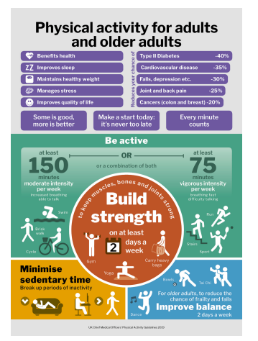
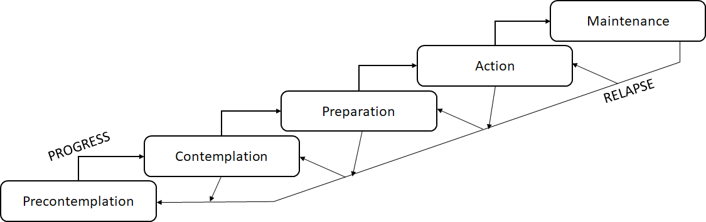
Codesign case study: unpaid carers
X THE PLACE OF USEFUL LEARNING
Frameworks for the development of Digital Health Interventions
Physical activity guidelines
Transtheoretical Model
Citation: Egan K, Hodgson W, Macdonald B, Meiklem R, Innes R, Kirk A, Fawcett B, Dunlop M, Maguire R, Flynn G, Stott J, Windle G A Mobile App (CareFit) Supporting Physical Activity for Informal Carers of People With Dementia: Mixed Methods Feasibility and Adaptation Study J Med Internet Res 2025;27:e56739 URL: https://www.jmir.org/2025/1/e56739 DOI: 10.2196/56739

Slide 24
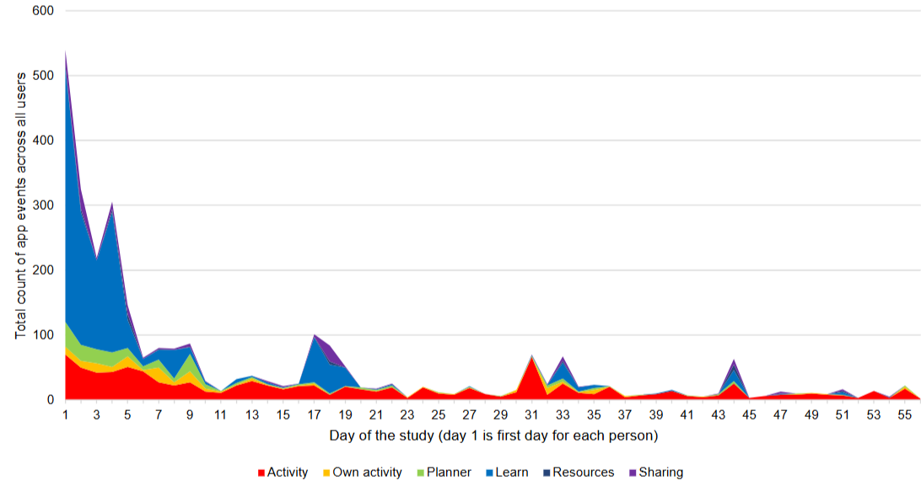
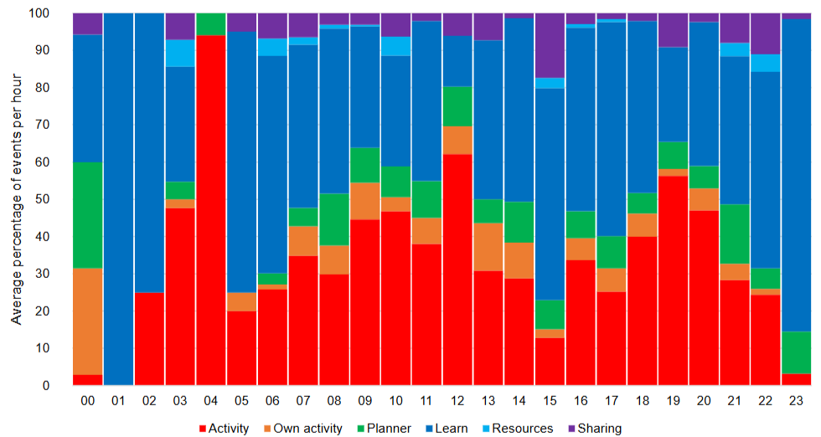
Codesign case study: a need for sustained engagement
What we designed
Co-designed, acceptable digital intervention
Good usability and positive feedback
Intervention was safe and valued, especially video content which was designed to connect carers socially
What we saw in practice
Recruitment was reasonable, but completion dropped: Approx 50% completion over 8 weeks
Selective and intermittent engagement
Early exploration and declining sustained use
Engagement shaped by carer capacity.
X THE PLACE OF USEFUL LEARNING
Carers were reshaping the intervention to make it usable within their daily lives
Citation: Egan K, Hodgson W, Macdonald B, Meiklem R, Innes R, Kirk A, Fawcett B, Dunlop M, Maguire R, Flynn G, Stott J, Windle G A Mobile App (CareFit) Supporting Physical Activity for Informal Carers of People With Dementia: Mixed Methods Feasibility and Adaptation Study J Med Internet Res 2025;27:e56739 URL: https://www.jmir.org/2025/1/e56739 DOI: 10.2196/56739

Slide 25
How could Regulation / Inspection pay attention to and discuss the role of co designed digital health supports and carer pathways
Require co-design as part of quality standards:
X THE PLACE OF USEFUL LEARNING
2. Depth: Inspectors could require evidence of impact of co-design learning in service development
3. Breadth: Probe how innovations support more vulnerable groups (e.g. due to challenges around reading ability, health literacy, cognitive capacity, more socioeconomically deprived groups)?

Slide 26
  Q4: How could Regulation / Inspection explore social connection as a measurable, accountable component of quality and safety for older people?
X THE PLACE OF USEFUL LEARNING

Slide 27
How to build a pathway for social isolation measure into standard practice
Incorporate proxy indicators
Embed/Adopt into inspection frameworks
Reframe social connection as a quality and safety issue
Use of a standardised measurement instrument
Link to accountability through standards and ratings
X THE PLACE OF USEFUL LEARNING
Codesign, test, iterate
Scale

Slide 28
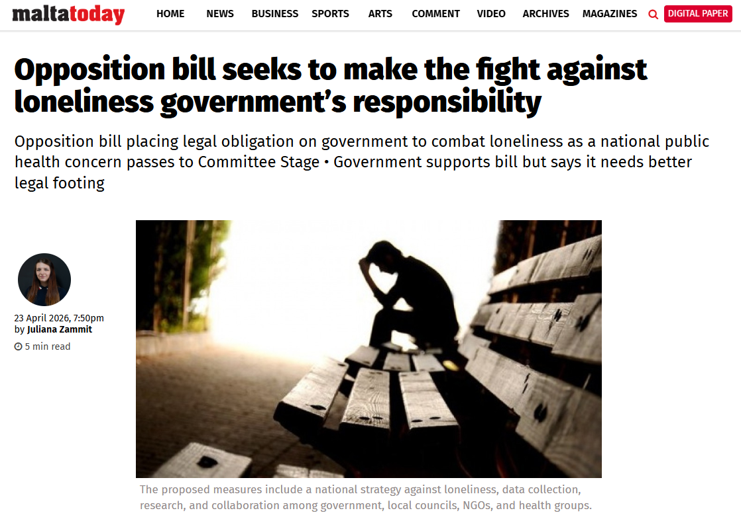
Will Malta become the early adopter once again?
“The most affected groups include the elderly, youth, people with disabilities, migrants, and those living alone.
“social changes such as less extended family, faster lives, longer work hours, and social media replacing real relationships, fragmenting communities.”
The proposed measures include a national strategy against loneliness, data collection, research, and collaboration among government, local councils, NGOs, and health groups.
X THE PLACE OF USEFUL LEARNING
The bill passed its second reading unanimously and will now move to the committee stage for further consideration.

Slide 29
Conclusions
Question (How could Regulation / Inspection) | Response
Become more aware of the persistent challenge of loneliness in dementia and carer communities? | Treat loneliness as a safety risk by routinely identifying it in dementia and carer populations through simple screening, inspection questions, and linking it to outcomes like depression, decline, hospital use (and mortality). There is no perfect measure of loneliness. Informal carers are now stretching increasingly into health and social care roles, further increasing solation and loneliness for both the carer and the person they are caring for. This is a challenge and opportunity.
Make better use of evidence and intervention models that reduce isolation and strengthen social participation? | Action review evidence (and meta-analyses) to make key decisions and recommendations. Ensure that testing reflects real world use as much as possible. Encourage and facilitate research network development and international learning (e.g. increase study quality, generalisability, access to care homes etc). Require providers to implement and demonstrate evidence‑based, relationship‑centred care models in daily practice for a prolonged period (e.g. demonstrating benefits over months).
X THE PLACE OF USEFUL LEARNING

Slide 30
Conclusions
Question (How could Regulation / Inspection) | Response
Pay attention to and discuss co-designed digital health supports and carer pathways | Embed co-designed digital and relational supports within care pathways, ensuring tools are shaped by carers and people with dementia and support connection over time, not as isolated solutions. Move beyond a tick box exercise: we should be able to demonstrate meaningful and sustained engagement (breath and depth) as systems and interventions evolve.
Explore how social connection can become a measurable, accountable component of quality and safety for older people? | Use validated standard tools (e.g. ONS/ Brief UCLA loneliness measures) Combine with observable indicators (participation, falls, service use) Embed into: Standards Inspection frameworks and Quality ratings
X THE PLACE OF USEFUL LEARNING

Slide 31
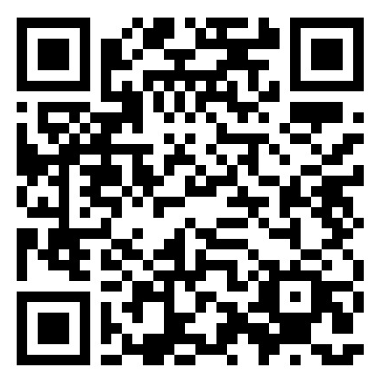

Thank you for your attention
Kieren.egan@strath.ac.uk
X THE PLACE OF USEFUL LEARNING

