Slide 1

SEPT 24-25 2025
Welcome
Dear EPSO friends and partners, speakers
and invited guests
Welcome to Malta Again !

Slide 2
SEPT 24-25 2025
Dear
  Love AFFAIR between Malta and EPSO?

Slide 3
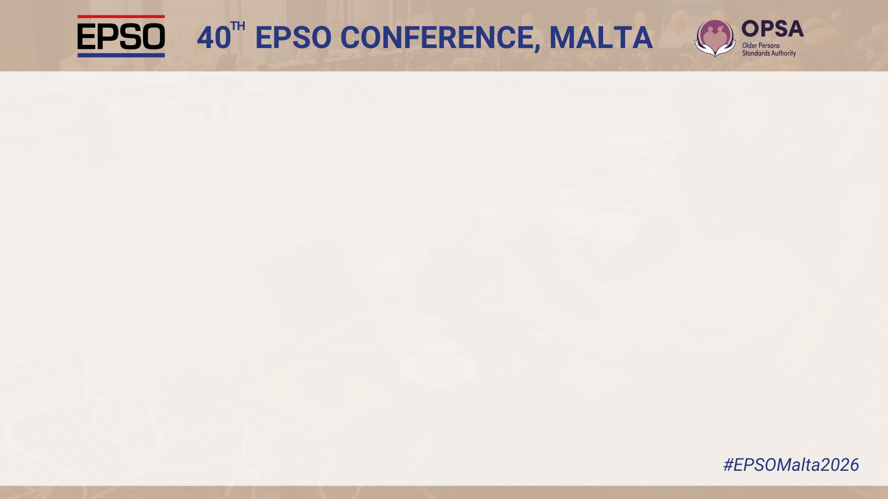
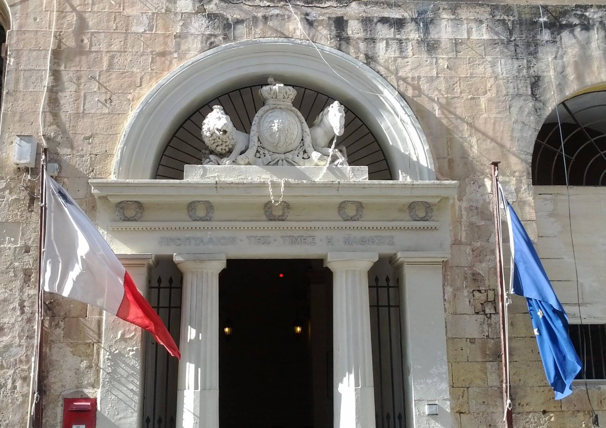
Because
  This is our 3rd EPSO Conference hosted by Malta!
  No other country in the world has hosted more EPSO conferences.

Slide 4




3 Maltese conferences
  The 29th EPSO-Conference: 23rd & 24th September 2020 - Due to Covid-19,
  traveling to Malta was not an option. Teleconference Online from The Hague,
  The Netherlands. However, the programme showed: supported by Malta
  Three years later: 34th EPSO Conference successfully hosted by the SCSA.
  Now: SCSA has been split into two separate regulators.The new regulator, OPSA, has invited us to return to Malta; We are extremely grateful for that!

Slide 5

  So certainly there is a very good relationship between EPSO and the Maltese Colleagues!
  The 40th EPSO conference hosted by OPSA is the result !

Slide 6
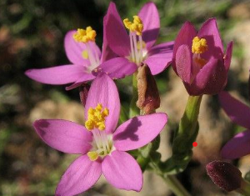
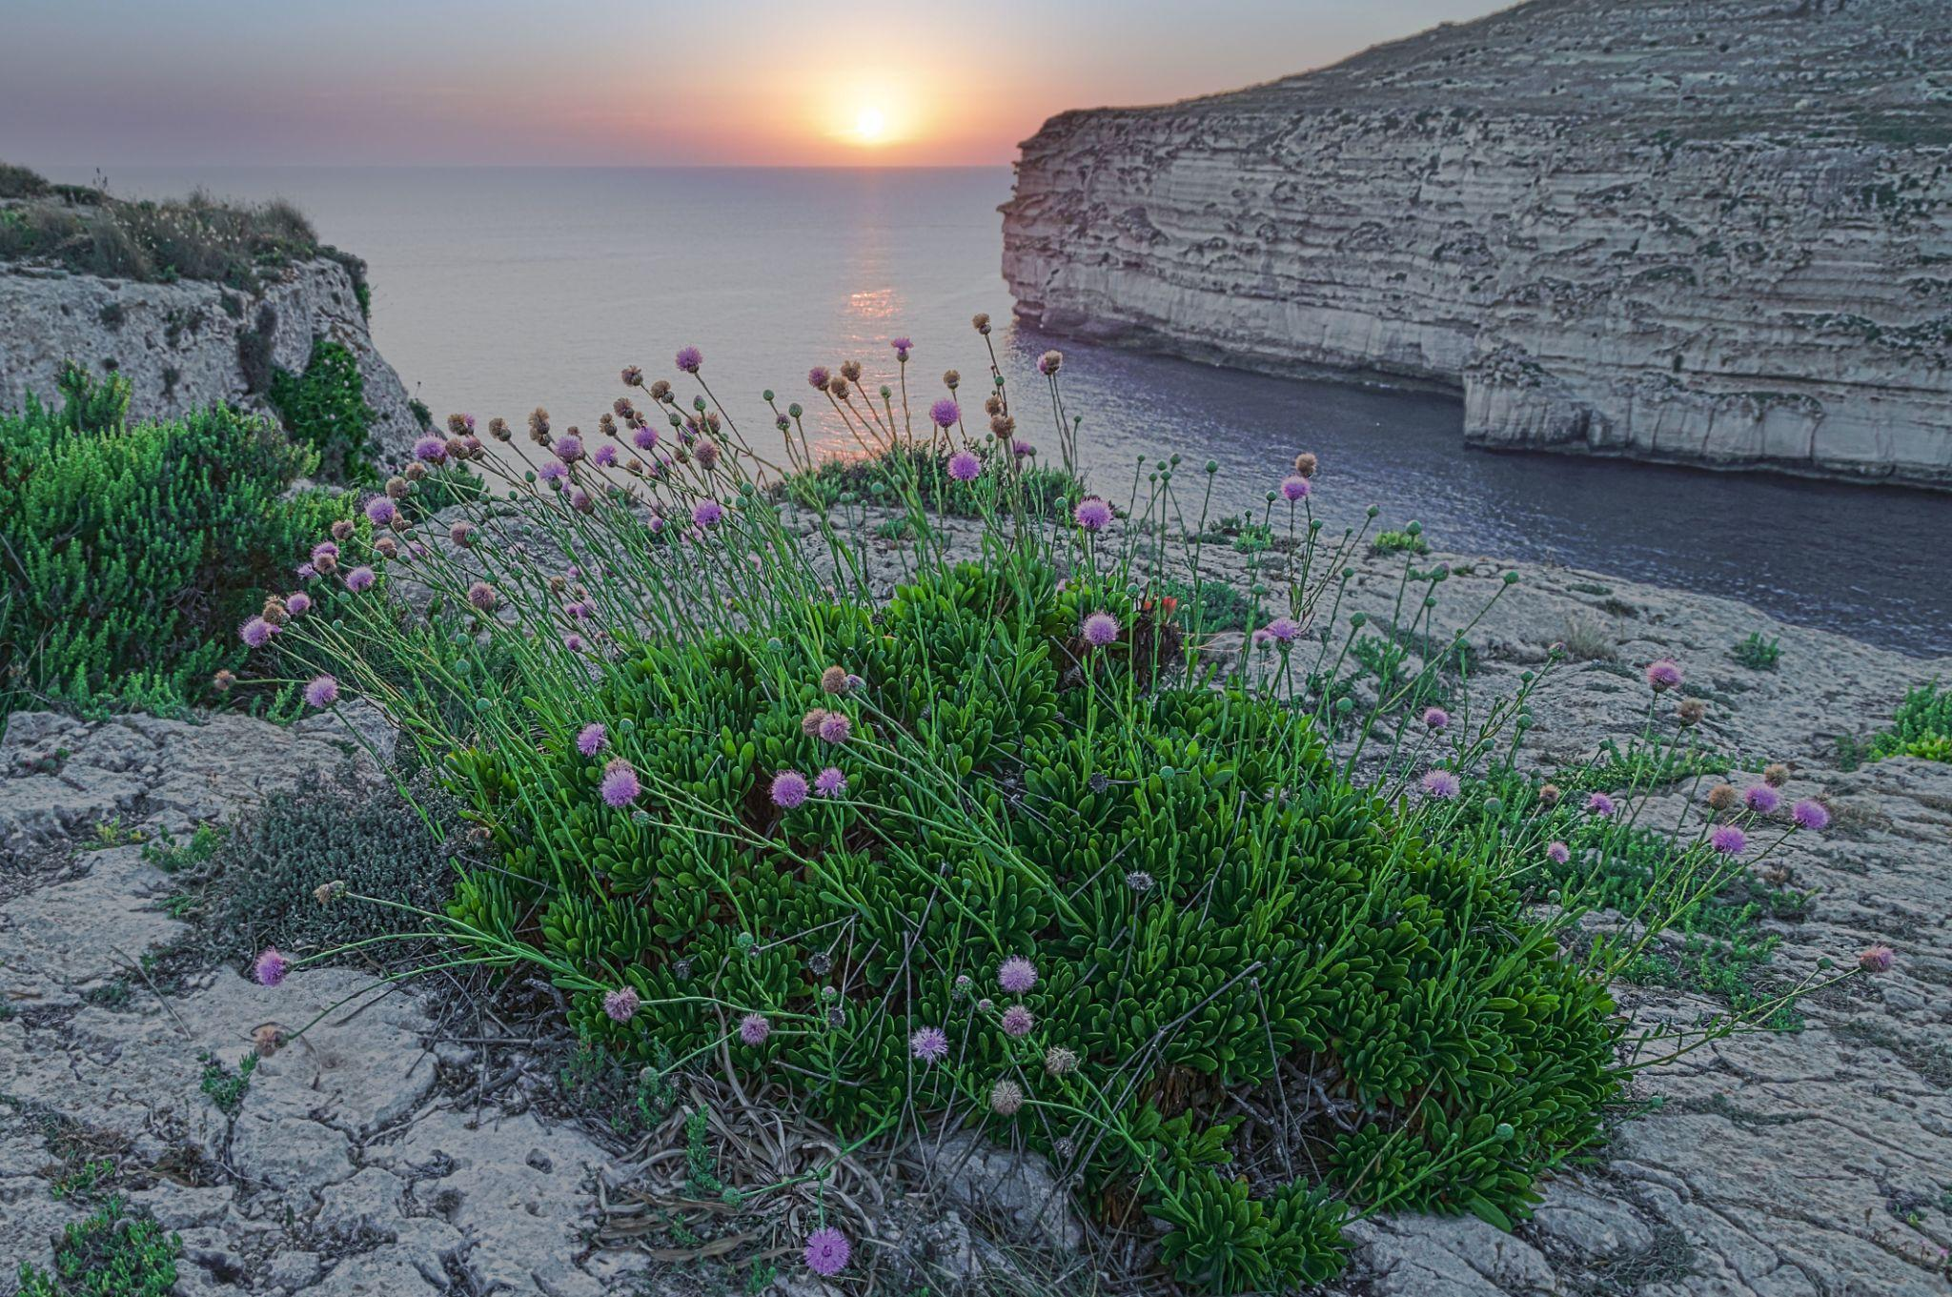
  But…not only the Maltese colleagues brings us here; also Malta as a unique Island in the Mediterranean:
    Malta was for ages at the forefront of fighting and battles between armies and cultures.
    Malta is situated amidst diverse cultures and has developed an open perspective that draws upon all those different cultures.
    It has a unique biodiversity of plants and flowers such as the Maltese national flower the Maltese centaury ( Widnet il-Baħar)
    The biodiversity reflects also in the way of thinking of the Maltese people!
  For EPSO this is most important !
  Malta has a very inspiring climate for innovation and new ideas!

Slide 7
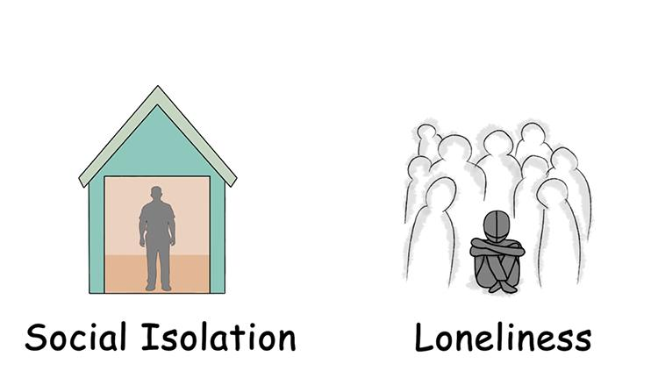
  An example of innovative ideas that came from Malta is the first topic of our conference today: Loneliness and Social isolation
  When Malta suggested this topic, we thought: Yes, is interesting but ….
  Is this a really new topic on the agenda for all countries?
  Should this really be a first priority ?
  is it really so important for all our health and social care regulators and inspectors ?
  Is it important for all age groups – not only for elderly?
  is this important for a broader view on the organization of health and social care?
  Is this important for organising health and social care regulation ?
  Maybe a little surprising but now we know ! The answer to all these questions is YES !!
  We are very pleased to have an excellent group of speakers who will
  approach this subject from so many different perspectives.

Slide 8

  We will discuss not only innovative ideas from Malta
  Other countries and EPSO partners made great contributions as well with topics such as :
  Data infrastructure and the use of AI by regulators is certainly one of the most topical themes we are discussing these days (better use of one's own database and AI as core concepts)
    Not just topical; we have also brought together a wealth of experience and depth in this field.
        Niek Klazinga, who has advised so many governments in this area for so many years,
        Misja, Kavitha and Alex, who organized a wonderful study day in a co-production between the Netherlands and Singapore;
        furthermore, we can expect truly great input on this subject from Ireland, France, England, Digital Health UK, Estonia, Latvia, and Singapore once again.

Slide 9
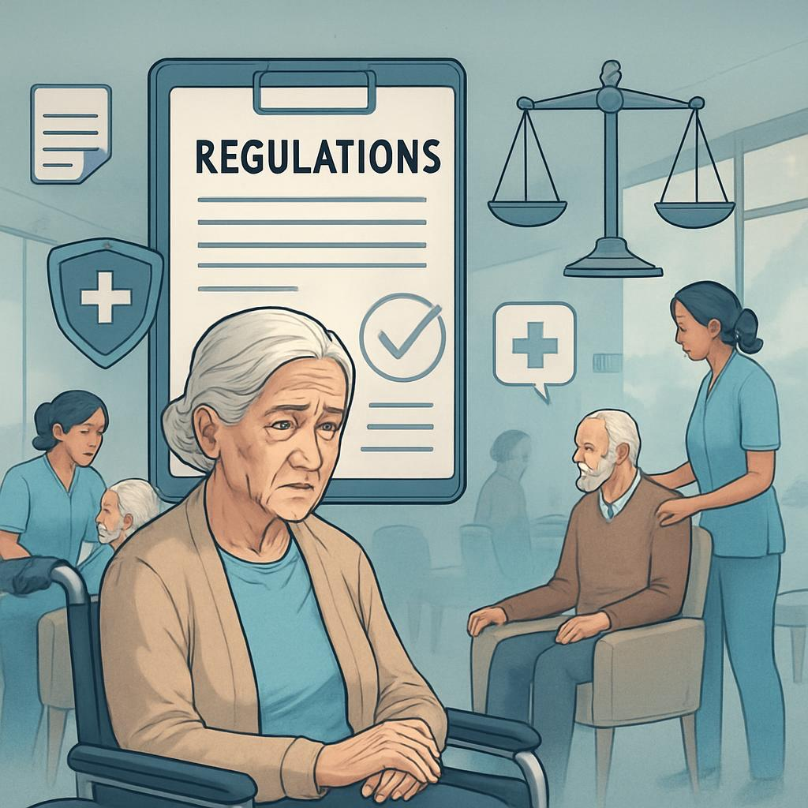

  Other topics these upcoming 2 days:
  Leadership and challenges in ‘Elderly Care Regulation’,
  special contributions from Norway, Singapore, Malta, England,
  and a comparative study in 6 countries from the Netherlands;
  Leadership and learning from experience
  with a focus on ‘Adverse Events’ with Norway in the lead
  and Scotland and Portugal taking the role of critical down to earth lessons and critical moderators

Slide 10
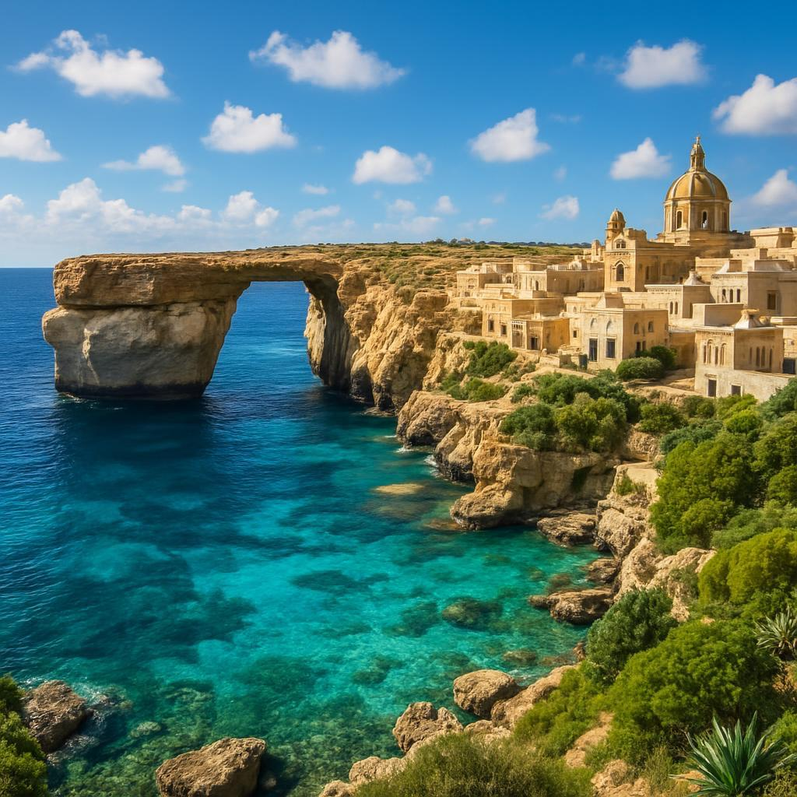
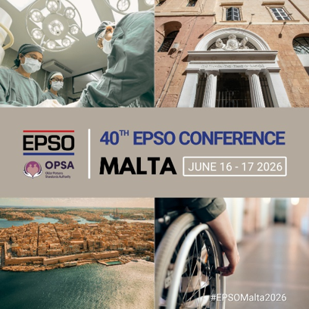
WISHING YOU all AN UNFORGETTABLE CONFERENCE at this inspiring Island in the Mediterranean
  With new and renewed contacts with EPSO partners;
  Practical lessons for better supervision and regulation;
  And as a result:
  Better Health and Care in all our countries

