Slide 1
58Th EPSO Monthly Meeting
GS1 in Healthcare
Jim Bracken GS1 Ireland CEO, retired
1st April 2026
Notes:
GS1 is a not for profit organisation which provides the open global standards for the management of supply chains to retail customers and patients, both in hospital and community settings. With 120 offices supporting 150 countries worldwide, our barcodes are on every food item that goes beep at the point of sale and on every medicine and medical device pack

Slide 2

Information is not Power;
Sharing Information is the Real Power
Agenda
Benefits for regulators
GS1 in Healthcare
Where GS1 can help
Ireland’s Haemophilia Treatment Track & Trace Solution
Notes:
I will talk briefly on all four topics, but the story of the Irish Haemophilia Track & Trace solution is recognised internationally as evidence of how barcodes support the safe administration of medicines to patients

Slide 3
What’s in it for Regulators?
Notes:
In this short presentation, it is not possible to go into detail. But I recommend that you read this Scan4safety report as it also provides hard evidence of how the scanning of barcodes improves patient safety. On page 22 there is reference to a study on a reduction in drug errors. A link to this report is included in my final slide.

Slide 4
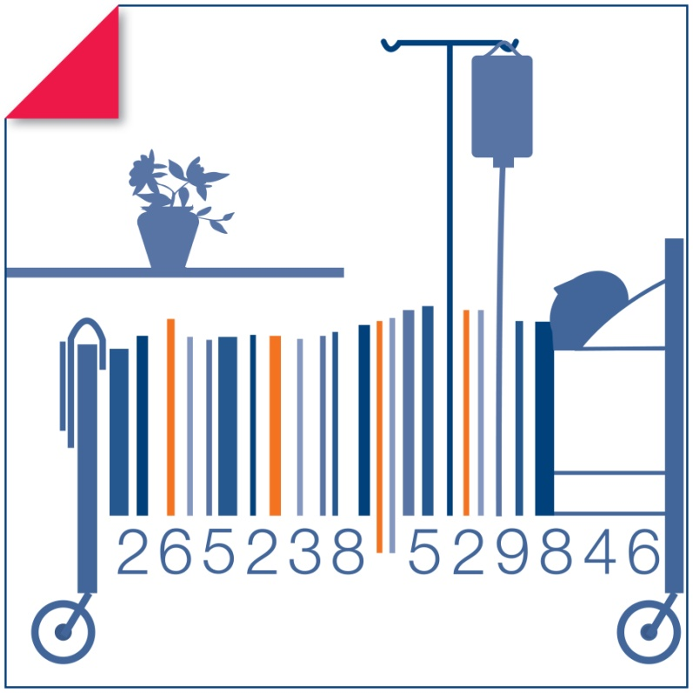
GS1 in Healthcare
GS1 Healthcare envisions a future where the healthcare sector utilises GS1 global standards for all items, locations, people and processes to drive patient safety and supply chain efficiency improvements starting with the manufacturer and ending with patient services.
Improving Patient Safety
by Reducing Risk through Certainty
Notes:
Building on the earlier work of EPC Global and GS1 in Europe’s European Healthcare Initiative, since 2005 GS1 Global Healthcare has been working with all stakeholders including regulators and patient safety organisations. This has enabled the implementation of global standards to support safer treatment regimes as well as the integrity of critical supply chains such as pharmaceuticals, medical devices and surgical instruments. The EU, FDA and numerous other countries including, China, Japan and India have “endorsed” the use of GS1 standards for the unique identification and bar coding of devices and medicines to verify their pedigree.

Slide 5
Key Global Medical Error Statistics
Medication Errors: affect 1 in 30 patients, with 25% of these being severe, estimated at US$42 billion p.a.
Surgical Errors: Over 300 million surgeries p.a., with 10% of preventable harm occurring in surgical settings, mostly during pre- or post-surgery
Diagnostic Errors: an estimated 5% to 20% of all deaths may be linked to diagnostic errors
Hospital-Acquired Infections: these occur at a global rate of 0.14% and rising
50% of these events were preventable mistakes
Source WHO
Notes:
Looking at medical errors, these are WHO figures which highlight the extent of the problems

Slide 6
Some of the Key issues in Healthcare, where GS1 Standards can help
Patient Safety and Risk Management
Medical errors (including medication errors)
Counterfeit (medicines & devices), UDI (unique device identifier)
Traceability requirements – EU, US and National
regulations
Notes:
Since 2002, we have been working with all stakeholders in the healthcare sector to help address these key issues. In introducing regulations to combat counterfeiters, the EU, the FDA and many national governments have recognised the role that GS1 can play in the unique identification of medicines, medical devices and surgical instruments etc.

Slide 7
Ireland’s National Track & Trace Solution for Treatment of Haemophilia
Notes:
Now, I want to give you a practical example of GS1 standards in action today. This project was launched in 2004 and went live in 2005 and is still regarded Internationally as best practice. It was the first example of the value of Serialisation of patient medication packs and today all prescription medicines packs contain the same barcode information as initiated by this successful track and trace solution.

Slide 8
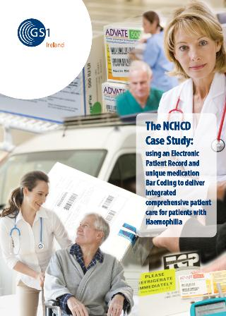
National Centre for Hereditary Coagulation Disorders (NCHCD)
Located at St James’s Hospital, Dublin
Manages patients with inherited and acquired bleeding disorders
Approximately 2000 patients with Haemophilia
Approximately 200 patients with severe haemophilia (require intensive care/treatment)
Over 75% Patients with severe Factor deficiency self medicate at home
Notes:
Located in St.James’s University Hospital in Dublin, the national treatment centre and provides haemophilia patients with a safer treatment process and better quality of life. It was established following the deaths of over 70 patients as well as the infection of a further 400 plus patients with HIV and Hepatitis C caused by the use of infected blood products

Slide 9
What triggered the initiative ?
Healthcare
The death of 70 patients and the infection of over 400 patients with Hepatitis C and HIV due to contaminated blood products.
Infected products remained in the supply chain after recall leading to subsequent infection
Lindsay Tribunal of Enquiry Report 2001
EU Blood Directive 2002/98/EC
Industry
COMBATING COUNTERFEIT A Report of the FDA: February 2004
FDA Counterfeit Drug Taskforce Report: 2006 Update
Notes:
Following the publication of the Lindsay Tribunal report and the EU Blood directive, Dr. Barry White the Director of the NCHCD who was the visionary behind the whole project. at the time, conceived a total end to end traceability solution for the safe treatment of this “at risk patient group”

Slide 10


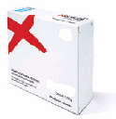





The Healthcare Issues
No product barcode
Multiple charts
Non validated delivery
Product wastage
Incomplete / retrospective treatment information
Non availability
Fragmented service
Notes:
So looking at the issues they faced, there were multiple patient charts preventing a clear view of a patient’s treatment regime and this resulted in a fragmented service. Deliveries of cold chain medications could not be validated due to multiple delivery methods. There was significant product wastage because patients could over order at will, and this was further exacerbated by products exceeding their expiry date.

Slide 11
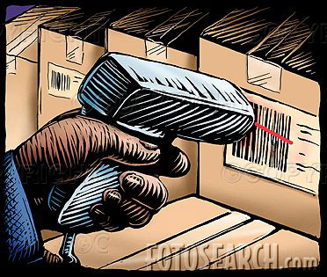


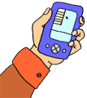

The Solutions
Encrypted Messaging
Unique GS1 barcoding
Validation
Electronic Patient record
Patient
Bedside/home
administration
Validated cold chain delivery
Notes:
GS1 Ireland provided the standards as well as free consultancy advice to the various parties involved in implementing the project. The barcode contained, product number, batch number, expiry date and a unique serial number on every single pack. By scanning the barcoded labels and the patient’s own barcode at the time of medication administration, each treatment episode is updated on the patient’s electronic record and the warehouse management system is also updated. The temperature of all stock on delivery and in the patient’s fridge is also validated.
The whole system underwent a full Good Management Practice, or GMP audit process

Slide 12



Delivery to the home and “in home” usage
Cold Chain receives home patient orders with GTIN & delivery location details GLNs
Electronic prescription
Data sent to the EPR and stock management system with product usage information
Details of all movements are sent to the stock management system
Patient scans product. Verification received from EPR
Cold Chain Supplier verifies Order at dispatch - recording batch and expiry dates - GLNs, GTIN
Cold Chain Supplier verifies delivery of product to Patient - recording batch and expiry details GLN, GTIN, GSRN
Notes:
The Home delivery service starts when the Electronic prescription is received by the cold chain delivery company. The pharmacist then dispenses and dispatches the required medication via the delivery service to the patient’s home. The product is delivered and the driver scans the product into the patient's fridge which updates the stock management system and the EPR.
The patient using their handheld device or mobile phone scans in the product to their home fridge .Upon using the product the patient scans the medication and self administers. This information is then sent back to the central Electronic Patient Record (EPR).

Slide 13
Solution for tracking and tracing products within the home
Removes paper trail
Reduces risk by providing a check on Patient & Product suitability
Enables real time alert and product recall (20 mins)
Complete traceability of medication to infusion
Ensures the availability of real time patient treatment data which enables a quick response to any issues with a patient’s condition
Notes:
Barcode scanning in the home, removes paper and enables the real time update on the patient’s medical record of every single treatment episode. But most importantly, it validates that it is the correct medication for that particular patient, because there may be two patients there with two different medications.
A full product recall across all locations can now be carried out within 20 mins.

Slide 14
Outcomes/ROI
Meets all compliance issues – Lindsay, EU directives
Since Cold Chain delivery started all products verifiably
delivered between 2⁰-5⁰ Celsius
Product wastage reduced from €90,216 to zero in the
year post service implementation
Documentation errors have reduced from 12 to zero in
the year post service implementation
Reduced usage and wastage of medication = €1million p.a.
Notes:
The return on investment per annum now is greater than the original capital investment. In my experience, in all traceability systems solutions there is always a real return on the investment in addition to the achievement of the main goal of consumer or patient safety.
While this may seem unimportant, obtaining funding for such projects is made easier, if the finance guys can see a financial benefit as well as the more critical patient safety case.

Slide 15
Critical Insights
Dr. Barry White’s vision of complete traceability
Barry’s commitment and leadership
Engagement and buy-in of all stakeholders, incl. patients and patient safety associations
Stakeholder Conference included EU and FDA (by videoconference)
Patients (children) helped with design of mobile app
Barry’s insistence on future proofing, e.g. migration from local re-labelling of products with linear barcodes to scanning of manufacturer applied 2D barcodes and ultimately RFID tags
Use of global, open standards
Notes:
The key reasons for the success of the project were: 1. Barry White’s leadership and vision of complete traceability of the medication from manufacturer to the patient. 2. obtaining the buy-in of all stakeholders including patients, patient safety groups and regulators 3. At the beginning, all medicine packs had to be over-labelled with a barcode containing – product number, batch and expiry details as well as the unique serial number of each pack. This continued for some years until the manufacturers, under EU regulation, began marking each pack with GS1 datamatrix barcodes, which contain the exact same information that Barry White had established years earlier.

Slide 16
Thank you and Questions
The benefits of scanning: https://healthcare.gs1uk.org/scan4safety
GS1 Healthcare: GS1.org

Slide 17
Additional Slides
Not being presented

Slide 18
GS1 Identifiers
GS1 Identifiers:
  GSRN - Global Service Relation Number
  GDTI - Global Document Type Identifier
  GLN - Global Location Number
  GTIN - Global Trade Item Number
  SGTIN - Serialised Global Trade Item Number
  SSCC - Serial Shipping Container Code
  GRAI - Global Returnable Asset Identifier
  GIAI - Global Individual Asset Identifier
Providing certainty of identification of
  People
  Products
  Places
People
Places
Products
Assets

Slide 19
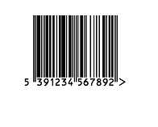
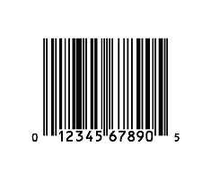
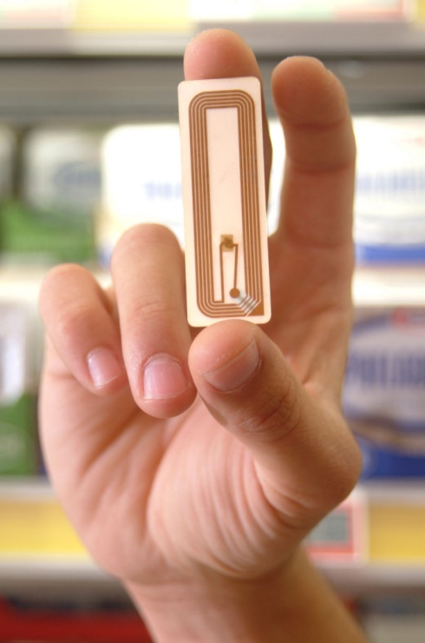

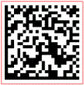
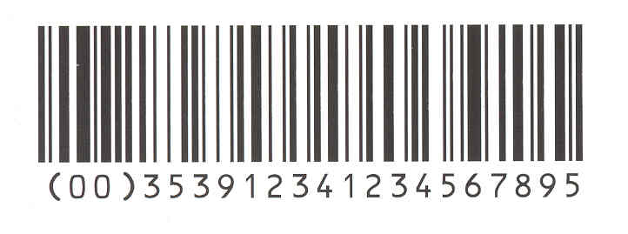
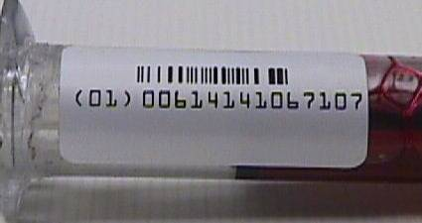
Data Carriers
Standard Data Carriers for representing data

Slide 20
Patient Wristband with GS1 Datamatrix

Slide 21
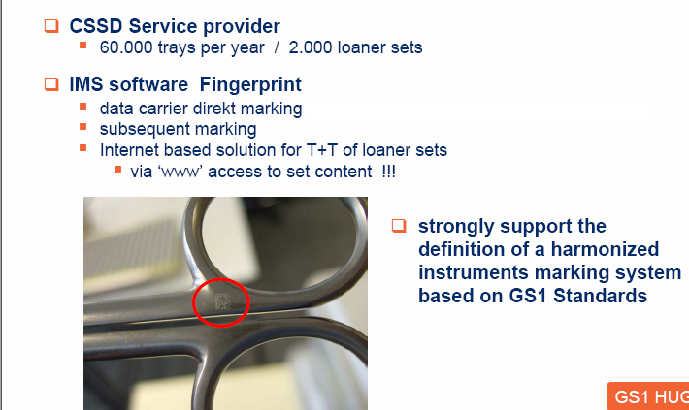
Surgical Instrument Processing centre

Slide 22
Why Track Instruments?
In the SSD
  Provide audit trail through processes; linking to cycles
  Identify ownership
  Ensure contents match user requirements
  Identify responsible technician
  Keep all items together; safety & recall issue
  Manage limited life devices
  Manage repair/replacement life cycle
In the Healthcare Organisation
  Patient safety (the count)
  Identify responsible scrub nurse
  Ensure ability to recall for process failure
  Allows patient/s to be matched with devices (look back)
  Match devices to patient/s
  Manage assets/inventory

Slide 23
GS1 Datamatrix on Pharma pack

