Slide 1




The Development model for
Integrated care
Prof. dr. Mirella Minkman
CEO Vilans, National Center of Excellence for care and support
Professor Innovation of organisation and governance of integrated care,
Tilburg University – TIAS Business school
vilans.nl
March 2026

Slide 2

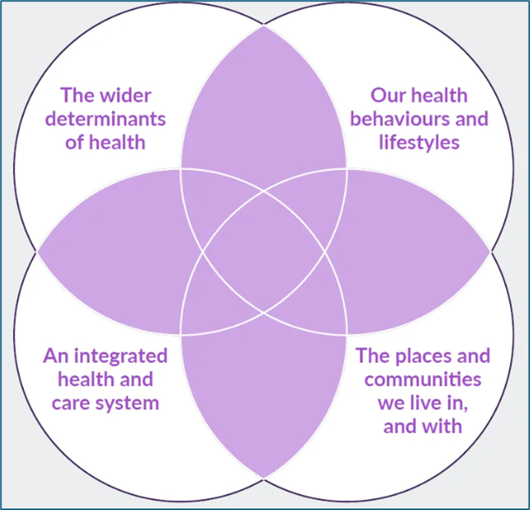

Our view on health is changing
Changing societies Integrated perspective Using knowledge

Slide 3
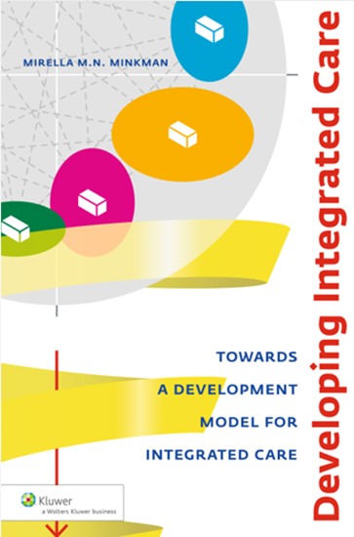
Conceptual knowledge for practical use
Observations in practice:
Quality is delivered in collaboration
Organising integrated care is multi dimensional
People and contexts differ, but organising integrated services does have generic components
Integrated services develop over time
The full concept of integrated care changes over time in our changing societies
But what are essential ingredients to work on?

Slide 4

Research Minkman et. al.(2007 - current)
Research questions
What are the essential ingredients of integrated care? Are they generic?
How can integrated care networks develop over time?
Literature studies and case studies
Literature review quality management models
Model development, validation
31 original cases (stroke, dementia, heart), numerous practical studies
Literature study about the dynamics of integrated care
National benchmarks (diabetes, stroke)
Delphi study, Concept Mapping study, questionnaires
Validation study in 84 integrated care services
Development of a (digital) self evaluation tool
What innovation of governance is needed? (supervision, accountability, leadership)
2025: Full model update and new systematic review
International and national use in multiple and diverse contexts
Further validation, application, new research
  Validation in many other types of networks, use >500
  Self assessments, workshops, practice reports, international use
  Follow up studies: decision making in networks, values of integrated care
  EISON: supervision (internal and external) for inter-organisational networks

Slide 5
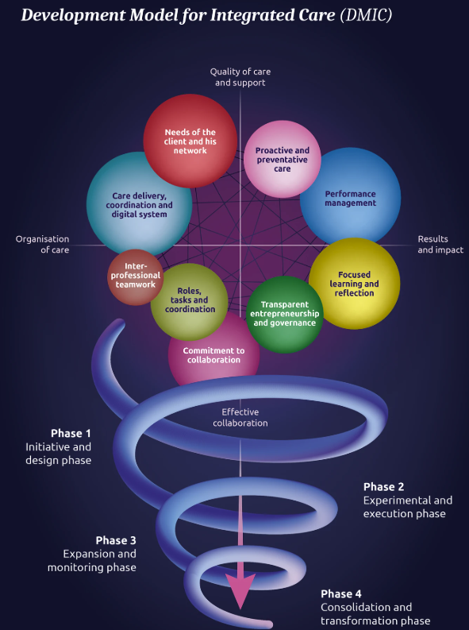
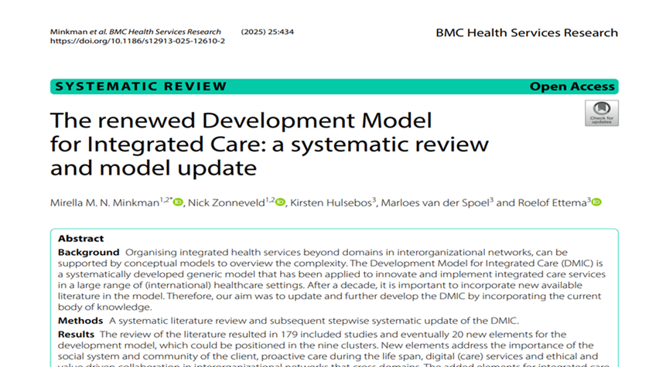
The DMIC model:
9 clusters
109 elements (89 + 20)
4 development phases
Element: activity focusing on the development (realisation, improvement, sustainability) of integrated care
Minkman et al., 2025

Slide 6
Nine clusters
1: Needs of the client and his network
2: Care, coordination and digital system
3: Performance management
4: Proactive and preventive care
5: Focused learning and reflection
6: Interprofessional teamwork
7: Roles, tasks and coordination
8: Commitment to the collaboration
9: Transparent entrepreneurship and governance
Four phases of development, not prescriptive, but reflective to assess where you are and what is relevant for the current and next phase.
Minkman et al., 2025

Slide 7

What’s new? (2025)
Literature review 2025: 20 new elements
No new clusters, or axes
Context of care, including
community, informal carers, SDM
Proactive care, preventive ways of working
Digital services, other networks
Collaborative relationships and values
Minkman, M.M.N., Zonneveld, N., Hulsebos, K. et al. The renewed Development Model for Integrated Care: a systematic review and model update. BMC Health Serv Res 25, 434 (2025). https://doi.org/10.1186/s12913-025-12610-2

Slide 8
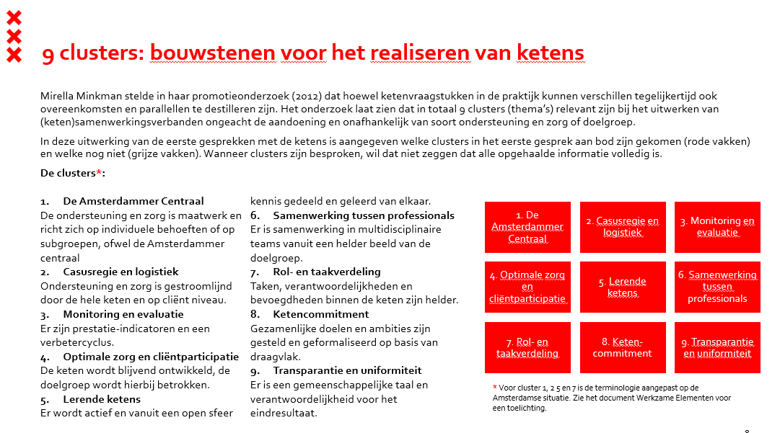
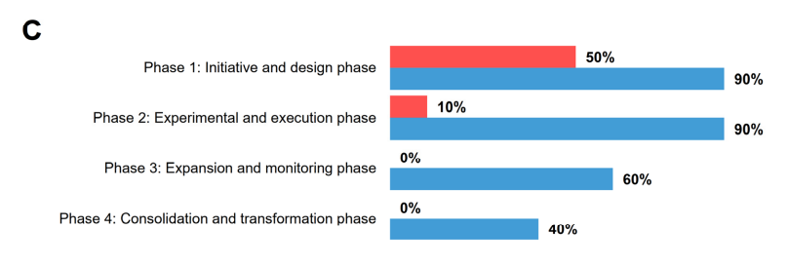
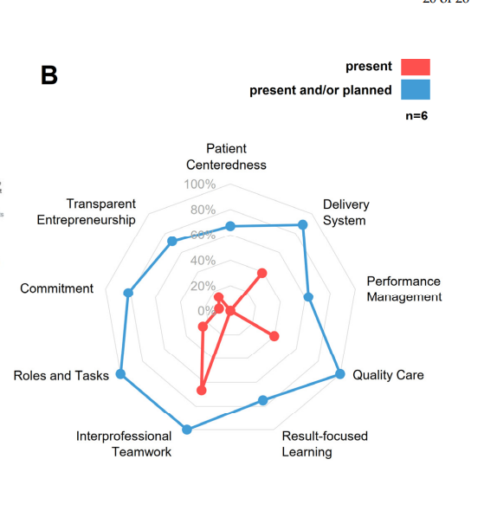
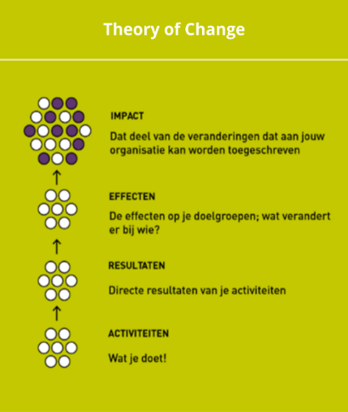
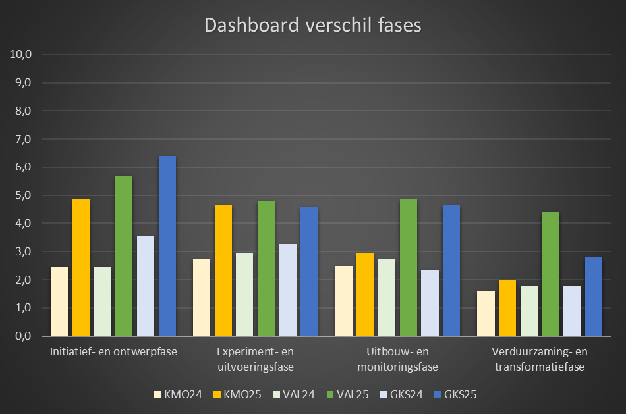
How to use the model?

Slide 9
According to AI…what’s the difference?
Feature | DMIC (Minkman) | Nine Pillars (IFIC)
Primary Focus | Developmental Process & Implementation | Strategic Framework & System Design
Time Dimension | Explicitly models 4 development phases | Generally conceptual, less focused on timing
Detail Level | High (108 specific elements/activities) | High-level, thematic, strategic
Applicability | Excellent for project/network self-assessment | Best for policy, vision, and system-wide design
Key Output | Conceptual model and tool to map progress and identify gaps | A framework to build, lead, and sustain

Slide 10
Further discussions..
More focused development
Dynamic use of knowledge for supervisors, practice, research
Contact: M. Minkman m.minkman@vilans.nl or m.minkman@tias.edu

