Slide 1
The 9 Pillars of Integrated Care
Brief Overview
EPSO meeting 4 March 2026
Note: this overview focuses on the original 9 Pillar model. The next version is due to be released at ICIC in Birmingham April 2026
Presented by: Andrew Terris
Senior Associate - IFIC

Slide 2
The International Foundation for Integrated Care (IFIC)
is a not-for-profit foundation dedicated to improving the lives of people and communities by advancing the science, knowledge, and adoption of integrated care around the world.
IFIC’s vision is that individuals, families, and communities benefit from person-centred, coordinated care and support that enables them to live healthy and fulfilling lives. IFIC works to overcome the fragmentation in health and care systems by promoting models of care that are holistic, co-produced, continuous, coordinated, equitable, and sustainable.
IFIC brings together researchers, health and care professionals, policymakers and people, families and communities providing a unique platform for collaboration, knowledge exchange, and innovation to drive system change.

Slide 3

The International Journal of Integrated Care (IJIC)
open-access, peer reviewed publication sharing global evidence and best practice
International conferences and regional networks
connecting people and ideas across sectors and borders
The Integrated Care Academy
offering education and training to develop the workforce needed for transformation
Applied research and implementation support
bridging policy and practice to build more effective and sustainable care systems
Knowledge platforms and solutions
enabling shared learning and practical action across IFIC’s global community

Slide 4
The Nine Pillars of Integrated Care
A Framework for Policy & Practice
Coordinated • Continuous • Person & Community-Centred

Slide 5
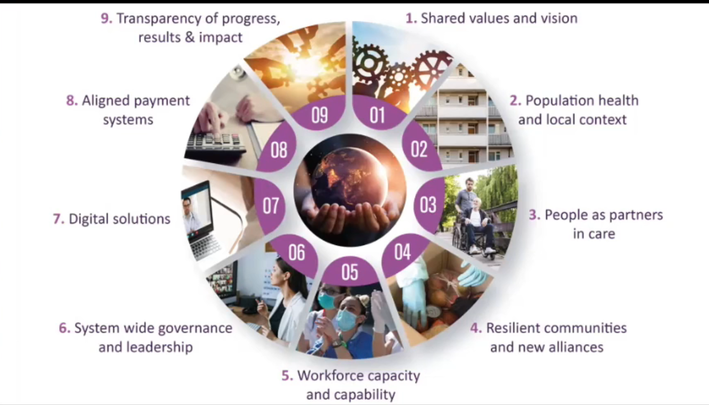

Slide 6
Pillar 1: Shared Values & Vision
Clear, shared commitment to integration
Explicit ambition for population health and wellbeing
Grounded in societal values (e.g., solidarity vs. individualism)
Cultural alignment across sectors

Slide 7
Pillar 2: Population Health & Local Context
Shift beyond 20th-century curative models
Prioritise equity and health promotion
Invest in public and population health
Use population data to guide redesign
Health & care contribute only 10–20% of overall health outcomes

Slide 8
Pillar 3: People as Partners in Care
Share power, knowledge and decision-making
Enable meaningful community participation
Co-produce services with people and families
Promote personal responsibility through empowerment

Slide 9
Pillar 4: Resilient Communities & New Alliances
Engage locally based community groups
Strengthen partnerships with the third sector
Look beyond traditional system boundaries
Build on community assets

Slide 10
Pillar 5: Workforce Capacity & Capability
Provide time and space for partnership working
Support multidisciplinary teamwork
Build collaborative competencies
Harness innovation driven by patient need

Slide 11
Pillar 6: System-Wide Governance & Leadership
Think beyond organisational silos
Shared accountability across sectors
Collaboration improves system performance
Governance aligned to integration

Slide 12
Pillar 7: Digital Solutions
(Pandemic) accelerated digital transformation
Digital tools now embedded in care delivery
Shared information supports coordination
Digital enables continuity and access

Slide 13
Pillar 8: Aligned Payment Systems
Payment systems incentivise behaviour
Many current models promote fragmentation
Funding must reward collaboration and outcomes
Financial reform essential for integration

Slide 14
Pillar 9: Transparency of Progress, Results & Impact
Measure what matters to people and communities
Avoid metrics that reinforce fragmentation
Use outcomes to drive improvement
Support continuous learning and adaptation

Slide 15
Conclusion: Using the Nine Pillars
Integrated care is a design principle, not structural upheaval
Provides a holistic framework for action
Supports prioritisation and practical implementation
Guides sustainable, long-term transformation

Slide 16
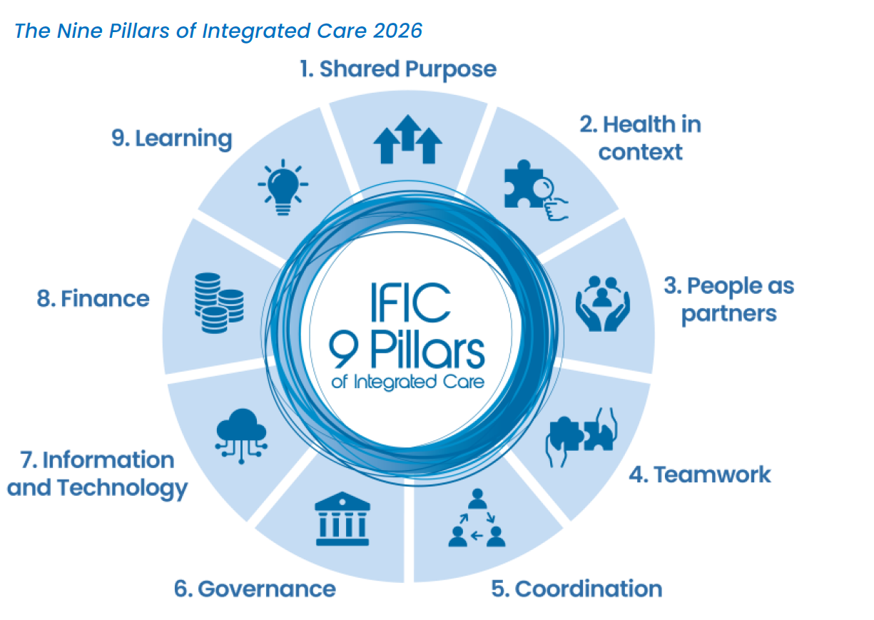
Next iteration – due for release
Modified Delphi process – expert panel 2025
Forum discussions & Q&A – expert across each pillar
Official launch of next version ICIC conference – Birmingham 2026

Slide 17
Email: info@integratedcarefoundation.org
Linkedin: mylinkd.in/IFICInfo
Facebook: facebook.com/IFICinfo
Vimeo: vimeo.com/integratedcare
Bluesky: @IFICinfo

