Slide 1
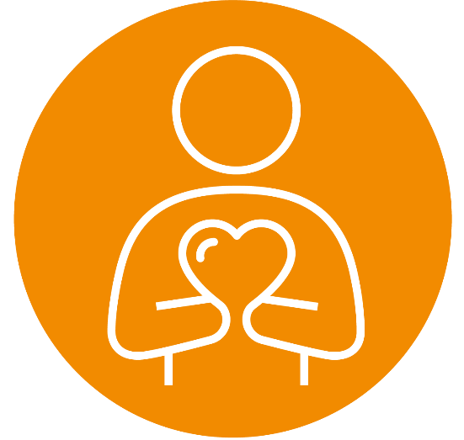
Cefnogi diwylliannau cadarnhaol mewn gofal cymdeithasol
Supporting positive cultures in social care

Slide 2
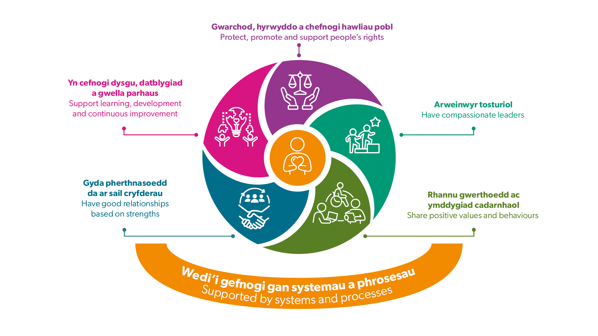
Egwyddorion diwylliannau cadarnhaol
Principles of positive cultures

Slide 3


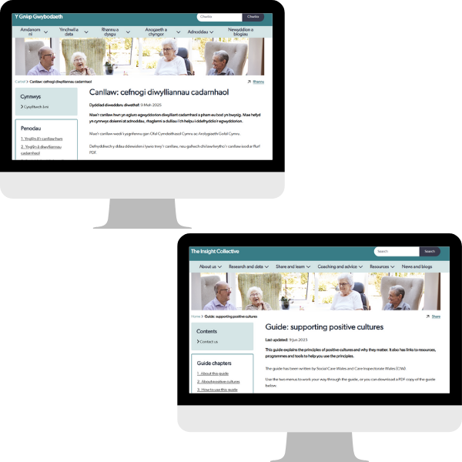
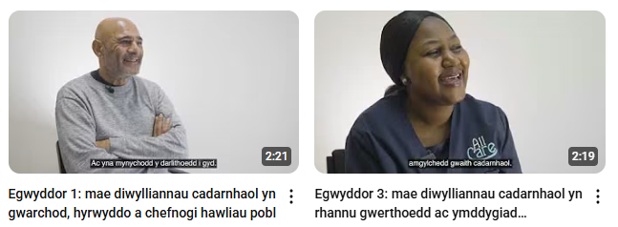
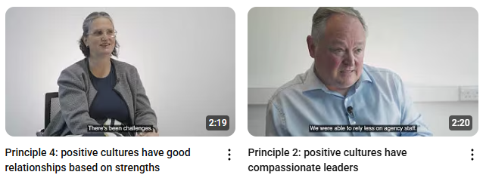

Adnoddau i'ch cefnogi
Resources to support you
Y camau nesaf
Next steps
Positive Cultures Guide

