Slide 1

Goal displacement and public supervision
Kees Huizinga & Martin de Bree
EPSO conference May 4, 2022

Slide 2
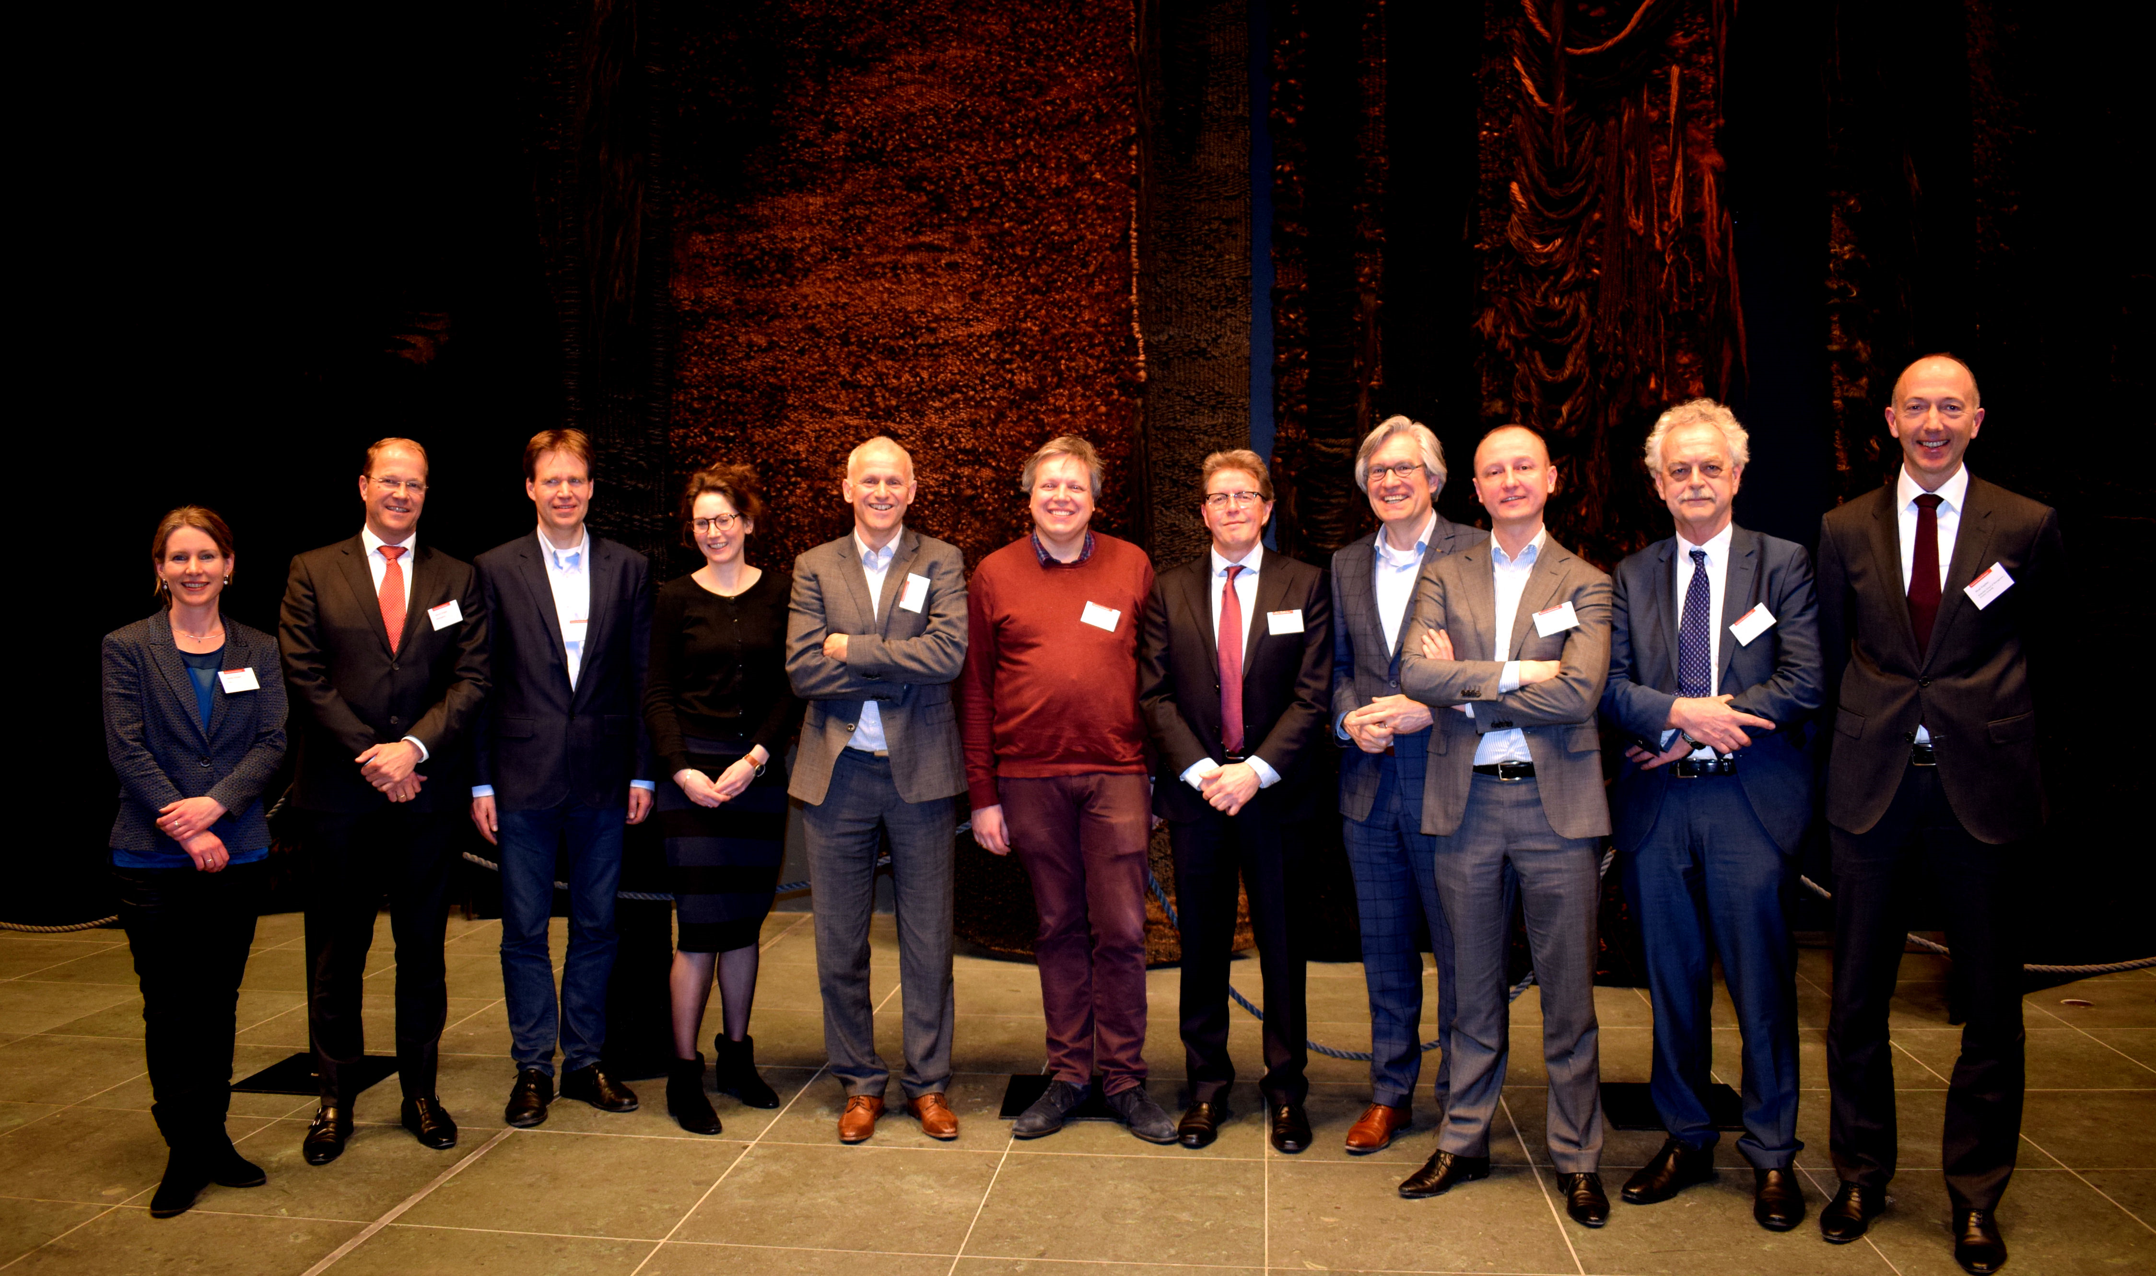
Leonie Schakel 2022
HealthCare Authority
Thesis: “Regulation through internal supervisors”
Kees Huizinga 2022
Human Environment & Transport Inspectorate
Thesis: “Goal displacement”
Aute Kasdorp 2022
Authority of Financial Markets
Thesis “Harmful but legal conduct”
Jos Verkroost 2016
Inspectorate of Education
Thesis: “Quality care, financial ratio’s and integration”
Marcel Snippe 2019
Tax Authority
Thesis: “Data sharing for regulation”
Lilian Petit 2017
Authority Consumers & Markets
Thesis “Legal cartels”
PhD group Modern Regulation 2013-2022
Goal: part time research by public regulators
Joint research effort guided by RSM
Positive group dynamics and networking

Slide 3
Definition and goal public supervision
Goal displacement within an organization:
Discrepancy between
Original goal (legal or other)
Actual pursued goal
Goal public supervision:
To determine to what extent sustainable behavioral changes as envisaged by standards or quality requirements have been implemented by supervised persons
In case of incomplete implementation: moving the supervised to full implementation

Slide 4
Problem
Notion that public supervision may be vulnerable for goal displacement because:
Often vague goals (like safety, quality)
Political pressure to justifiy approach
Loss of effectiveness

Slide 5

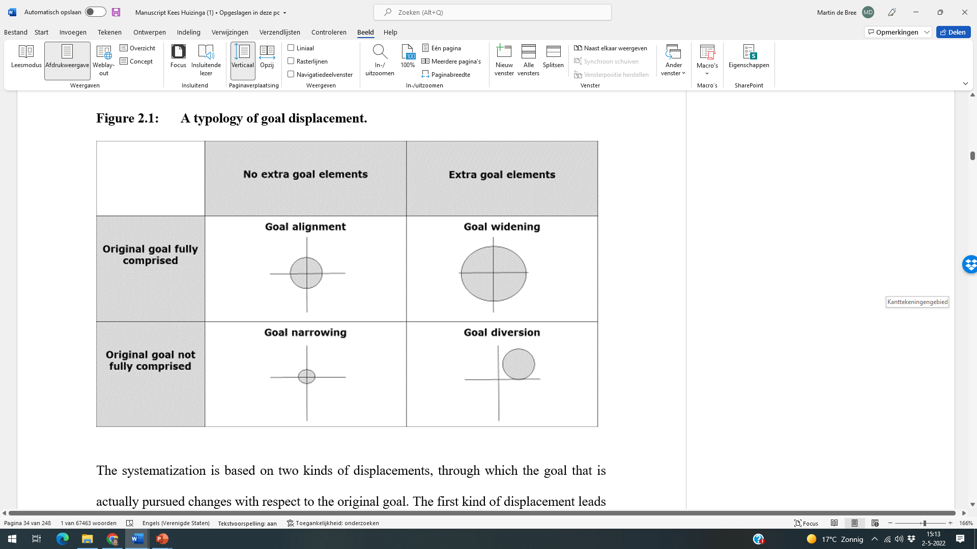
Typology goal displacement

Slide 6

Examples
Focus on general well-being of patients
Fit and proper test of directors

Slide 7

Overreliance on letter of the law or protocol
Sticking to a given inspection technique or method
Examples

Slide 8

Examples
% of students exam passing as a proxy for quality of education
Number of inspections as a proxy for safety or quality

Slide 9

Measures
Be(come) aware of risk of goal displacement
Do not overshoot after incidents
Balance letter and spirit of the law
Flexibility for regulatees may come with a price of uncertainty and legitimacy issues
Mind that method or protocol does not become automatism

Slide 10
Thank you!
More information:
Kees.huizinga@ilent.nl or mbree@rsm.nl
Source: Huizinga, K.(2022). The quest for effective regulatory enforcement; A goal displacement perspective, PhD thesis.

