Slide 1
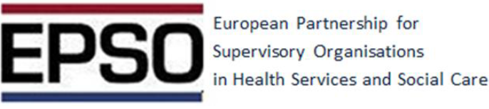
Combating Fraud in Public Healthcare Systems of the European Union:
Legal Instruments, Policy Strategies, and Governance Challenges
Prof. Álvaro Moreira da Silva
Portugal
Board EPSO

Slide 2
Combating Fraud in Public Healthcare Systems of the European Union
Fraud undermines equity, efficiency, and public trust in healthcare.
Estimated 6.2% of global health spending lost to fraud .
EU impact: national and EU-funded healthcare programmes affected.

Slide 3
Incidence and Cost of Healthcare Fraud in Europe
Cost:
Healthcare fraud in Europe is estimated to amount to around > €56 billion annually, which represents over 5% of national health budgets across the region.
Insurance Claims:
Combined detected and undetected fraudulent activities are estimated to account for ~10% of total claims expenditure across European insurance lines —including health insurance.
Appl Health Econ Health Policy (2018) 16:289–302
Notes:
Fraud in public healthcare systems presents a persistent and costly challenge across the European Union (EU), threatening financial sustainability, undermining equity, and eroding public trust. Despite shared principles of solidarity and universality, Member States exhibit varying degrees of preparedness and response to fraudulent behavior. This article provides a critical analysis of healthcare fraud typologies in EU systems, the legal and institutional instruments available at both national and EU levels, and the implementation of detection and prevention strategies. Particular attention is given to digital monitoring tools, cross-border cooperation, and whistleblower protections. The article concludes with strategic policy recommendations to harmonize anti-fraud efforts and strengthen institutional resilience across the EU.
Public healthcare fraud affects every Member State of the European Union. Whether through overbilling, false claims, supplier collusion, or abuse of entitlements, fraud contributes to financial losses estimated in the tens of billions of euros annually. As health spending rises—particularly after the COVID-19 pandemic—the imperative to secure public funds and ensure accountability in healthcare delivery is more pressing than ever.
The €56 billion figure comes from estimates by the European Healthcare Fraud & Corruption Network (EHFCN), emphasizing that fraud and corruption significantly impact healthcare financing across multiple European countries quotidianosanita.it+4pure.port.ac.uk+4PMC+4.
Insurance fraud beyond healthcare—including motor, property, and other lines—further highlights the broader scale of the problem across the insurance industry, reinforcing the ~10 percent of claims loss figure
European healthcare systems lose tens of billions of euros annually due to fraud and corruption—significant enough to meaningfully impact national healthcare budgets and patient care. While this level of fraud aligns with global averages, it's nonetheless substantial and a critical area for prevention and oversight.
In recent years, the fight against healthcare corruption has intensified. Estimates from the European Healthcare Fraud and Corruption Network calculate na approximate €56 billion annual loss to Europe as a result of corruption. In recent years, the fight against corruption in the healthcare sector has intensified owing to the growing consensos that corruption in its various forms heavily distorts national healthcare purposes, undermines the aims of health policy measures and reforms, and leads to a tremendous waste of resources. According to recent reports on the cost of fraud
in healthcare, estimates of the magnitude of corruption and social fraud range between 3% and 8% of national health expenditures.
The British Centre of Counter- Fraud Studies examined relevant data from six countries using different methodological calculations. According to the Centre of Counter-Fraud Studies, since 2008, losses as a result of corruption have increased by 25% worldwide and even by 37% for the National Health Service in the UK [5]. For Europe, the European Healthcare Fraud and Corruption
Network (EHFCN) estimates a loss of €56 billion annually The Global Healthcare Anti-Fraud Network [6, 12] promotes cooperation and communication between international organisations
European healthcare systems lose tens of billions of euros annually due to fraud and corruption—significant enough to meaningfully impact national healthcare budgets and patient care. While this level of fraud aligns with global averages, it's nonetheless substantial and a critical area for prevention and oversight.
Impact: Higher costs, worse health outcomes, loss of trust
Complexity: Multi-actor systems → patients, providers, payers, regulators

Slide 4
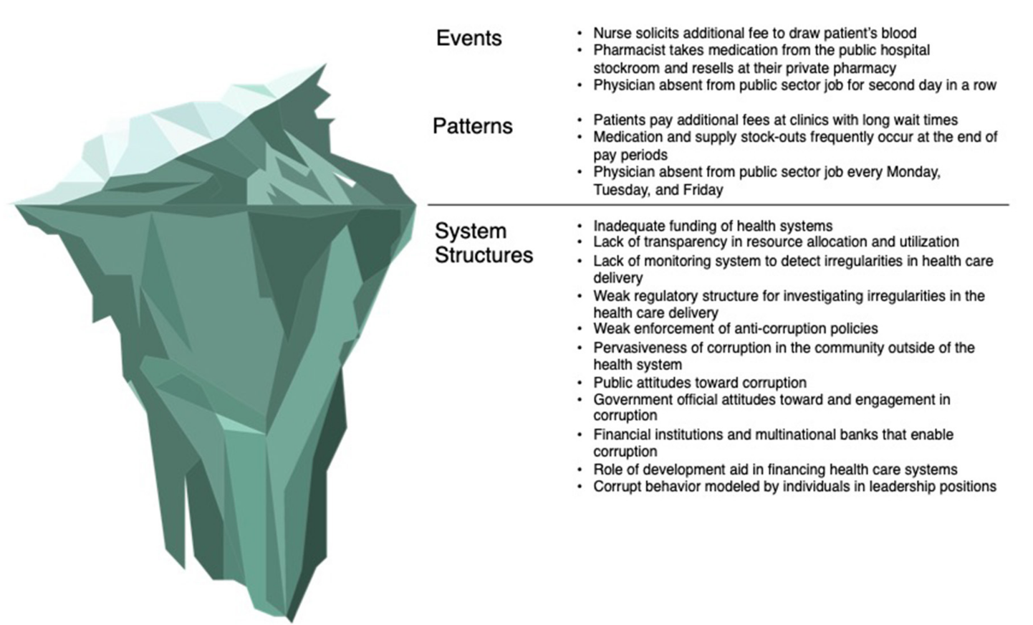
Combating Fraud in Public Healthcare Systems of the European Union:

Slide 5
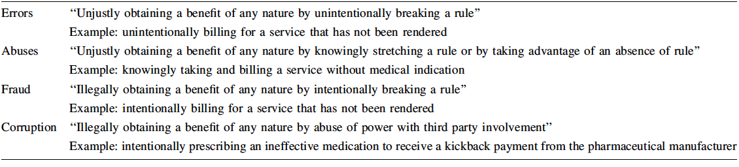
European Healthcare Fraud and Corruption Network (EHFCN) categories generic definitions and waste typology
EHFCN. Waste typology matrix: European Healthcare Fraud and Corruption Network. 2016
Notes:
In recent years, European Healthcare Fraud and Corruption Network the EHFCN, constituted in 2005 by the EU, has become the pioneer in developing a typology for discriminating between error, abuse, fraud, and corruption and also between intentional and unintentional trespasses and misdemeanours in healthcare
Individual vs Institutional Corruption:
Individual: Bribery, fraudulent billing.
Institutional: Systemic failures enabling corruption (e.g., weak procurement laws)
In recent years, the EHFCN, constituted in 2005 by the EU, has become the pioneer in developing a typology for discriminating between error, abuse, fraud, and corruption and also between intentional and unintentional trespasses and misdemeanours in healthcare (Table 1)
To support the audit and control of institutions in regard to operationalisation, the EHFCN further developed a Waste Typology Matrix in 2014, which classifies waste according to error, abuse, fraud and corruption with respect to its consequences. The EHFCN typology is meant to be applied in operationalisation in the controlling and auditing of healthcare institutions.
In 2013, an EU report on corruption in the healthcare sector [7], which was updated in 2017 [29], clustered corrupt and fraudulent actions into six main categories of corrupt activities in healthcare (

Slide 6
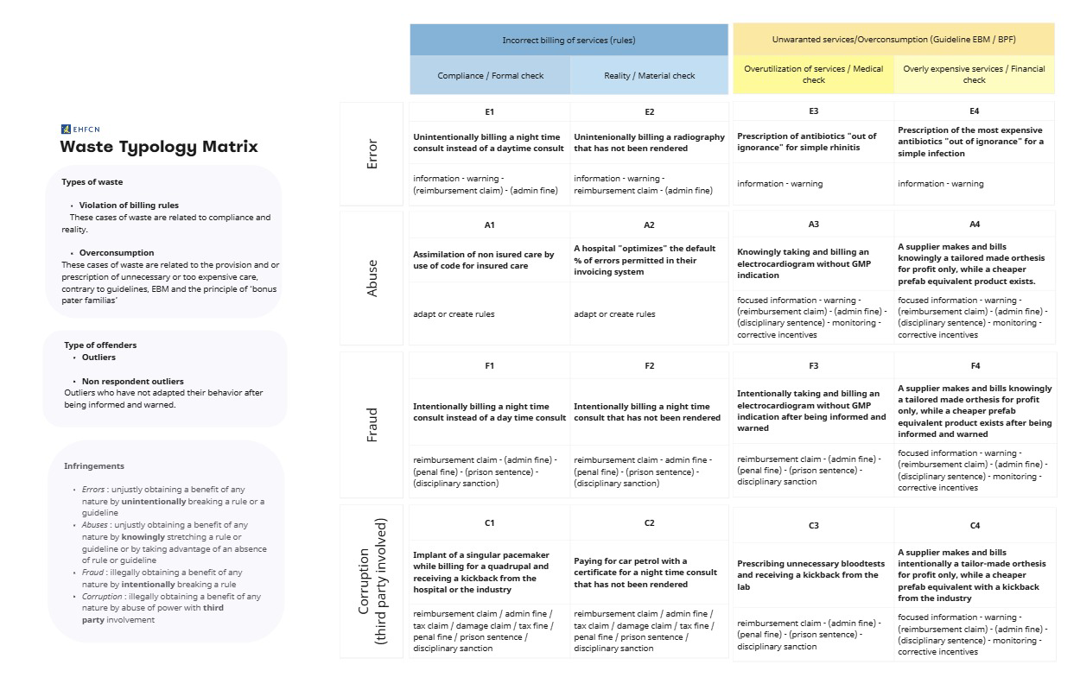
Waste typology matrix: European Healthcare Fraud and Corruption Network. 2016
Notes:
To support the audit and control of institutions in regard to operationalisation, the EHFCN further developed a Waste Typology Matrix in 2014, which classifies waste according to error, abuse, fraud and corruption with respect to its consequences. The EHFCN typology is meant to be applied in operationalisation in the controlling and auditing of healthcare institutions.

Slide 7
Types of infringements and inefficient use of resources - European Healthcare Fraud and Corruption Network (EHFCN)
No waste in the healthcare services, there are 2 main areas:
Failure to comply with existing regulations;
Failure to rely on scientific evidence.
In both areas, the infringement can take 4 different forms:
Error obtaining a benefit by unintentionally breaking a rule
Abuse obtaining a benefit by knowingly stretching a rule or by taking advantage of an absence of rule.
Fraud obtaining a benefit by intentionally breaking a rule
Corruption obtaining a benefit by abuse of power with third party involvement
Notes:
The terms ‘corruption’ or ‘fraud’ are often used colloquially as a catch-all term for various forms of regulatory infractions and inefficient use of resources in health care. It is a good use of a single term to draw attention to these issues. in which an inspection department can operate.
However, if we wish to gain insight into the extent, causes and possible actions to detect, prevent or respond to fraud/corruption/waste, it is essential to state clearly what it is about. Not ‘to be correct’ but because each type of infringement requires different actions. This way we can better cooperate and benchmark.
In both areas, the infringement can take four different forms, each having a different cause and consequently requiring a different type of action:

Slide 8
EU Legal & Regulatory Framework
OLAF (European Anti-Fraud Office): Investigates EU budget fraud
EPPO (European Public Prosecutor’s Office): Prosecutes crimes against EU financial interests
AMLA (Anti-Money Laundering Authority): Coordinates AML/CFT oversight
Union Anti-Fraud Programme (Hercule III → UAFP): Funds prevention, data systems (AFIS, IMS)
EUROPOL & Eurojust: Support cross-border investigations
PIF Directive: Harmonized criminal definitions & sanctions
Notes:
EU-Level Instruments
Regulation (EU, Euratom) 2018/1046 on the financial rules applicable to the general budget, including health-related spending.
European Public Prosecutor’s Office (EPPO): empowered to investigate and prosecute fraud affecting the EU budget, including in healthcare.
OLAF (European Anti-Fraud Office): conducts administrative investigations and supports national authorities.
Directive (EU) 2019/1937: on the protection of whistleblowers across Member States.

Slide 9
National-Level Frameworks
National health inspectorates or audit authorities
Public procurement watchdogs
Health insurance funds or agencies
National anti-corruption bodies and financial police
Notes:
Each Member State maintains its own regulatory structure, often including: However, significant disparities exist in capacity, resources, and implementation.

Slide 10
Governance Challenges
Fragmented laws and enforcement.
OLAF relies on national follow-up.
Under-reporting due to fear of retaliation.
Reactive rather than proactive risk management.

Slide 11
Legal and Regulatory Caveats
Fragmentation across member states:
EU directives require national transposition, leading to uneven enforcement and reporting standards.
Jurisdictional overlaps:
OLAF, EPPO, national prosecutors and inspectorates may have overlapping mandates, creating duplication in investigations.
Limited EPPO scope:
EPPO focuses primarily on EU funds; domestic health fraud often remains under national control, reducing cross-border coordination.
Data-sharing barriers

Slide 12
Governance Challenges
Fragmented laws and enforcement.
OLAF relies on national follow-up.
Under-reporting due to fear of retaliation.
Reactive rather than proactive risk management.

Slide 13
Prevention Strategies
Risk prevention plans: mandatory in some EU states but compliance gaps persist
Procurement transparency: open contracting, e-procurement
Internal controls: Segregation of duties, whistleblower hotlines
Ethical training & culture change: Codes of conduct, conflict-of-interest disclosures
Patient empowerment: Reporting channels, awareness campaigns

Slide 14
Detection & Monitoring
Traditional methods: Audits, inspections
Innovation and Technology
Data-driven detection:
Rules-based systems: Frequency edits, anomaly flags
Machine learning: Outlier detection, network analysis
E-health records & claims data mining: Cross-institution checks and real-time analytics and benchmarks
Notes:
Innovation and Technology
Blockchain for claim transparency. AI in anomaly detection (billing, prescribing).Real-time analytics and benchmarks.
Barriers: Data quality, ethics, digital readiness.

Slide 15
Detection and Monitoring Tools
Digital Surveillance and Data Analytics
Deployment of machine learning algorithms to detect anomalies in billing and prescribing patterns.
Use of interoperable eHealth platforms to track care episodes across regions and borders.
Real-time dashboards for public procurement transparency.
Whistleblowing and Citizen Reporting
Anonymous reporting channels, reinforced by EU whistleblower directive.
Integration of whistleblower protections into national law (not yet fully implemented)
Audit and Compliance Units
Targeted audits using risk-based selection models.
External and internal compliance teams in hospitals and public health authorities.

Slide 16
Detection and Technology Caveats
Data silos:
Health, procurement, and insurance data often reside in separate systems, limiting analytics integration
Machine learning biases:
Algorithms trained on incomplete or biased datasets risk false positives (flagging legitimate providers) or false negatives (missing fraud)
Resource disparities:
High-income countries deploy advanced detection tools; lower-income EU members may rely on audits/manual methods

Slide 17
Economic and Operational Caveats
Cost of compliance:
Implementing digital procurement, AI detection, and real-time audits can be financially prohibitive for smaller health systems
Risk of overregulation:
Excessive controls may burden legitimate providers, reducing efficiency and patient access
Underreporting incentives:
Hospitals and insurers may prefer internal settlements to avoid reputational damage, limiting data for systemic reforms

Slide 18
Policy & Supervision Recommendations
Harmonize and strengthen EU oversight
Extend EPPO’s mandate to cover all Member States and increase funding.
Mandate EU-wide minimum standards for anti-fraud controls in national health systems.
Build a culture of transparency
Require public disclosure of procurement data and contract awards.
Mandate integrity training for health professionals and administrators.
Leverage technology
Promote standardized data sharing protocols across Member States.
Fund national-level investments in AI-based fraud detection systems.
Protect and Incentivize Reporting
Fully implement Directive (EU) 2019/1937
Create safe channels for whistleblowers with legal, psychological, and financial support.
Notes:
Combatting healthcare fraud across the European Union requires not only strong laws but capable institutions, technological innovation, and a sustained political commitment to transparency. As health systems face increasing strain, protecting public resources through efficient fraud detection and prevention is essential to upholding the social contract of universal care.

Slide 19
Roadmap for Healthcare Inspectorates
Harmonize legal definitions & cooperate
Centralized health fraud data hubs (claims, procurement) and invest in audit and digital capacity
Rules-based + ML analytics for detection & network analysis
Mandatory Risk Prevention Plans (PPRs) & Annual anti-fraud reports & Public dashboards for transparency
Sanctions ladder: education → fines → exclusion → prosecution
Staff training, cybersecurity upgrades
Phased rollout: quick wins → data integration → AI detection
Notes:
Harmonise definitions across Member States. Mandate transparent procurement & waitlists. Support and protect whistleblowers. Invest in audit and digital capacity.
Enhance OLAF-EPPO collaboration.

