Slide 1
From Recommendations to Reality: Lessons from IGAS Inspections on Trust, Control and Compliance in French Health and Social Care
Fabienne Bartoli
Inspector General of Social Affairs, France

Slide 2
IGAS (France)
Who We Are
IGAS is the French interministerial inspectorate for health, social protection, employment, and inclusion.
Independent body conducting audits, evaluations, and inspections since 1967.
Advises government, supports reforms, and ensures compliance with rules and standards.
Mission: improve effectiveness, efficiency, and quality of social and health policies.
Notes:
Let me start by briefly introducing IGAS. We are the French General Inspectorate of Social Affairs, an interministerial and independent body created in 1967. Our mandate covers health, social protection, employment and inclusion. We conduct audits, evaluations, and inspections, not only to control compliance, but also to advise the government and support reforms. Our mission is simple: to make policies more effective, efficient, and fair for citizens.
Beyond introducing who we are, today I would like to share with you some very concrete lessons from our recent inspection reports. They show what happens when our recommendations are implemented, and what happens when they are not. This offers a useful perspective on the conference theme: how trust and control interact in compliance and enforcement.

Slide 3
From Guidance to Reality
Roadmap for Today
When guidance is followed :
  Disability services reform
  Transition of Metz Hospital into a Teaching Hospital
  Crisis management structure
When guidance is not fully embraced :
  Territorial Hospital Groups (GHTs)
  Hospital “Pôles”
What these cases teach us :
  Why some reforms succeed
  Why others stall
Closing message :
  Trust and control as twin pillars of compliance
Notes:
To orient you, let me briefly map the journey we’ll take.
We begin with three moments where guidance translated into concrete change. First, disability services: a progressive shift from institutions toward inclusive community support. Second, Metz Hospital’s transition into a teaching hospital: a staged plan built on joint medical projects and an operational guide. Third, crisis management: not a full directorate, but a dedicated function that improved coordination and preparedness.
We’ll then look at two reforms that remained below expectations and why: territorial hospital groups that struggled without a clear ‘number one’ and sufficient trust, and clinical ‘pôles’ where formal delegation rarely became real autonomy. With these five cases on the table, I will step back to extract cross-cutting lessons—what enabled success (clear governance, shared objectives, stakeholder ownership) and what held reforms back (fragmented leadership, weak incentives, and, above all, trust deficits).I’ll close with the core takeaway for regulators and inspectors: durable compliance needs both sides of the equation—clear rules and credible enforcement—and an equally deliberate investment in trust, transparency, and shared leadership.”

Slide 4
Part 1 When guidance is followed :
  Disability services reform
  Transition of Metz Hospital into a Teaching Hospital

Slide 5
Part 1 : When guidance is followed
Disability Services Reform
IGAS Report (2025): “Transformation of support for people
with disabilities”; Recommendation : shift from institutional care to inclusive community
services
Follow-up :
  New inclusive housing & schooling initiatives
  Strong involvement of user associations
Lesson : Alignment with international standards (UN CRPD);
strong advocacy push to effective implementation

Slide 6
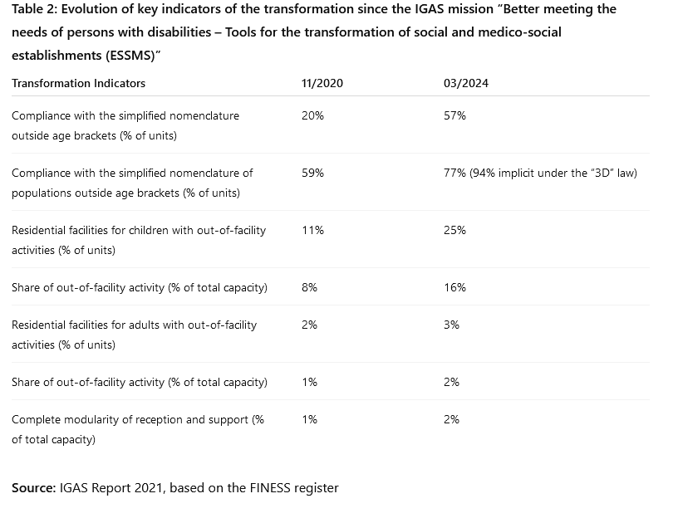
Part 1 : When guidance is followed
Disability Services Reform
Notes:
This table shows how our guidance has translated into measurable change between 2020 and 2024. Compliance with the new simplified nomenclature rose from 20% to almost 60%.
For population categories, compliance reached 77%, and even 94% under the new 3D law. Out-of-facility activities also doubled for children, from 11% to 25%, and increased for adults as well, though still modest. These numbers demonstrate that the shift toward more flexible, inclusive, and community-based services is not just a policy ambition. It is already visible in practice.

Slide 7
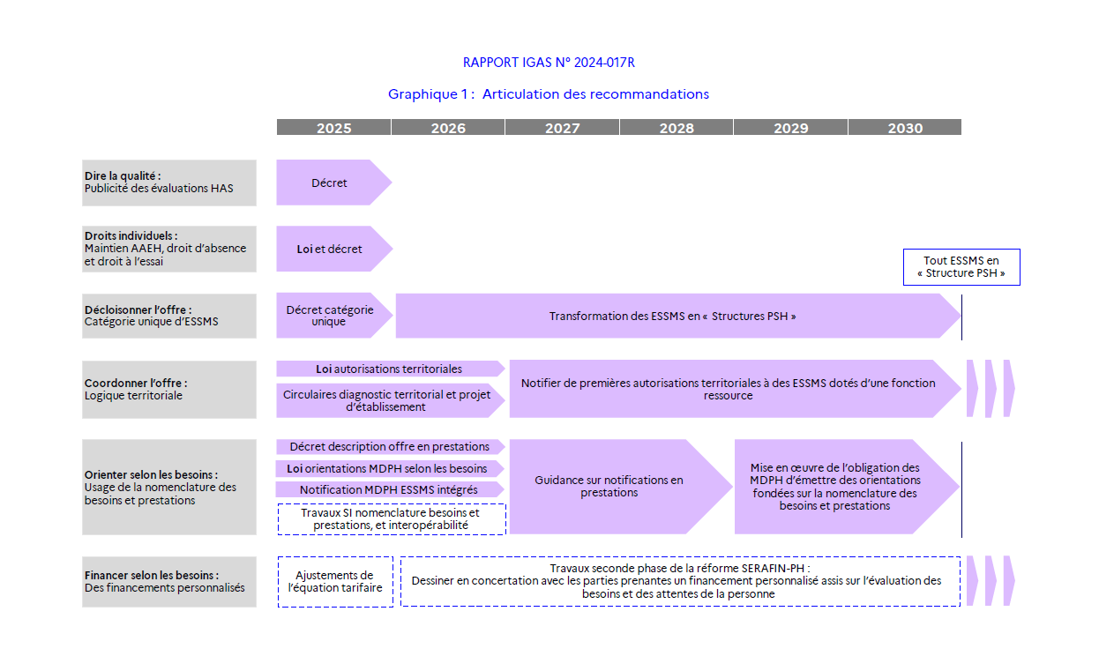
Part 1 : When guidance is followed
Disability Services Reform
Notes:
Short term (2020–2022): Simplify nomenclature, first inclusive housing projects
Medium term (2023–2025): Expand out-of-facility activities, develop local service networks
Long term (2026–2030): Full modularity of support, deinstitutionalization as the norm
This trajectory illustrates how the shift from institutions to inclusion is designed as a progressive process. In the short term, the goal was to simplify administrative nomenclatures and launch the first inclusive housing projects. In the medium term, the priority is to expand out-of-facility activities and to build local service networks. And in the longer term, by 2030, the ambition is to achieve full modularity of support and to make deinstitutionalization the norm. The key point is that this is not a sudden reform, but a carefully staged transformation that combines regulatory changes, investment, and new practices on the ground.

Slide 8
Part 1 : When guidance is followed
Transition of Metz Hospital into a Teaching Hospital
Metz–Thionville Regional Hospital (CHR), created in 1977
Today: the only French regional hospital of its category not yet a university hospital
Large catchment area in Lorraine (4 départements, Sillon Lorrain), with high level of clinical activity
2019 convention with Nancy University Hospital & University of Lorraine
but results below expectations
IGAS–IGESR guidance (2023):
Progressive transition with a defined scope of specialties
Adoption of an operational guide
Shared medical projects in teaching & research (e.g. cardiology, hematology)
Lesson: requires trust, governance clarity, and step-by-step integration
Notes:
Metz–Thionville is a large regional hospital created in 1977. Despite its size and strategic role in the Lorraine region, it remains today the only French regional hospital of its category not to have become a university hospital. A convention signed in 2019 with Nancy University Hospital and the University of Lorraine was supposed to change this, but results fell far short of expectations. The main obstacles were a lack of trust, unresolved disagreements on specialties to be a teaching hospital, and competing strategic priorities.
Our IGAS–IGESR mission in 2023 recommended a progressive transition, focused on a defined set of specialties, supported by a clear operational guide. Concrete results are now visible: the guide has been adopted, and new hospital–university posts in cardiology and hematology have been created. The lesson is clear: such a transition cannot succeed by decree alone; it requires structured governance, a clear scope, and above all, a partnership mindset to overcome mistrust.

Slide 9
Part 2 When guidance is not fully embraced
  Territorial Hospital Groups (GHTs)
  Crisis management structure
  Hospital “Pôles”, Clinical hospital divisions

Slide 10
Part 2 : When guidance is not fully embraced
Regional Hospital Groups (GHTs) : Ambition vs Reality
Created in 2016 to coordinate public hospitals within a territory
Goal : common medical strategy and pooling of support functions
Guidance : clear leadership, shared governance, delegated responsibilities
Achievements :
  Shared hospital IT systems
  Centralised procurement & purchasing
  Joint training programs
  Some shared medical projects (oncology, imaging, laboratories)
Limits :
  No “number one” leader (Director + CME President not unified)
  HR & recruitment powers not delegated
  Weak medical project integration
  Trust deficit between institutions
Notes:
The Regional Hospital Groups, or GHTs, were created in 2016 to coordinate hospitals across territories. Their ambition was to establish a common medical strategy and pool support functions, while ensuring delegated responsibilities and shared governance. In practice, some progress has been made: many GHTs have developed common IT systems, centralised procurement has generated savings, and some joint projects have emerged in areas such as oncology, medical imaging, and laboratory medicine.
But the reality falls below expectations. Human resources and recruitment remain managed locally, medical projects are weakly integrated, and governance has no clear ‘number one’—leadership is split between the Director and the President of the Medical Executive Committee (conseil medical d’établissement, local medical board in each hospital, peer-elected members). Above all, trust between hospitals has been insufficient, preventing deeper cooperation. The lesson is that while technical functions can be pooled relatively easily, true integration requires clear leadership and, most of all, mutual trust.

Slide 11
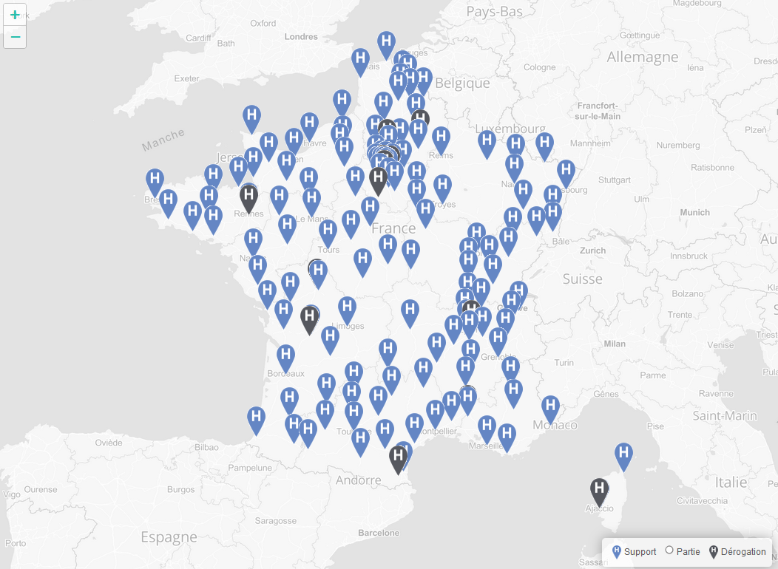
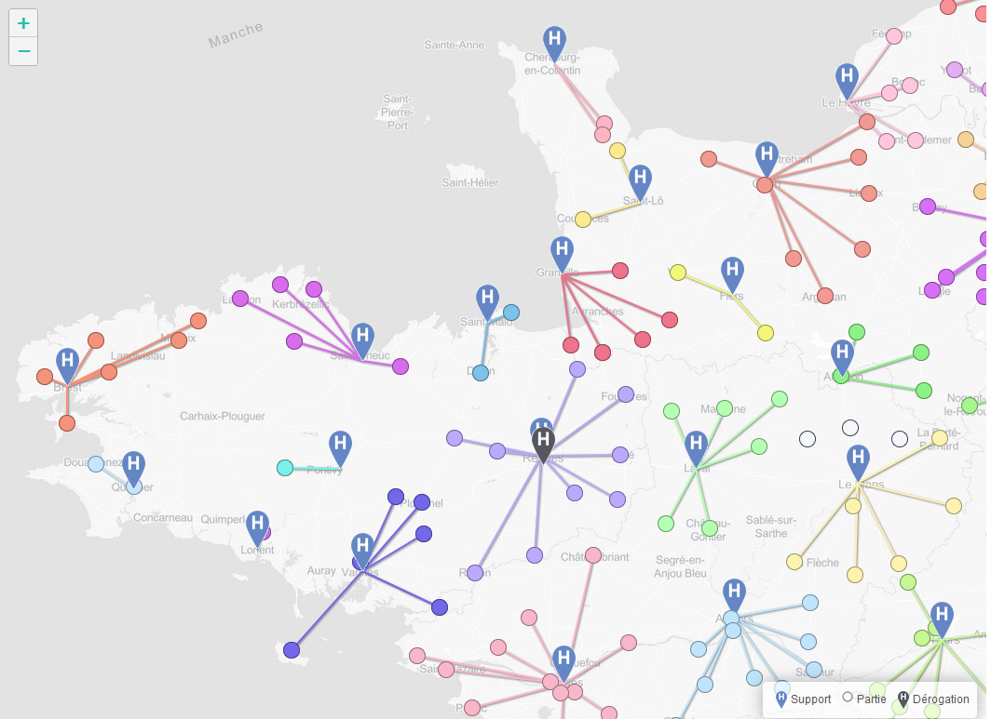
Part 2 : When guidance is not fully embraced
Regional Hospital Groups (GHTs) : Ambition vs Reality
2025 Map https://nominations.hospimedia.fr/carte-des-ght/

Slide 12
Part 2 When guidance is not fully embraced
From Ad hoc to Permanent : Crisis Management at the Ministry of Health
2022: IGAS mission : proposal for a dedicated Crisis Management Directorate
Diagnosis:
  Fragmented responsibilities (DGS, DGOS, SG)
  Weak anticipation & preparedness capacity
  Under-investment in digital tools and crisis staffing
2023 outcome :
  creation of a permanent Crisis Management Service within DGS
Implemented measures:
  Standing crisis unit established
  Stronger coordination with Regional Health Agencies (ARS) and inter-ministerial partners
  Investment in crisis IT systems
Remaining limits:
  Not a full “directorate” as initially envisaged
  Resources still below strategic needs
Notes:
The COVID crisis revealed both the ministry’s resilience and its structural weaknesses. During the pandemic, crisis response relied on ad hoc units, without a permanent structure. In 2022, the IGAS mission recommended creating a full Crisis Management Directorate to consolidate anticipation, preparedness, and operational command.
The diagnosis was clear: fragmented responsibilities between the Directorate-General for Health, the Hospital Directorate, and the Secretariat General, with insufficient anticipation, limited crisis staffing, and under-investment in digital tools.
In 2023, the ministry acted on this guidance—though with a narrower scope—by creating a permanent Crisis Management Service within the Directorate-General for Health. This service now ensures a standing crisis unit, stronger coordination with regional health agencies and inter-ministerial partners, and investment in crisis IT systems.
The limitation, however, is that this remains a service rather than the full directorate initially envisaged, with resources still below strategic needs. But the key lesson is that institutionalising crisis capacity, even at a smaller scale, marks a real step forward from the ad hoc model of the past.”

Slide 13
Part 2 When guidance is not fully embraced
Hospital Clinical Divisions : Delegation Without Autonomy
Reform created Clinical Divisions (pôles), grouping several departments, each led by a division head
Goal: delegate budget, HR, and operational management to division heads
Claris 2020 mission (with IGAS support) :
  Expected stronger delegation to divisions and services;
  57% of respondents supported internal delegation;
  Yet 89–92% of division and service heads reported insufficient resources to exercise managerial roles
Reality:
  Recruitment and budget decisions remain centralized;
  Few effective contracts between management and division heads;
  Leadership perceived as distant (Director / Medical Executive Committee dyad)
Lesson : symbolic delegation without resources or authority undermines trust and blocks reform
Notes:
The reform introducing Hospital Clinical Divisions was meant to modernise governance by grouping several departments, each led by a division head, and granting them responsibility over budgets, staffing, and daily management. The principle was clear: real delegation in exchange for accountability.
The 2020 Claris mission, carried out with the support of IGAS, showed that this ambition has remained largely unfulfilled. While 57% of respondents supported stronger internal delegation to divisions and services, almost 90% of division and service heads reported that they lacked sufficient resources to fulfil managerial duties. Recruitment and budget decisions continue to be centralised, contracts are often symbolic, and leadership is perceived as remote, concentrated in the Director and Medical Executive Committee dyad.
The lesson is straightforward: reforms fail when autonomy is promised but not delivered. Delegation without real authority and means generates frustration, erodes trust, and blocks change.

Slide 14
From Case Studies to Cross-cutting Lessons
Why some reforms succeed Why others stall
Cross-cutting Lessons

Slide 15
Part 3 : From Case Studies to Cross-cutting Lessons
Why Some Reforms Succeed and Others Stall
Two reforms where guidance was implemented :
Disability care transformation
Academic hospital development in Metz
Three reforms where guidance remained unfulfilled :
  Crisis management structure
  Regional Hospital Groups (GHTs)
  Hospital Clinical Divisions
What makes the difference?
Trust between actors
Clear leadership
Real delegation of authority
Adequate resources
Notes:
We have now reviewed three cases where our guidance was implemented, and two where reforms stalled. What explains this contrast?
From these examples, we can already see the same issues recurring: trust, leadership, delegation, and resources.
These are the cross-cutting lessons that help us understand why some reforms take root and others remain symbolic. Let us now look at these lessons more systematically.

Slide 16
From Case Studies to Cross-cutting Lessons
Cross-cutting Lessons
Trust vs Control :
Sustainable reforms require both : rules and monitoring and mutual trust between actors.
Leadership Matters :
Clear, recognised leadership (not divided between several heads) is essential for reform credibility.
Delegation Must Be Real :
Accountability without genuine authority frustrates professionals and blocks change.
Resources Shape Reality:
Even well-designed reforms fail without adequate staffing, funding, and digital tools.
Notes:
Across all our cases, four cross-cutting lessons stand out.
First, reforms cannot succeed on control alone: sustainable compliance requires a balance between trust and control.
Second, leadership matters. When leadership is divided, as we saw in the hospital groups, reforms lose credibility. Third, delegation must be real. Giving division heads responsibility without authority is a recipe for frustration and stagnation.
And finally, resources shape reality. Even the best-designed reforms cannot be implemented without adequate staff, funding, and digital tools.
Taken together, these lessons remind us that reform is not only about legal design, but about governance, trust, and means.

Slide 17
From Case Studies to Cross-cutting Lessons
Cross-cutting Lessons
Resources
Delegation
Leadership
Trust
Notes:
Across all our cases, four cross-cutting lessons stand out. First, reforms cannot succeed on control alone: sustainable compliance requires a balance between trust and control. Second, leadership matters. When leadership is divided, as we saw in the hospital groups, reforms lose credibility. Third, delegation must be real. Giving division heads responsibility without authority is a recipe for frustration and stagnation. And finally, resources shape reality. Even the best-designed reforms cannot be implemented without adequate staff, funding, and digital tools.
Taken together, these lessons remind us that reform is not only about legal design, but about governance, trust, and means.

Slide 18
Conclusion
Sustainable Compliance : Balancing Trust and Control

Slide 19
Conclusion
Sustainable Compliance : Balancing Trust and Control
Our case studies show a simple truth :
Reforms succeed when trust is built among actors
And when control mechanisms ensure clarity and accountability
Without trust, cooperation stalls
Without control, reforms lack consistency and durability
The balance of trust and control is the condition for sustainable compliance
Notes:
Let me conclude with one key message that resonates with the theme of this EPSO conference. Sustainable compliance cannot be achieved by control alone, nor by trust alone. Our case studies show that reforms succeed when actors trust each other enough to cooperate, and when control mechanisms guarantee fairness, accountability, and consistency.
Without trust, cooperation stalls. Without control, reforms lack durability. The balance of both is what makes compliance sustainable. And this is, I believe, the essential lesson for public sector reforms across Europe.

Slide 20
Sources
Transformation of care provision for persons with disabilities – IGAS Report (2024)
  (Transformation de l’offre d’accueil des personnes handicapées, IGAS Report n° 2024-017R)
  https://igas.gouv.fr/sites/igas/files/2025-03/2024-017R%20rapport%20.pdf
Universitarisation of Metz-Thionville Regional Hospital – IGAS/IGÉSR Report (2023)
  https://www.grand-est.ars.sante.fr/media/112212/
Crisis management structure at the Ministry of Health – Mission Letter (2022)
https://www.apmnews.com/documents/202211141350150.Lettre_mission_Mme_Cecile_COURREGES.pdf
Regional Hospital Groups (GHTs) – Interim Review – IGAS Report (2019)
https://igas.gouv.fr/sites/igas/files/2024-05/Bilan%20d%E2%80%99%C3%A9tape%20des%20groupements%20hospitaliers%20de%20territoire%20(GHT).pdf
Hospital Clinical Divisions and governance – Claris Mission with IGAS support (2020) https://sante.gouv.fr/IMG/pdf/rapport_claris_version_finale_1_.pdf

