Slide 1
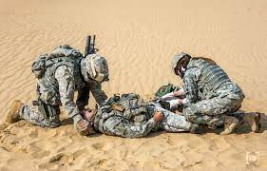
Medical preparedness in Dutch Military Services
Military Healthcare Inspectorate
Liesbeth de Stoppelaar > strategic advisor
Nanda van Klink > chief of staff
Challenges for supervision of operational units

Slide 2

About the Military Healthcare Inspectorate
Independent supervisory authority of the Minister and the Ministry of Defence (MoD)
Founded in June 1989

Slide 3
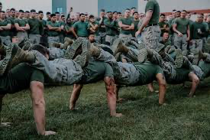
Our mission
The IMG contributes to the operational readiness of military personnel by safeguarding, protecting, maintaining, and promoting their health.

Slide 4
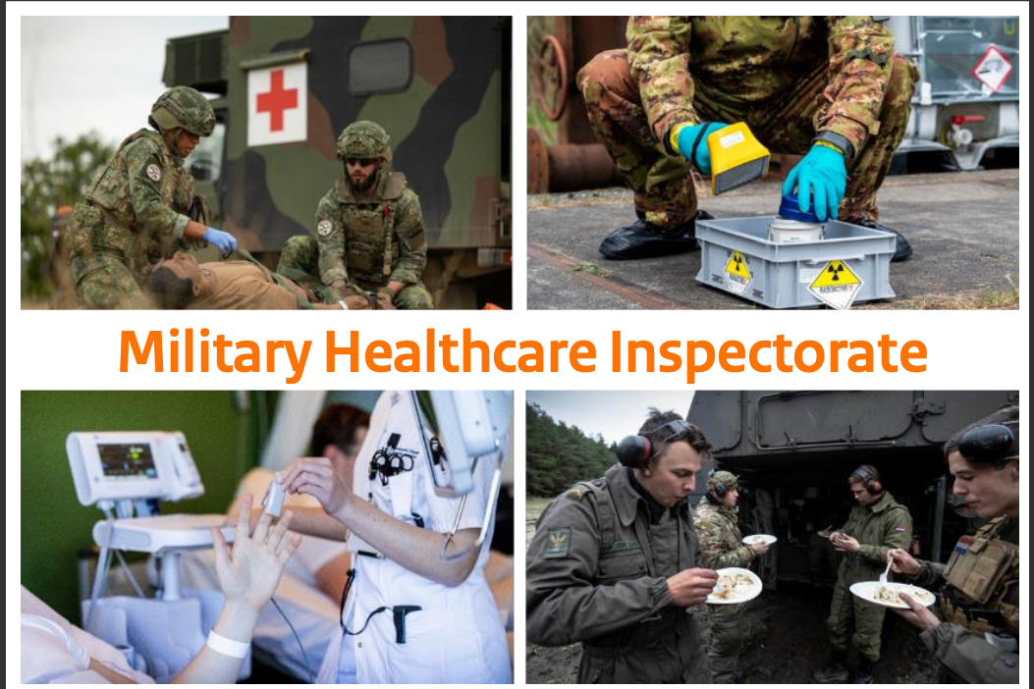
Domains
We supervise five domains
1. Regular military healthcare
2. Operational military healthcare
3. Health protection, including animal welfare
4. Nuclear safety and radiation protection
5. Food safety

Slide 5
Core Values
We actively engage with our environment while maintaining independence in judgment.
We encourage learning and improvement, and enforce where necessary.
We act based on healthy trust, recognising that trust is a reciprocal process.
We are transparent about our processes and careful in sharing information.

Slide 6
Supervisory approach
Responsive and reflective
Graduation in interventions
Effectiveness
System-based supervision (focused on the functioning of the system and not on personal actions)
Risk-based supervision (operational/situational circumstances)

Slide 7

Dilemma preparing LSCO
What is the role a superviser in a large-scale combat operation (LSCO)?
go to the beach actively involved

Slide 8
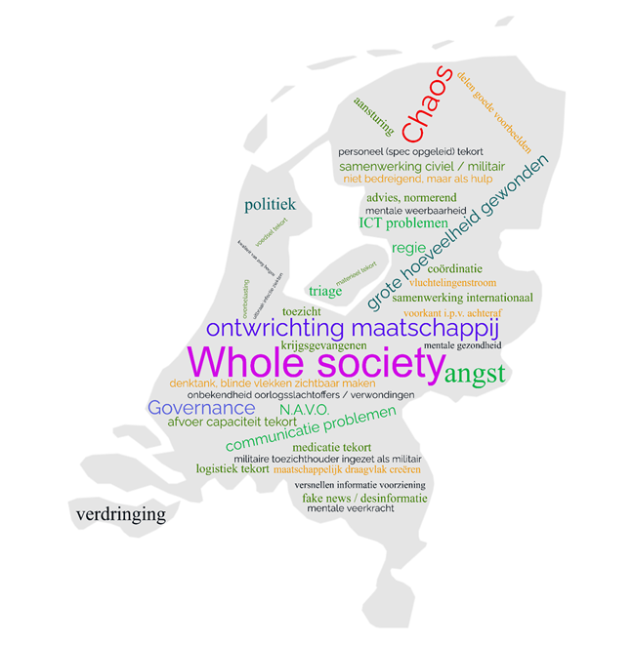
Retrieved information

Slide 9
Analysis
The IMG contributes to optimal operational readiness of military personnel and to prevent avoidable health damage and lost of personnel.

Slide 10
Risk-based supervision
Taking into account the context and phase of deployment
Early in the process
Short-cycle supervision
Focused on Integrated Risk Managament (IRM)
Aimed at preventing the ‘normalisation of deviance’
Aimed at safeguarding the minimum standards

Slide 11
Early in de process
How does the supervisor safeguard its independence from the process and the decision-making?

Slide 12
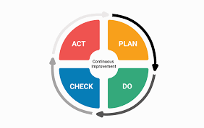
Short cycle supervision

Slide 13
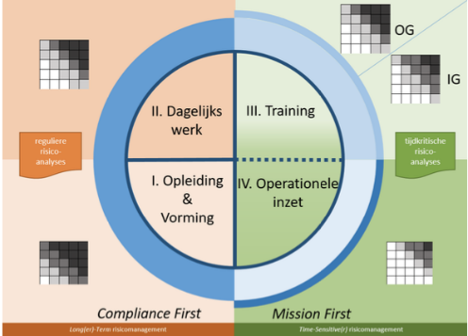
Integrated Risk Management
1. Identify risks
2. Mitigate risks
3. Assess residual risks
4. Accept residual risks:
-depending on context
-on the appropriate level
-communicate them
5. Conduct management of change

Slide 14
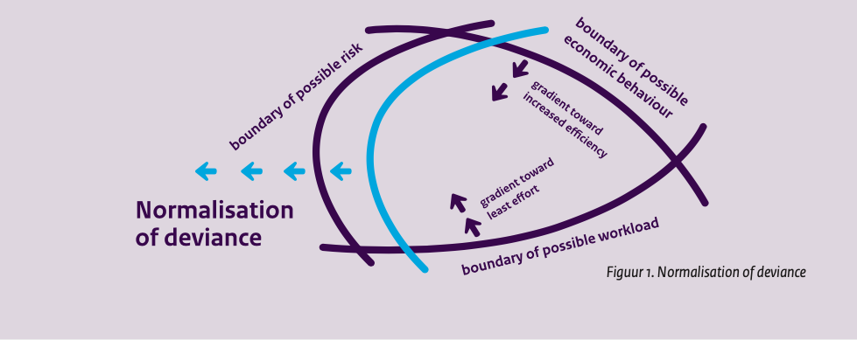
Preventing Normalisation of deviance
Ensure that concrete agreements are made to return to the standard,
or
require acceptance of the deviating boundary.

Slide 15
Safeguarding minimum standards
Which deviation of the standard is justified?
Based on what?

Slide 16
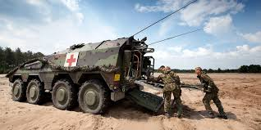
Examples
Training exercise African country
Signals:
time to hospital over 4 hours
no adequate care during transport
food poisoning

Slide 17
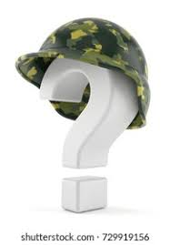
Questions

Slide 18
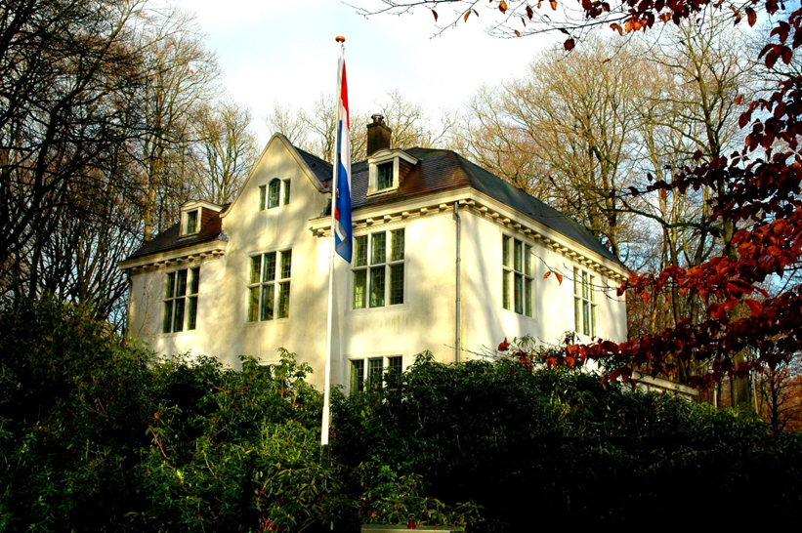
Contact
Landgoed de Zwaluwenberg, Hilversum
Email: %IMG@mindef.nl
Phone: +31 88 9566322

