Slide 1
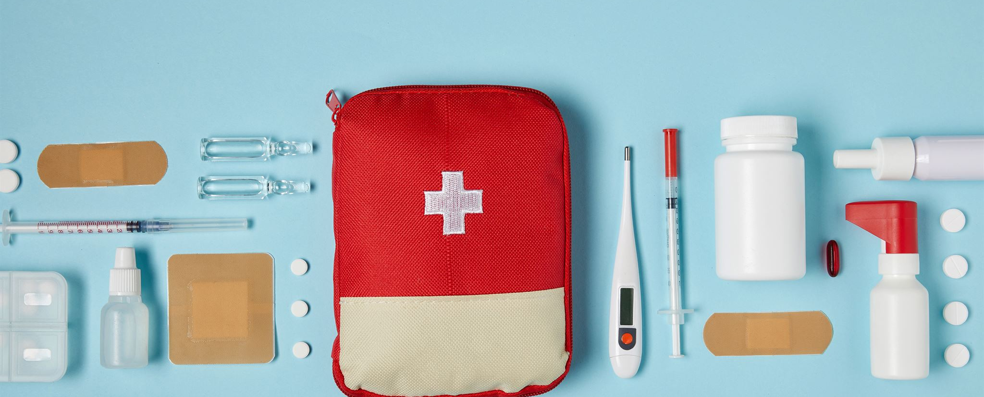
Health Security - preparedness for civil and military crises Challenges for the healthcare and social care sector to be prepared for crises in Latvia.
Challenges for the medicines sector. The role of the State Agency of Medicines (ZVA)
Notes:
---

Slide 2

CRISES Are Always Present, but every each hits diffferently
Resources are always limited and you are never fully prepared.

Slide 3
Strategic Role of ZVA in Crisis Preparedness
Notes:
Introduction, ZVA's Critical and High-Priority Functions

Slide 4

Introduction
ZVA’s Strategic Role
  The State Agency of Medicines plays a critical role in crisis preparedness and health security at national and has its role as a partner on European levels.
Global and European Trends
  The presentation highlights global megatrends and European strategic choices impacting the healthcare regulatory landscape.
Latvian Regulatory Evolution
  Latvia's evolving regulatory framework is examined to understand implications for health security and agency functions.
Presentation Context and Sources
  Insight is drawn from key reports and training materials to provide a comprehensive overview for EPSO conference attendees.
Notes:
This presentation outlines the strategic role of the State Agency of Medicines (ZVA) in crisis preparedness, highlighting global megatrends, European strategic choices, and Latvia's evolving regulatory landscape. It is designed for inspection leaders attending the EPSO Conference in Dublin in September 2025. The presentation draws on insights from the HMA meeting report, the VOMK training presentation, and the ESPAS Global Trends to 2040 report. It aims to provide a comprehensive overview of ZVA’s current functions, its role in national and European health security, and the implications of potential regulatory changes in Latvia. The content is structured to support a detailed and substantive presentation lasting over 25 minutes.

Slide 5

ZVA's Critical and High-Priority Functions
Crisis Coordination and Alert Evaluation
  ZVA participates in national emergency meetings and rapidly evaluates EU health alerts to ensure better supply and safety.
  Continuous IT Services for Medicine Registries
  Maintaining uninterrupted IT systems ensures reliable management of medicine registries during crises.
Pharmaceutical and Medical Device Vigilance
  ZVA oversees vigilance systems for pharmaceuticals, biovigilance, and medical devices to safeguard public health.
Regulatory Roles and Clinical Trial Management
  Issuing licenses, certificates, and managing clinical trial authorizations are key high-priority functions of ZVA.
Notes:
ZVA plays a pivotal role in Latvia’s health system, particularly in ensuring continuity and safety during crises. Its critical functions include participation in national emergency coordination meetings, rapid evaluation of alerts from the EU’s Rapid Alert System, and maintaining uninterrupted IT services for medicine registries. High-priority functions encompass laboratory testing, maintaining data on medicine availability and pricing, issuing licenses and certificates for manufacturers and distributors, and overseeing vigilance systems for pharmaceuticals, biovigilance, and medical devices. ZVA also manages clinical trial authorizations and supervises SoHO structures. These responsibilities position ZVA as a central actor in Latvia’s health crisis response infrastructure.

Slide 6
European Regulatory Insights and Strategic Context
Notes:
Insights from HMA Meeting Report, Global Megatrends and Challenges

Slide 7

Insights from HMA Meeting Report
EMANS 2028 Strategy
  The EMANS 2028 strategy focuses on improving access to medicines, promoting digitalization, and ensuring network sustainability across Europe.
Key Megatrends
  Technological acceleration, demographic changes, and climate change were emphasized as driving forces impacting regulatory strategies.
EU Health Initiatives
  Programs such as EU4Health and the Critical Medicines Act aim to strengthen regulatory capacity and supply chain resilience.
Regulatory Coordination
  The meeting highlighted the need for coordinated enforcement inspections and responses to environmental and health challenges.
Notes:
The HMA meeting in Copenhagen in September 2025 provided critical updates on European regulatory strategies. Key discussions included the EMANS 2028 strategy, which emphasizes access to medicines, digitalization, and network sustainability. The meeting highlighted the importance of megatrends such as technological acceleration, demographic shifts, and climate change. Initiatives like the EU4Health program and the Critical Medicines Act aim to bolster regulatory capacity and supply chain resilience. The meeting also addressed the integration of enforcement inspections and the need for coordinated responses to environmental and health threats. These insights underscore the strategic alignment between ZVA’s national role and broader European objectives.

Slide 8

Global Challenges
Global challenges
  Geopolitical fragmentation, climat emergency and technological convergence
Health Challenges and Opportunities
  Climate change and antimicrobial resistance require strong preparedness, while technology enables innovation in health regulation.
Need for Strategic Foresight
  Anticipatory governance and strategic foresight are essential to navigate complex, uncertain global challenges.
Alignment with Preparedness Efforts
  ZVA’s preparedness must align with these trends to ensure resilience and adaptability against evolving threats.
Notes:
The ESPAS Global Trends to 2040 report identifies ten key megatrends that will shape Europe’s future, including geopolitical fragmentation, economic pressures, demographic shifts, environmental emergencies, and technological convergence. These trends present both challenges and opportunities for health regulators. For example, climate change and antimicrobial resistance demand robust preparedness strategies, while technological advances offer tools for innovation and efficiency. The report emphasizes the need for anticipatory governance and strategic foresight to navigate a complex and uncertain global landscape. ZVA’s preparedness efforts must align with these trends to ensure resilience and adaptability in the face of evolving threats.

Slide 9
Latvia’s Evolving Regulatory Landscape
Notes:
Latvia's Regulatory Evolution, ZVA's Role in Crisis Response

Slide 10

Latvia's Regulatory Evolution
Is it time for centralisation?
  Enforcement inspection functions may move from Health Inspectorate to ZVA, expanding ZVA's role.
Enhanced Crisis Response
  The change enhances ZVA's ability to respond effectively to health crises and emergencies.
Streamlined Oversight
  Consolidation streamlines regulatory processes, improving efficiency and compliance assurance.
Strategic Preparedness
  This evolution strengthens Latvia’s preparedness and resilience against future health challenges.
Notes:
The Latvian Ministry of Health is currently evaluating the transfer of enforcement inspection functions from the Health Inspectorate to ZVA. This potential shift would expand ZVA’s mandate beyond GxP inspections to include enforcement activities, aligning with European trends toward integrated regulatory oversight. Such a change would enhance ZVA’s capacity to respond to crises, ensure compliance, and streamline regulatory processes. It reflects a broader strategic move to consolidate expertise and resources within a single competent authority, thereby improving efficiency and responsiveness in health regulation. This evolution is critical for strengthening Latvia’s preparedness and resilience in the face of future health emergencies.

Slide 11

ZVA's Role in Crisis Response
Inspections
ZVA assesses Good Manufacturing Practice (GMP), Good Distribution Practice (GDP), SoHO, PhV and GCP compliance.
Medicine Availability Coordination
  ZVA works closely with wholesalers to maintain steady medicine supplies during crises, ensuring accessibility. ZVA partners internationally to activate solidarity mechanisms and secure essential medical supplies.
Rapid Alert and Procurement
  ZVA manages rapid alert systems and supports emergency procurement to respond quickly to health needs.
Infrastructure and Continuity
  ZVA oversees critical pharmacy infrastructure and ensures care continuity with regulatory flexibility during emergencies.
Notes:
ZVA is central to Latvia’s crisis response framework. It coordinates with wholesalers to ensure medicine availability, manages rapid alert systems, and supports emergency procurement strategies. During crises, ZVA facilitates the redistribution of medicine stocks, oversees critical infrastructure in pharmacies, and ensures continuity of care through regulatory flexibility. It also collaborates with international partners to activate solidarity mechanisms and secure essential supplies. These actions demonstrate ZVA’s proactive approach to crisis management, emphasizing preparedness, coordination, and adaptability. By integrating enforcement functions and aligning with European strategies, ZVA can further enhance its role in safeguarding public health during emergencies.

Slide 12
Strategic Outlook and Conclusion
Notes:
Strategic Choices for Europe, Conclusion

Slide 13

Strategic Choices for Europe
Geopolitical Balance
  Europe aims to balance autonomy with cooperation in geopolitics to address future challenges effectively.
Sustainable Economy
  Adapting economic models for sustainability and ensuring equitable green transitions are key strategic priorities.
Technology and Regulation
  Regulating emerging technologies while enhancing digital infrastructure and regulatory agility is essential.
Social Solidarity and Trust
  Reinforcing social solidarity and fostering public trust supports resilience and inclusiveness across Europe.
Notes:
Europe faces critical strategic choices in the coming decades, as outlined in the ESPAS report. These include balancing autonomy and cooperation in geopolitics, ensuring equitable green transitions, adapting economic models for sustainability, regulating emerging technologies, and reinforcing social solidarity. For health regulators like ZVA, these choices translate into operational priorities: investing in digital infrastructure, enhancing regulatory agility, and fostering public trust. The EU’s emphasis on resilience, innovation, and inclusiveness provides a framework for national agencies to align their strategies. ZVA must navigate these choices to remain effective and responsive in a rapidly changing global environment.

Slide 14
Conclusion
Strategic Positioning
EUROPE IS IMPORTANT, but we have to do our homework first
For the best interest of patients and the healthies population ZVA is positioned to strengthen Latvia’s resilience during health crises through strategic foresight and innovation.
European Alignment
Rigorous Joint Assessment Procedure (JAP) and Mutual Recognition Procedure (MRP) standards.
Future Preparedness
Investment in regulatory capacity and anticipatory governance ensures Latvia’s readiness for future health emergencies.
Capacity building remains a key challenge, requiring strategic investment in inspectorate resources.
Networking: EPSO, HMA PIC/S and joint training programs enhances harmonization and inspector competence.
Strengthening inspection capabilities is essential for maintaining high regulatory standards.
Ensuring consistency across Member States demands advanced regulatory alignment.
These requirements place significant demands on ZVA’s operational capacity and expertise
High-quality documentation and robust coordination mechanisms are critical.
Aligning with European foresight and megatrends enables ZVA to lead in regulatory innovation and preparedness.
Notes:
ZVA is strategically positioned to enhance Latvia’s resilience in health crises. By aligning with European foresight and megatrends, ZVA can lead in regulatory innovation and preparedness. The agency’s expanding mandate, proactive crisis response, and integration into European networks underscore its importance in safeguarding public health. As global challenges intensify, ZVA’s role will become increasingly vital. This presentation calls for continued investment in regulatory capacity, strategic alignment with EU initiatives, and a commitment to anticipatory governance. Through these efforts, ZVA can ensure that Latvia remains prepared, responsive, and resilient in the face of future health emergencies.

Slide 15

Contacts
State Agency of Medicines of Latvia
Jersikas street 15, Riga, LV-1003, Latvia
Phones: (+371) 67078424, (+371) 29447659
info@zva.gov.lv
Deputy Director in Pharmaceutics, Sergejs Akuličs
Sergejs.Akulics@zva.gov.lv
Head of Department of Information on Medicines Distribution, Katrīna Lukša
Katrina.Luksa@zva.gov.lv
https://www.zva.gov.lv

