Slide 1
Healthcare in armed conflicts
Challenges and new approaches
Andras ARMVÄÄRT, MPH
Head of Health Emergency Preparedness Department
Dublin, 25 Sept 2025

Slide 2
Health Board as lead authority in public health emergencies
Health care crisis structure, including 24/7 crisis call center - threat monitoring
Emergency risk analysis and response plan - the logic of emergency response
Participating agency in other agencies’ response plans - every crisis is a healthcare crisis
Coordinating vital service providers risk assessments and continuity plans - ensuring healthcare service resilience
Preparing health care for national defense - civil-military cooperation
Organizing cross-border medical humanitarian aid – a capable provider and receiver of humanitarian aid

Slide 3

NATIONAL DEFENSE IN HEALTH CARE
Prepare for the long run: plans for 180+ days
In today’s war, healthcare is a strategic target
Cyber ​​threats - aim to destroy not disrupt
It is not possible to guarantee support in the occupied area
Supply and logistics to hospitals –
  Israeli war on Palestina experience - 1 month supply consumed in 1 day
Notes:
Tervishoiuvarud:
ETO varud ca 7-14p (erinevad suuresti teatud artiklite lõikes)
Apteek ja hulgid 1+1 kuu
RTV ca 20p
EVK delegeeritud varud elanikkonnale
ERCC (civ) ja ERDCC (mil-civ) – rahvusvaheline abi

Slide 4
Civ-mil cooperation - preparing together
Civilian hospitals for all patients (green or not)
  Defence Forces and NATO rely on civ hospitals from Role 3
Trainings (MIMMS, HMIMMS, TEKE)
Exercises (Decisive Lancer, NATO Vigorous Warrior)
Reciprocal help
(strategic) evacuation
  regionally and internationally
Stockpiles (MASCAL trauma, CBRN)
Shelters in civ hospitals

Slide 5
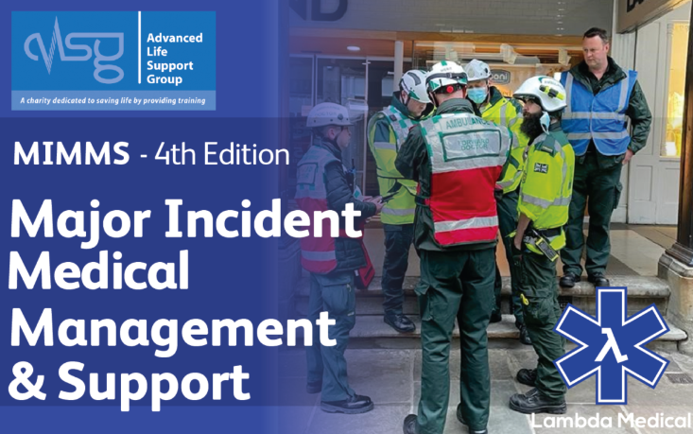

Slide 6
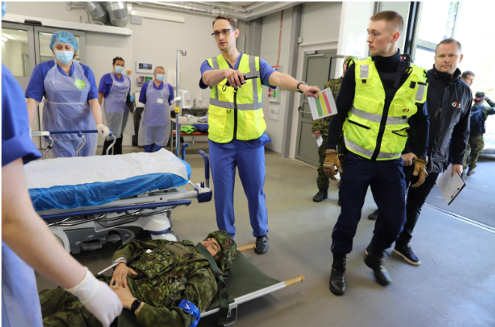

Slide 7
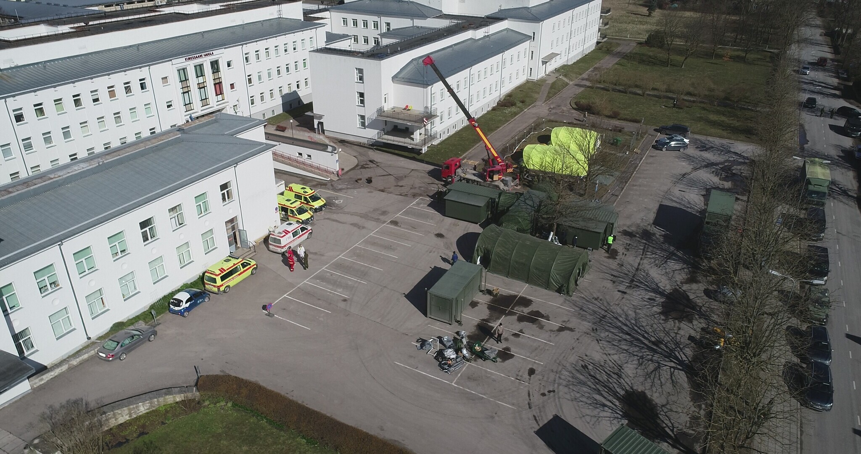

Slide 8
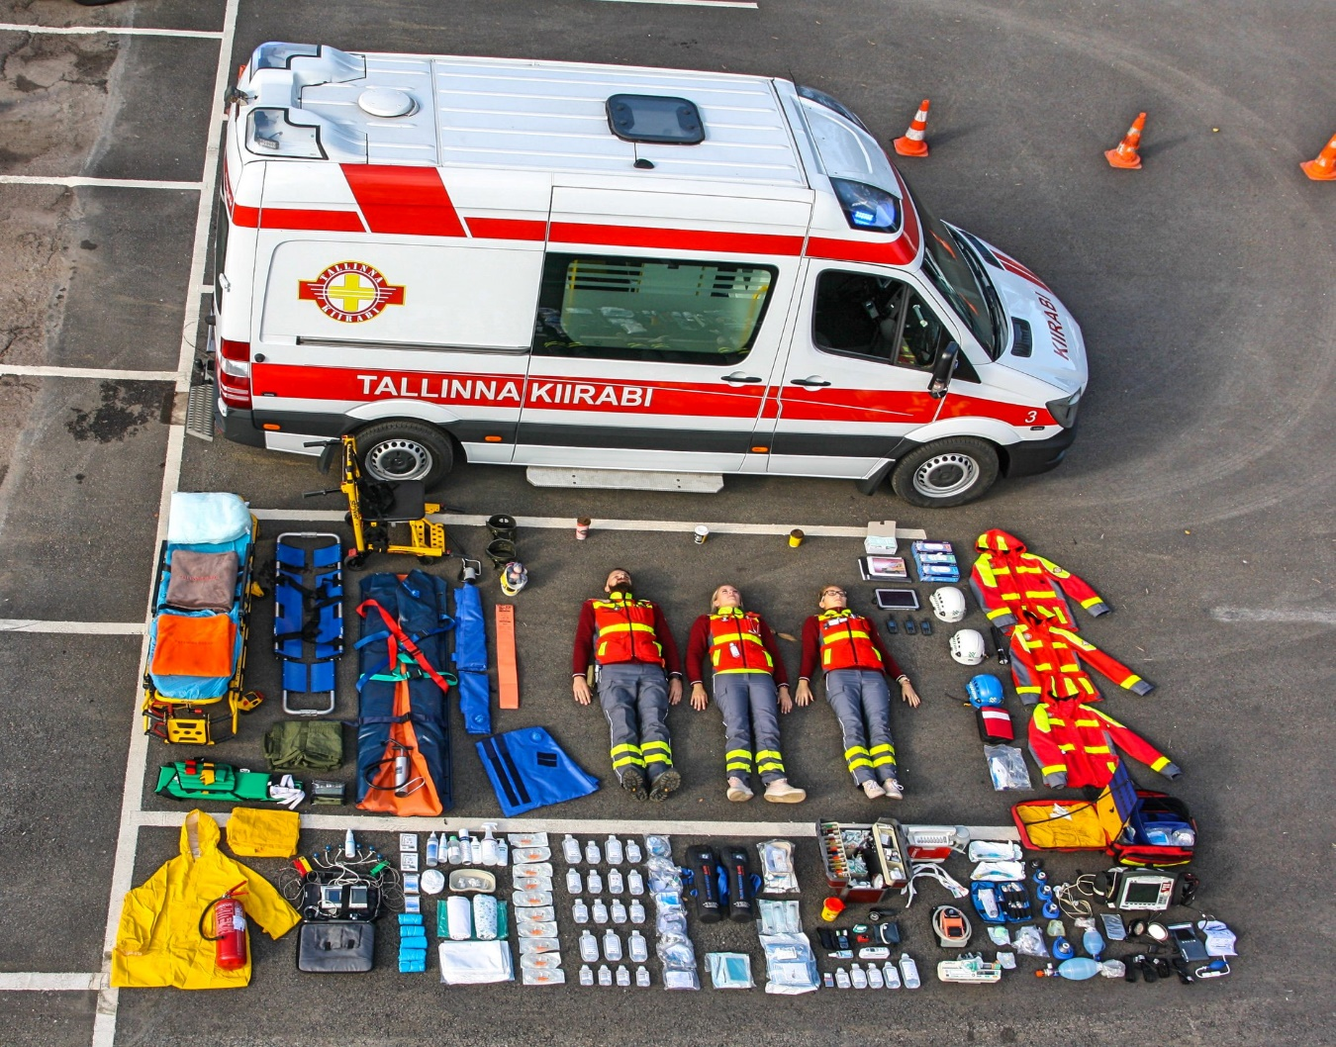
EVERY CRISIS IS A HEALTHCARE CRISIS!
Andras Armväärt andras.armvaart@terviseamet.ee

