Slide 1



ENHANCING REGULATORY AND ENFORCEMENT STRATEGY WITH TRUST
Presented by:
Ms Letizia Marmara’
Quality Assurance Director
AGEING STRONGLY
TOGETHER

Slide 2


QUALITY ASSURANCE FRAMEWORK
Strategic Foundations
Regulatory Framework Design
Enforcement Strategy
Monitoring and Compliance
Governance and Improvement

Slide 3
STRATEGY FOUNDATION –
QUALITY ASSURANCE DIRECTORATE
Ensure Quality and Compliance
Develop and Strengthen Regulatory Standards
Foster Stakeholder Engagement and Collaboration
Promote Evidence-Informed and Continuous Improvement

Slide 4
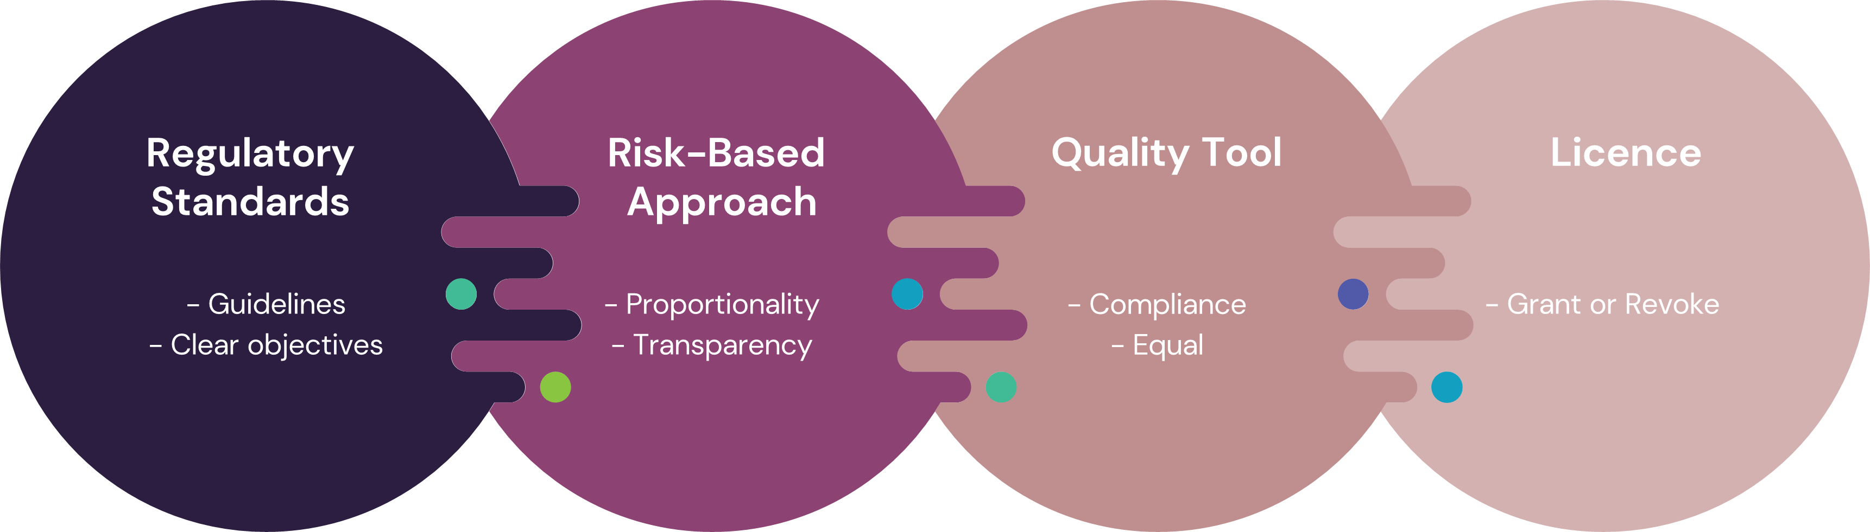
REGULATORY FRAMEWORK DESIGN

Slide 5
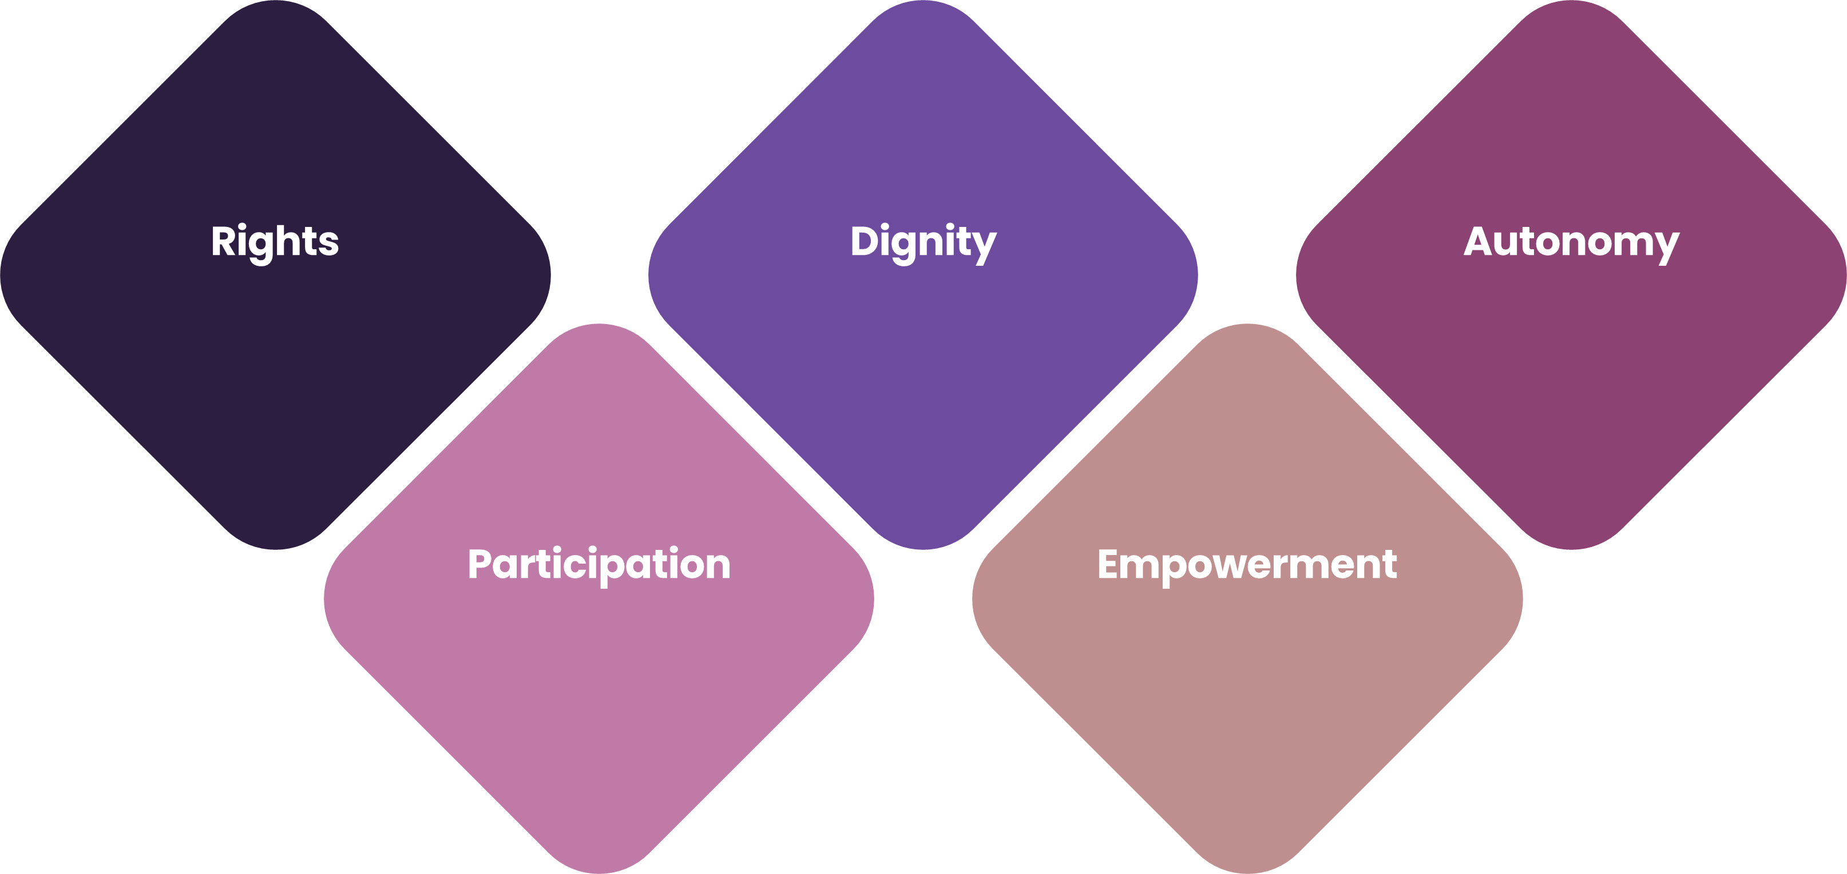
FOUNDATION OF THE REGULATORY STANDARDS

Slide 6
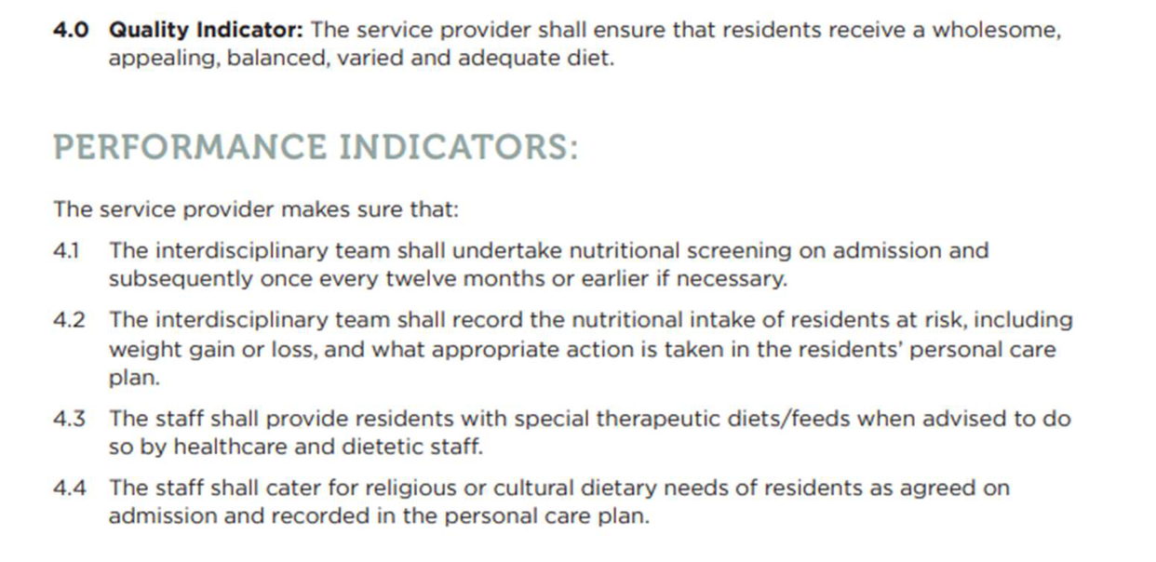
REGULATORY STANDARDS

Slide 7
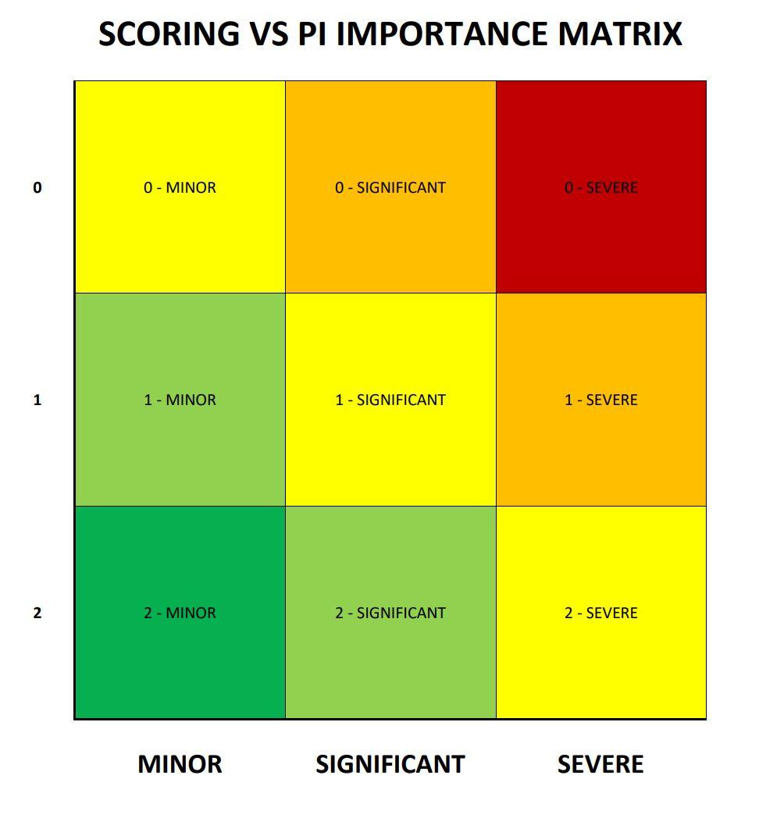
RISK-BASED MATRIX

Slide 8
RISK-BASED APPROACH
Standard Number | Quality Indicator | Performance Indicator | Pilar | Matrix
1 | 1 | 6 | Management | Significant
1 | 2 | 6 | Management | Minor
1 | 2 | 13 | Management | Severe

Slide 9
RISK-BASED APPROACH

Slide 10
RISK-BASED APPROACH

Slide 11
STAKEHOLDER ENGAGEMENT
Post-Licensing Meeting
Collaborative Platforms
Focus Groups
Public Consultation

Slide 12
MONITORING AND COMPLIANCE
Data Analysis
Constant Monitoring and Follow-up Visits
Proactive Assessment
Investigations

Slide 13
ENFORCEMENT STRATEGY
Penalties
Administrative Sanctions
Warning & Corrective Action
Education & Guidance

Slide 14
GOVERNANCE AND IMPROVEMENT
GOVERNANCE:
Clear Roles
Decision-Making protocols
Appeals and reviews
Staff Training
Technology Enhancement
Collaboration with other Regulatory Bodies (Local and International)

Slide 15
GOVERNANCE AND IMPROVEMENT
CONTINUOUS IMPROVEMENT:
Ensuring compliance with processes and auditing tools
Analysis of the performance of service providers
Review of Regulatory Standards
Meeting with service provider
Empowering and engaging service users
Involving service users’ relatives

Slide 16
KEY FACTORS
Clarity of Purpose
Balanced Approach
Strengthen Governance and Accountability
Continuous Improvement

Slide 17
PROMOTING TRUST THROUGH THE
WELL-BEING AND OUTREACH OFFICE
Presented by:
Ms Christine Sammut
Manager - Well-Being and Outreach Office
AGEING STRONGLY
TOGETHER

Slide 18
PURPOSE OF THE UNIT
Hard Approach
Enforcement
Regulatory Compliance
Administrative Penalties
Soft Approach
Collaboration
Support
Holistic Care
Smart Approach
Effective
Efficient

Slide 19
Visits in Care Homes
Building trust through open conversations with residents, staff and relatives
Collaborate with management to identify solutions
Frequent and extended visits (including evenings and weekends)
Carrying out visits independently
Taking a preventive approach
KEY RESPONSIBILITIES

Slide 20
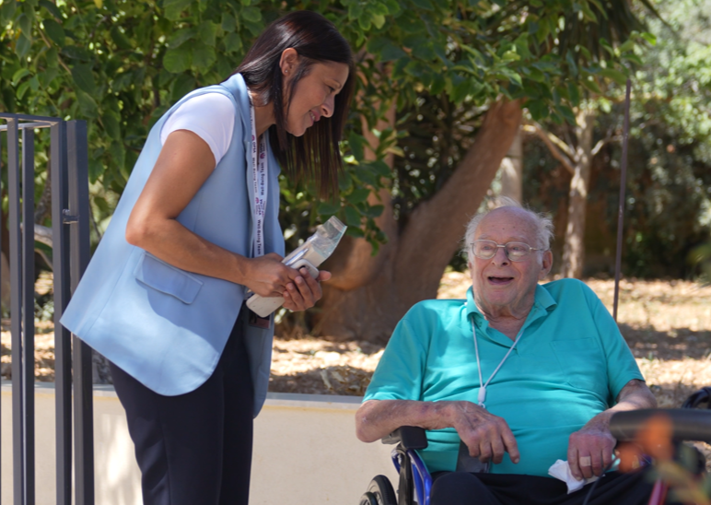
Data Collection
Identifying areas for improvement to maintain or raise standards of care
Ensuring that suggestions are evidence-based
Well-Being Tool:
        Environmental Well-Being
        Support with Daily Activities
        Emotional and Psychological Well-Being
        Social Well-Being
KEY RESPONSIBILITIES

Slide 21
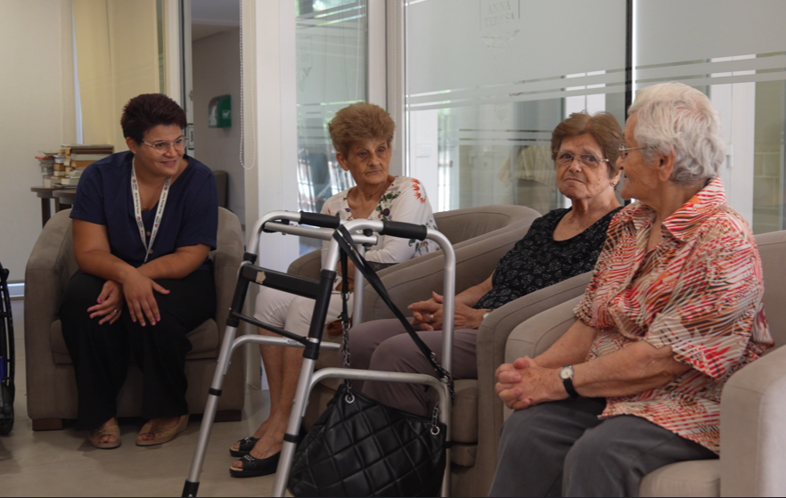
Group Sessions - Memories from the Past
Reliving memories
Mental stimulation
Supports residents with dementia
Social connection
Empathy and understanding
KEY RESPONSIBILITIES

Slide 22
Information Sessions
Based on feedback and data collected
Cover various topics
Designed for different audiences
Aim to teach and provide practical support
KEY RESPONSIBILITIES

Slide 23

An Introduction to Maltese Culture in Residential Care Homes
Understanding how local culture improves residents’ well-being
    Traditions, values and daily routines
    Religious influence
    Celebrations and cultural events
    The Maltese language
    Daily practices

Slide 24
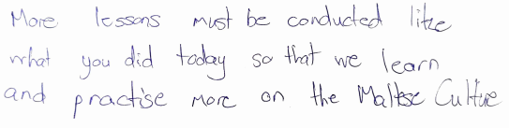










Feedback & Suggestions

Slide 25
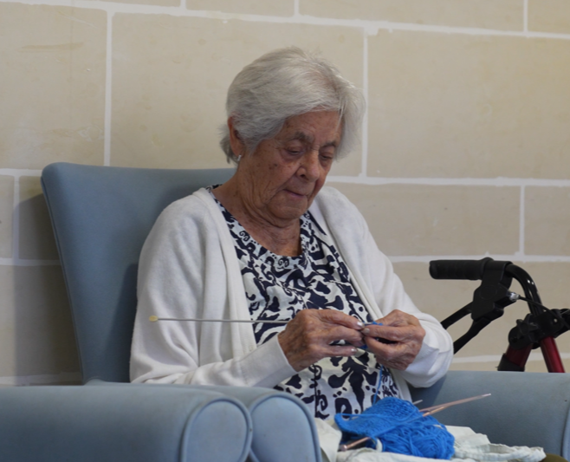
Outreach
Collaborative Platforms
Insights and Innovations Forums
Bridging Care Forum
Talenti B’Għożża
External Stakeholders
KEY RESPONSIBILITIES

Slide 26


Feedback & Suggestions

Slide 27
THANK YOU
Free Phone: +356 8000 2002
Email: externalrelations.opsa@gov.mt
Facebook: https://www.facebook.com/opsamt
Instagram: https://www.instagram.com/opsa_malta/
Address: OPSA, The Exchange, It-Telgħa Ta’ Spencer, Il- Marsa MRS 1982

