Slide 1


Environmentally Sustainable Healthcare
^{EPSO Meeting September 2025}
Notes:
Steven Hunt, Manager for Environmentally Sustainable Healthcare, Northern NSW Health District, sharing preparedness practices with European Partnership for Supervisory Organisations.

Slide 2
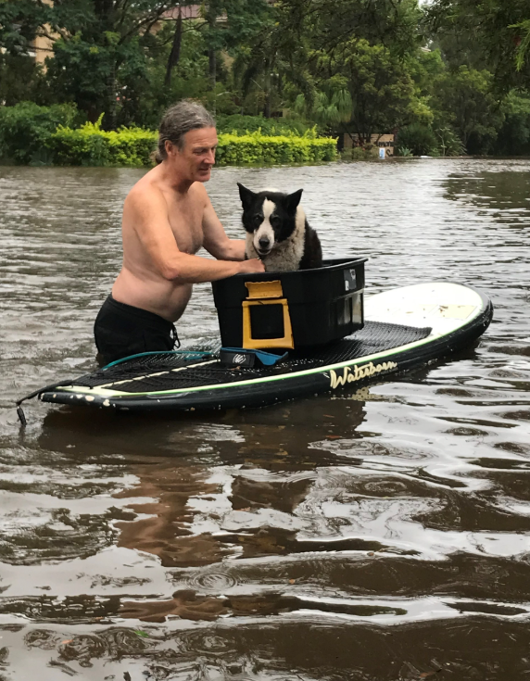
Creating a Sustainable Future Together :
Climate Change Preparedness at
Northern New South Wales Local Health District
An Australian Experience
A Cancer Care staff member's 16-year-old dog, Tiki, being evacuated during floods
Notes:
Three themes: Climate Reality & Health System Impacts, Strategic Response & Collaborative Solutions, and Learning, Adaptation & Future Action.

Slide 3

Acknowledgement of Country
Artwork by Jason King: Aboriginal Community Health and Wellbeing
Northern NSW Local Health District
Notes:
Acknowledgement of Widjabul Wia-bal Country and Traditional Custodians, respecting Aboriginal and Torres Strait Islander Ancestors and Elders.

Slide 4
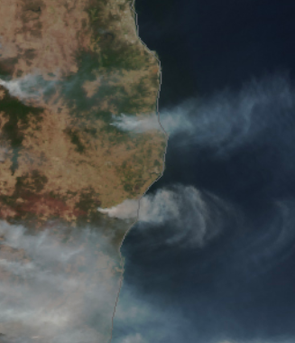
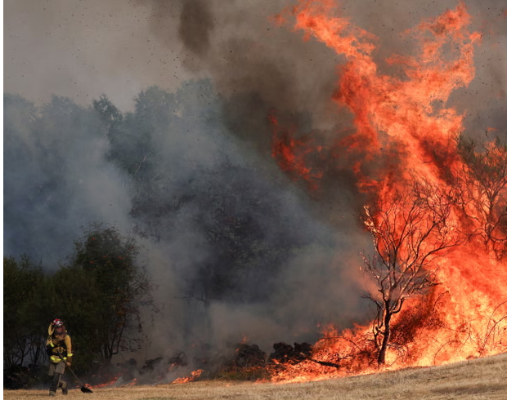
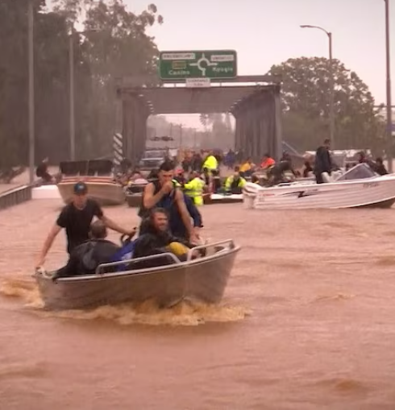
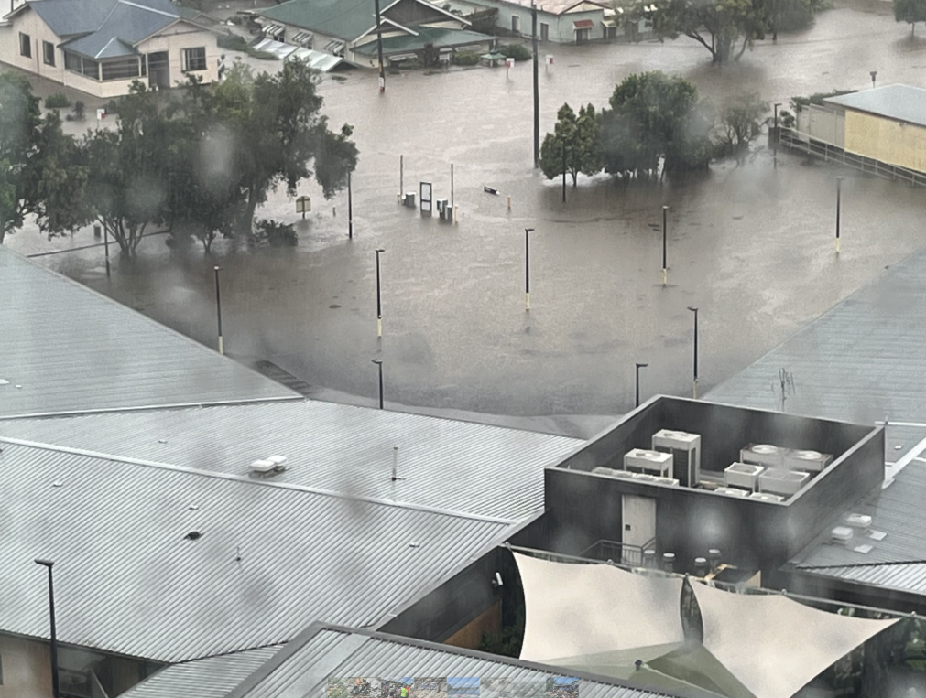
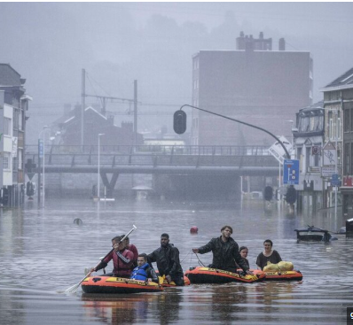
Northern NSW, Australia 2019
Parafita, Galicia region, Spain 2025
Global Imperatives
&
Our Local Reality’s
Lismore NSW 2022
Liege, Belgium 2021
Notes:
Northern NSW faced 29 declared natural disasters since mid-2018 as extreme weather events become the new normal globally.

Slide 5
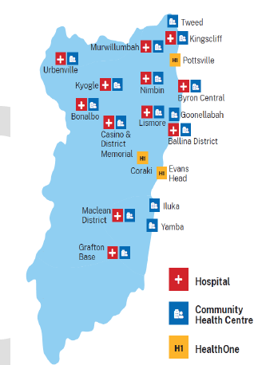
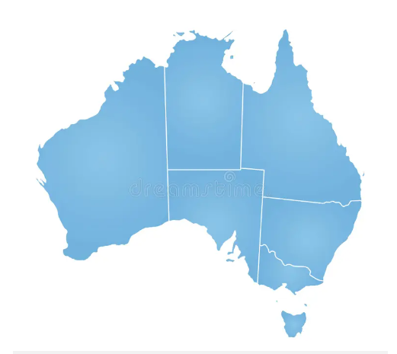
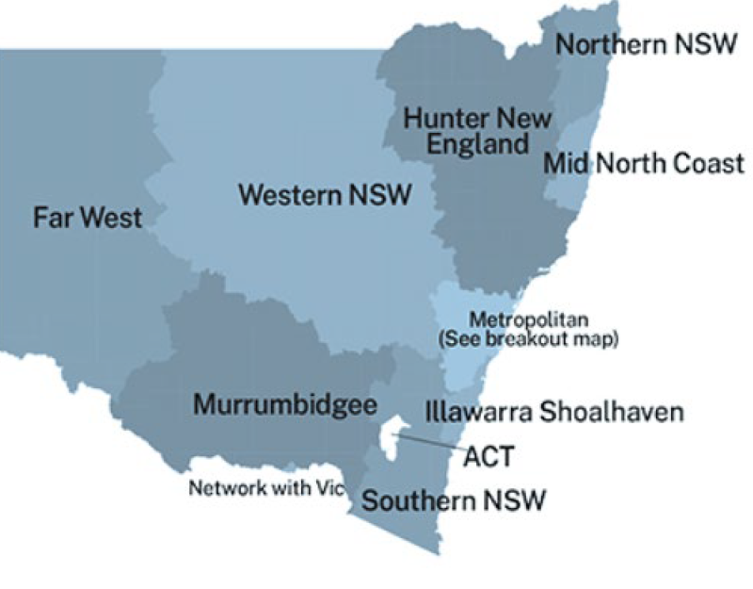
The District delivers a broad range of health services in state-of-the-art facilities
The geographical area serviced is about the same size as Wales
Northern New South Wales Local Health District
Notes:
Northern NSW Local Health District serves over 300,000 residents across 20,732 square kilometres

Slide 6
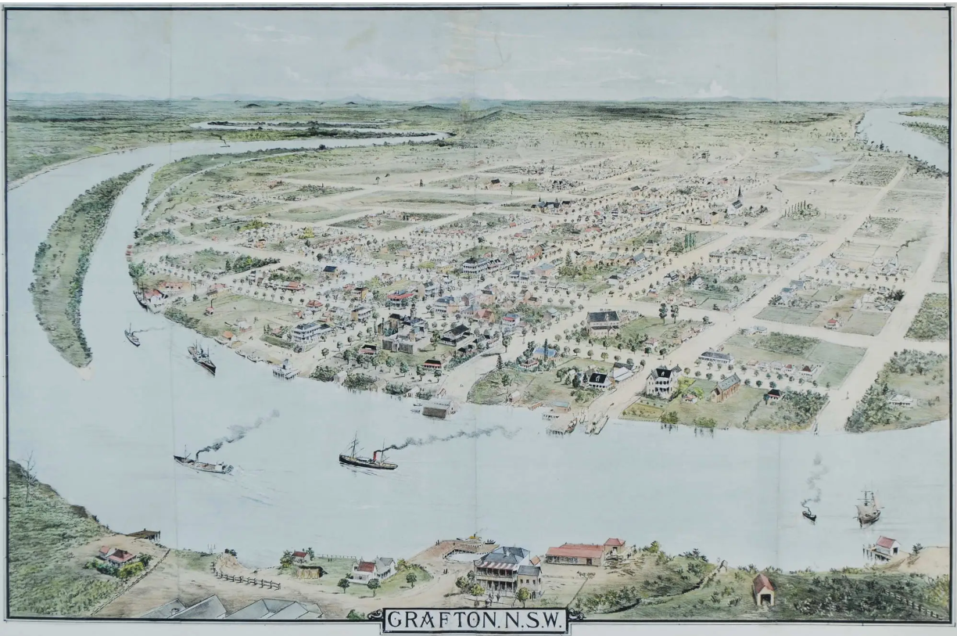
Grafton, NSW
This bird’s-eye view of Grafton was originally published in The Illustrated Sydney News, 31 May 1888.
Notes:
Major towns of Lismore and Grafton were established along the rivers, long before roads connected the region

Slide 7
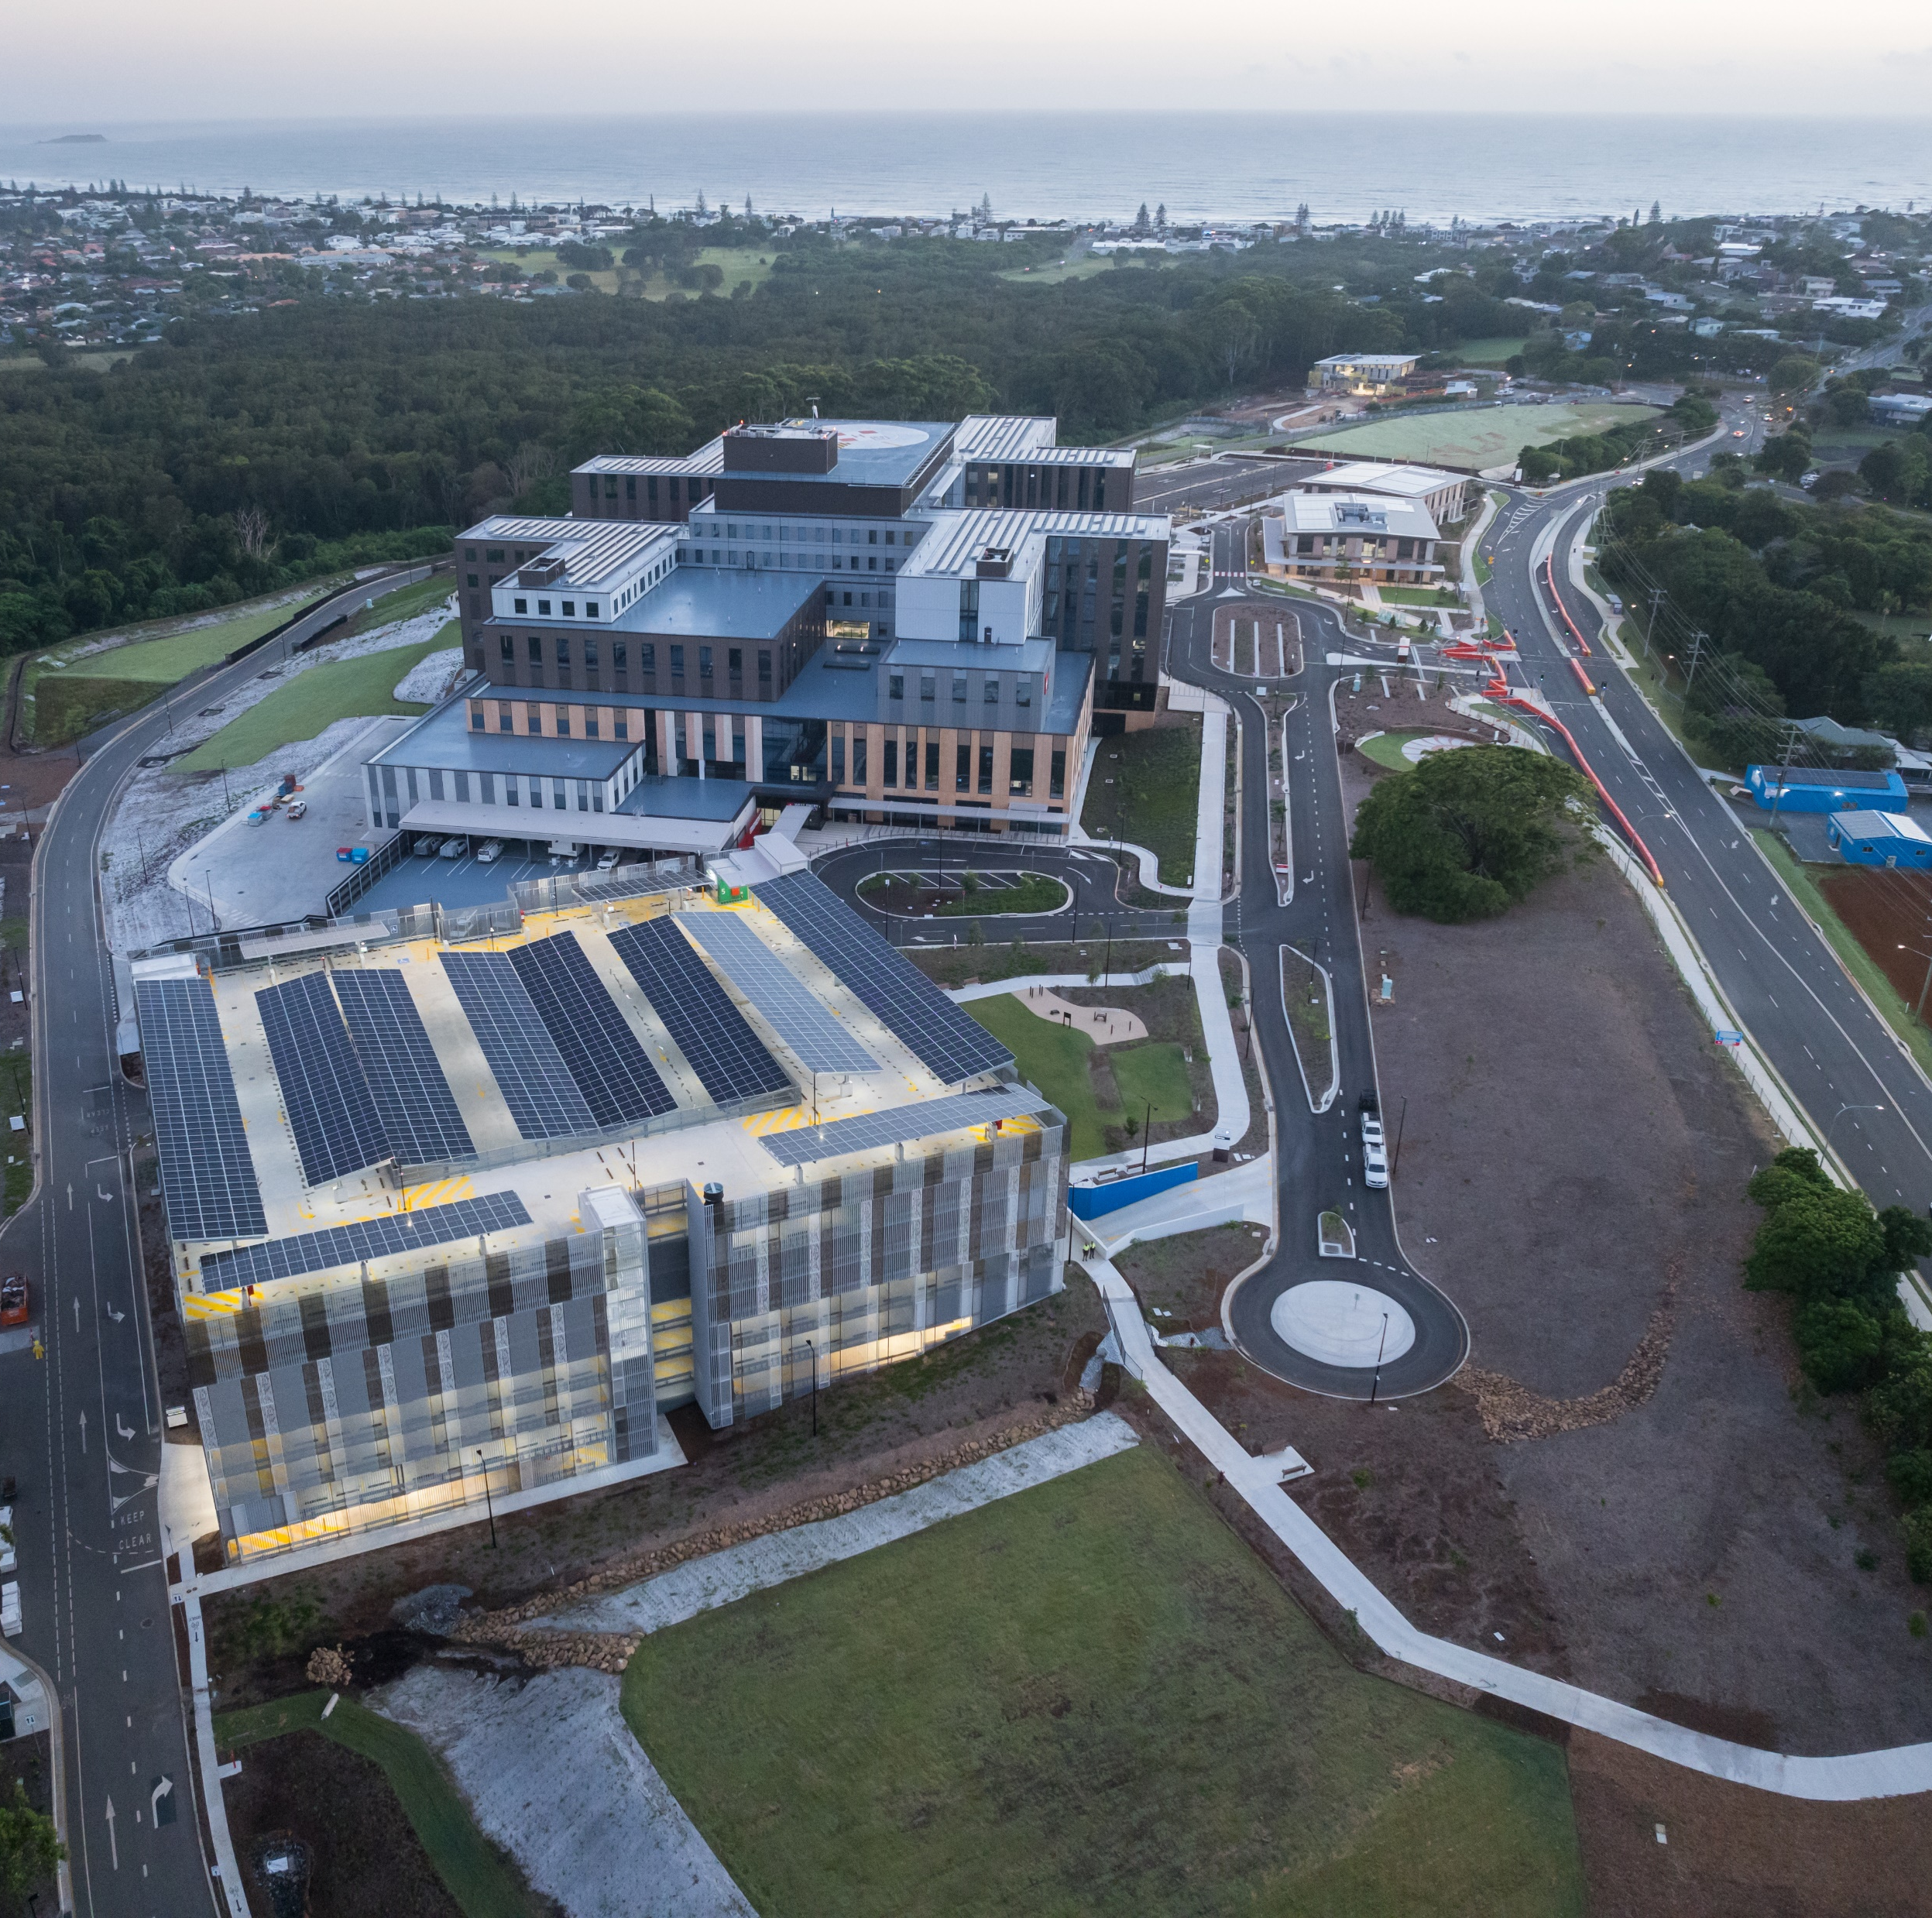
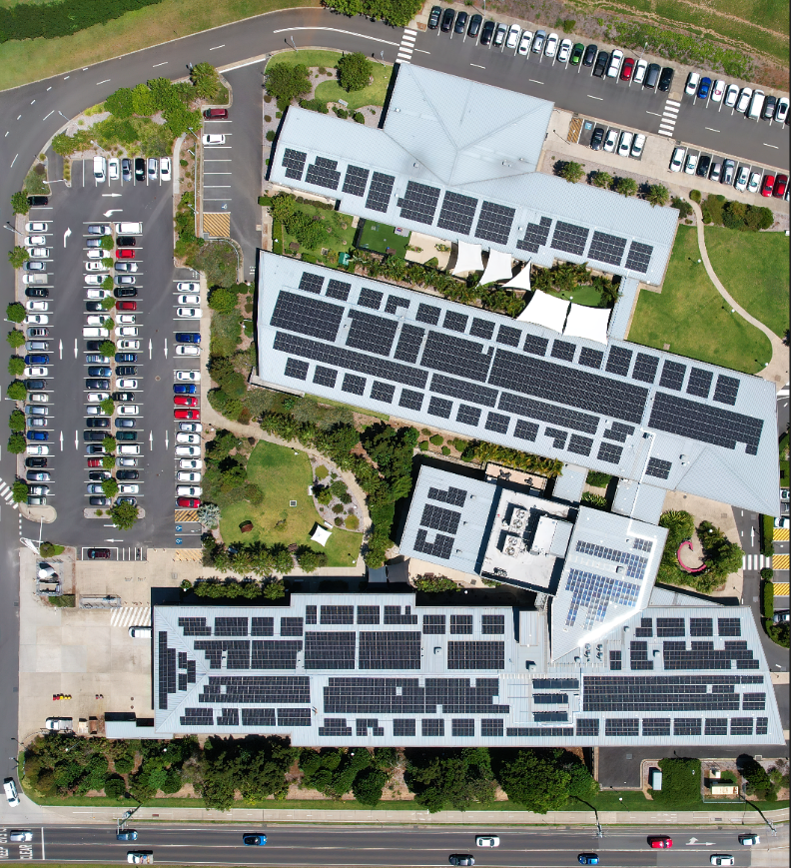
Tweed Valley Hospital Byron Central Hospital
Notes:
Northern NSW Local Health District delivers comprehensive healthcare from state-of-the-art facilities like the new Tweed Valley Hospital to community health programmes reaching remote communities

Slide 8
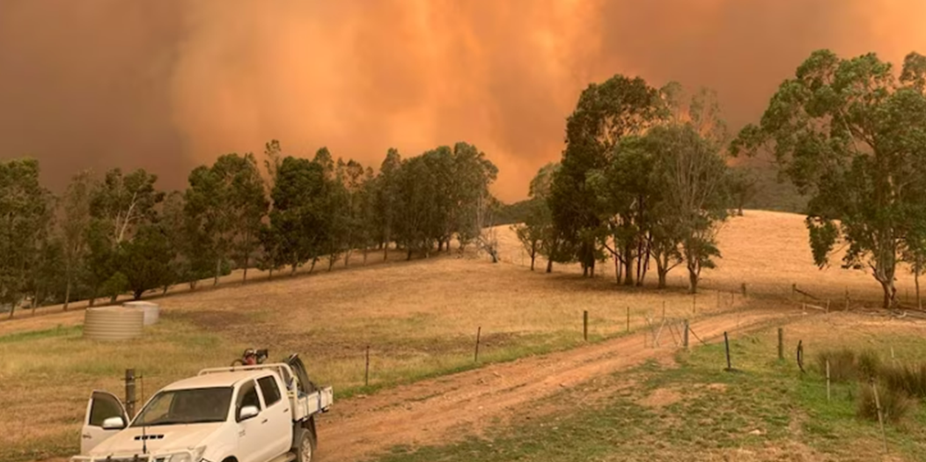
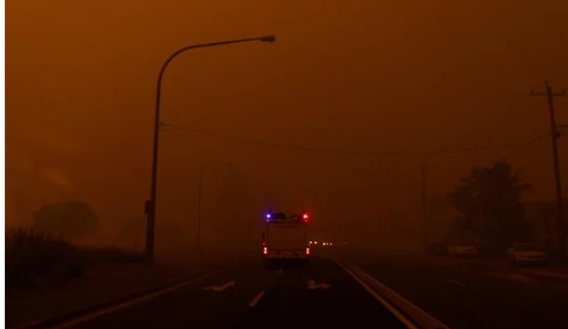
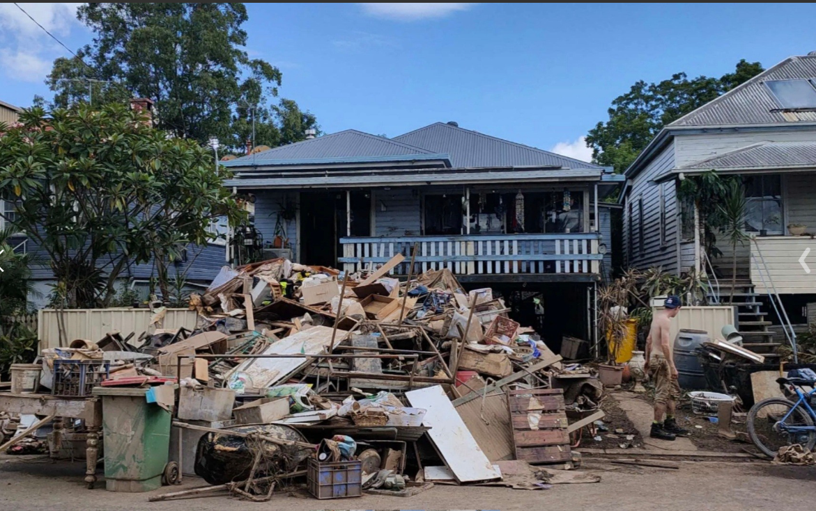
Lismore Base Hospital, Mental Health Carpark 2022
Notes:
Faced driest conditions in 120 years (2017-2019), bushfires disrupting hospital operations, and record-breaking 775mm rainfall floods in 2022.

Slide 9
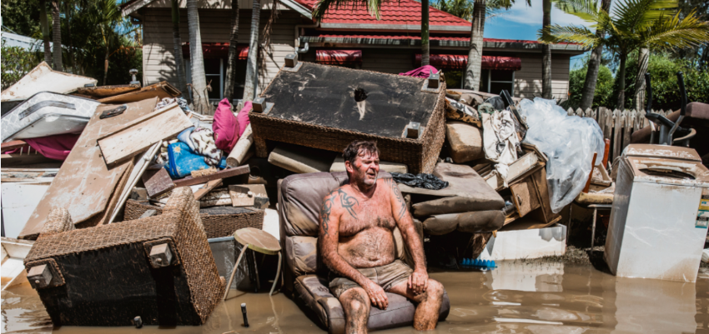
View from Lismore Base Hospital ICU 2022
Lismore artist Natalie Grono photo entitled 'Peter takes a moment’.
This photo won the Nikon-Walkley Photo of the Year Award in 2022
Notes:
Activated emergency protocols, evacuated Ballina District Hospital, ran generators for power, with staff sleeping on-site during disasters.

Slide 10
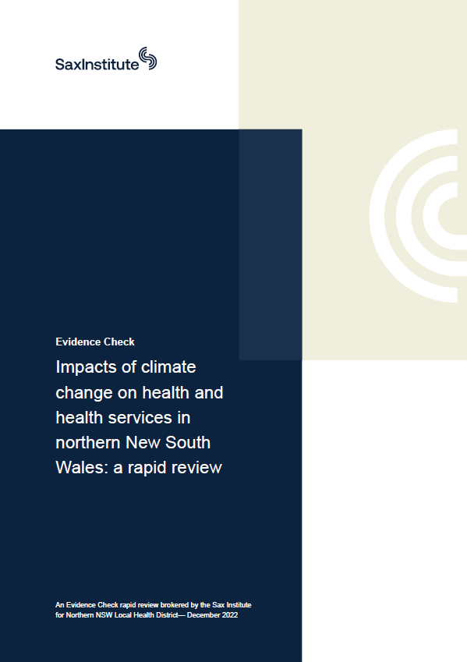

Major Challenges from Climate Change
Northern NSW Local Health District
- More heat-related illnesses, especially in elderly and vulnerable groups
- Increased mental health issues from floods, droughts, and displacement
- Worsening respiratory & cardiac conditions due to bushfire smoke/allergens
- Surge in vector-borne diseases (e.g. Ross River virus) after rain events
- Higher risk of food-, water-, and zoonotic diseases (e.g. Q fever)
- Increased demand on emergency, ambulance, and hospital services
- Disruption to healthcare access during extreme weather events
- Marginalised communities face greater exposure and reduced access to care
- Health workforce under pressure—burnout, displacement, service gaps
- Need for system-wide planning, surge capacity, and climate resilience
Notes:
Partnered with researchers analyzing 90 peer-reviewed studies confirming climate change drives increased health risks for vulnerable populations.

Slide 11
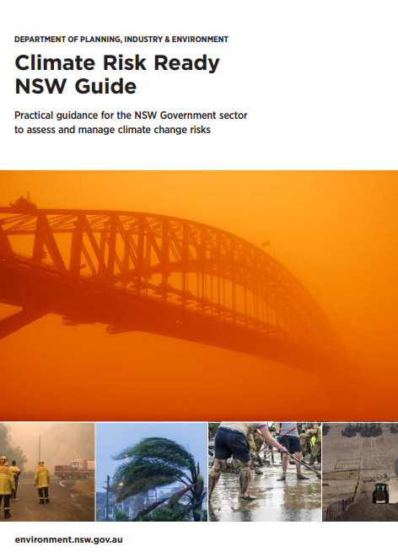
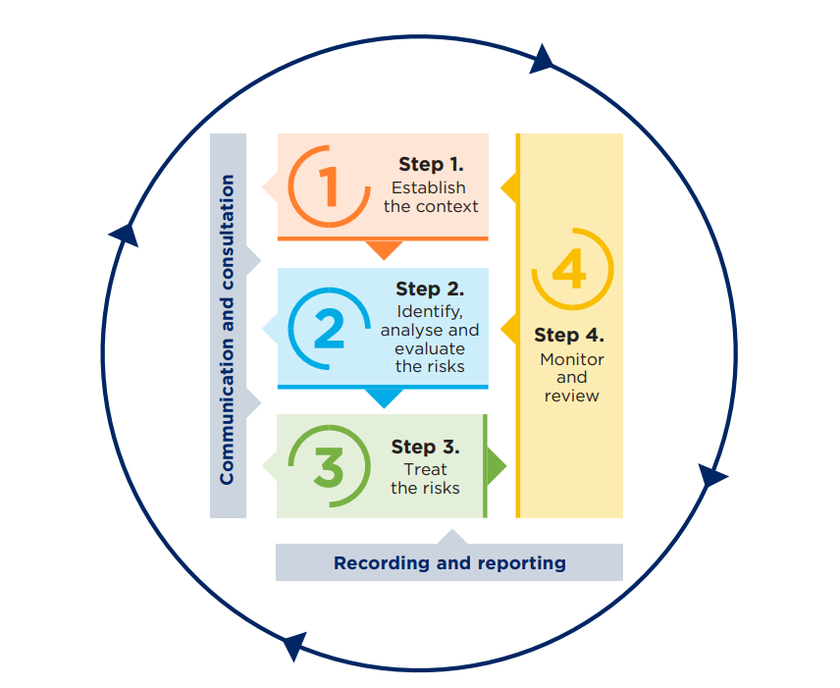
Notes:
Conducted enterprise-level climate risk assessment using NSW Climate Risk Ready Guide methodology across 2030, 2050, and 2070 timeframes.

Slide 12
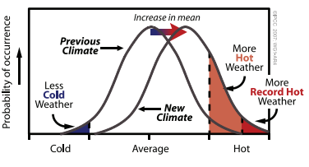
the new normal
Notes:
Climate distribution shifting toward extremes - what used to be rare "hot weather" is now average, requiring new risk planning.

Slide 13
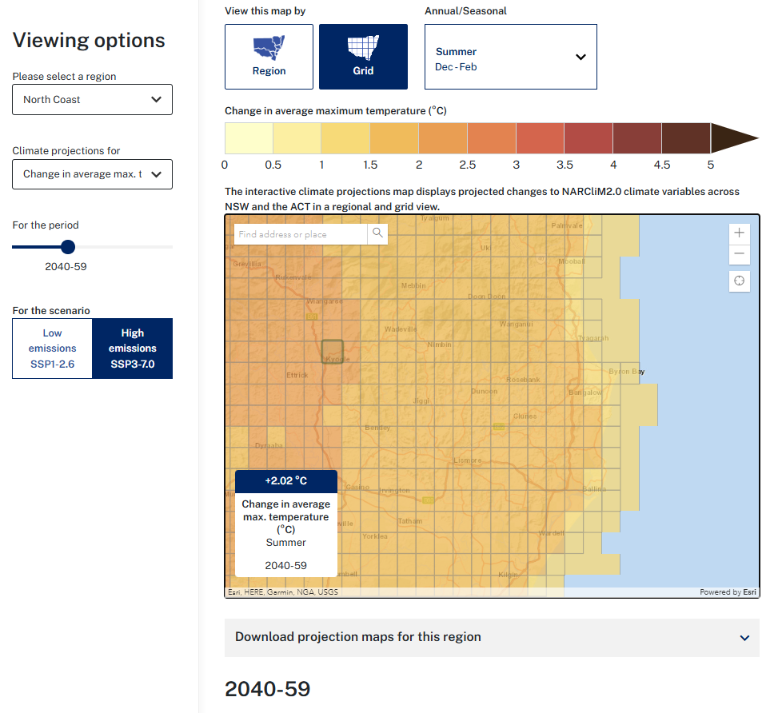
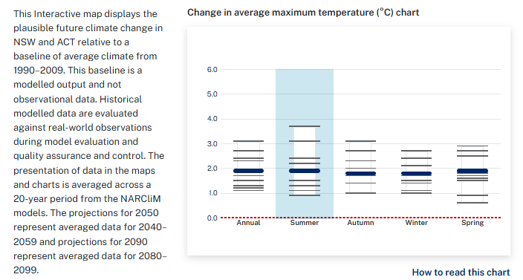
data driven decision making
Notes:
Utilised NARCliM2.0 climate modeling with 4km grid resolution, processing 3,000 years of simulations over 235 million CPU hours.

Slide 14
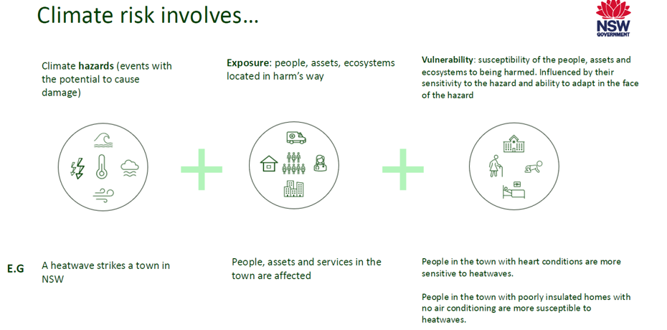
Developing Climate Risk Statements
End
Notes:
Brought together service directors, risk managers, and staff in collaborative workshops to share crisis experiences and identify system vulnerabilities.

Slide 15
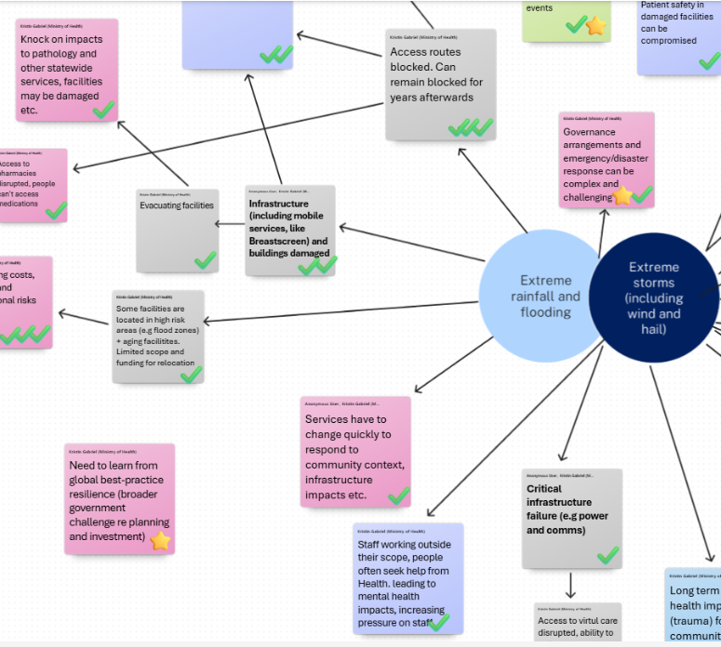
Climate impact mapping with staff
-scenario planning for climate preparedness,
-developing risk statements to inform adaptation plans
End
Notes:
Cross-departmental mapping sessions generated 24 enterprise-level climate risk statements, transforming individual experiences into organisational knowledge.

Slide 16
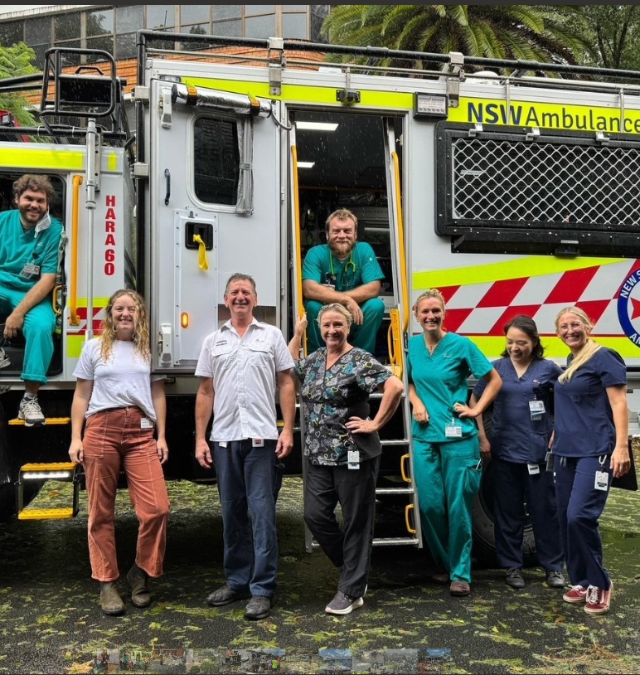
Climate Reality Check: Four Essential Insights
Break Down the Silos
”Climate change doesn't respect organisational silos and neither should your response.”
Your mapping is only as strong as your weakest connection.
Your Risk Lives Next Door
“The flood that hits our neighbour's supply chain becomes your crisis tomorrow.”
Local mapping, global thinking.
Yesterday's Data, Tomorrow's Disaster
Climate change is a risk modifier, the climate of 2019 isn't the climate of 2035 – are your adaptation plans keeping up?
Static plans for a dynamic planet are plans to fail.
Front-Line Wisdom Beats Satellite Data
Your staff lived through the last flood, drought, and heatwave – why aren't they mapping the next one?“
Local experience plus decision-making power equals real preparedness.

Slide 17
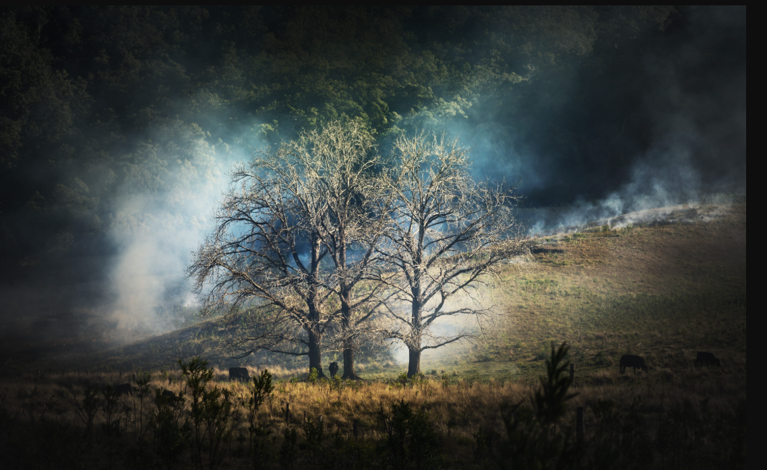
The best time to plant a tree was 20 years ago. The second-best time is now
END
Questions?
Steven.Hunt1@health.nsw.gov.au
Notes:
Northern NSW represents one meaningful part of global climate resilience efforts - invitation for discussion and questions.

