Slide 1


Developing standards for supervision in healthcare networks
EPSO conference 2025
Marloes Berkelaar
Sander Merkus,
Annemarie Koopman
Sandra Dahmen
Mirella Minkman
vilans.nl

Slide 2

Marloes Berkelaar
Nice to meet you
Consultant strategy and collaboration long term care at Vilans

Slide 3


Slide 4


Slide 5
Supervision in healthcare networks

Slide 6
Responsibilities of Supervisory Boards in NL
Employer of the Executive Board
Supervision on governance
Advisor to the executive board
Guardian of proper dialogue
The supervisory board is explicitly non-executive

Slide 7
Main challenges of Dutch Healthcare
Aging population & - workforce
Persistent labour market shortage
Increase in demand because of aging
Innovation, Adaptation & Implementation
Sustainability & European regulation
Geopolitical developments
Social challenges: Individual debts & Loneliness

Slide 8
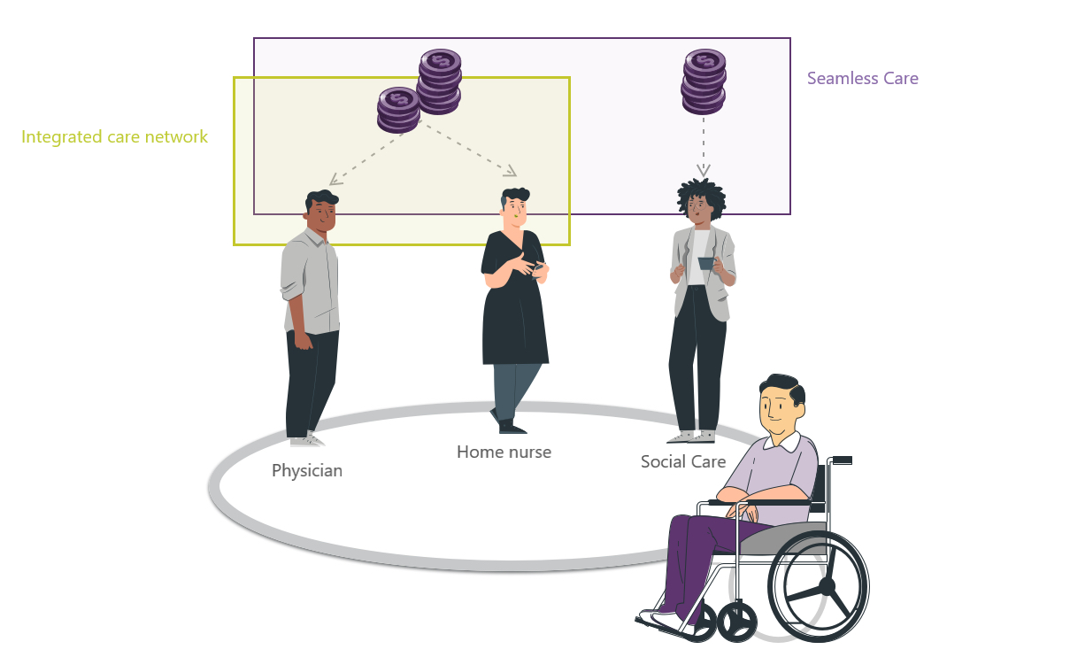


Slide 9
Supervisory Boards of the Future
Let social responsibility prevail over financial interests
Challenge the executive board with fundamental questions about the strategic way forward
Don’t focus on growth; focus on the needs of the environment of the institution

Slide 10
"Several members of our partnership have to go to the supervisory board for approval. This causes significant delays."
Practice statements
We're considering whether we want our own supervisory board for our network collaboration, or whether we should ask supervisors from network members to share their thoughts with us.
"As a director, I find myself torn between two extremes: I do my best to act in accordance with the social mission. And the supervisory board questions me from the perspective of the organization's interests."
We have asked supervisors to explicitly consider the social challenge when discussing collaborations.
The directors are really not happy when I, as a network coordinator, send a piece to the supervisory board
I've noticed that supervisors talk from the perspective of social interests, but often act based on organizational interests.
“I think our network will move a lot faster if supervisors have a better understanding of what we are doing in our network.”

Slide 11
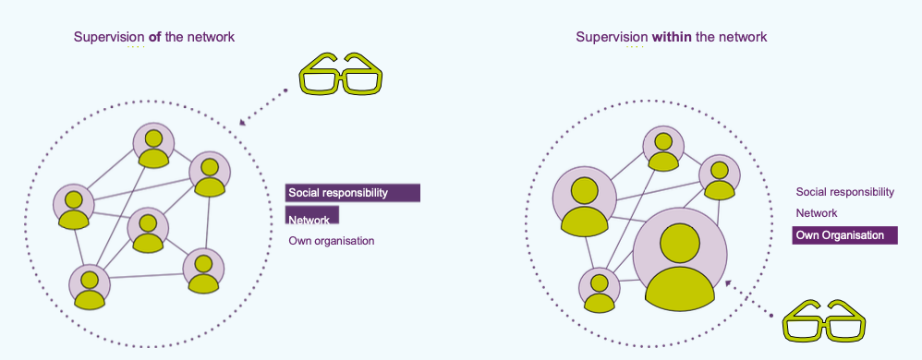
Network cooperation and supervisory boards
Barbara Geurtsen, Levinas Governance Instituut
Notes:
Supervisory boards hebben te maken met seamless care, maar er is geen supervisory board voor het netwerk. Hoe kijken die daarnaar? Grootste finding: Naar het geheel (seamless) of naar eigen organisatie binnen dat netwerk? Meeste toch naar eigen organisatie in het netwerk, zeker als je doorvraagt of als het spannend wordt.

Slide 12
How?

Slide 13
Perspectives and objects of supervision
Object | Organization | Network
Egocentric | Quadrant 1 Does participation in the network add value for the own organization? Supervision focuses on the benefits and risks of participation for the own organization. | Quadrant 2 Does participation align with the strategy/interests of the own organization? Supervision focuses on the strategic fit of network participation.
Ecocentric | Quadrant 3 Does the organization contribute to the functioning and performance of the network? Supervision focuses on the organization’s contribution to network goals. | Quadrant 4 Does the network deliver results? Does it help solve societal problems? Supervision focuses on evaluating the value of the network’s impact.
(Van Montfort & Kenis, 2023)

Slide 14
Enabling conditions for supervision focused on societal challenges in network collaboration
Within the Organization | Within the Network
A. Contracting between Supervisory Board and Executive Board | A. Availability of network documents on shared vision and values
B. Shared awareness and common network terminology | B. Organizing joint meetings for Supervisory board and Executive board of network partners
C. Joint determination of strategic content for network collaboration | C. Joint agreements on how to structure supervision within the network
D. Composition and competencies of the Supervisory Board
E. Evaluation of the Supervisory board’s own role and actions in network collaboration
F. Supporting tools and instruments

Slide 15
A. Contracting between Supervisory Board and Executive Board
Within the organisation
Establish clear agreements about roles, expectations, and information exchange.
Discuss how the Supervisory board can receive signals from the network, even outside the Executive board.
Allow executives room to experiment and reflect together on outcomes.
Prepare for crisis situations and deviations from standard governance.

Slide 16
B. Shared awareness and common network terminology
Within the organisation
Provide joint education on networks for both the Supervisory board and Executive board.
Define together what is meant by network collaboration.
Engage in dialogue about societal interests versus organizational interests.
Use the egocentric and ecocentric perspectives as lenses in discussions.

Slide 17
C. Joint determination of strategy for Network collaboration
Within the organisation
Prioritize which networks are strategically important.
Discuss which collaborations deserve attention and why.
Ensure the Supervisory board is actively involved in relevant networks.
Reflect on the balance between societal impact and organizational interest.

Slide 18
D. Composition and competencies of the Supervisory Board
Within the organisation
Include members with regional knowledge and connections to local stakeholders.
Involve members from other domains (e.g., municipalities, housing, citizen initiatives).
Select competencies such as collaboration and innovation.
Consider appointing a member focused explicitly on societal impact over organizational interest.

Slide 19
E. Evaluation of the supervisory board’s own role and actions
Within the organisation
Periodically evaluate whether supervision is sufficiently focused on societal challenges.
Reflect on the mix of competencies within the Supervisory board.
Discuss whether network collaboration is adequately addressed in meetings.

Slide 20
F. Supporting tools and instruments
Within the organisation
Develop a supervision vision that explicitly includes network collaboration.
Use future scenarios (short, medium, long term) as a framework for assessment.
Involve network partners in drafting profiles for new executives.
Use the board secretary as a link between Supervisory board and Executive board for agenda setting and reporting.

Slide 21
A. Availability of network documents on shared vision and values
Within the network
For example:
Shared vision and implementation agenda
Agreements regarding the collaboration, sometimes laid down in a covenant
Monitoring information (e.g., an impact map) on achieving the social objective (outcomes)
Progress reporting (on the results and process of collaborative projects)
Evaluations of the collaboration within the network

Slide 22
B. Organizing joint meetings for Supervisory board and Executive board of network partners
Within the network
Organize learning programs for Supervisory boards and Executive boards on networks and societal challenges.
Facilitate meetings between Supervisory boards of different organizations within the network.
Discuss shared risks, interests, and opportunities from an ecocentric perspective.

Slide 23
C. Joint agreements on how to structure supervision within the network
Within the network
Clearly articulate the role of the Supervisory board in relation to network collaboration.
As a network, create a crisis plan focusing on how to handle situations of crisis. Include in this plan which events the supervisory boards will be informed about or will act.

Slide 24
Guidelines for structuring the supervision process from an ecocentric perspective
Information gathering
Dialogue, analysis & assessment
Interventions

Slide 25
Guidelines for the network
Object | Information gathering | Dialogue, analysis and assessment | Interventions
Ecocentric perspective with network as object: The Supervisory Board focuses on the impact of the whole network. | Progress on network goals Information on the quality of collaboration Board of Directors provides information (supplements network information) | Supervisory Board & Executive Board Meeting Supervisory Board & Executive Board Network Meeting Progress: 1) Content and Task-Oriented 2) Quality of Collaboration | Interventions on the content Interventions on the organization of the network

Slide 26
Guidelines for the organisation
Object | Information gathering | Dialogue, analysis and assessment | Interventions
Ecocentric perspective: the organization as an object: The supervisory board focuses on whether its organization optimally contributes to the network. | Contribution of own organization to network and network goals. Information about the role and contribution of own organization to collaboration and network goals. Progress reports and network evaluations enriched with information about the contribution and role of own organization. Board of Directors provides information (supplements network information) | Supervisory Board & Executive Board meeting Progress: Content & organizational commitment Executive Board: What is needed in the organization to achieve societal goals? Which substantive themes does the organization address & what is its contribution to the shared goal? Role & functioning & impact of the organization in networks Is the organization's collaboration strategy being implemented? How does the Executive Board reflect on its own organization's role & commitment & impact on the shared task? | Interventions on content: Address the lack of substantive progress due to the involvement of the organization itself. Intervention on contribution to collaboration: Collect information from the organization about the collaboration and the role of the organization itself.

