Slide 1
The challenges of risk-based regulation
Four meta-risks that can undermine your risk-based regulation
Linda Janssen-Pinkse, 3 September 2025
Part-time PhD student
Supervisors: Prof. Dr. M.A. van der Steen & Dr. Ing. M. A. de Bree

Slide 2
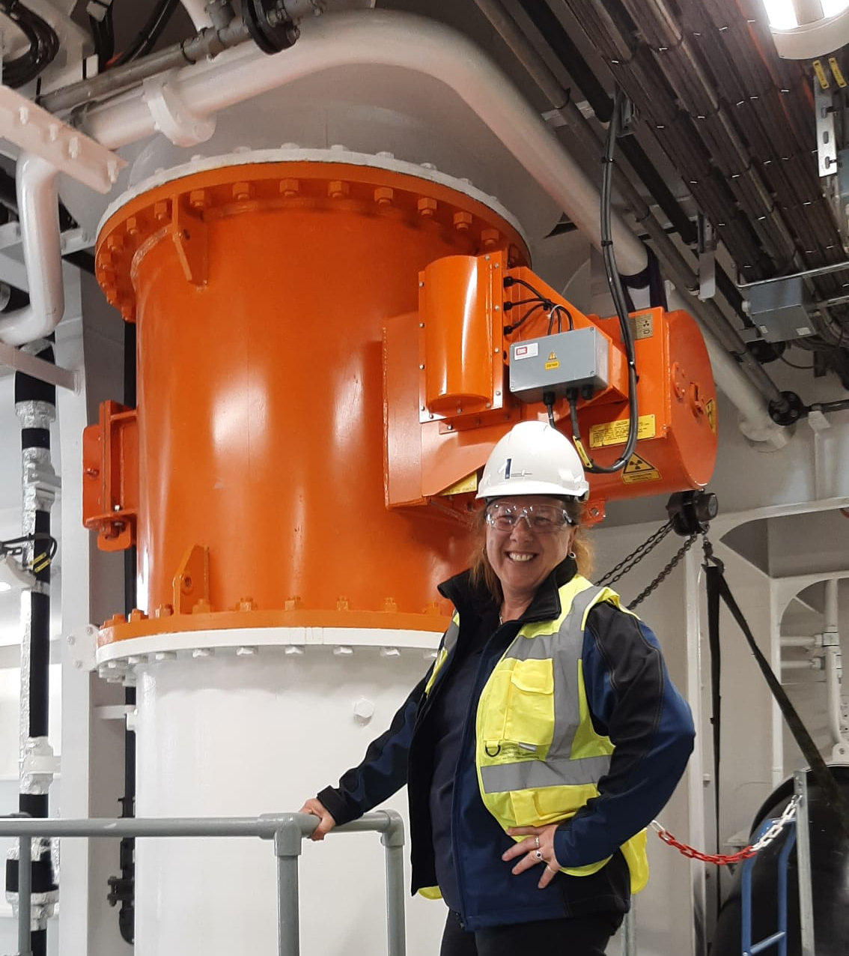





Introduction
Radiation protection officer
Safety officer
Inspection and enforcement

Slide 3
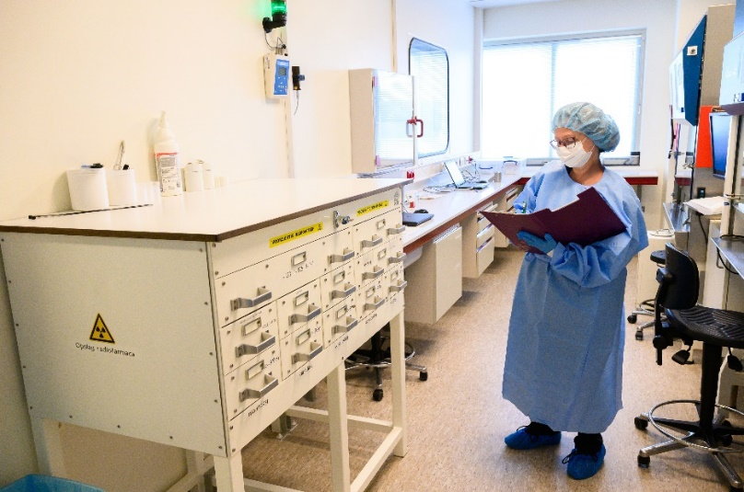

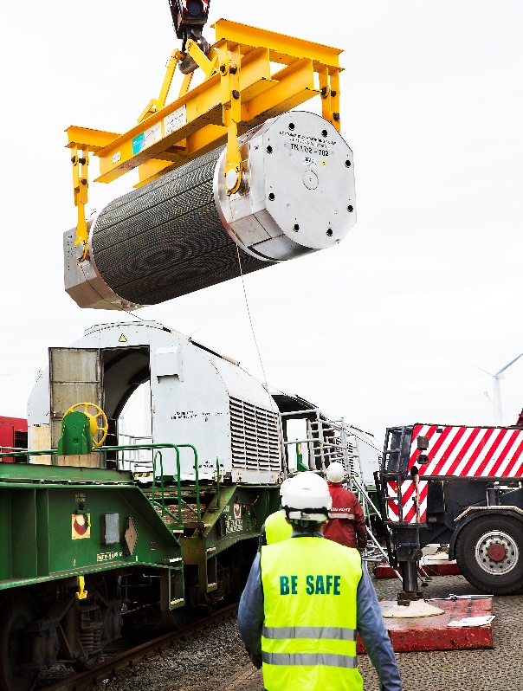

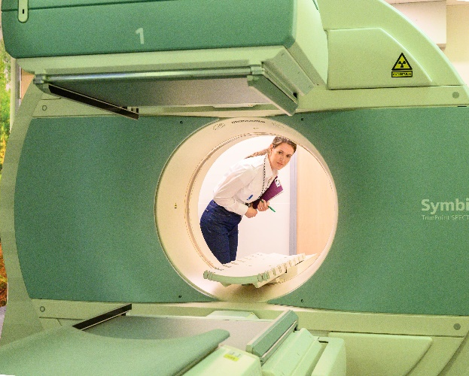
Why this subject?

Slide 4
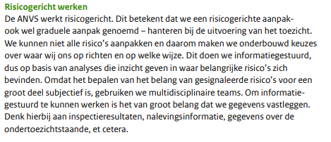
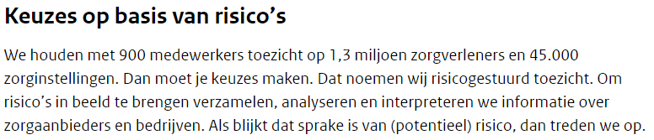
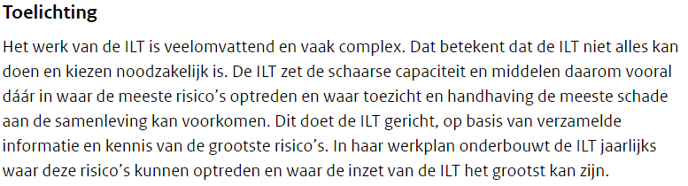
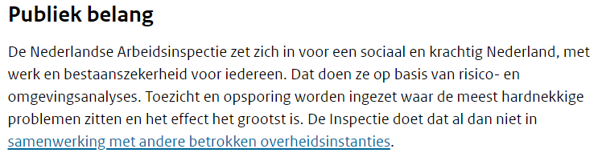
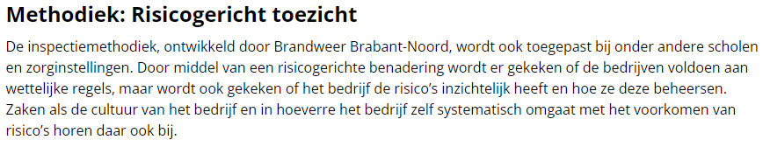
Risk-based regulation in the Netherlands

Slide 5
Risk-based regulation
"Risk-based regulation is commonly taken to mean that regulators operate decision-making frameworks and procedures to prioritize regulatory activities and the deployment of resources according to an assessment of the risks that regulated firms pose to the regulator's objectives.” (Baldwin and Black, 2016, p. 567)

Slide 6
Reseach question
How can a regulatory authority navigate the risks inherent in risk-based regulation within a complex and changing environment?

Slide 7
Single loop and double loop learning
Assumptions of the regulator
System of risk-based regulation
Output of risk-based regulation
Knowledge and information
Four meta-risks
Chris Argyris and Donald Schön

Slide 8
Single loop learning (first order)
Challenges in literature are more focused on the system of risk-based regulation (first order), for example:
How to identify, select and prioritize the drivers and shapers of risk? (Baldwin, 2016).
Which risk factors to include and how to weight them? (Lloyd-Bostock, 2008)
How is the framework operable, dynamic, transparent, and justifiable? (Black, 2012)
‘Around the globe, it is observed that risk-based regulatory governance has become a routine rather than a tailored intervention.’ (Heijden van der, 2021)

Slide 9
Double loop learning (second order)
Assumptions of the regulator
"Risk-based regulation is commonly taken to mean that regulators operate decision-making frameworks and procedures to prioritize regulatory activities and the deployment of resources according to an assessment of the risks that regulated firms pose to the regulator's objectives.” (Baldwin and Black, 2016, p. 567)

Slide 10
The first outline of these meta-risks
Meta-risk | Dangers
Illusion of control | Reactive attitude regulator Neglect real dangers Static vs dynamic Lags so new risks are unidentified
Goal displacement | Loss of focus on legitimate task Blurred output-outcome differentiation
Distraction of the regulated firm | Lazy regulatees Reactive attitude regulatees Less focus on risks Less innovation
Reactive inspector | Less focus on risks Lazy inspectors Prevention of passing on new risks

Slide 11
Illusion of control
Machine metaphor
Risk-based regulation
Predict the future
Complex
In control
Illusion of control

Slide 12
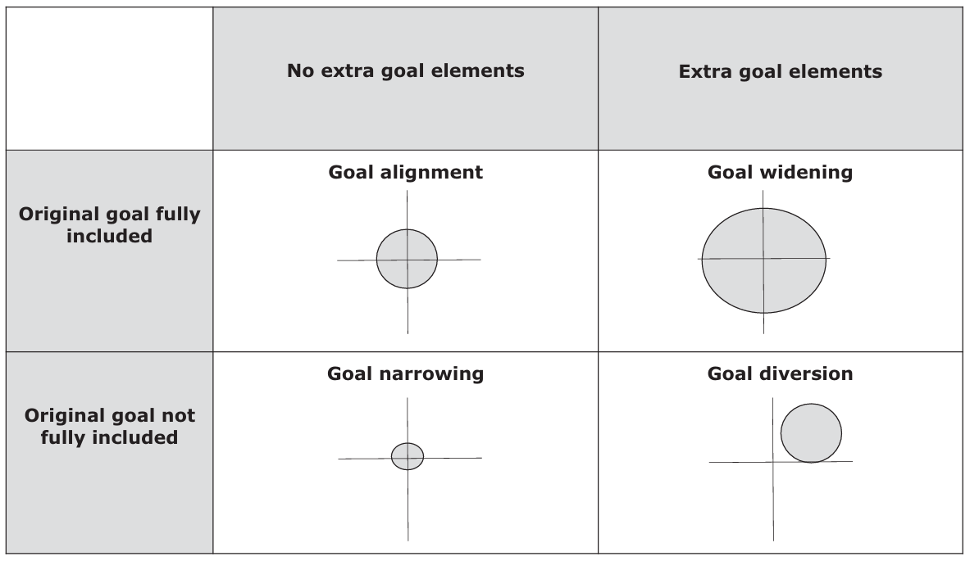
Goal displacement
Different dangers: goal narrowing, goal widening and goal diversion
Risk-based regulation becomes a goal itself (goal diversion)
Ref. Huizinga, 2023

Slide 13
Distraction of the regulated firm
Risk analysis
Overreaction to risks
Rules
Coercive pressure
Distraction of effective risk management
Comply
Regulated firm
Ref. Dimaggio & Powell, 1998

Slide 14
Reactive inspector
Risk analysis
Overreaction to risks
Rules
Coercive pressure
Inspector
Reactive behaviour
Comply
Ref. Dimaggio & Powell, 1998

Slide 15
The first outline of these meta-risks
Meta-risk | Dangers
Illusion of control | Reactive attitude regulator Neglect real dangers Static vs dynamic Lags so new risks are unidentified
Goal displacement | Loss of focus on legitimate task Blurred output-outcome differentiation
Distraction of the regulated firm | Lazy regulatees Reactive attitude regulatees Less focus on risks Less innovation
Reactive inspector | Less focus on risks Lazy inspectors Prevention of passing on new risks

Slide 16
Food for thought
To what extent does risk-based regulation remain a valid conceptualization of ‘good regulation’?
To what extent are regulators aware of the potential risks associated with the adoption of risk-based regulation?
Are the identified risks comprehensive and clearly recognizable, or might certain relevant risks be overlooked?

Slide 17
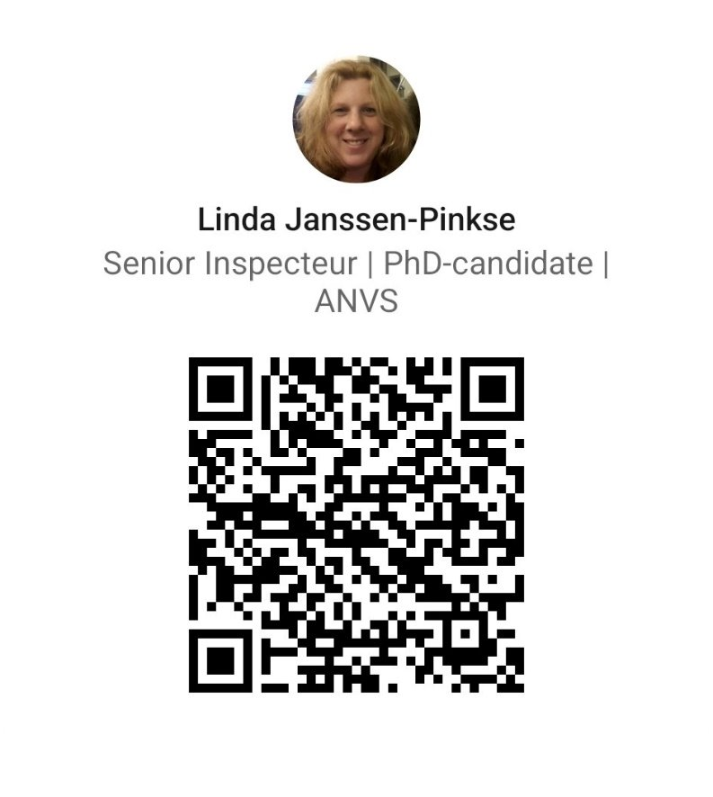
Thank you Are there questions or suggestions?
Linda Janssen-Pinkse
Erasmus School of Social and Behavioural Sciences
janssen@rsm.nl
LinkedIn

