Slide 1


Standard setting in health accreditation in practice – the ISQua EEA experience
39th EPSO Conference
Dublin, 25 Sept 2025

Slide 2
About ISQua EEA
The International Society for Quality in Health Care External Evaluation Association (ISQua EEA) was established by the International Society for Quality in Health Care (ISQua) in 2018 to deliver its external evaluation services.
ISQua EEA’s primary programme is the International Accreditation Programme (IAP).
The IAP delivers a unique global accreditation service to health and social care external evaluation organisations and standards developing bodies. ISQua’s extensive network spans over 70 countries and 6 continents.
Since 1999, the IAP has provided these organisations with an independent third-party assessment process to validate existing systems and drive continuous quality improvement.

Slide 3
Introduction to the International Accreditation Programme (IAP)
We ‘Accredit the Accreditors’ through four unique programmes:
Programme | Standards/Principles
Accreditation of Health and Social Care Standards (desktop/remote survey) | 5th Edition of the Principles for the Development of Health and Social Care Standards (6th edition recently released)
Accreditation of Surveyor Training Programmes (desktop/remote survey) | 4th Edition of the Standards for Surveyor Training Programmes
Accreditation of Quality and Patient Safety Training Programmes (desktop/remote survey) | 1st Edition of the Standards for Quality and Patient Safety Training Programmes
Accreditation of External Evaluation Organisations (virtual/on-site survey) | 5th Edition of the Standards for External Evaluation Organisations

Slide 4
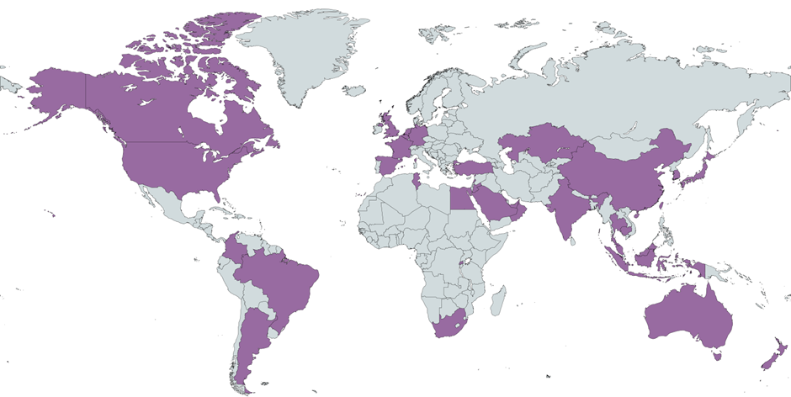
International reach
Operating in over 35 countries/regions:

Slide 5

Why not one global standard?

Slide 6
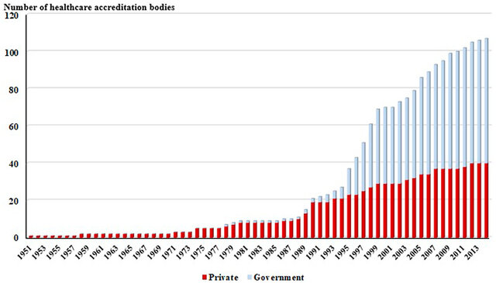

Slide 7
One size does not fit all
Different environments
Different types of healthcare providers
Notes:
.

Slide 8

Some challenges when developing standards

Slide 9

The concept of quality has broadened over time “Doing what I do according to professional standards”

Slide 10
New expectations
Person-centredness
Sustainability
Equal access to newest treatments
A safe and healthy workplace

Slide 11
From the Triple Aim to the Quintuple Aim
Triple Aim 2007:
Improved Patient Experience
Better Outcomes for the Population
Lower Cost
Quadruple Aim 2014:
Clinician Well-Being
Quintuple Aim 2021:
Health Equity

Slide 12
Adding up to a Sextuple Aim
Planetary Health:
The health of human civilization and the state of the natural systems on which it depends
Better Outcomes for the Population → Improved Planetary Health
OR

Slide 13
Prudent standardisation
Helping individual professionals by providing a toolbox
If we do this, we do it in that way
Reduce the complexity of integrating services across different providers by
Clarifying roles and expectations
Creating a framework to set common goals
Creating a framework to discuss “what matters to you”
Facilitating a common language

Slide 14
How do we develop standards?

Slide 15
Extensive environmental scanning exercise including interviews with technical experts
Evaluation data collated from clients, surveyors and stakeholder groups
Working groups followed by drafting of the updated Principles
Consultation on draft 6th edition Principles for nine weeks
Pilot of revised Principles by client organisations and surveyors
Updating of Principles including feedback from Accreditation Council
Approval by ISQua EEA Board
Publication and launch March 2025
Revision Process

Slide 16


Slide 17
6th Edition Principles | No. of criteria
Standards Development and Rating Methodology | 16
2. Organisational Governance, Leadership and Management | 8
3. Person-Centred Care | 11
4. Patient/Service User Safety and Organisational Risk Management | 13
5. Process of Care Delivery | 12
6. Sustainable Care | 7
7. Digital Care and Artificial Intelligence | 8
8. Supporting the Care Workforce | 10
9. Quality Performance | 5

Slide 18
Principle 6 – Sustainable Care
No. | Criterion
6.1 NEW | The standards require organisations to undertake a strategic level review of the impact of environmental issues, sustainability of service provision and how negative environmental impacts arising from activities can to some extent be mitigated.
6.2 NEW | The standards require organisations to provide information to their staff and patients/service users on the organisation’s strategic approach to environmentally sustainable care and the organisation’s goals in this area.
6.3 NEW | The standards require organisations to monitor their progress against defined goals for environmentally sustainable care and to report on this progress to the governing body.
6.4 NEW | The standards require organisations to consider the responsible stewardship of resources in their use of supplies and management of procurement.
6.5 NEW | The standards require organisations to manage their use of non-renewable energy by: a) monitoring their use of energy including electricity, gas, oil and other fuel sources b) taking steps to reduce the use of energy from fossil fuels.
6.6 NEW | The standards require organisations to carry out an assessment of their carbon footprint to monitor and help reduce greenhouse gases produced through the care processes provided.

Slide 19
Principle 7 - Digital Care and Artificial Intelligence Systems for Care
No. | Criterion
7.1 NEW | The standards require organisations to have a documented process for the assessment, costing, implementation and ongoing management of digital care systems.
7.2 NEW | The standards require that organisations have a process to ensure that the use of digital care does not disadvantage patients/service users who are not able to use digital devices or do not have access to the internet to facilitate the use of digital approaches.
7.3 NEW | The standards require organisations to have access to technical expertise to support the effective use of digital care systems.
7.4 NEW | The standards require organisations to introduce and manage AI systems in accordance with any national or regional legislation or regulations on the use of AI, where these exist, or in their absence, based on available guidance for best practice.
7.5 NEW | The standards require organisations to monitor and evaluate the use of AI systems to deliver safe, high-quality care, with mitigation of any unintended consequences.
7.6 NEW | The standards require organisations to consult with staff delivering care, prior to the introduction of AI systems, to gain understanding of the practical implications and staff training needs.
7.7 NEW | The standards require that organisations consider accountability arrangements for all care and treatment delivered with support from AI systems.
7.8 NEW | The standards require organisations to inform patients/service users when aspects of care are delivered with the use of AI systems.

Slide 20
Principle 8 – Supporting the Care Workforce
No. | Criterion
8.6 NEW | The standards require organisations to take steps to protect staff from violence and aggression from individuals including patients/service users.
8.7 NEW | The standards require organisations to have a systematic approach to gaining feedback from the workforce on their experience of working for the organisation and to implement improvement based on the feedback.
8.8 NEW | The standards require organisations to monitor and analyse data on staff sick leave and the reasons for staff leaving and these are used to inform organisational learning and changes in practice to support staff wellbeing and retention.
8.9 NEW | The standards require organisations to have processes to monitor, review and respond to issues of equality, diversity, inclusion and equity, in relation to recruitment, work allocation, scheduling and promotions across the workforce.
8.10 NEW | The standards require organisations to support workforce wellbeing and psychological safety.

Slide 21
Standards of the future?
WAI
Organisation
WAI
Staff perception
WAD
Staff perception
WAD
Actual
Output
Outcome

Slide 22
Which challenges do our stakeholders see?
/
Healthcare provider buy-in
Increasing cost (time, money, human resources)
Proof of value outside assessment cycle
Standardisation with global programmes
Changes in care models

Slide 23
Accreditation and regulation
Traditional regulator | Traditional accreditor
Mission is to protect the public | Mission is to support the provider
Empowered by law, but also limited by legal mandate | Can address anything stakeholders find important and relevant
Can back up its recommendations with power | Essentially dependent on provider’s willingness to improve
Potentially an enemy | Can be a friend but also a creator of red tape At times tension between management view and staff view
Has someone violated the law? | How can the system improve?
Mandatory | Voluntary
Acts both proactively and reactively – demands for “action on issues” often crowd out the proactive part | Proactive
This is to illustrate a spectrum – different regulators and accreditors may be at different places on this spectrum

Slide 24


Slide 25



Save the Date For
#ISQua2026
ISQua’s 42nd International Conference will be held in Dublin, Ireland, from 27th to 30th September 2026
In partnership with the Irish Department of Health (DoH), and the Health Service Executive (HSE)
www.isqua.org

Slide 26
Call for Abstracts open on:
Wednesday 12th November 2025
www.isqua.org

Slide 27

Contact us
International Society for Quality in Health Care External Evaluation Association, Multifiduciaire Genève,Carrefour de Rive 1, Case postale 3369, 1211 Genève 3 Switzerland
support@ieea.ch
https://www.ieea.ch/

