Slide 1

Reflections on the application of a Human Rights Based Approach to Regulation by the Mental Health Commission
​
GARY KIERNAN, DIRECTOR OF REGULATION
MENTAL HEALTH COMMISSION

Slide 2
OVERVIEW
Human Rights Approach to
Mental Health Regulation ​
Practical Application: Reduction of Restrictive Practices in Ireland -
A Compelling Argument for Adopting a Human Rights Approach ​
Conclusion
---------------------
MENTAL HEALTH COMMISSION

Slide 3

A Human Rights Approach to Mental Health Service Provision​​
Respects dignity, autonomy, and freedom, ensuring quality care, free from discrimination or coercion
Recognises the same rights and freedoms for individuals with mental health difficulties as anyone else.
---------------------------------------------------------
​Strives to balance rights fairly while protecting safety and facilitating recovery.
MENTAL HEALTH COMMISSION

Slide 4

Mental health services balance individuals' rights with their own safety and that of others.​
Balancing
Mental Health Care and
Human Rights
---------------------------
Rights like privacy and bodily autonomy might be limited in cases of significant risk to life or well-being.
CHALLENGES IN MENTAL HEALTH SETTINGS
Rights of individuals with mental health difficulties are sometimes overlooked or denied.
Any restriction of rights must be necessary, proportionate, and justified with legal and ethical reasoning.
MENTAL HEALTH COMMISSION

Slide 5

Case Study
  Regulation of Restrictive Practices:
  A compelling argument for adopting a human rights-based approach to
  mental health regulation
------------------------------------------------------------
MENTAL HEALTH COMMISSION

Slide 6

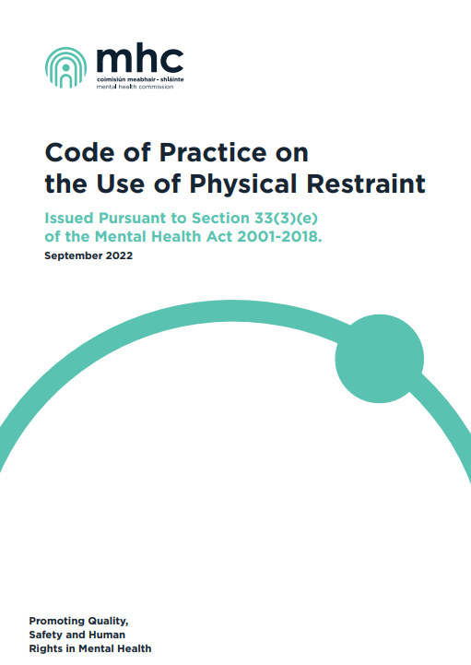
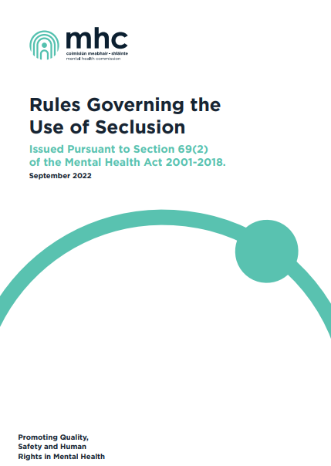
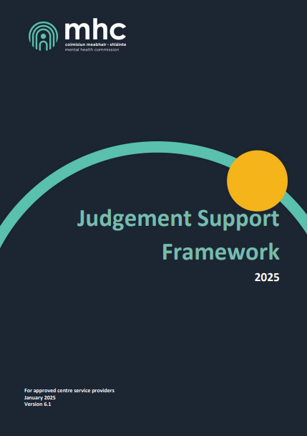
---------------------
MENTAL HEALTH COMMISSION

Slide 7
THE EVIDENCE REVIEW HIGHLIGHTED
THE USE OF SECLUSION/RESTRAINT:
Extensive consultation and evidence review informed the revision of the Rules/COP
Offers no therapeutic value and is not treatment
  Can cause physical and psychological harm
  May increase the risk of trauma and may trigger symptoms of previous experiences of trauma
CONSULTATION WITH PEOPLE WITH EXPERIENCE OF SECLUSION/RESTRAINT IN APPROVED CENTRES SHOWED EVIDENCE OF:
--------------------------------------------
Trauma
Subsequent negative impact on recovery
MENTAL HEALTH COMMISSION
Damage to the therapeutic relationship - leading to a “lack of trust” and “a huge power imbalance”.

Slide 8


Slide 9
PEOPLE DESCRIBED FEELING:
Consultation with people with experience of seclusion/restraint in approved centres
‘disrespected’
‘vulnerable’
'controlled'
‘humiliated’
‘abused’
---------------------
‘disempowered’
‘frightened’
‘helpless’
‘angry’
'anxious’
WHEN SECLUSION OR RESTRAINT WAS USED

Slide 10
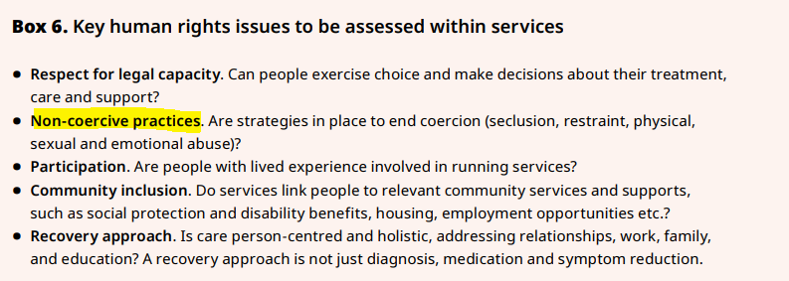
Move to reduction and elimination through governance
and quality improvement initiatives
Evidence
In line with Sharing The Vision Recommendation 92
“zero seclusion, zero restraint”.
2025 WHO Guidance on mental health policy and strategic action plans
---------------------------------------------------------
---------------------

Slide 11
Key changes to the rules/code: Human Rights
Seclusion/restraint can only be used where there is an
immediate risk of serious harm to self or others
PRINCIPLES WHICH MUST UNDERPIN THE USE OF SECLUSION/RESTRAINT:
The inherent rights of a person to personal dignity and freedom in accordance with national and international human rights instruments and legislation.
Mandatory training
(including in human rights, trauma informed care)
--------------------------------------------------
  Used in rare and exceptional circumstances as an emergency measure.
  Proportionate to the assessed risk
  Least restrictive option
and as a last resort
  Dignity and respect
  Ban on mechanical
restraint on children

Slide 12
Key changes to the rules/code: Involvement of the person in the review of each episode
A person-centred in-person debrief with the person who was secluded/restrained takes place within 2 working days of the episode (unless it is the preference of the person to have it outside of this timeframe).
Optional for the person to participate.
Discussion re alternative de-escalation strategies that could
be used to avoid RPs in future.
-----------------------------------------------------------
---------------------
Discussion re person's preferences in the event where a RP is needed in the future (e.g. what RP they would not like to be used)
Person has the option of having their representative or their nominated support person attend the debrief with them.

Slide 13
MDT REVIEW WITHIN 5 WORKING DAYS OF EACH EPISODE
Key changes to the rules/code: Governance & Oversight
  the duration of the episode and whether this was for the shortest possible duration
Identification of the trigger/antecedent events
  Review of any missed opportunities for earlier intervention
  Considerations of the outcomes of the person-centred debrief
---------------------------------
---------------------------------
  Identification of alternative
  de-escalation strategies to be used in future
  Assessment of the factors in the physical environment that may have contributed to the RP
---------------------
Establishment of a multidisciplinary review and oversight committee
to analyse in detail every episode of seclusion/restraint:
- Compliance with rules/code -
- Areas for improvement -
- Report of each committee meeting -
(shared with staff to promote ongoing learning) and with the MHC if requested

Slide 14
Key changes to the rules/code: Notifications
  Every episode of seclusion/physical restraint must be notified to the MHC within three working days
Risk Rating, trend analysis and request for assurances more timely
---------------------------------------------------------
--------------------------------------------------
MHC now has real time data and can intervene, as necessary.
MHC regularly request outcome of MDT reviews and other assurances.

Slide 15

Results:
Reductions in reported restrictive practices
  62% reduction in Restrictive Practices 2018-2024
"Use of restrictive practices in approved mental health centres in Ireland: Consideration of five years of data reported to the MHC from 2018 to 2022"
RP rate per 100,000 population fell by 65% since 2018 and
34% since 2022

Slide 16
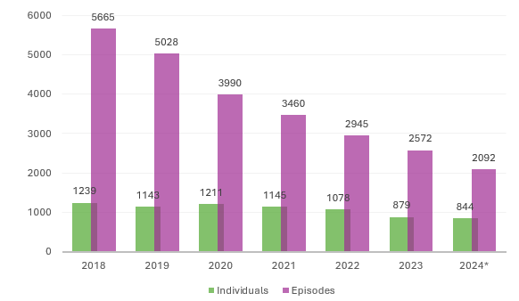
Physical
Restraint
---------------------
MENTAL HEALTH COMMISSION

Slide 17
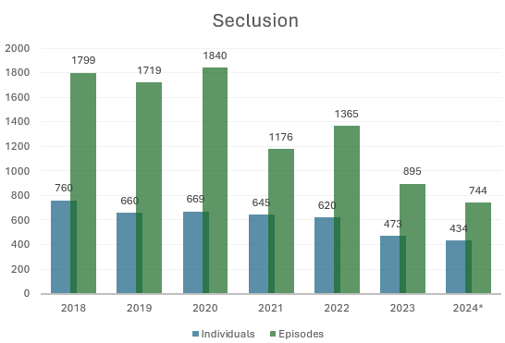
Seclusion
---------------------
MENTAL HEALTH COMMISSION

Slide 18
SECLUSION
Results:
Important reductions in reported restrictive practices
  59% reduction in no. of episodes during the period 2018-2024
  46% reduction since 1 Jan 2023
  30% reduction in the number of people secluded since 1 Jan 2023
PHYSICAL RESTRAINT
---------------------
  63% decrease in no. of episodes since 2018
  29% reduction in the number of episodes since 1 Jan 2023
  22% reduction in the number of people physically restrained since 1 Jan 2023
MENTAL HEALTH COMMISSION

Slide 19
A human rights-based approach to mental health care is achievable and realistic.
Irish mental health services have already demonstrated the capacity to be world leaders in the area of human rights as applied to restrictive practices.
As regulators, clinicians and service providers we all have a role in protecting rights and reducing harm.
If we apply the lessons learned from the restrictive practice journey, we will be successful.
Thanks to those in this room who are already leading the way in this field!
Conclusion
---------------------
MENTAL HEALTH COMMISSION

Slide 20
Thank you!
Comments/Questions to
standards@mhcirl.ie
MENTAL HEALTH COMMISSION

