Slide 1
The regulatory dialectic? Restoration and accountability in health services
Richard Hamblin
New Zealand

Slide 2
Agenda
Quick recap of NZ system
The strengths of learning approaches for a safe system
The limitations of learning approaches for a safe system
“Horses for courses” or synthesis?

Slide 3

NZ system
  Some characteristics :
  “Healing, Learning and Improving from Harm” part of a wider system and context
  Professional Regulation/ “Sex, drugs and rock’n’roll” offences
  Healthcert
  No suing (Govt compensation as part of broader accident compensation system)
  Blame free learning system for improvement undertaken locally using materials developed by New Zealand’s Health Quality and Safety Commission (independent organisation).
Notes:
The Accident Compensation Corporation (ACC) legislation protects health practitioners from being sued.
The Health & Disability Commission (HDC) legislation sets the consumers rights for care
Criminal offences are dealt with through the police system.
The reporting and improvement system by the Health Quality and Safety Commission ( New Zealand's health improvement agency)

Slide 4
The illusion of moral certainty when value judgements are made
Frame 1 | Frame 2
Nice versus nasty | Bold versus avoidant
Sophisticated versus simplistic | Definite versus woolly
System thinking versus blaming | Avoidant versus definite
Notes:
Individual psychology and linguistic encoding
“Nice” encoded words versus “nasty” ones
“Rigorous” words against “woolly” ones
“Scientific” words against

Slide 5
Strengths of a learning system
Open, honest and transparent flows of information incentivised
Focus on broad structural causes – more likely to resolve issues
Self-reporting and focused quality improvement (the in-hospital falls example)
Culture and safety II
Focus on restoration and reparation

Slide 6
Limitations of a learning system
“Everyone comes to work to go a good job” is an untested proposition
The limitations of air safety as an analogy
Resilience under pressure – does it even work as a system if the circumstances aren’t right?
Ethical fading
Set of assumptions about hierarchical gradients

Slide 7
Horses for courses – towards synthesis
Grey area
Support
System reform
Punitive
Malign | Reckless | Incompetent | Overwhelmed | “bad luck”
Limitation is its individual focused

Slide 8

Cause
Social Determinants
Sub – optimality
Individual bad behaviour
Team lack of capability
Team/Org. lack of capacity
System design
Insufficient System capacity
Emergent risk
Org. lack of capability
Poor “outcome” at triple/quadruple aim level
Q.I.S
Org. redesign
Org.
design
Q.I.S
System redesign
Increase Resources
Regulatory/
Disciplinary
Q.I.S
System redesign/ policy change
Replacement
Increase Resources
Policy change
Org. design
Capability building
Replace leaders
Regulatory
Potential responses
In some instances potential to use Performance Management as a supporting mechanism if done intelligently
Response
Consumer Voice + Choice

Slide 9
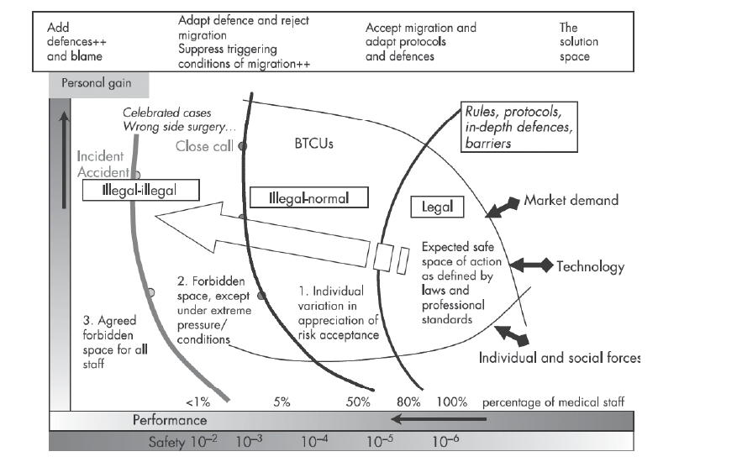
But system operation is a hugely important context
Amalberti R, Vincent C, Auroy Y, de Saint Maurice G. Violations and migrations in health care: a framework for understanding and management. Quality and Safety in Health Care 2006;15(suppl_1), i66-71.

Slide 10
Synthesis: (or a messy set of compromises)
Enough learning/openness to spot early where they may be problems
Enough rigour to accurately diagnose potential causes
Enough accountability and teeth to robustly deal with bad and unsafe practice where that exists
Enough wisdom to balance all three

Slide 11
Questions that follow
What are the skills that are needed within the system to achieve a successful messy compromise?
What are the structures and processes (organisational and system routines) that are going to be needed?
How do we know when the messy compromises are working?

