Slide 1
Compliance and Enforcement – a Singapore Perspective
EPSO Conference Dublin 2025
Ministry of Health, Health Regulation Group
Notes:
“Good morning, everyone. I’m Ivan, Director (Regulatory Policy and Legislation) from Singapore's Ministry of Health, Health Regulation Group. Today I'll share Singapore's perspective on compliance and enforcement in healthcare regulation - how we've transformed our approach to meet evolving challenges while maintaining patient safety.”

Slide 2

Disruptive Technologies
Rising Expectations for Efficient, Business-friendly Regulation
    The Central Question:
    How do we regulate more effectively with less?
Growing Healthcare Sector
Constrained Regulatory Resources
Traditional Regulatory Frameworks
Notes:
Slide 2: The Global Challenge
"Let me start with the universal pressures we all face as health regulators. Healthcare sectors are growing rapidly, but our regulatory resources remain constrained. Disruptive technologies like telemedicine and AI are outpacing our traditional frameworks. Meanwhile, there's rising expectation for efficient, business-friendly regulation that doesn't compromise patient safety.
This brings us to the central question: How do we regulate more effectively with less? This challenge led Singapore to fundamentally rethink our regulatory approach."

Slide 3


Singapore's Strategic Response - Paradigm Shift
  From Control to Collaboration:
Traditional approach: "Referee" - catching failures after they occur
New approach: "Coach" - helping licensees succeed proactively
Key Philosophy: Trust and control are complementary, not opposing forces
Ways that we have shifted our philosophy and approach:
Moved from rigid, premises-based regulation to flexible, services-based framework
Involved stakeholders in regulation setting and implementation
Regularly updated FAQs on website to guide and address common queries
Notes:
Slide 3: Singapore's Paradigm Shift
"Singapore's response was a paradigm shift from control to collaboration. Traditionally, regulators acted as referees - catching failures after they occurred. We've moved to being coaches - helping licensees succeed proactively. Our philosophy is that trust and control are complementary, not opposing forces.
This shift enabled us to move from rigid, premises-based regulation to flexible, services-based frameworks. We created clear distinctions between criminal offences and regulatory breaches, and most importantly, we enabled graduated enforcement responses that match the severity of violations."

Slide 4

Singapore's Strategic Response - Paradigm Shift
  Regulatory Sandbox: Example of Coaching and Collaboration
Context Create a safe space for regulators to work with providers to co-create effective and efficient regulatory approaches Objectives Better understand risks of new innovations Encourage safe growth of value-based services/ models and innovations; and Co-create regulations with stakeholders
Approach
Telemedicine (TM) regulatory sandbox:
2018: 11 private providers, and collected 40k points of data
  No major patient safety/welfare issues
  Co-identified risks and co-created mitigations for TM
  Encouraged safe-growth of TM
Successfully closed sandbox in Feb 2021:
  Transited to voluntary listing of direct TM service providers (~850 to-date)
  Learnings from sandbox distilled into free e-training for healthcare professionals to enable safe use of TM during COVID-19
  Telemedicine now licensed under HCSA from 26 Jun 2023 via the remote MOSD of certain LHSes.
Notes:
Slide 4: Regulatory Sandbox
"The regulatory sandbox exemplifies our collaborative approach. We created safe spaces to work with providers and co-create effective regulations. Our telemedicine sandbox involved 11 private providers and collected 40,000 data points.
We found no major patient safety issues, co-identified risks, and co-created mitigations. This encouraged safe growth of telemedicine. We successfully closed the sandbox in 2021, transitioning to voluntary listing of 850 providers. Learnings became free e-training for healthcare professionals during COVID-19. Telemedicine is now fully licensed under HCSA."

Slide 5
Risk-Based Regulation Framework
  A Spectrum of Regulatory Tools Are Used To Define Regulatory Policy
Regulatory Policy
Regulatory Design
Regulatory Review
Regulatory Tools
Low Compliance Burden
High Compliance Burden
Stakeholder Education
Guidelines / Standards
Industry
Self-Regulation
Regulatory
Sandbox
Accreditation
Regulations/
Legislations
Supporting Enablers:
Data Analytics, Behavioural Insights, Stakeholder Consultation, Horizon Scanning
Regulatory Operations
Licensing
Audit
Enforcement
Notes:
Slide 5: Spectrum of Regulatory Tools
"This diagram illustrates our comprehensive toolkit. We use a spectrum of regulatory tools based on compliance burden. Low-burden tools include stakeholder education, guidelines, and industry self-regulation. Higher-burden tools include formal regulations and enforcement actions.
The key is matching the right tool to the right situation, supported by data analytics, behavioural insights, and continuous stakeholder consultation. This approach optimises regulatory effectiveness while minimising unnecessary burden."

Slide 6
HCSA Framework
Inpatient Services
Outpatient Services
Clinical Support Services
1. Acute Hospital Service
2. Community Hospital Service
3. Nursing Home Service
4. Ambulatory Surgical Centre Service
5. Assisted Reproduction Service
6. Outpatient Dental Service
7. Outpatient Medical Service
8. Outpatient Renal Dialysis Service
9. Blood Banking Service
10. Clinical Laboratory Service
11. Cord Blood Banking Service
12. Emergency Ambulance Service
13. Medical Transport Service
14. Radiological Service
15. Human Tissue Banking Service
16. Nuclear Medicine Service
Risk-Based Regulation Framework
  Core Principle: Smart Resource Allocation
    Risk assessment drives regulatory intensity:
      High compliance history = reduced oversight burden
        Less frequent inspections, longer licence tenure
      Poor compliance history = enhanced scrutiny
        More frequent inspections, shorter licence tenure
    Cultural Transformation:
    From process-focused to outcomes-focused regulation
    From one-size-fits-all to personalised regulatory approach
      PHMCA: Single regulatory framework applied uniformly to all healthcare providers
      HCSA: 16 distinct Licensable Healthcare Services with tailored requirements based on service type and risk profile:
        Inpatient Services (3 LHSes)
        Outpatient Services (5 LHSes)
        Clinical Support Services (8 LHSes)
    Each service category has specific regulatory requirements matching its unique operational risks
Notes:
Slide 6: Risk-Based Framework
"Our risk-based regulation framework embodies smart resource allocation. Risk assessment drives regulatory intensity. Licensees with strong compliance histories get reduced oversight - less frequent inspections, longer licence tenure. Those with poor compliance face enhanced scrutiny.
This represents a cultural transformation from process-focused to outcomes-focused regulation, and from one-size-fits-all to personalised approaches. Under our previous PHMCA framework, we had a single regulatory structure applied uniformly to all healthcare providers. Now under HCSA, we have 16 distinct Licensable Healthcare Services with tailored requirements based on service type and risk profile - organised into Inpatient Services, Outpatient Services, and Clinical Support Services. Each service category has specific regulatory requirements matching its unique operational risks.”

Slide 7
Expanded Enforcement Philosophy
  Expanded Spectrum of Enforcement and Regulatory Actions under HCSA
    PHMCA (Traditional): Limited options (warnings, financial penalties or prosecution)
    HCSA (Modern): Graduated enforcement toolkit matching severity of breach
    Proactive Intelligence System:
    Multi-source detection and early intervention
    Collaborative approach with industry stakeholders
    Preventive rather than purely reactive enforcement
      Minor violations: Warnings, additional licence conditions, additional security deposits
      Moderate violations: Financial penalties, security deposit forfeiture, licence modifications and/or shortening
      Serious violations: Criminal prosecution, step-in powers, public disclosure, licence suspension/ revocation
Notes:
Slide 7: Expanded Enforcement Philosophy
"Our enforcement philosophy has expanded dramatically. Under the old system, we had limited options - warnings, financial penalties, or prosecution. The HCSA provides a graduated toolkit matching violation severity.
Minor violations get warnings or additional licence conditions. Moderate violations face financial penalties or licence modifications. Serious violations can trigger step-in powers or licence suspension. This proportionate approach is supported by proactive intelligence systems that enable early intervention rather than purely reactive enforcement.
Our multi-source detection capabilities include proactive and routine inspections conducted based on risk profiles, complaints and whistleblowing from the public, patients, or industry stakeholders, and intelligence surveillance.
We emphasise preventive rather than purely reactive enforcement through routine inspections conducted less frequently for licensees with good track records and lower risk profiles, and more frequently for those with poor compliance history and higher risk operations. We also conduct HCSA implementation stakeholder engagement sessions to facilitate dialogue and address industry concerns, and publish regularly updated FAQs on MOH's website to address common licensee queries and emerging issues. This collaborative approach enables us to identify and address issues early."

Slide 8

New Enforcement Challenges
  Growing enforcement challenges as healthcare landscape evolve
Core Challenge: Maintaining patient safety while enabling healthcare innovation in a rapidly evolving landscape
Key Challenge Areas:
Digital advertising - Online healthcare platforms outpacing traditional frameworks
Health product advertising - Inappropriate promotion of prescription medicines
Vaping enforcement -Resource-intensive enforcement to mount comprehensive response
SStrategic Response:
Multi-agency coordination (Cross-agency joint enforcement)
Adaptive enforcement for emerging healthcare models
Enhanced guidance and education for licensees and platforms
Notes:
Slide 8: New Enforcement Challenges
"However, the evolving healthcare landscape brings new enforcement challenges. Digital advertising on healthcare platforms is outpacing traditional frameworks. Health product advertising requires preventing inappropriate promotion of prescription medicines. Vaping enforcement demands resource-intensive action to mount comprehensive response.
Our strategic response includes multi-agency coordination across the Ministries, adaptive enforcement for emerging healthcare models, and enhanced guidance and education for licensees and platforms. The core challenge remains maintaining patient safety while enabling innovation in our rapidly evolving digital landscape."

Slide 9
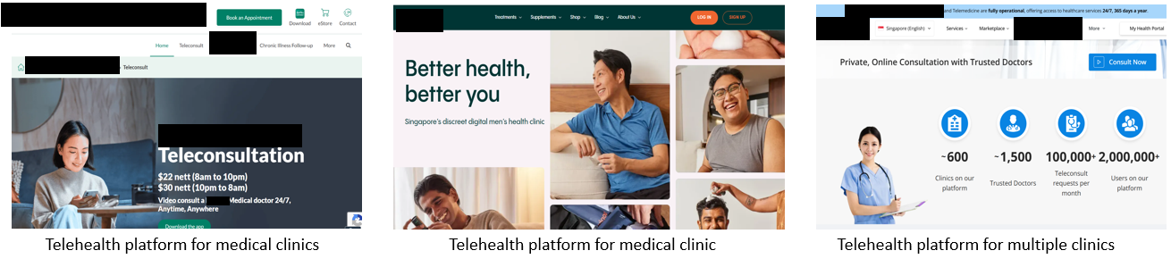
New Enforcement Challenges
  Example: Online Advertisements
Increased advertising of healthcare services online especially on digital health platforms that enable or facilitate patients’ access to telehealth consultation services provided by doctors.
These platforms may be in-house or a vendor to licensed clinics.
Notes:
Slide 9: Online Advertisement Examples
"Let me show you specific examples of our digital advertising challenges. We're seeing increased healthcare advertising on digital platforms - some in-house, others third-party vendors serving multiple clinics.”

Slide 10

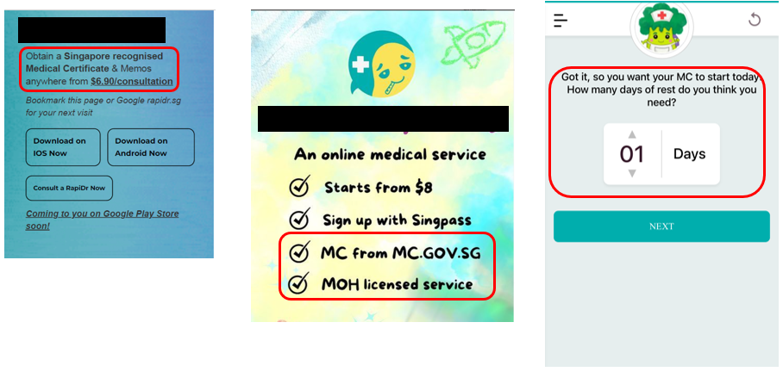
New Enforcement Challenges
  Example: Online Advertisements
Advertisements that promote Medical Certification-driven consultations, allow patients to pre-select MCs. It advertises the potential for patients to obtain an MC, which have the effect of soliciting or encouraging use of LHS provided by the Licensee.
Figure A. Advertisement and Pre-selection of MCs
Notes:
Slide 10: Online Advertisement Examples
"Problematic patterns include medical certification-driven consultations where patients can pre-select MCs. It advertises the potential for patients to obtain an MC, which have the effect of soliciting or encouraging use of LHS provided by the Licensee.”

Slide 11
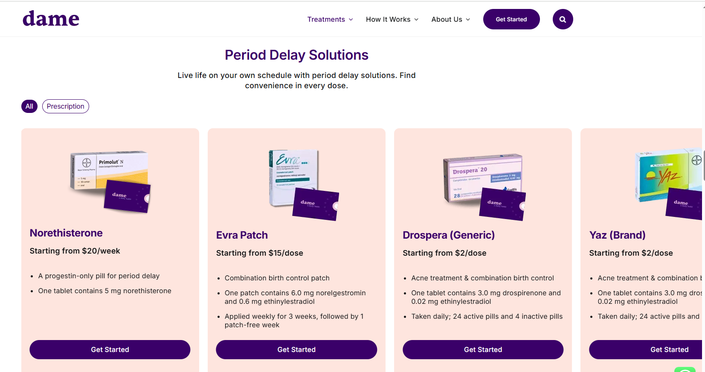
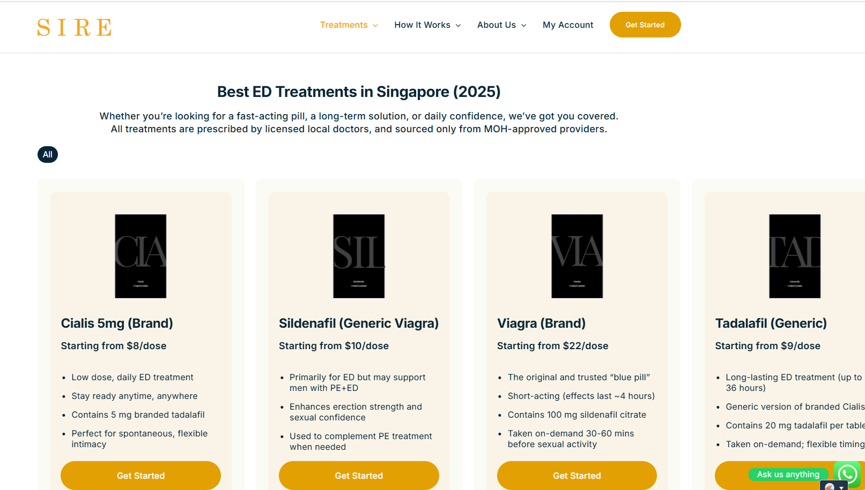
New Enforcement Challenges
  Example: Online Advertisements
Advertisements that promote prescription medicines-driven consultation, which have the effect of soliciting or encouraging use of LHS provided by the Licensee.
Figure B. Pre-selection of prescription medicines on telemedicine service provider’s platform
Notes:
Slide 11: Online Advertisement Examples
"Another example is prescription medicine-driven consultations where patients choose medications before clinical assessment. These undermine proper clinical evaluation and encourage inappropriate use of healthcare services.
These examples illustrate how traditional advertising rules struggle with digital innovation, requiring adaptive enforcement approaches."

Slide 12
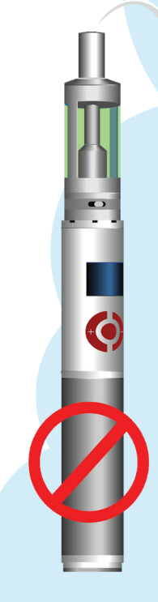
New Enforcement Challenges
  Example: Vaping Enforcement
Singapore has a longstanding prohibition on the import, distribution and sale of imitation tobacco products, such as e-vaporisers, under the Tobacco (Control of Advertisements and Sale) Act. The prohibition was extended to cover purchase, use and possession from February 2018.
  This prohibition is premised on the harmful effects of e-vaporisers and the need to prevent e-vaporisers from becoming normalised, particularly among youths.
The ban on e-vaporisers is part of Singapore's multi-pronged tobacco control strategy towards a nicotine-free future
Despite the ban, Singapore is not spared from the challenges arising from the global rise in vaping, particularly given the aggressive marketing tactics towards youths and ease of access to e-vaporisers
To mount a comprehensive enforcement response against e-vaporisers, coordinated efforts across agencies, beyond the Ministry of Health and Health Sciences Authority are required.
Notes:
Slide 12: Vaping Enforcement Background
"Let me share another enforcement challenge - vaping. Singapore has a longstanding prohibition on e-vaporisers under the Tobacco Control Act, extended to cover purchase, use and possession from February 2018. This prohibition is premised on the harmful effects of e-vaporisers and preventing normalisation, particularly among youths, as part of our multi-pronged tobacco control strategy towards a nicotine-free future.
Despite the ban, Singapore faces challenges from the global rise in vaping, particularly given aggressive marketing tactics towards youths and ease of access to e-vaporisers. To mount a comprehensive enforcement response, coordinated efforts across agencies beyond MOH and HSA are required."

Slide 13
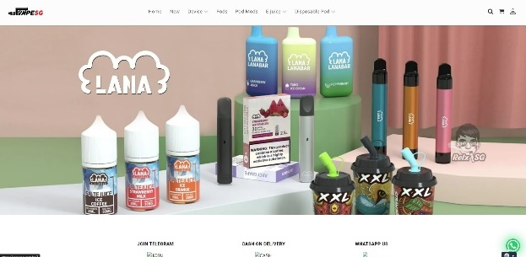
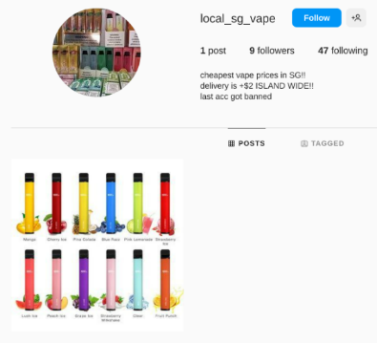
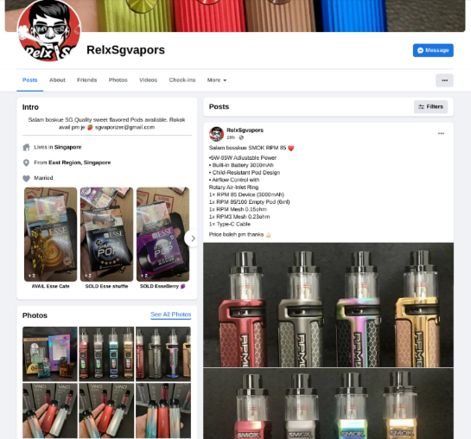
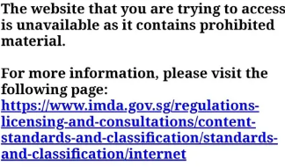
New Enforcement Challenges
  Example: Vaping Enforcement
Online sales and advertisements of e-vaporisers
  HSA works with the Ministry for Digital Development and Information and Infocomm Media Development Authority to block e-vaporisers peddling websites and conducts proactive surveillance across digital platforms and engages with platform owners to better detect and remove e-vaporisers-related listings
Notes:
Slide 13: Vaping Enforcement - Online Operations
"One key challenge area is online sales and advertisements of e-vaporisers. HSA works with the Ministry for Digital Development and Information and Infocomm Media Development Authority to block e-vaporiser peddling websites, conducts proactive surveillance across digital platforms, and engages with platform owners to better detect and remove e-vaporiser-related listings. This demonstrates our multi-agency coordination approach to tackle digital enforcement challenges."

Slide 14
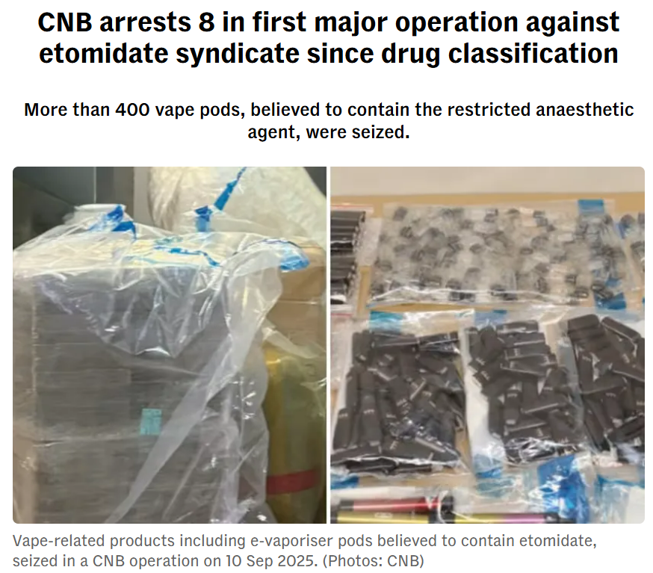
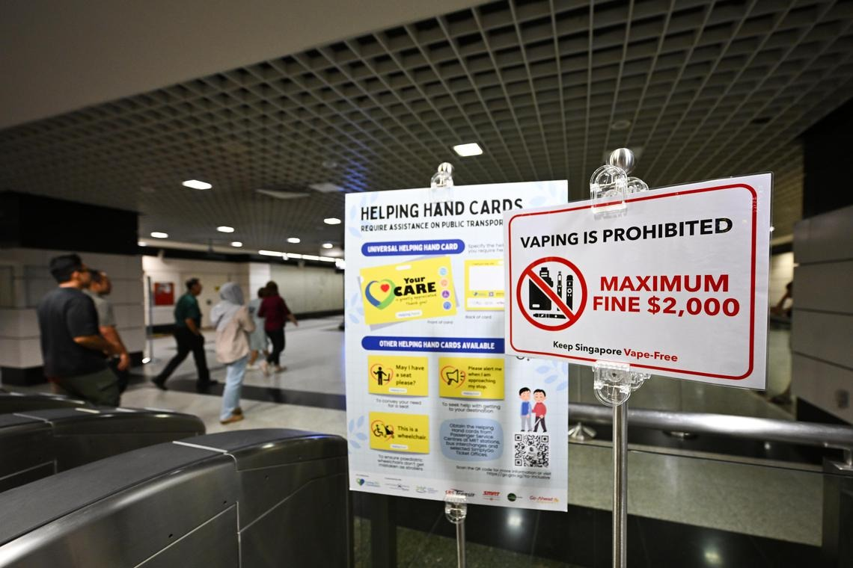
New Enforcement Challenges
  Example: Vaping Enforcement
Border and inland enforcement against suppliers
  The Immigration & Checkpoints Authority, Central Narcotics Bureau and Singapore Police Force work closely with HSA to enhance operations and investigations against smuggling and syndicated activities, and strengthen enforcement at border checkpoints
  On top of inland operations by HSA, other enforcement agencies also refer cases of sales and distribution of e-vaporisers to the HSA for enforcement
Vaping in the community
  Agencies across the Government have stepped up enforcement against vaping in public spaces including public transport, parks and institutional premises such as schools and Institutes of Higher Learning (IHLs)
Photo from Straits Times
Notes:
Slide 14: Vaping Enforcement - Comprehensive Response
"Our comprehensive response includes border and inland enforcement against suppliers. The Immigration & Checkpoints Authority, Central Narcotics Bureau and Singapore Police Force work closely with HSA to enhance operations and investigations against smuggling and syndicated activities, and strengthen enforcement at border checkpoints. Other enforcement agencies also refer cases to HSA for enforcement.
For vaping in the community, agencies across Government have stepped up enforcement against vaping in public spaces including public transport, parks and institutional premises such as schools and Institutes of Higher Learning. This exemplifies how emerging products can strain traditional enforcement models, requiring strategic resource deployment and innovative multi-agency approaches."

Slide 15

Closing - Key Takeaways
  Key Takeaways
Paradigm Shift: From control to collaboration - regulators as "coaches" not just "referees“
Collaborative Innovation: Regulatory sandboxes and stakeholder engagement enable safe innovation
Adaptive Enforcement: Multi-agency coordination and flexible frameworks for emerging challenges
Core Philosophy: Trust and control are complementary, not opposing forces
What Singapore learnt: Regulatory effectiveness isn't about having more resources - it's about using them smarter
Photo from Straits Times
Notes:
Slide 15: Closing
"In conclusion, Singapore's journey shows that effective modern healthcare regulation requires fundamental paradigm shifts. We've moved from control to collaboration, from rigid to flexible frameworks, and from reactive to proactive enforcement.
Our graduated enforcement toolkit, risk-based approaches, and collaborative tools like regulatory sandboxes demonstrate that trust and control can work together. While new challenges like digital health platforms and vaping enforcement test our frameworks, our adaptive approach positions us to maintain patient safety while enabling innovation.
What Singapore learnt through this transformation is that regulatory effectiveness isn't about having more resources - it's about using them smarter through risk-based allocation, collaborative approaches, and graduated responses that match the challenge at hand.
Thank you.”

