Slide 1




Slide 2

Alternative Education & Enforcement in Ireland
24th September 2025
Mike Corcoran – Head of Regulatory Enforcement
Grant Landon – Head of Regulatory Practice & Development

Slide 3


Definition and Scope
Alternative Education Types​
Alternative education includes home education and non-recognised schools outside the mainstream system in Ireland.​
Legal Framework and Protection​
Alternative education is constitutionally protected and regulated under the Education (Welfare) Act 2000 and Education Act 1998.​
Assessment and Support Services​
Alternative Education Assessment & Registration Service (AEARS) assesses and registers children in alternative education; Tusla Education Support Service (TESS) offers welfare support to prevent disengagement.

Slide 4

Snapshot for 2025
Home-Educated Children​
In 2025, 2,499 children in Ireland were registered as home-educated, reflecting a rising trend in alternative education choices.​
Non-Recognised Schools​
There are 42 non-recognised schools with 1,100 children attending, highlighting a growing sector outside mainstream education.​
Drivers of Alternative Education​
Factors such as dissatisfaction with mainstream schooling, special needs, and philosophical preferences drive the increase in alternative education.​
Need for Regulation​
The rising numbers emphasise the importance of strong regulatory frameworks to maintain educational standards and child welfare.

Slide 5

Constitutional and Statutory Basis
Constitutional Education Rights​
Article 42 affirms family's role in education and the right to home or private schooling.​
Irish State's Education Mandate​
The State must ensure children receive a ‘certain minimum standard’ of education as mandated by law.​
Registration and Assessment Laws​
The Education (Welfare) Act 2000 and additional statutory instruments require registration and child-centred assessments.

Slide 6
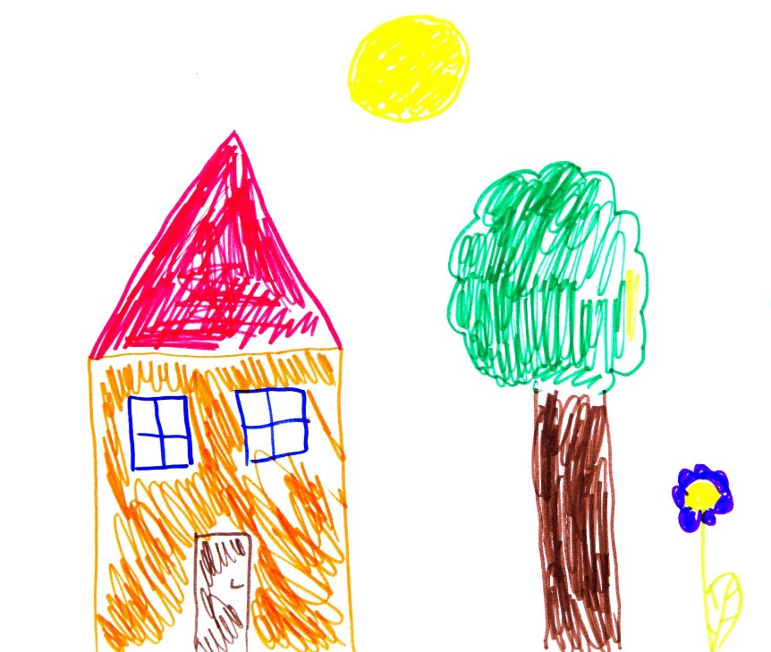
Home Education and Independent Schools
Home Education Flexibility​
Home education offers informal and flexible learning tailored to each child’s individual needs and pace.​
Registration and Assessment​
Children in home education require individual registration and assessment by AEARS to ensure educational standards.​
Independent Schools Characteristics​
Independent schools operate outside official recognition, following unique pedagogical or religious philosophies.​
Oversight and Compliance Challenges​
This educational mode allows diversity but presents challenges in oversight and adherence to statutory requirements.

Slide 7
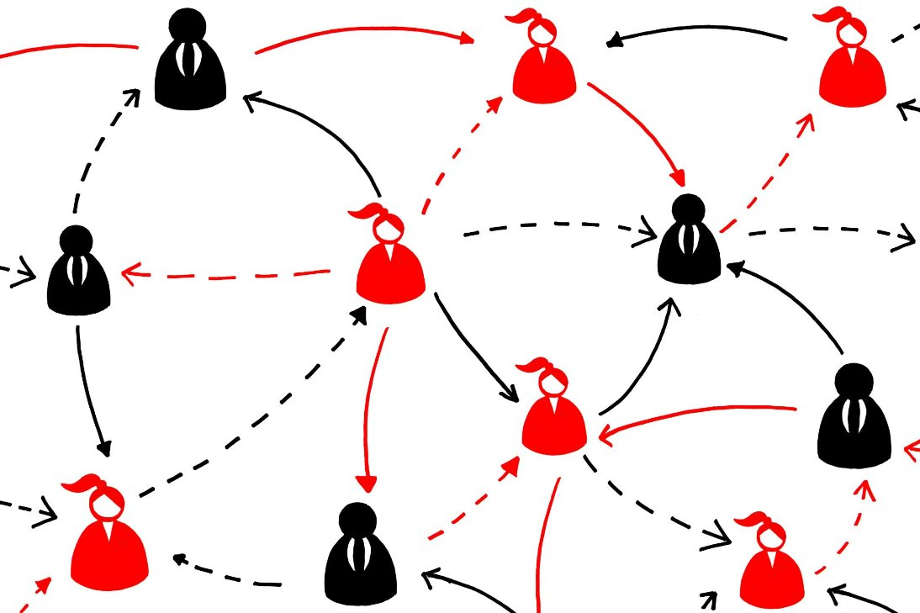
Systemic and Procedural Issues
Perceptions of Registration​
Families and Non-recognised schools can view home education registration as intrusive and burdensome, impacting compliance.​
Ambiguity in Education Definition​
Unclear definitions of 'certain minimum education' complicate registration and assessment processes.​
Systemic Gaps and Enforcement​
Lack of registration for non-recognised schools and lack of enforcement powers creates enforcement blind spots and weakens the system’s integrity.
Best Interests of the Child
The Children First Act 2015 mandates prioritising child welfare in all protection and education contexts in Ireland, but this is not reflected directly in Education acts.

Slide 8

Why Enforcement is necessary ? – The regulatory “biosphere”
A facilitatory model where a parental duty is vindicated by discretionary adherence to guidelines
The model incoherently permits high inherent risk and expects a high tolerance of residual risk by the regulator post registration.
High probability of misalignment rights and duties of parent and those of their children
Hidden harm is axiomatic

Slide 9

Setting the mission – Enforcement innovation
Enforcement as a risk response and not a sanction
Enforcement is neither light touch or last resort. Its purpose is to enable change or prevent inevitable harm
Re-sets the mission balance between the parent and the state

Slide 10
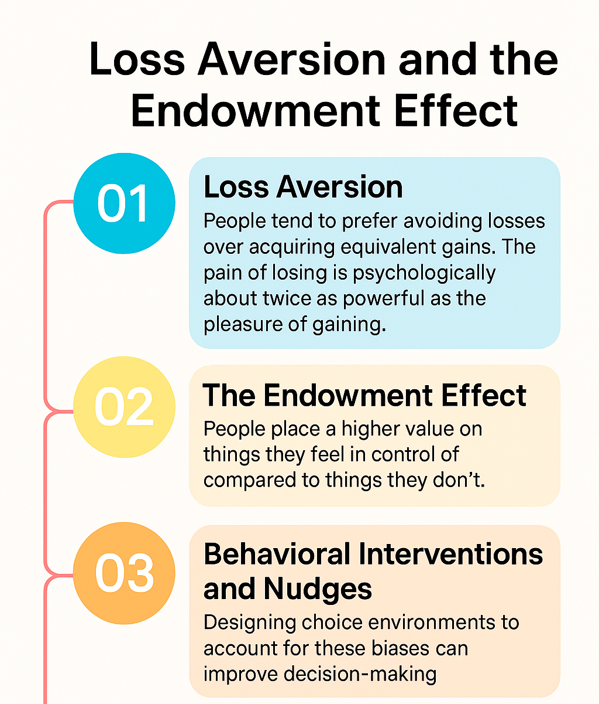
Enforcement as an agent of change – Principles
Leans heavily on foundations of behavioural economics
P1 Loss Aversion – The impact of loss is greater than the pleasure of equivalent pain
P2 Endowment Effect – People place a higher value on things they feel in control of compared to things they don’t
These principles apply equally to individual behaviour as to organisational behaviour

Slide 11

The strategic environment – adaptive regulation
Risk profiling from point of application
Earlier escalation and enforcement to reduce exposure to harm
Effective partnerships with other state bodies
Invitation to parent to revisit their duties and responsibilities

Slide 12

Thank you.

Slide 13


