Slide 1
Regulatory sandboxes: from safe testing to effective delivery
24th September 2025
39th EPSO Conference
Notes:
Today I’ll explore how regulatory sandboxes can help supervisory bodies like yours foster innovation in health and care, while safeguarding patients and vulnerable populations. We’ll look at OECD principles, concrete examples, and the opportunities for EPSO.

Slide 2
Overview
Theoretical Framework and Definitions
Setting up a Sandbox (OECD Toolkit)
From Sandbox to Regulatory Delivery
International Best Practices

Slide 3


The Dilemma: Innovation moves faster than regulation
fast innovation
cautious regulation
New (digital) tools emerge rapidly.
Traditional regulatory approval takes years.
Regulators face a difficult balance:
Too slow → patients and citizens miss out on benefits.
Too fast → safety, trust, and equity are at risk.
Regulatory sandboxes provide a “third way”: safe, supervised testing of innovation.

Slide 4
Theoretical Framework and Definitions

Slide 5
Theoretical Foundations: What is a Regulatory Sandbox?
Controlled environment for supervised testing of innovation
Regulatory flexibility
Defined structure
Risk management
Performance measurement
Stakeholder engagement
temporary relief from certain rules.
time-bound, clear conditions, exit plans.
safeguards to protect consumers and patients.
KPIs, monitoring, evaluation.
innovators, regulators, users, society.
Origins: Originated in fintech (UK FCA, 2016), now across multiple sectors
Purpose: to identify risks and opportunities, reduce uncertainty, and adapt regulation based on evidence.
Helps bring innovation to market faster and safer, with oversight.
Allows regulators to trial new regulatory approaches in a structured way.

Slide 6

Theoretical Foundations: EU Definition of regulatory sandboxes
EU has no single agreed definition of “regulatory sandbox.” Still, the Commission has developed reference points:
Council Conclusions (16 Nov 2020): set out key sandbox elements.
Better Regulation Toolbox – Tool #69:
Sandboxes = schemes for testing innovations in a controlled real-world environment, under a plan developed and monitored by a competent authority
Commission Guidance on Sandboxes (2023) outlines core principles:
Must involve a genuine innovative element.
Testing in a controlled real-world environment.
Operates under a specific plan developed with and monitored by a competent authority.
Includes safeguards to preserve safety and consumer protection.
Aimed at regulatory learning – producing insights to adapt rules.

Slide 7
Theoretical Foundations: Legal Derogations in Sandboxes
Flexibility within the law: Competent authorities may apply proportionate, context-specific approaches.
When derogations are used:
Require a specific experimentation clause in legislation as a binding legal basis.
Common in sectors like AI (AI Act: sandbox participants may avoid penalties if they follow guidance) and pharma (proposal allows “adapted, enhanced, waived, or deferred” requirements).
In some fields (e.g. energy), derogations may be granted via regulator ordinances if within their competence.
Important nuance:
A sandbox does not always require a legal derogation.
What is always necessary: involvement of a competent authority, linking the sandbox to current or future regulation.

Slide 8
Setting up a Sandbox (OECD Toolkit)

Slide 9

OECD Toolkit for Regulatory Sandboxes Purpose and Core elements
Purpose of the Toolkit
Provides practical guidance for governments and regulators on how to design, implement, and evaluate regulatory sandboxes.
Defines principles to make regulation risk-based, proportionate, and adaptive
Core Components of the Toolkit
Structured testing plans
Regulatory flexibility
Risk management
Monitoring and evaluation
Stakeholder engagement

Slide 10
OECD Toolkit for Regulatory Sandboxes Principles in Action (Health Sector)
Risk-based
Proportionate
Responsive
Focus resources on high-risk innovations (AI triage tools, new digital therapies) while applying lighter-touch supervision to lower-risk tools (e.g. wellness apps).
Regulations are adapted in real-time, based on lessons learned from sandbox trials, not only on theory.
Avoid overburdening small digital health startups with the same requirements as established pharmaceutical companies.

Slide 11
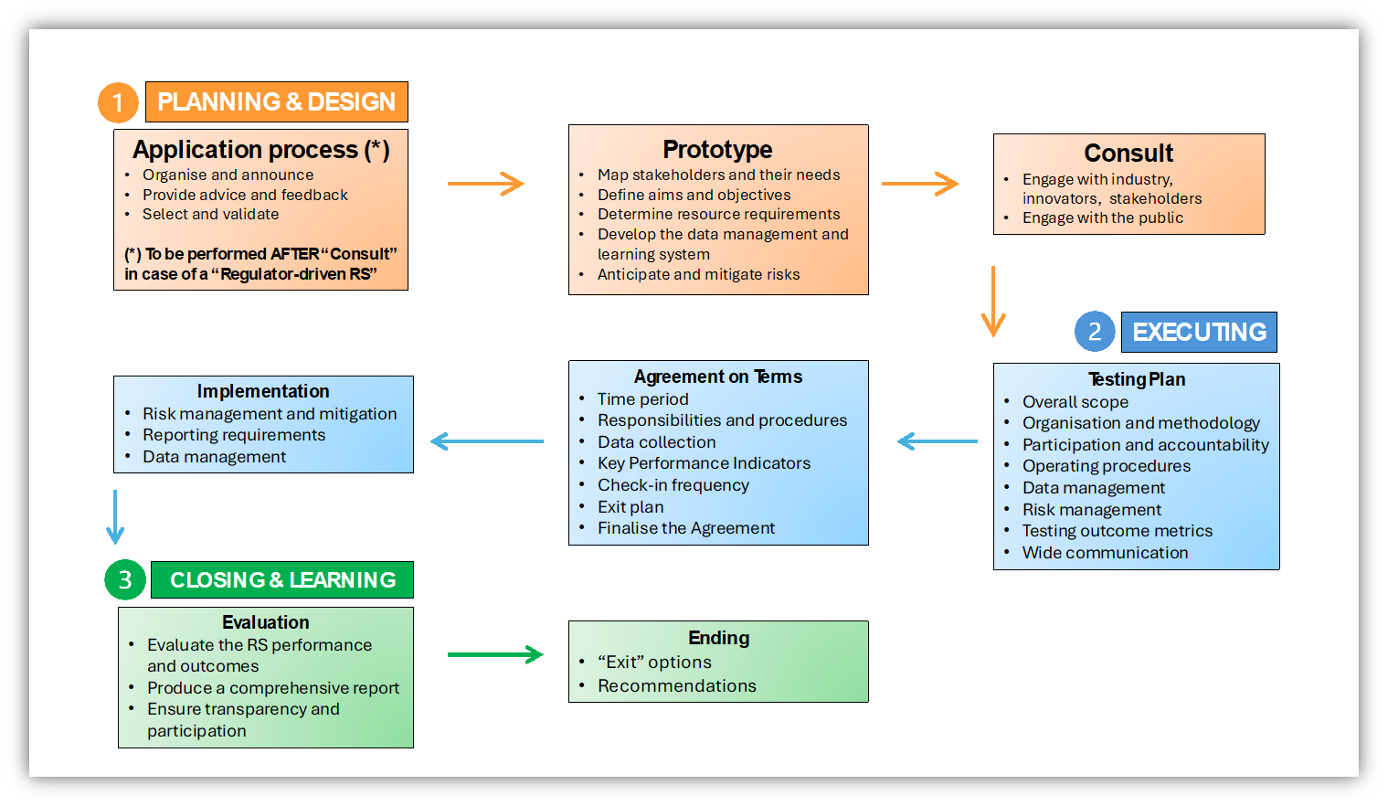
OECD Toolkit for Regulatory Sandboxes The Steps of a Regulatory Sandbox

Slide 12
OECD Toolkit for Regulatory Sandboxes Recommendations for implementation
Leadership and communication
Develop awareness of regulatory experimentation and implement a clear government policy to encourage agile and innovative approaches to regulating and policymaking more generally.
Institutional and policy co-ordination and guidance
Set up procedures for dialogue coordination and consider implementing measures to further institutionalise a community of practice in Croatia around RE and agile regulatory governance.
Work methods and knowledge management
Explore options to build in-house capacity and consider setting up a centralised repository of RE-relevant examples, data and information, and expanding it as RE practice develops
Stakeholder engagement and advice
Put in place mechanisms for public and stakeholder engagement regarding RE and the regulatory process more broadly and consider creating a one-stop-shop dedicated to regulatory experimentation
Capacity, resourcing and skills
Develop guidance and provide initial training to policy teams in ministries and agencies, while developing training and capacity-building opportunities for policy teams

Slide 13
From Sandbox to Regulatory Delivery: How Sandboxes Enable Regulatory Learning
Evidence base for regulation
Controlled testing reveals how innovations interact with existing legal frameworks.
Identifies outdated, ambiguous, or missing rules.
Capacity building for regulators
Hands-on exposure to emerging technologies
Regulators gain practical understanding beyond abstract reports.
Builds confidence in assessing risks and opportunities of new business models.
Adaptive learning and iteration
Sandbox results directly inform regulatory adjustments (guidelines, licensing criteria, technical standards).
Creates a continuous feedback loop: Test → Observe → Adjust → Update.
Collaboration and co-learning
Multi-stakeholder dialogue between regulators, innovators, consumers, and academics.
Joint problem-solving fosters mutual understanding of risks, safeguards, and market needs.
OECD Toolkit – Evaluation & Learning
Define KPIs and success criteria at sandbox entry.
Require monitoring, reporting, and stop-conditions.
Include exit strategies (graduation, further trials, discontinuation).
Results should feed into proportionate, risk-based regulation.

Slide 14
International Best Practices

Slide 15

Case Study Germany: Regulatory Sandbox Act (Reallabore-Gesetz)
Reallabore-Gesetz (2021):
Umbrella law creating a general framework for regulatory sandboxes.
Provides the legal basis for time-limited derogations (2–5 years) across sectors.
Federal ministries can insert experimentation clauses into sectoral laws (e.g. energy, digitalisation, health).
Safeguards
Projects require approval by the competent authority.
Must include risk assessments, monitoring, and reporting.
Derogations are limited in scope and duration, with revocation possible if risks arise.
Implementation Guidance for Experimentation Clauses
Developed alongside the Act to support lawmakers and regulators.
Promotes systematic integration of experimentation into legislative drafting.
Modular framework

Slide 16

Case Study France: CNIL Data Protection Sandbox (Digital Health)
Launched 2021 by CNIL (France’s data protection authority).
Focus: digital health (and EdTech) innovations → ensure GDPR compliance from the start.
Activities:
8 pilot projects supported (data networks, AI diagnostics, gamified therapy).
Months of one-on-one coaching from CNIL on privacy-by-design, anonymisation, consent, and security.
Collaborative sandbox: safe space to test without fear of immediate enforcement.
No legal exemptions – instead, tailored advice and regulatory guidance.
Outcomes
Published recommendations and best practices for the wider health sector.
Clarified how to train AI on real hospital data in a GDPR-compliant way.
Increased trust: innovators gained confidence, regulators ensured patients’ rights were protected.

Slide 17

Case Study UK: ICO Regulatory Sandbox (Data & Health Tech)
Run by: Information Commissioner’s Office (ICO), UK’s data protection regulator.
Focus:
innovative projects using personal data, with strong health/care participation (e.g. data-sharing platforms, AI diagnostics).
Activities:
Open application process; free support for accepted projects.
ICO works with innovators to identify privacy risks and design solutions.
Enforcement paused during sandbox → reassurance while working toward compliance.
Outcomes:
Joint reports and sector guidance published with participant consent.
Sandbox learnings have informed ICO’s wider GDPR guidance, e.g. on real-world health data use in research.
Built a knowledge base for privacy in digital health, benefiting both innovators and regulators.

Slide 18
Conclusions
Regulatory sandboxes are not about lowering standards.
They are about smarter regulation that balances innovation with protection.
For supervisors, sandboxes:
Provide early insight into risks.
Enable proportionate and adaptive regulation.
Strengthen public trust in innovation.

Slide 19
Thank you!

