Slide 1




  WELCOME to Dublin
  Jooske Vos - chair EPSO Board
TH
39 EPSO CONFERENCE
DUBLIN
SEPT 24-25 2025
#EPSODublin2025

Slide 2

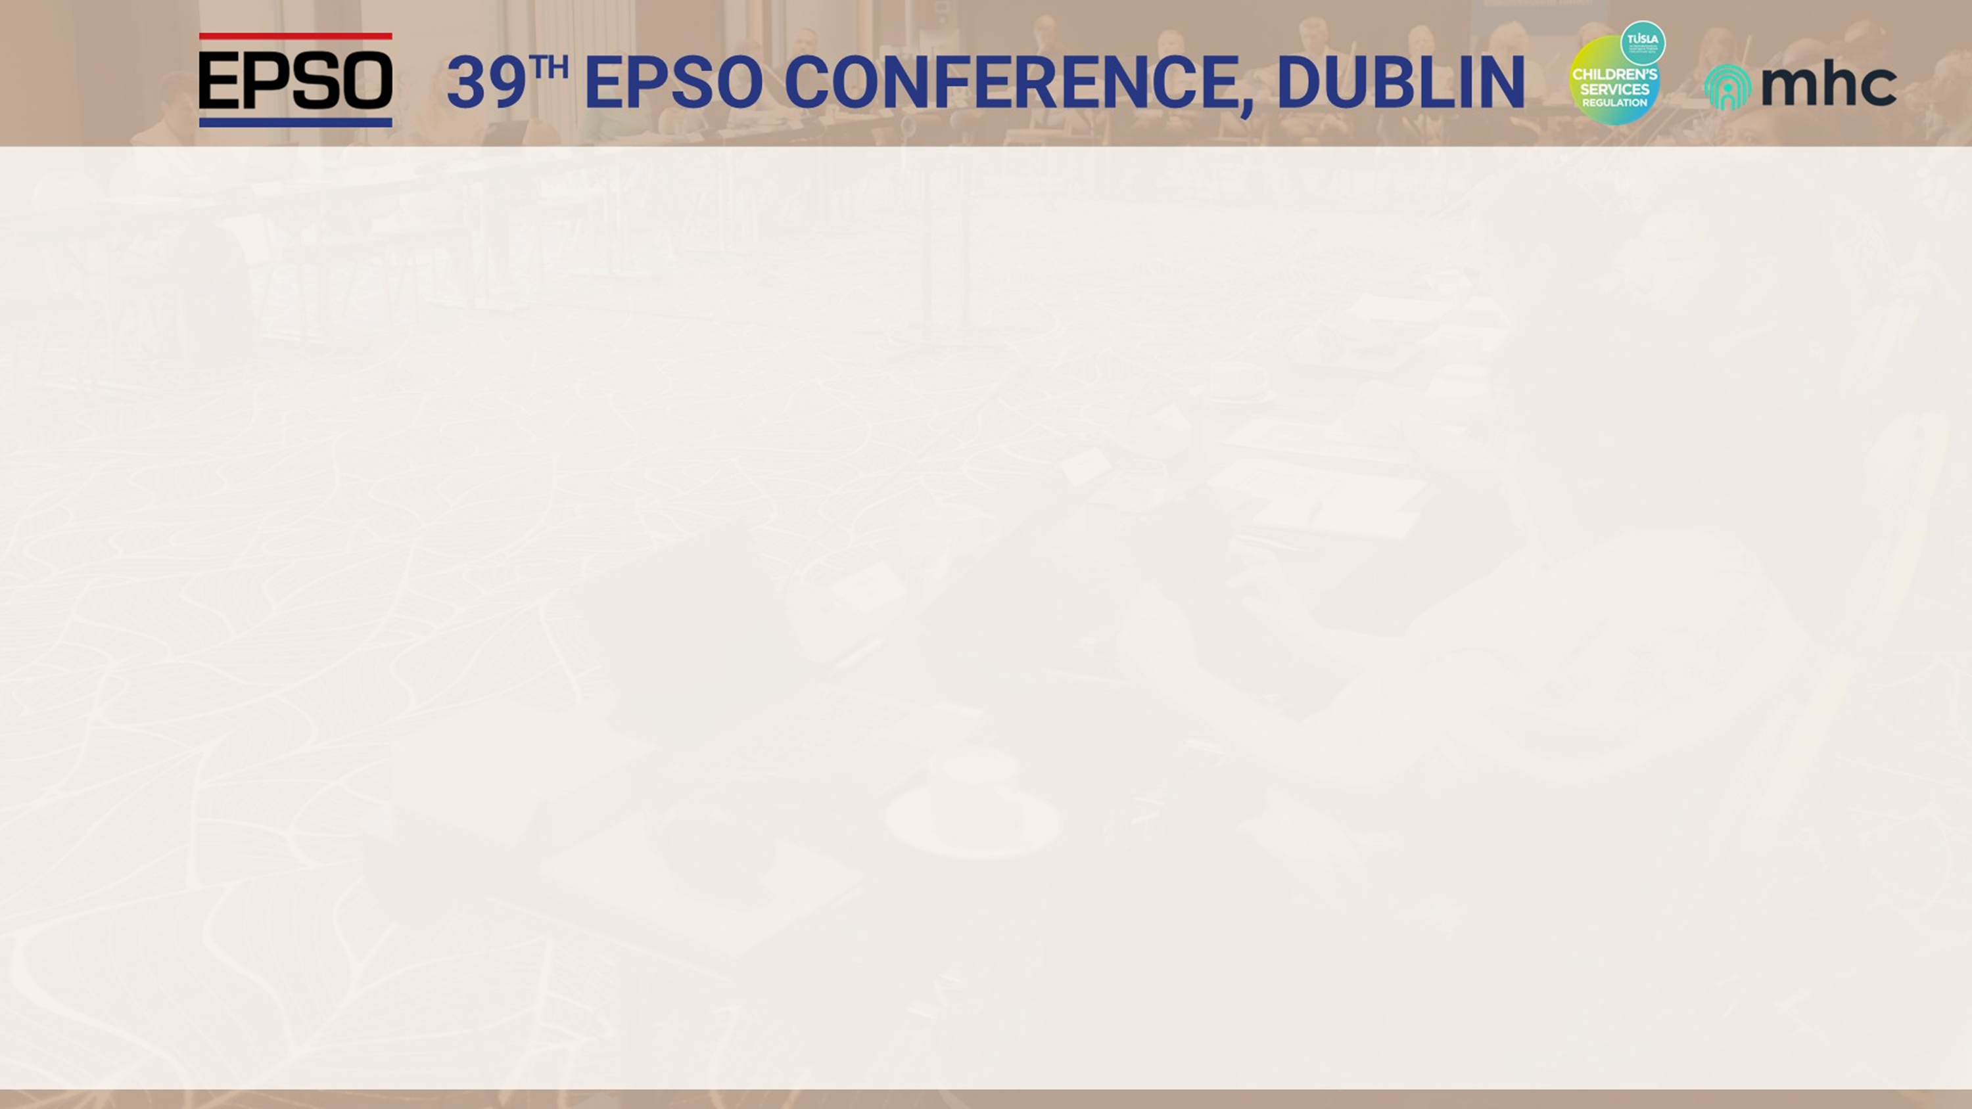

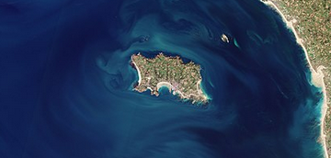
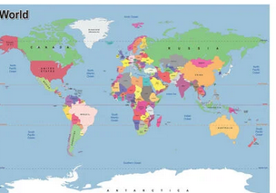
38 EPSO CONFERENCE, JERSEY
TH
What a challenge for such a small Island
to invite the EPSO colleagues
from all over the world
Good morning, all
My name is Jooske Vos - Chair of EPSO
However: What a result !
#EPSOJersey2025

Slide 3

38 EPSO CONFERENCE, JERSEY
TH
What a challenge for such a small Island
to invite the EPSO colleagues
from all over the world
A very warm welcome to all of you from all over the world!
We are so happy that all of you made it to Dublin !
However: What a result !
#EPSOJersey2025

Slide 4
38 EPSO CONFERENCE, JERSEY
TH
What are our conferences about
Get away from your familiar environment and
absorb new impressions on a kind of virtual “EPSO Island
give new ideas,
test existing ones,
provide opportunities for reflection;
make new friends
strengthen existing friendships;
connect with colleagues from around the world;
What a challenge for such a small Island
to invite the EPSO colleagues
from all over the world
However: What a result !
#EPSOJersey2025

Slide 5
38 EPSO CONFERENCE, JERSEY
TH
First: a big thank you for
Tusla and MHC
who kindly offered to host this 39th EPSO Conference.
May I have an applause for them
They have done a lot of work
spent a lot of time and money
to host your presence on this beautiful island Ireland!
Thank you : Fiona McDonnell, Grant Landon, Niamh O'Doherty!
Thank you: John Farrelly, Deirdre Myles!
What a challenge for such a small Island
to invite the EPSO colleagues
from all over the world
However: What a result !
#EPSOJersey2025

Slide 6

38 EPSO CONFERENCE, JERSEY
TH
What a challenge for such a small Island
to invite the EPSO colleagues
from all over the world
Sorry the presents we ordered for you in did not arrive timely 😞it will be sent afterwards 😊
But…we do have: very special EPSO tea and coffee cups to reuse at the office.
Here’s are the first ones for you!
However: What a result !
#EPSOJersey2025

Slide 7

38 EPSO CONFERENCE, JERSEY
TH
Before we start some words about this conference
We started with some hic ups
NFL American football in Dublin
Minnesota Vikings and the Pittsburgh Steelers
80,000 visitors- no hotels available 🙁🙁🙁
Our EPSO partners have these days 🙁🙁🙁
      Norway – their Nordic conference;
      Singapore Duke Nus - their conference featuring EPSO speakers
England and Scotland not allowed to travel at all 🙁🙁🙁
What a challenge for such a small Island
to invite the EPSO colleagues
from all over the world
However: What a result !
#EPSOJersey2025

Slide 8

38 EPSO CONFERENCE, JERSEY
TH
What a challenge for such a small Island
to invite the EPSO colleagues
from all over the world
Should we postpone or reschedule?
          Would enough people attend?
          Would we even find an affordable hotel in Dublin?
We thought about you our loyal and dedicated colleagues
Focused on a GREAT PROGRAMME a very special Conference!
However: What a result !
#EPSOJersey2025

Slide 9
38 EPSO CONFERENCE, JERSEY
TH
What a challenge for such a small Island
to invite the EPSO colleagues
from all over the world
Look now, here we are:
more than our maximum of 50 (delegates and speakers)
to discuss incredibly interesting topics that affect us all !
on which we undoubtedly all have something to say
fantastic speakers
a truly beautiful venue
a wonderful social Programme
And…
Colleagues even from New Zealand, Japan , Hong Kong and Singapore in-person
WHAT MORE COULD WE WISH FOR?
However: What a result !
#EPSOJersey2025

Slide 10
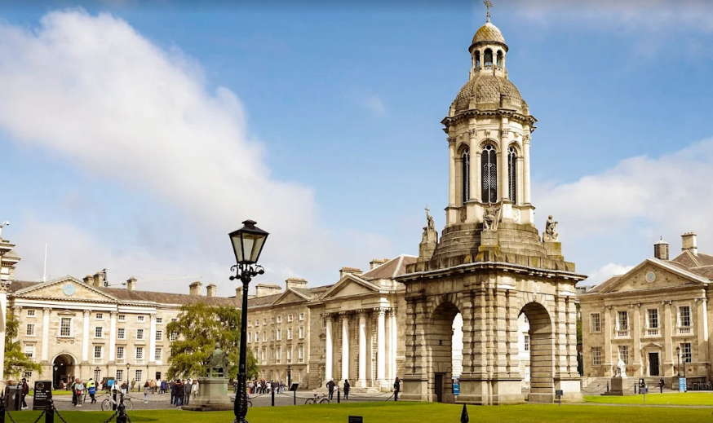
38 EPSO CONFERENCE, JERSEY
TH
All together in-person on this beautiful and fascinating island of Ireland, brimming with history and the connections between science and healthcare.
a great working environment full of energy; with a desire to learn from each other and work together on better regulation in healthcare- mental health care and childcare.
We only have to look at Trinity and its links to Medical innovation over time,
and we know we're in the right place.
What a challenge for such a small Island
to invite the EPSO colleagues
from all over the world
However: What a result !
#EPSOJersey2025

Slide 11
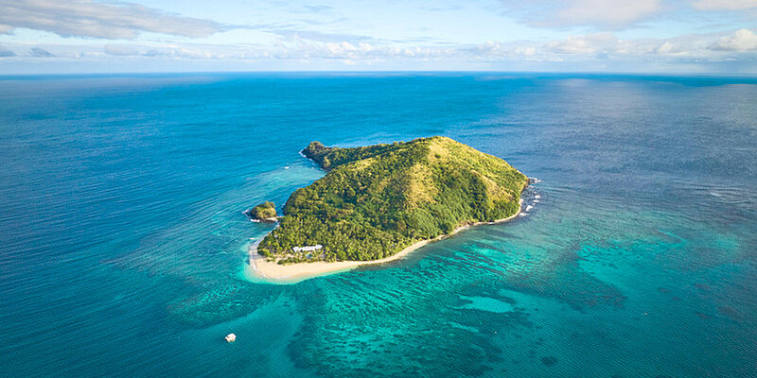
38 EPSO CONFERENCE, JERSEY
TH
What a challenge for such a small Island
to invite the EPSO colleagues
from all over the world
before finishing this introduction let me ask you a question:
What does EPSO have to do with islands?
Jersey -one of the smallest islands in Europe.
Saaremaa -one of the largest islands in Europe.
Wales -part of the largest island in Europe, also mention
Malta- most beautiful in the meditterranian
Iceland -most Nordic
Ireland most fascinating !
However: What a result !
#EPSOJersey2025

Slide 12
38 EPSO CONFERENCE, JERSEY
TH
What a challenge for such a small Island
to invite the EPSO colleagues
from all over the world
no, we do not have a special relationship with islands!
But …. we do have something with “the island feeling”
However: What a result !
#EPSOJersey2025

Slide 13

38 EPSO CONFERENCE, JERSEY
TH
Let me explain :
The island feeling stands for networking in a small community
    where communication and feedback are essential
    where the introspective aspect of being on an island
    can make the islanders to look at their own practices and think about improvement.
A sense of safety and protection shielded from the outside world
What a challenge for such a small Island
to invite the EPSO colleagues
from all over the world
However: What a result !
#EPSOJersey2025

Slide 14
38 EPSO CONFERENCE, JERSEY
TH
What a challenge for such a small Island
to invite the EPSO colleagues
from all over the world
For us at EPSO
this ‘island feeling’ stands for the feeling to connect as if on an island, to be free to share knowledge, to learn from colleagues,
to share innovative but also good and bad practices, to learn from good but even more from bad practices.
important to have that island feeling two times a year at our conferences
Our virtual EPSO island makes it possible to learn, think and get inspired twice a year sometimes even on a real island like Ireland
However: What a result !
#EPSOJersey2025

Slide 15

38 EPSO CONFERENCE, JERSEY
TH
What a challenge for such a small Island
to invite the EPSO colleagues
from all over the world
We are absolutely convinced that this will happen again in Dublin
        You will learn
        You will be inspired to think
        you will also have FUN
We from EPSO wish you a wonderful conference !
And afterwards please give us your feedback
At office@epsonet.eu or info@epsonet.eu
However: What a result !
#EPSOJersey2025

