Slide 1
Professor James Kingsland OBE
Primary Care Physician
Clinical Professor, School of Medicine, UCLan
Visiting Professor, Tribhuvan University, Nepal
Chair, Digital Clinical Excellence Forum (DiCE) UK
Clinical Advisor, MoH, Singapore
Notes:
Some considerations about digital healthcare and its regulation

Slide 2
Healthy Ageing and access to healthcare Is it DOB dependent?
Notes:
Understanding different demographics. Up to 2010 there were 6 defined generations living now in a rapidly changing world. Regulation may have to be dynamic and responsive to different age groups and their needs and rislks.
Most of the following data about generational trends comes from US and Australian research… there’s been little done on this in Europe.
Planning services and their regulaltion for the future should be based on a deep understanding of the customer (person who becomes a patient) need/want.
We need to be careful about generalizing a ‘new normal’ for all as some provision may revert as well as moving to a combination of AI and genomics axis. we just need to know how much.

Slide 3
..and now…Generation Alpha
Notes:
The hopes, fears and expectations of the current generations. The ‘greatest generation (1901 -24) is an ever-decreasing number. However still some living who remember life without aeroplanes, TV (and radio), electricity & refridgerators.
The silent generation (1924 -45) which make up the ‘Maturists’ who are still alive but born before the end of the second WW number more than 5.5 million who are over 75, 1.5 million over 85 and 0.5 million >90. It is unlikely that this generation will adapt to the digital age of medicine and still expect the care delivery in the form they’ve had since the NHS was created. They incorporate stay-at-home mothers, children who were seen but not heard, had jobs for life and largely encourage to conform with the social norms, despite the rise of civil rights leaders. They have little or no experience of utilizing technology in the home or work and will have great difficult in adapting.
The Baby Boomers post 2nd WW, tuned in, got high and dropped out and became the swinging sixties and hippy seventies. They used slide rules and then early calculators at school and still have variable adoption of technology.
Generation X – street smart but more isolated. Yuppies, but most still remember being at school without computers. Regular career changes unlike previous generations and late to marry, early to divorce. The MTV generation, often in debt and digital immigrants.
Generation Y – the millennials have delayed steps into housing and marriage and living with parents for longer. They have come of age during this technological time of globalization and economic disruption. Technology wise they are the first generation of digital natives which defines the way they shop and use healthcare (when they are relatively well and want rapid information about early symptomatology)
Generation Z born after 1995 have never known a world without technology, computers and moile phones. They don’t know who Elvis is. Expecting digital consultations (over 16 yr olds) but only make up 10-115 of the population. Globally focused, virtually engaged, educationally transformed and experiment with nano computing, 3d printing and driverless care. Technoholics entirely dependent on IT…. But is that their only future? What happens when they age, become chronically ill and then may want (need) the humanistic skills of a healer?
And now Gen Alpha. The first to be born entirely in the 21st C and born at a time of falling fertility. Children of the millennials or younger siblings of Gen Z. Born from 2010 -2024, children during the covid-19 pandemic and dominated by electronic technology, social media networks and streaming services. By 2025 possibly 25% of the world population and majority living in Asia and Africa. Europe and Americas tend to have too few children to replace themselves.
Generation Alpha – born between 2010 – 2024. Children of Generation Y. First generation entirely born in 21st Century with deep immersion in technology from a young age. Digitally native and highly adaptable to new technologies. Globally connected, relying on technology, redefining education, careers and health need..and as of today there’s approximately 2 billion of them worldwide.
Generation Beta from 1 January 2025. A cohort born up to 2039. What will be their needs and expectations…particularly from health care provision.

Slide 4
‘Free at the point of need and not based on anyone’s ability to pay’
Figures from the Association of British Insurers (ABI) reveal that a record 4.7 million citizens were covered by Private Medical Insurance (PMI) through their employer in 2023 – the highest in more than 30 years of data collection. There is a year-on-year linear increase.
Around 53% of people say that they would like to invest in some form of health insurance scheme for their employees or themselves and their families.
The Independent Healthcare Providers Network (IHPN)’s UK Going Private 2024 report – which takes a comprehensive look at public attitudes and behaviours around private healthcare – found that almost seven in ten of people (67%) say that they would consider using private healthcare, with over one third (34%) saying they would pay for treatment in the next 12 months if they needed it. This rises to almost half (44%) of 25-34-year-olds who expect to use private healthcare in the coming year.
There are roughly 8 million people in the UK with active private health insurance policies in 2024, which is around 13% of the British population.
It is estimated that in 2024, 25% of the British public sourced treatment from the private healthcare sector.
Why Faster access to treatment. Shorter waiting times for all services. Increasing NHS waiting times (1.4M > 1 year ONS 2024).
Clinic or consultant choice. Seniority of clinician and decision making.
More intimate, confidential, personalised and courteous.
Private rooms.
Insurance good for large medical bills
Other perks and benefits
Notes:
It's common knowledge in the UK that the NHS is under pressure and this is one of the main reasons more people are deciding to take out health insurance or self-paying for private healthcare.
Statistics from the Office for National Statistics (ONS) released last year (2024) revealed 1.4 million people wait longer than a year for an appointment and one in five people in England are stuck on a waiting list.
Being on a long NHS waiting list can have a knock-on effect on our health when suffering with injuries or illnesses; injuries can worsen, diseases can progress, and the emotional stress can impact quality of life.
There are many benefits of health insurance policies.
These vary among health insurance providers but most do offer:
A digital GP with 24/7 access to telephone and video support
Mental health and well-being support
Gym membership discount and discounted fitness products
Lifestyle and nutrition consultations
Cancer cover
These additional benefits can be a contributing factor to taking out private health insurance and help to create or maintain a healthy lifestyle.

Slide 5
Service Quality – What matters to patients hierarchical value
Availability and accessibility – waiting and access is the public’s top concern. Flexibility of provision.
Local and Responsive – largely provided in their community
Communication skills – ‘bed-side manner’
Interpersonal attributes of care – listening, empathy, patience, time management
Continuity of care – consistency in their trusted healer
Range of on-site services – ability to have comprehensive and timely assessments
Technical competence – surprisingly low on the list!....or is it?
What matters to patients? A timely question for value-based care July 9, 2020
https://doi.org/10.1371/journal.pone.0227845
Notes:
As we move towards patient-centred and value-based care models, patient needs (which are usually wants) remain largely unchanged over time, but vary slightly with demographics. These are unlikely to change in a more digitally orientated future. Tony Blair said…when there was ‘only 24 hours to save the NHS’, that the public’s top concern about the NHS was waiting and access.. And so it remains. Covid 19 has undoubtedly worsened this. Non clinical, humanistic factors remain vitally important; compassion, personality, bedside manner, listening and patience. The continuity of care may now be through a comprehensive patient care record, easily transferred and accessible between health and care professionals. Whilst valuing clinical quality of care, technical competence is rarely at the top of the list.. As Edwards Deming famously said… 97% of what’s important in most organisations isn’t measured.

Slide 6
Care modelling
Telemedicine
Telehealth – e-health – m-health - digital health
Telecare - Telemonitoring – Teleconsultation (real-time vs asynchronous approaches)
Technology enabled healthcare – telehealth teams (retaining humanistic factors)
Connectivity
Satellite technology
Most recent accelerator – Covid-19 pandemic
Health Inequalities – digital exclusion
Notes:
Terminology often used interchangeably. Definitions complex and multifaceted.
Telehealth is the use of digital information and communication technologies to access health care services at distance and remotely manage an individual’s healthcare needs.
Covid-19 realisation how to keep safe if individual has infectious disease
Satellites to connect healthcare professional remotely, especially in disaster zones. Track spread of diseases and identifying risks. Disaster management and co-ordinating relief efforts. Space technologies to test therapies before applied in practice – digital twins of patients. Social distancing (avoiding crowds) – crowdless app.

Slide 7
European Health Data Space
Notes:
EHDS came into force in the European Union on 26 March 2025
The infographic visually represents the key aspects of the European Health Data Space. At the centre, different sources of health data, including electronic health records, medical apps, and registries, are highlighted. Various groups benefit from the EHDS: individuals gaining more control over their data, health professionals accessing relevant patient information, policymakers utilising health data for decision-making, and researchers benefiting from improved data access. The overall aim is to enhance healthcare outcomes, foster innovation, and create more efficient health policies across the EU.

Slide 8
Digital Clinical Excellence https://digitalclinicalexcellence.com/
Supporting service quality, clinical care improvement and safety in digital healthcare to develop excellence in digital care standards.
To also build public trust in online healthcare.
Notes:
This forum for Digital Clinical Excellence 'DiCE', is a network whose aim it is to drive excellence and improve quality and safety in digital healthcare. Created in March 2019, it provides a collective clinical voice for the growing community of digital healthcare providers. It benefits from a depth and strength of construct through the alignment of three stakeholders; DiCE central PMO team; network participants; professional and regulatory bodies (CQC, GPhC, GMC, HFMA, Royal Colleges as well as DHSC and NHSE and NHS Scotland.

Slide 9
Joining DiCE and onboarding with Credentially
Process
Updated terms of reference
Added assurance checks
Digitalised and streamlined process through Credentially
Piloted with 4 new business
Used feedback to drive improvement
Protecting our reputation
Company profile
Questionnaires
- Application form
- Social media
Terms of reference
Optional
- Real time registration and DBS checks

Slide 10
Assurances
Application form
Company’s House checks
Who is your regulator?
Roles and responsibilities
Declarations
Inspection reports
Reason for joining DiCE
Social media checks
List of channels
Spot check on a sample from each channel
Advertising compliance

Slide 11
Quality assurance
Best Practice Guidelines
BPGs
5 active
Dynamic working documents –
in the style of NICE guidance
Review and Updating –
Sub-group monitoring
Future BPGs – more generic
1 in preparation

Slide 12
The DiCEMark™

Slide 13
DiCE Mark Governance Framework - Discussion
Key elements
Understanding the business and the use of digital technology
Previous inspection reports
Clinical safety
Data protection
Cyber security
Reviews, Marketing, Google search
Utilisation of BPGs
How to be recognised as a quality marker by regulators and public
ASA compliance
Challenges
DiCE is not a regulator (nor aims to be!)
Proportionality of governance (productive not onerous)
Applicable to both GPhC and CQC registered providers
Obtainable for both small and large organisations
Manageable for both organisation and peer reviewers (not too labour intensive or expensive)

Slide 14
Considerations
Licensing in the jurisdiction of the patient as well as the clinician’s own jurisdiction
Individual, provider organisation or system as a whole
Maintaining the same standards of care through telemedicine as when face to face
Maintaining patient records and maintaining confidentiality
Consistency between regulators both nationally and internationally
Comparison with other industry approaches
Dynamic approach
Assurance in patient safety
Notes:
Doctor is say physically based in Singapore but patient is in the UK
Training, qualifications, experience, code of conduct, scope of individual’s practice, fitness to practice
3. Quality in treatment of a patient should be independent of consulting environment
4. May help promote universal EPR – but access may be a problem
5. UK has several regulators; Medicines and Healthcare Products Regulatory Agency (MHRA), CQC (England) HIS, GPhC, GMC, NICE, Healthwatch
6. Financial services, engineering or surveying, airlines
7. In some jurisdictions telemedicine has been practiced for many years and relatively common – but new applications of telemedicine bring new challenges and risks so relevant regulation may need to evolve.

Slide 15
Regulating asynchronous digital health
identity verification (patient and practitioner)
Informed consent process and capacity assessment
Validity of assessment tools (including form-based assessments) detailing past medical history and current clinical picture
Access to patient’s long-term medical records. Privacy, confidentiality and security of personal data and medical records
Clinical decision-making support systems and their accuracy
Process for determining risk/benefit analysis, scientifically evidenced to inform viable and effective treatment options
Ability to diagnose and treat without physical examination or low-quality images
Follow up arrangements and further support plus any additional educational materials for patients,
including the reporting of side effects and adverse reactions
Referral policies to/from telemedicine practitioner
Notes:
Case study of leadership. Controversy in UK about online weight management. Poor leadership in debate. DiCE showing leadership in solution focussed approach.

Slide 16
The UK public is opting for weight management medications through digital healthcare providers
Growth driven by GLP1’s being used to treat weight management
1,527k packs in March 2025, Mounjaro and Wegovy packs contain 1x Pre-filled syringe with 4 doses for once weekly administration (i.e. 1 pack per patient)
Mounjaro – indicated for Type 2 diabetes and weight management. Recent growth in NHS usage assumed usage for Mounjaro’s diabetes indication
Wegovy – indicated for weight management only
NHSBSA data only available up to January 2025 (Scotland Dec 2024). Private market reflects all supply for these months

Slide 17
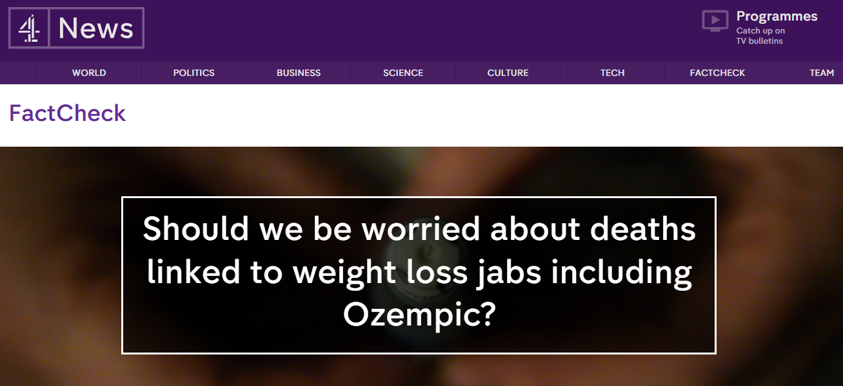
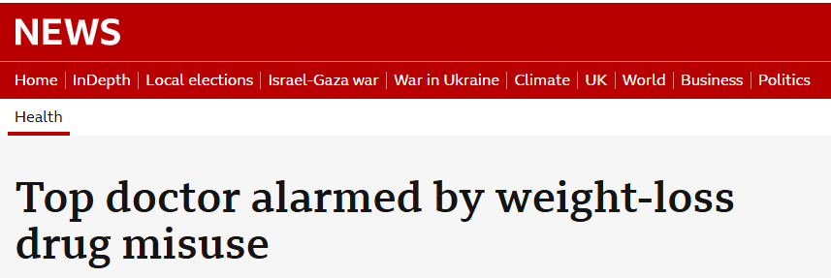
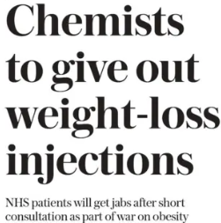
The digital healthcare provision of Wegovy and Mounjaro is disrupting conventional NHS access to medicines-causing tensions

Slide 18
The digital healthcare provision of Wegovy and Mounjaro is disrupting traditional NHS models and causing tensions
Reputable digital healthcare providers are being collectively criticised, irrespective of their compliance with Good Practice Guidelines for Independent Prescribing and the quality of their patient support programmes
Over 1.5 million UK citizens a months access Mounjaro and Wegovy via Online Digital Providers - taking proactive control of their weight management
Digital Healthcare Providers being positioned by the Professional Bodies, NHS leadership as putting patients at risk
Digital Health Providers of GLP1s are disrupting the traditional NHS model of doctors as ‘gatekeepers’ to innovative medicine and care
The NPA has written to the General Pharmaceutical Council (GPhC) calling out safety concerns and demanding tougher controls
Society for Acute Medicine-calling out inappropriate use; RCGP call out on use without clinical supervision; NHSE CMO highlighted the dangers of GLP! use without clinical supervision
Pharmacy and clinician organisations are increasingly vocal about their concerns regarding the safety and governance of GLP1 provision by independent providers
Obesity impacts underserved populations disproportionately, many of whom are not in employment
Digital healthcare providers are seen by some in the NHS as exacerbating health inequalities that impact deprived populations
HCPs are encouraged to report all suspected AEs to these medicines through the Yellow Card Scheme
There is concern that digital healthcare providers may compromise the principles of the Black Triangle scheme
Wegovy and Mounjaro are ‘Black Triangle’ drugs –as such they require intensive monitoring post license

Slide 19
The study will evaluate real-world treatment efficacy, safety & clinical outcomes in participants receiving weight management medication through DiCE network
DiCE Study: Primary and Secondary Research Objectives
Unified data: a foundation for generating robust, nationally representative, clinically meaningful real-world insights
Capture broader patient experience | Greater Statistical Power | Improved Data Quality | Richer Insights
Type: Retrospective real-world study
Focus: Participants using digital health platforms to access anti-obesity medications
Scope: Demonstrate benefits of digital-first, wrap-around care models
Key Features
Emphasis on improved patient outcomes through digital care pathways
Demonstrates the viability of digital-first care models, informing future regulatory frameworks for digital therapeutics and remote prescribing
Showcase system-level safeguards in place to ensure patient safety
Primary objectives aims to:
Demonstrate efficacy, safety, adherence and governance of digital first wrap-around care
Illustrate effectiveness of digital health interventions
Showcase best-in-class digital weight management tools
Secondary objectives:
Investigate socio-economic impact: Does digital delivery reduce barriers to access, particularly among lower-income and mobility-limited populations
Explore system-level safeguards ensuring safe prescribing
Impact on healthcare resource utilisation
What is the aim?
What are the objectives?

Slide 20
This RWE Study will enhance the Reputation for Clinical Excellence and Leadership of DiCE Alternative Model of Care
Reputation
Reach
Revenue
Rules
Demonstrating excellence in digital provision of innovative medicines
Demonstrating commitment to research
Enhancing reputation with NHS institutional bodies that they are trusted providers with patient interest at heart
Enhancing visibility and reputation with government ministers about contribution DHPs are making to obesity crisis and potentially economic growth Regulatory authorities (e.g. MHRA) to provide useful insights on side effects, dosing etc
Assurance to NHS - demonstrate clinical excellence. Most citizens have positive outcomes when taking medications prescribed by DHPs
Reach to senior policy makers (obesity and prevention policy makers),
Government demonstrating contribution to NHS goals (analogue to digital, sickness to prevention, hospital to community) and economic productivity
Cost of Provision & Clinical Cost Effectiveness with a new Model of Care-NICE/NHSE agenda
Reach to manufacturers who will have even greater appreciation of the DHPs in generating access and innovative medical evidence generation
Becoming trusted partners within the institutional pharmacy community of the NHS and NHS clinicians
Positive publicity – balance negative coverage by having accurate info
UK citizens will prefer a provider that has taken part in evidence-based research approach than a simple provider of drug
Pharmaceutical industry will apply value to obesity data across multiple providers to perform ongoing research
Pharmaceutical industry will see private providers as a new means of improving access to innovative medicines that the NHS phase are not affordable e.g. dementia treatments
Investors – disruptor to current treatment landscape
Governance of weight management
Establish evidence to influence policy and governance
Rules by which deliver care
Publications
Reporting accurate information
The study output will be a comprehensive whitepaper showcasing the value of digital health solutions, officially launched to the UK government to help inform positive policy change within the healthcare system.

Slide 21
Sustainability – why reforms often fail, particularly in relation to the transition to more community or digitally delivered services?
Care reform cannot ultimately be sustained
without
payment reform
resulting in
institutional reform
Notes:
Fundamental principles, internationally recognised but rarely enacted.
The reason why transition to more community based (primary care-led) services is so difficult.
Most healthcare systems are intuitively, emotionally, historically in modern times, and politically driven to focus on hospitals. It is also driven by hierarchy, risk, indemnity, media and public perception of what is most important.

Slide 22
Thank you
James.Kingsland@nhs.net
james.kingsland@btinternet.com
X @JamesPKingsland
LinkedIn:James Kingsland OBE

