Slide 1
The importance of regulation in ensuring high quality care, building better and sustainable regulatory practice with a focus on learning (including patients and stakeholders)
Nigel Acheson MD FRCOG
Chair, Jersey Care Commission
16th June 2025

Slide 2
How regulation supports delivery of high quality care
Regulation implemented, which leads to changes in
The behaviour of individuals or entities targeted or affected by regulation, which ultimately leads to changes in
Outcomes
(Cary Coglianese, Evaluating Regulatory Performance, University of Pennsylvania Carey Law School, 2023)

Slide 3
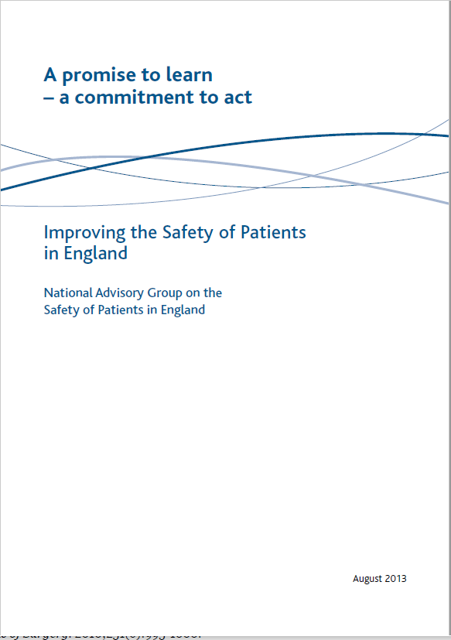


Slide 4
A promise to learn, a commitment to act, Berwick, 2013
“For [all] staff:
Participate actively in the improvement of systems of care
Acquire the skills to do so
Speak up when things go wrong
Involve patients as active partners and co-producers of their own care”

Slide 5
A promise to learn, a commitment to act, Berwick, 2013
“For patients and carers:
As far as you are able, become active partners in your healthcare and always expect to be treated as such by those providing your healthcare
Speak up about what you see – right and wrong. You have extraordinarily valuable information on the basis of which to make [services] better”

Slide 6
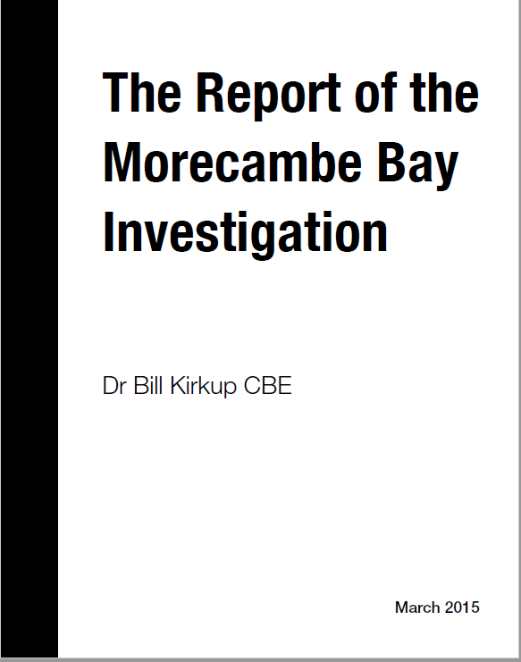

Slide 7
“The prime responsibility for ensuring the safety of clinical services rests with the clinicians who provide them.”
“The prime responsibility for ensuring that they provide safe services, and that the warning signs of departure from standards are picked up and acted upon, lies with the trust.”
The Report of the Morecambe Bay Investigation

Slide 8
CQC publication, March 2020
Getting safer faster: key areas for improvement in maternity services
Governance, leadership and risk management
Individual staff competencies, team-working and multiprofessional training
Active engagement with women using maternity services
“It is particularly concerning that some of our inspections have found that issues identified in the Kirkup report 5 years ago are still affecting the safety of maternity care today”
Nigel Acheson, deputy chief inspector and lead for maternity

Slide 9
High reliability – impacted by vested interest of hospitals, health care professionals, professional representative organisations, commissioners
Chassin and Loeb. “High reliability health care: getting there from here”. Millbank Q; 2013; 91: 459-490

Slide 10
High reliability – impacted by vested interest of hospitals, health care professionals, professional representative organisations, commissioners
Chassin and Loeb. “High reliability health care: getting there from here”. Millbank Q; 2013; 91: 459-490
Can regulatory practice support the delivery of high quality care with high reliability?

Slide 11
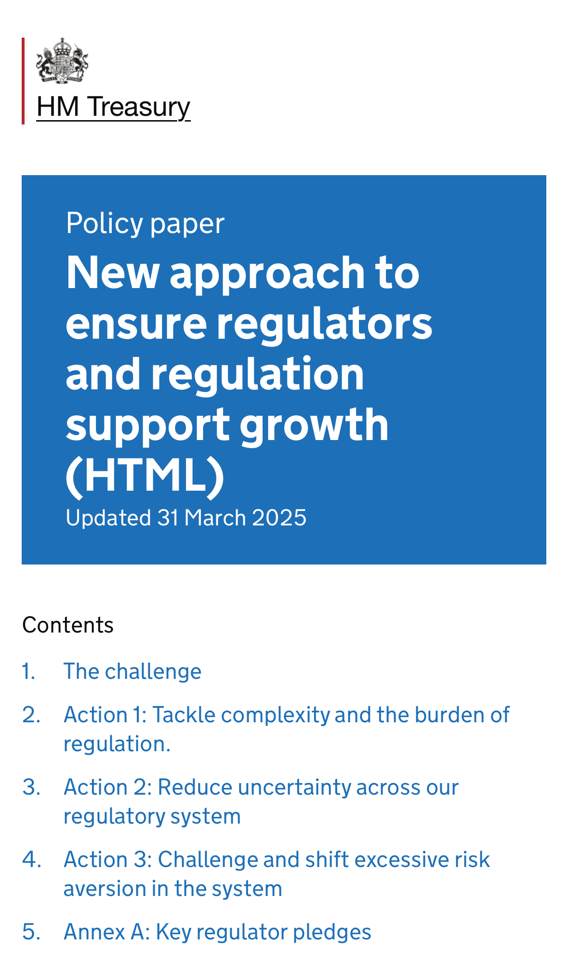
Need regulation to show value and effectiveness
Tiering and risk assessing regulated providers
Proactive assessment of risk
Data – harnessing and work with others
Patients as partners
“Don’t fight regulation, reprogramme it”
Bill Gates, Microsoft

Slide 12

Tiering and risk assessing providers
It is possible to assess the risk/complexity of the regulated activity being undertaken and the capacity and capability of the leadership in the regulated provider.
Using this information a matrix can be constructed to guide the types/frequency of regulatory activity

Slide 13
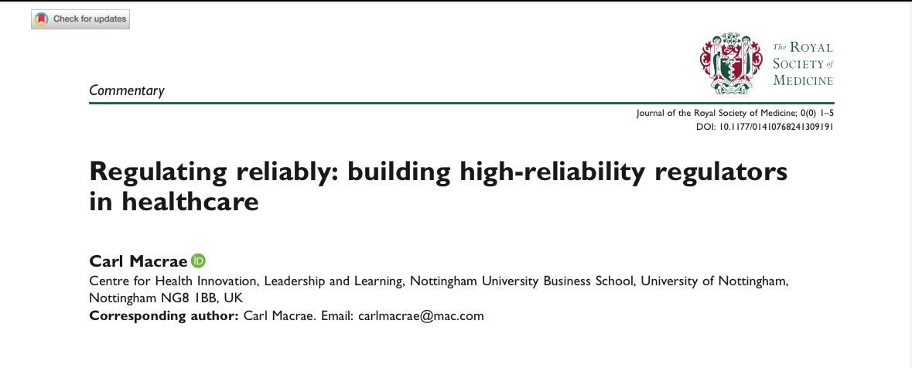
Proactive assessment of risk
Maternity
Artificial intelligence

Slide 14
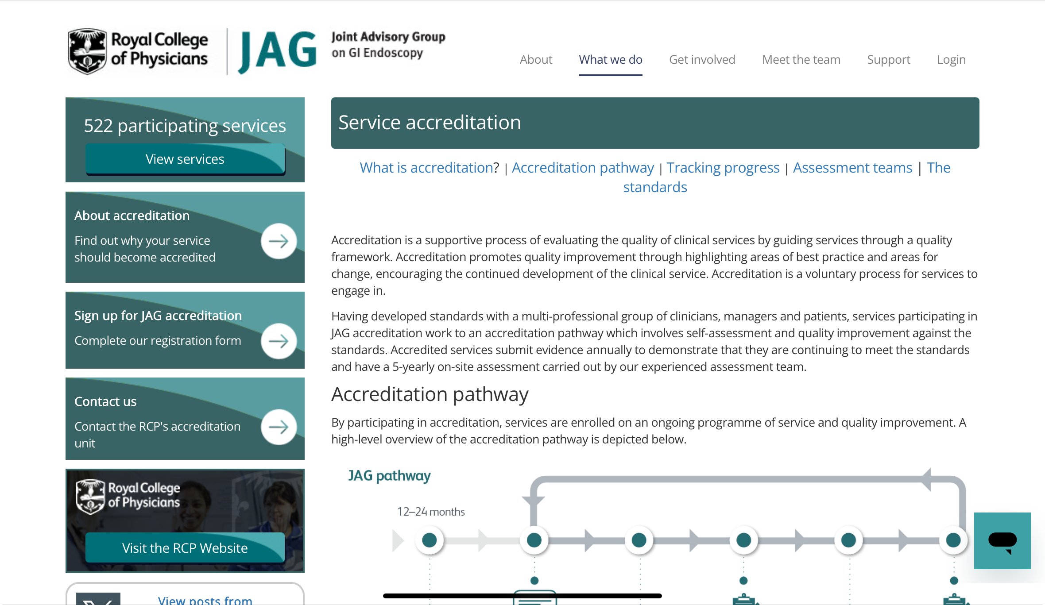
Harness and work with others:
National clinical audit
CQC outlier programme
Identifies and supports
improvement

Slide 16
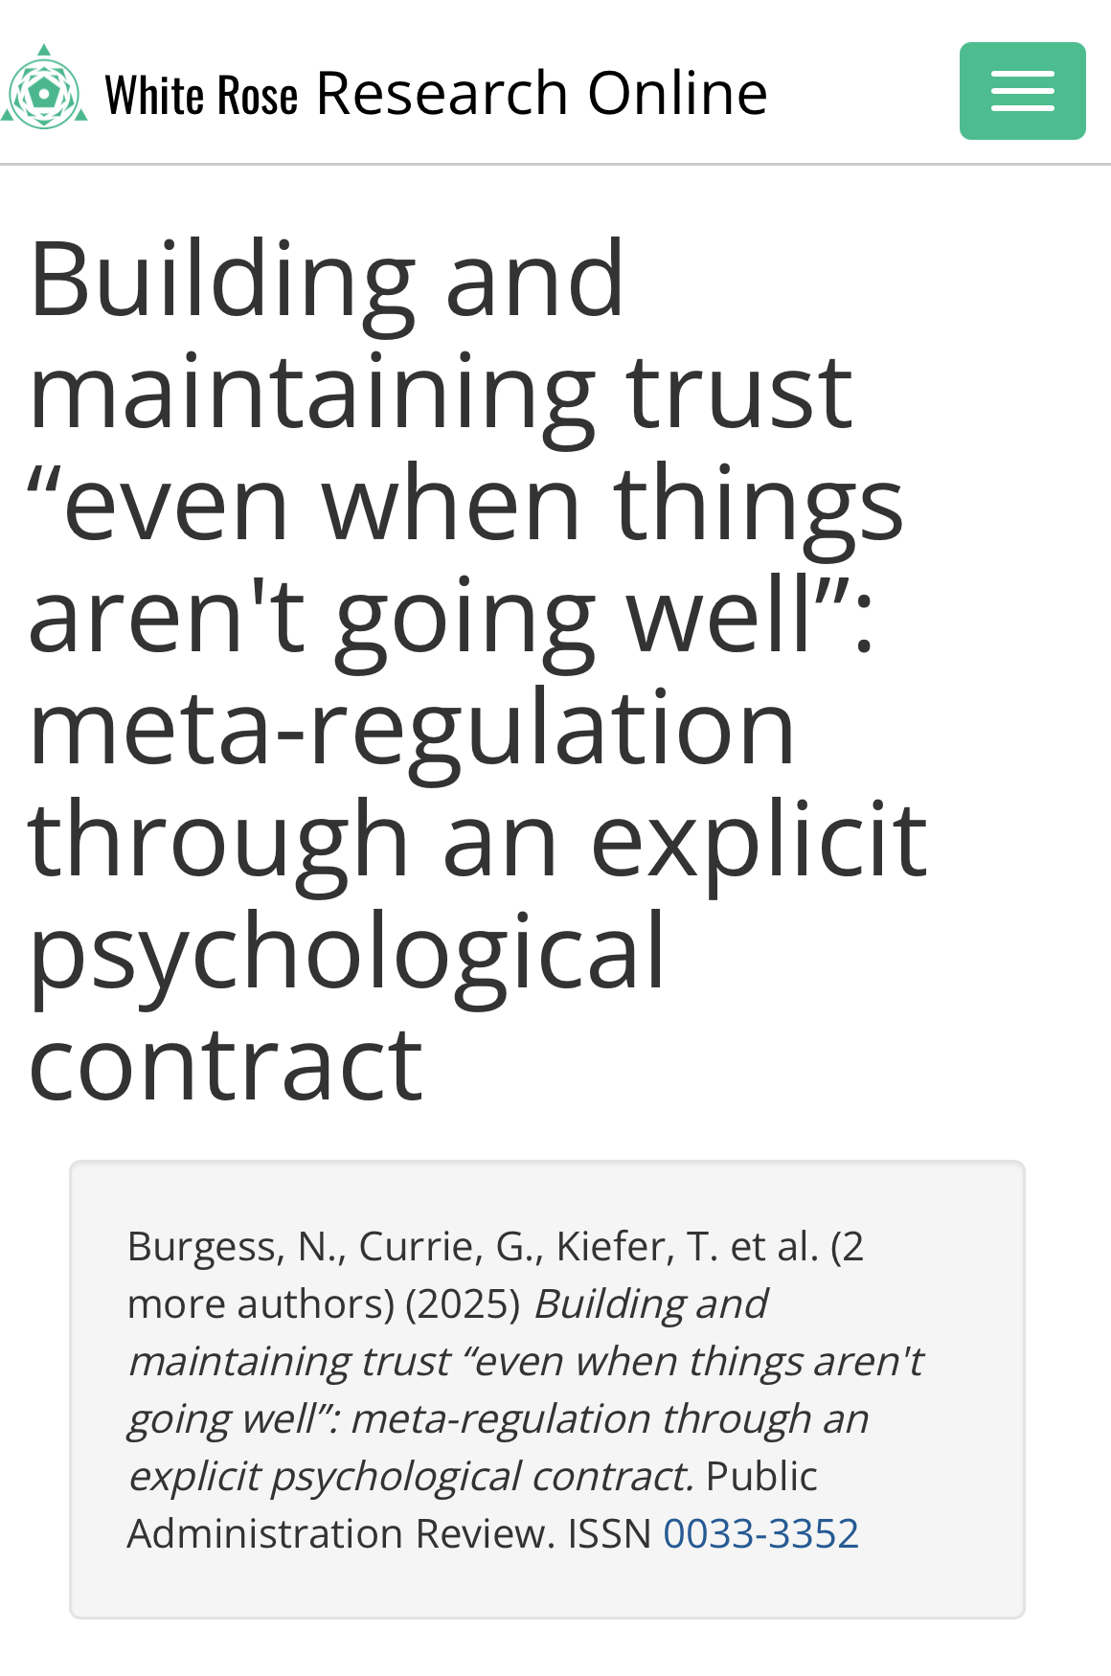

Slide 17



Patients as partners
Enhanced recovery
Co-design at end of life
Maternity

Slide 19
([patients + staff] X kindness) + curiosity
= outstanding quality care

Slide 20
([patients + staff] X kindness) + curiosity
= outstanding quality care & regulation

Slide 21
Thank you
Questions?
Nigel Acheson MD FRCOG
Chair, Jersey Care Commission
n.acheson@carecommission.je

