Slide 1


Physician-Assisted Dying in the Netherlands
Agnes van der Heide
Erasmus MC
Rotterdam
The Netherlands

Slide 2

Overview
Introduction
Practices
Review procedure
Current debates and future prospects

Slide 3
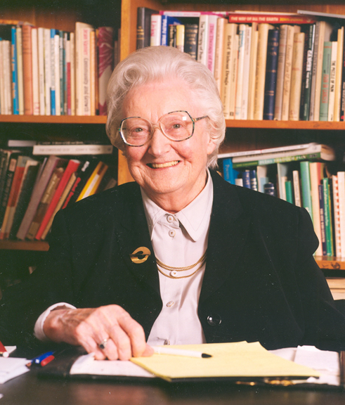

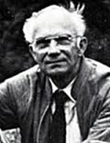
In the 60ties …
UK: Dame Cicely Saunders, St. Christopher’s hospice
Professionalisation of care for the dying
“You matter because you are you, and you matter to the end of your life. We will do all we can not only to help you die peacefully, but also to live until you die.”
NL: debate about end-of-life decisions
“A physician should preserve, improve and prolong patients’ life ... but only when that is beneficial”

Slide 4




Establishment of the Termination of Life on Request and Assisted Suicide (Review Procedures) Act
Case law Medical profession Research Different policy steps

Slide 5
History of the euthanasia law in the Netherlands
1973 -1986 | Postma case, Wertheim case, Schoonheim case | Development of palliative and end-of-life care
1985 | State Commission: euthanasia should be allowed
1990/1991 | 1st nationwide study on practice of end-of-life decision making
1993 | Review procedure (review by public prosecutor)
1993-1995 | Chabot case (psychiatric suffering may qualify)
1995/1997 | 2nd nationwide study
1998 | Review by multidisciplinary review committees
1998-2002 | Brongersma case (‘tired of life’ does not qualify)
2001/2003 | 3rd nationwide study, European study
2002 | Euthanasia law
2005/7 – 2010/12 – 2015/17 | 4th + 5th + 6th nationwide study including scientific evaluations of the law
2016 | Schnabel committee: do not extend law re being ‘tired of life’
2017 | Heringa case (assistance in dying by family)
2021/2023 | 7rd nationwide study including 4th evaluation of the law
2022 | Arends case (first legal prosecution)

Slide 6
Wtl: underlying principles
  Most important ethical principle: beneficence
  The Act provides physicians with a framework to support them when they experience a conflict of professional duties:
      The duty to preserve life
      The duty to relieve unbearable suffering
  Euthanasia is no legal right of the patient, but respecting patient’s autonomy (the request) is the second underlying principle
  Euthanasia is never a professional duty for the physician
  Transparancy and control are considered essential

Slide 7

Dutch Review procedure Termination of life on request and assistance in suicide Act
Adopted in 2001 by parliament and enforced in 2002
Largely codification of existing practice
It is a law for physicians, who have to report their life ending act to a multidisciplinary review committee
Every five years the law is scientifically evaluated by a multidisciplinary group of researchers (open call)

Slide 8

Dutch Penal Code
Section 293 :
He who intentionally ends the life of another person at his express and earnest desire shall be punished by imprisonment for a term not exceeding 12 years or a fifth-category fine.
The offence referred to in the first paragraph is not punishable if it is committed by a doctor who, in doing so, complies with the due care requirements referred to in (…) the Act on the Termination of Life at Request and Assisted Suicide (Review procedures) and notifies the municipal coroner of this (…).

Slide 9
Dutch Penal Code
Section 294:
(…)
He who intentionally assists another person in committing suicide or provides him with the means to do so shall, if the suicide follows, be punished with imprisonment of not more than three years or a fine of the fourth category. Section 293 (2) shall apply mutatis mutandis.

Slide 10
Termination of Life on Request and Assisted Suicide (review procedures) act (2002)
In order to comply with the due care criteria referred to in section 293 (2) Penal Code
Code, the physician must:
Be satisfied that the patient’s request is voluntary and well considered;
Be satisfied that the patient’s suffering is unbearable, with no prospect of improvement;
Have informed the patient about his situation and his prognosis;
Have come to the conclusion, together with the patient, that there is no reasonable alternative in the patient’s situation;
Have consulted at least one other, independent physician, who must see the patient and give a written opinion on whether the due care criteria set out in (a) to (d) have been fulfilled;
Have exercised due medical care and attention in terminating the patient’s life or assisting in his suicide.

Slide 11
Overview
Introduction
Practices
Review procedure
Current debates and future prospects

Slide 12





Fourth evaluation of the euthanasia law
Agnes van der Heide
Johan Legemaate
Bregje Onwuteaka-Philipsen
Fenne Bosma
Hans van Delden
Paul Mevis
Kelly Mink
Roeline Pasman
Liselotte Postma
Sophie Renckens
Ghislaine van Thiel
Suzanne van de Vathorst

Slide 13

Fourth evaluation of the euthanasia law
AIM: to examine whether the goals of the law are achieved
How are the provisions of the law applied in practice?
How is the practice of end-of-life decision making developing?
What are current debates or challenges?
Focus on 2017 – 2022

Slide 14

Fourth evaluation of the euthanasia law
Studies within the evaluation:
Legal study
Empirical study
  Death certificate study (n = 3718)
  Physician survey (n = 746) + interviews (n = 15)
  General public survey (n = 1097) + interviews (n = 15)
Study of the review committees and procedure
Ethical reflection

Slide 15
Definition used in empirical studies
1. Was death the result of medication prescribed or administered by you or another physician with the explicit intention of hastening death (or enable the patient to end their own life)?
2. Was this act performed at the explicit request of the patient?
Both questions answered with YES = euthanasia or assistance in suicide

Slide 16
Frequency of end-of-life decisions (% of all deaths)

Slide 17
Frequency of euthanasia and physician-assisted suicide (% of all deaths)
Source: death certificate studies

Slide 18
Main characteristics of the practice of physician-assistance in dying
62% patients with cancer
71% patients < 80 years
60% life expectancy < a month
90% performed by a general practitioner
100% because of a combination of somatic, psychosocial and existential suffering

Slide 19
Granted and non-granted requests
Notes:
13000 verzoeken waarvan 4000 niet ingewilligd

Slide 20
Why are some requests for PAD denied?
Notes:
30% van 4000 = 1000-1500

Slide 21
Denied requests in different patient groups
Notes:
30% van 4000 = 1000-1500

Slide 22
Overview
Introduction
Practices
Review procedure
Current debates and future prospects

Slide 23


Review procedure (1)
A Review Committee (physician, ethicist, lawyer)
assesses in every reported case whether
physician-assisted dying has been carried out
in accordance with the due care criteria.
If in accordance: physician is informed, case is closed
If NOT in accordance: physician, Public Prosecution service and
Health Inspectorate are informed

Slide 24
Transparency – number of reported cases of PAD
Notes:
In 2015 ca 6800 euthanasie en hulp bij zelfdoding; meldings% 81% vergelijkbaar met 78% in 2005; dus toename gemelde gevallen is volledig toe te schrijven aan stijging aantal euthanasiegevallen
Dit plaatje roept 2 vragen op: waarom meldt 20% niet én hoe komt het dat er een stijging in euthanasiegevallen is

Slide 25
Transparancy – number of cases of PAD (total and reported)
Notes:
In 2015 ca 6800 euthanasie en hulp bij zelfdoding; meldings% 81% vergelijkbaar met 78% in 2005; dus toename gemelde gevallen is volledig toe te schrijven aan stijging aantal euthanasiegevallen
Dit plaatje roept 2 vragen op: waarom meldt 20% niet én hoe komt het dat er een stijging in euthanasiegevallen is

Slide 26
Transparancy – Increased public oversight
% of all cases that is reported to a euthanasia review committee

Slide 27

Reasons for not reporting
1990:
  No official notification procedure
1995 and 2001:
  Fear for judicial consequences
  Administrative hassles of reporting
  ‘It actually was not euthanasia’: use of opioids
2005, 2010, 2015, 2021:
  ‘It actually was not euthanasia’: use of opioids

Slide 28
Termination of life on request and assisted suicide (review procedures) act (2002)
 | Reported cases | Not in accordance with the criteria of due care
2017 | 6585 | 12
2018 | 6126 | 6
2019 | 6361 | 4
2020 | 6938 | 2
2021 | 7666 | 7
2022 | 8720 | 13

Slide 29
‘NOT IN ACCORDANCE WITH THE DUE CARE CRITERIA’
 | Total 2017-2022 | Total 2012-2016 | Total 2007-2011
Voluntary and well-considered request | 10 | 4 | 2
On bearable and hopeless suffering | 14 | 8 | 3
Well-informed | 1 | 2 | 0
No reasonable alternatives | 12 | 7 | 2
Consultation independent physician | 15 | 11 | 15
Act performed with due medical care | 13 | 14 | 17

Slide 30
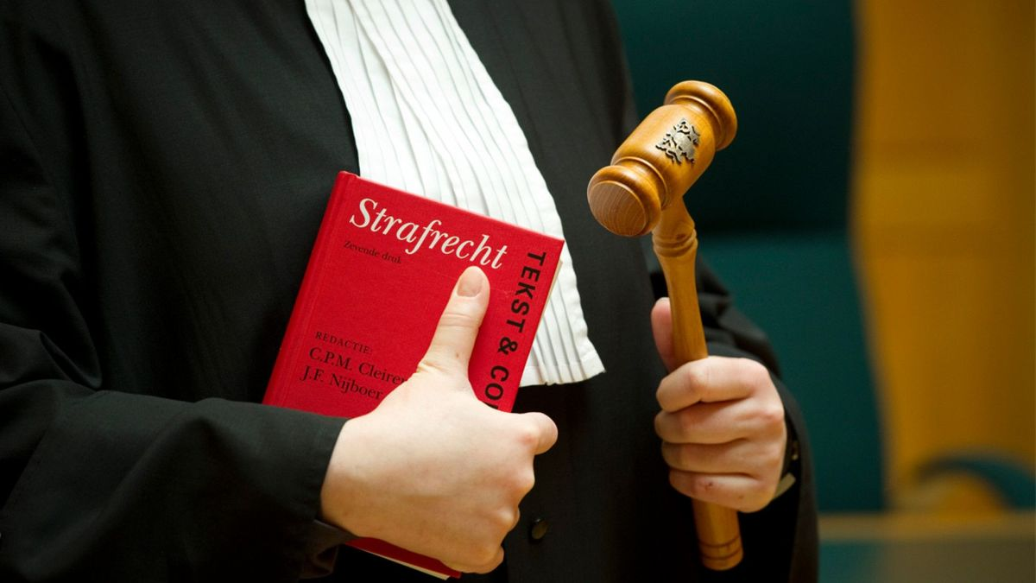
Review procedure (2)
Between 2017 – 2022: 44 out of 42396 reported cases judged as ‘not according to the criteria of due care’ (0.1%)
The Public Prosecutor's office and Health Inspectorate are not obliged to initiate a procedure in these cases, but they can independently decide to do so
The PP focuses on potentially criminal offences (no criminal procedures between 2017 – 2022)
The Inspectorate invites the physician for a meeting and focuses on the intentions and reflections of the physician (one disciplinary complaint between 2017 – 2022)
Verdicts of the review committees that a physician had not acted in accordance with the criteria of due care rarely lead to formal follow-up action
Notes:
Die disciplinary complaint ging over een geval van euth bij gevorderde dementia en was er mede op gericht een tuchtrechtelijke uitspraak te krijgen over de grenzen van het medisch-professioneel handelen op dit gebied.

Slide 31

The ‘Arends case’
The first criminal prosecution under the Act since 2002
A physician who had ended the life of a patient with advanced dementia based on her written advance directive
  If a patient aged sixteen or over who is no longer capable of expressing his will, but before reaching this state was deemed capable of making a reasonable appraisal of his own interests, has made a written declaration requesting that his life be terminated, the attending physician may comply with this request. The due care criteria referred to in subsection 1 apply mutatis mutandis.
The Supreme Court ruled in April 2020 that the due care criteria are 'applicable by analogy‘.

Slide 32
Overview
Introduction
Legal aspects
Empirical findings
Current debates and future prospects

Slide 33

Current debates and future prospects
All stakeholders are quite satisfied about the law
Practice is still on the move
  Rising numbers
  Changing characteristics
  More emphasis on autonomy (?)
Is the law future-proof?
  From a practical point of view?
  From a societal point of view?
  From physicians’ point of view?
  From lawyers’ point of view?

Slide 34
Opinions of the general public and physicians on euthanasia in different groups
Public: should this be allowed?
Physicians: would you ever grant a request?

Slide 35
Comparison with other laws
Belgium (2002), Spain (2021), New-Zealand (2021), Australia (Victoria, 2017), Canada (2021)
Mixed findings: most laws are more restrictive (e.g. age limits, terminal phase, psychiatry, advanced dementia)
Due care crietria re unbearable suffering:
  Ducth law: physician should be convinced that …
  Anglosaxon countries: suffering that cannot be relieved in a manner that the person considers tolerable

Slide 36
Comparison with other laws - control
Belgium: similar system of retrospective control (one national committee)
Spain: committe that controls prospectively
New-Zealand, Australia, Canada: limited retrospective control (e.g. only procedural or only by indication), but more procedural requirements (e.g. notification of every step to Registrar)

Slide 37
Possible future scenario’s
No changes
Changes in the current law: e.g. physician does not perform a potentially criminal act unless …; differentiate between due care criteria; adaptations in the review procedure
The law is replaced by a new law that takes the right to self-determination as its starting point
An additional law to facilitate termination of life for people who have a ‘completed life’
Regulation of assistance in suicide becomes less strict

