Slide 1
Assisted Dying In Jersey: Policy Development JUNE 2025

Slide 2
Contents
Assisted dying in Jersey
Background
Overview of proposals + draft law
Focus on oversight and regulation
Timeframe & next steps

Slide 3
1. Background

Slide 4
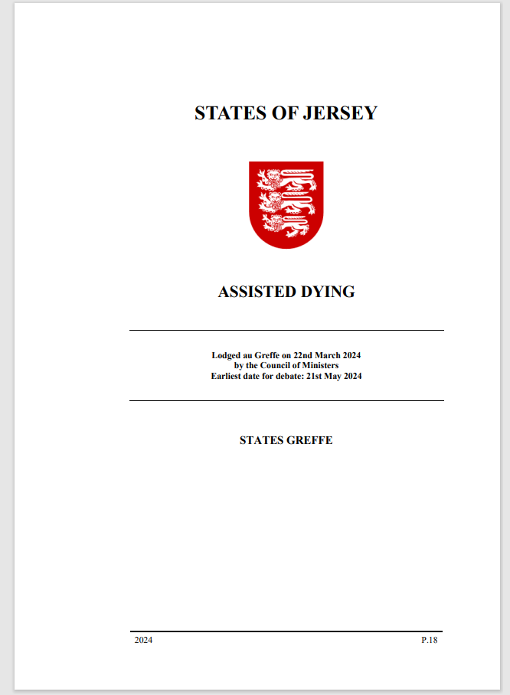
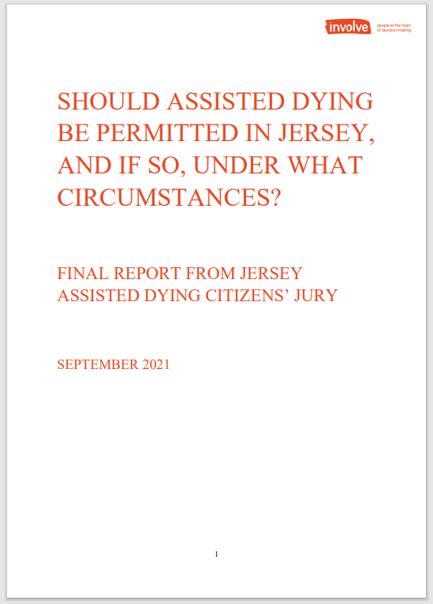
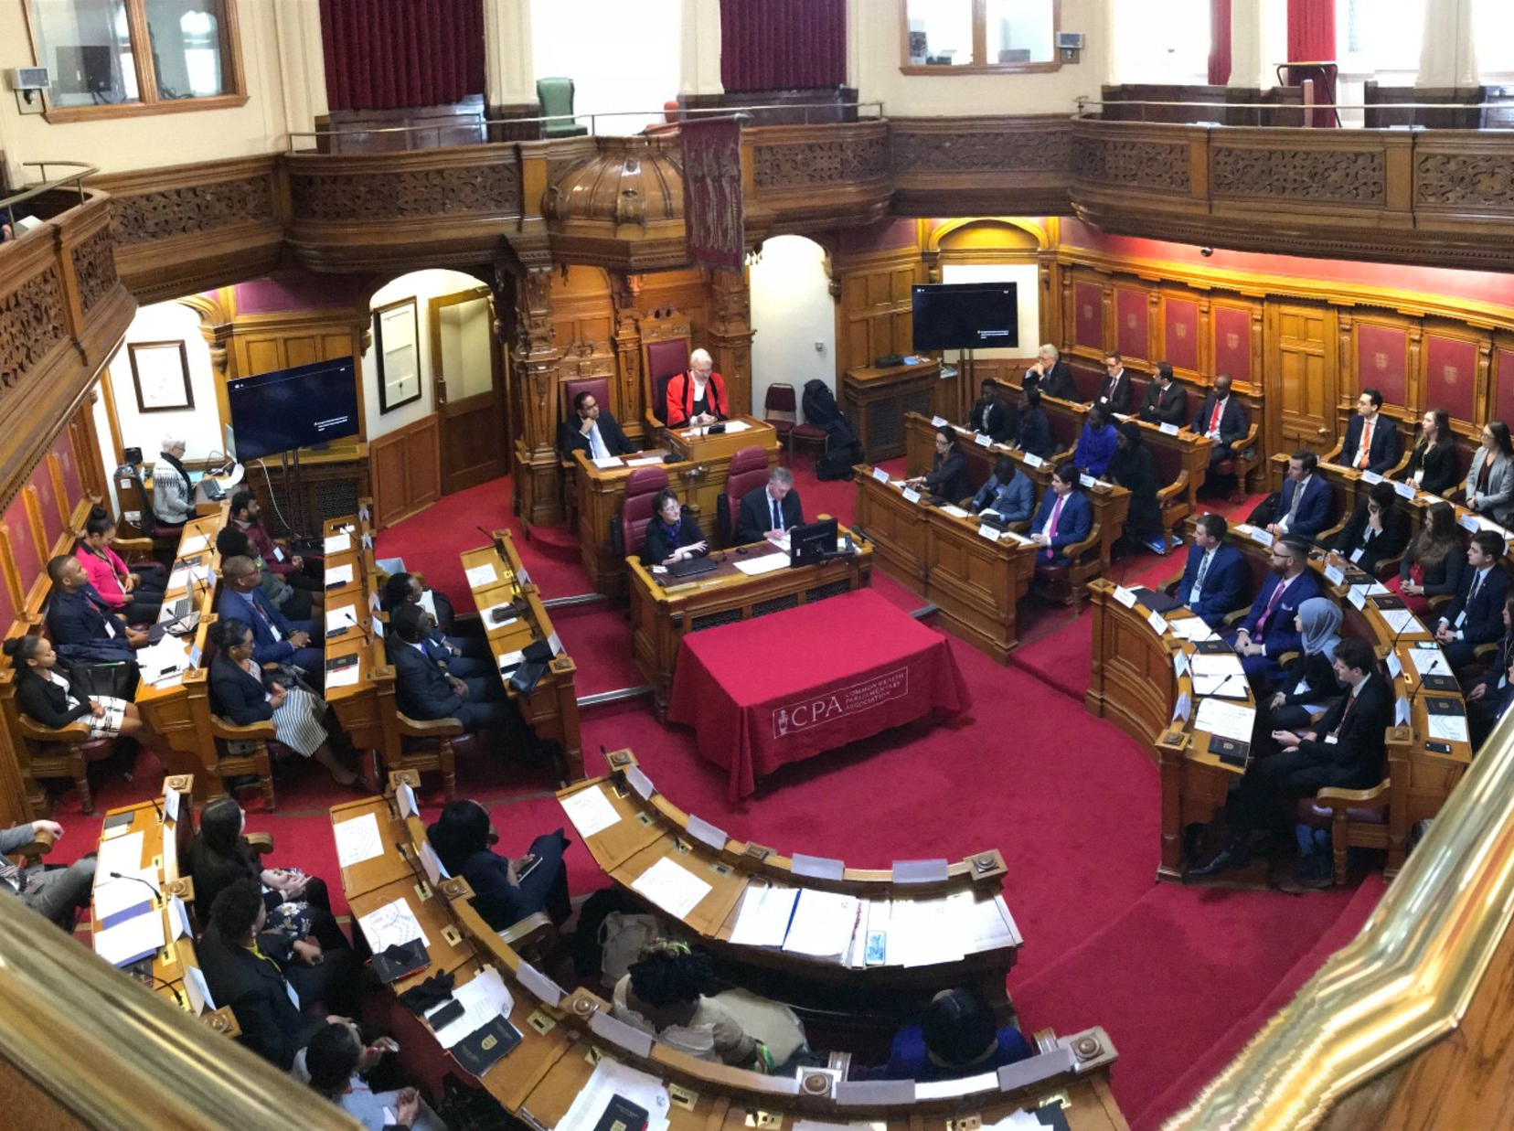
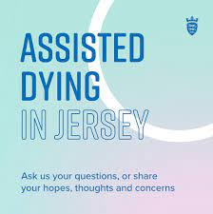
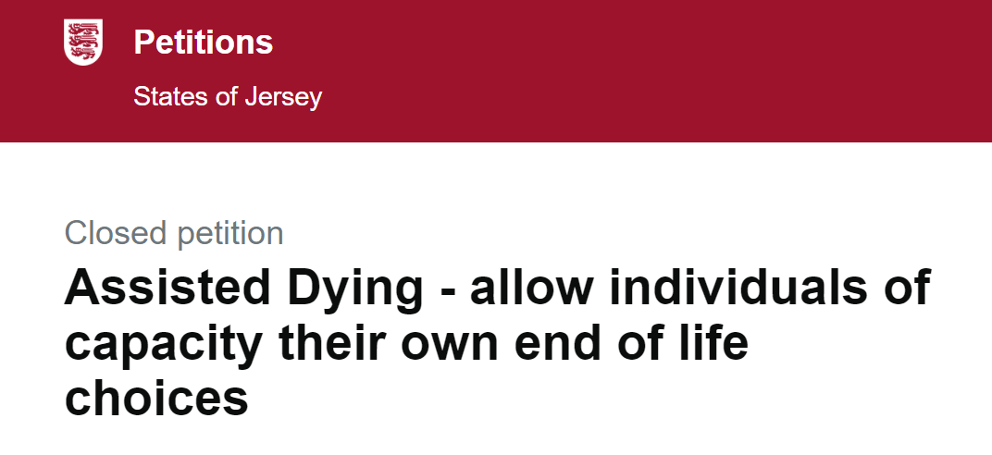
Development of Assisted dying proposals
2018
2021
2022
2023
2024
extensive consultation and engagement on and off-island
www.gov.je/assisteddying

Slide 5
2. Overview of proposals + draft law

Slide 6
Eligibility criteria
Overview of proposals 1
Over 18 years
Jersey resident (12 months ordinary residence)
Voluntary, clear, settled and informed wish
Decision-making capacity
Diagnosed with a terminal illness:
which is giving rise to, or is expected to give rise to unbearable suffering; and
is reasonably expected to cause person’s death within 6 months (or 12 months for neurodegenerative conditions)

Slide 7
Jersey Assisted Dying Service
Overview of proposals 2
delivered by Health Care Jersey, as a separate service
oversight from Assurance + Delivery Committee
free to access
Jersey Assisted Dying Service will:
provide information to all about assisted dying (AD)
support people to navigate the process
and
support loved ones (including access to wellbeing & bereavement support)
coordinate and deploy professionals engaged in the assisted dying process (+ provide wellbeing support)

Slide 8
Assurance and Delivery Committee
Overview of proposals 6
Independent chair + membership to include:
on-island professional leads (Medical Director, Chief Pharmacist etc.)
those with experience of overseeing health svcs
reps for services that support those at end of life
patient representatives
Committee will:
develop competencies framework, training & register of AD professionals
oversee delivery of Service – quality and safety
develop (in consultation) service standards & operational guidance
establish post-death review panel

Slide 9
Involvement of health + care professionals
Overview of proposals 3
Opt-in registration: to practice an assisted dying practitioner role, professional must:
choose to opt-in; be registered with the JCC; complete assisted dying training + meet competencies framework requirements
Right to refuse to participate: Law will state that no-one can be compelled to participate in assisted dying on any grounds
not participating must be in accordance with UK professional guidance (i.e. not obstruct or express their personal beliefs in an inappropriate way)
+ Care home providers would have right to refuse AD taking place on premises
Law ‘neutral’ on raising the subject of AD with patients, but training and advice on how to have conversations about assisted dying (Appropriate Conversations Guidance) available to all health and care staff on-island [NMC and GMC support this position]
Employment protections for those supportive and opposed to assisted dying (and option to introduce safe access zones)

Slide 10
Assisted dying practitioner roles
Overview of proposals 4
Care Navigator – non-clinical role, administrative support and point of contact
Assessing doctors:
Co-ordinating Doctor – does the first assessment and approves/declines request
Independent Doctor – does the second assessment
Multidisciplinary team – group of health and care professionals including nurse and social worker to support assessing doctors to make their decision
Pharmacy professional – prepare and dispenses assisted dying substance, works within JGH
Administering practitioner – supports the person with the assisted death

Slide 11
Assessment, approval and provision of AD
assisted dying process steps
Overview of proposals 5
1
First Formal Request
2
First Assessment by Coordinating Doctor
Potential Second Opinion Assessment
request, assessment & approval
3
Independent Assessment
Potential Second Opinion Assessment
Person in control
moves to each step at own pace
can withdraw request at any time
Minimum timeframe 14 days
[Unless life expectancy less than 14 days]
4
Second Formal Request
5
Administrative Review by Coordinating Doctor (approve or decline)
Appeals process
Assisted death care planning with Administering Practitioner
Waiver of final confirmation of consent
6
planning & delivery
7
Assisted death
8
After an assisted death

Slide 12
2. Oversight + Regulation

Slide 13
Assisted Dying Review Panel
Independent Panel appointed by Assurance + Delivery Committee
post-death review of each assisted death
+ reviews of requests that do not result in assisted death
Purpose:
to ensure whether proper adherence to guidance and legislation
make recommendations for improvement to processes
identify actions of assisted dying practitioners that may require further investigation
Review process: Review all documents on individual record, request additional information from involved professionals or any other person deemed relevant
Post-death review panel report including determination & findings to Committee
Committee to agree actions (if any) to take and notify JCC
e.g.s of findings – improvements to process, referrals to relevant body e.g. employer, registration bodies, police, Viscount
Panel membership: agreed by TOR could include: legal, medical ethicists, medical practitioners, social care practitioners, experts in clinical service governance

Slide 14
Independent regulation by Jersey Care Commission
Assisted Dying Service required to register with Jersey Care Commission (JCC)
JCC to inspect service at least once a year - and may inspect at any other time announced or unannounced
access to individuals’ records, on request, for purposes of inspection (or deciding whether to inspect)
Acting on findings arising from inspections or Review Panel:
If any failings are found, JCC will take action in line with escalation and enforcement policy:
in the first instance, issue a Service with an improvement notice
where Service fails to comply with improvement notice, JCC may refer to Attorney General to decide on prosecution
JCC will have powers to:
Suspend or cancel registered manager’s registration
Cancel service provider’s registration

Slide 15
Other involvement of JCC, set out in draft law
Act as a consultee, including:
development of TOR for Assurance & Delivery Committee and Review Panel
On other matters as required by Minister – e.g. guidance on referrals regarding AD practitioners to regulatory bodies
Committee must send copy of AD Review Panel reports and detail of any actions to be taken to JCC
Committee must provide JCC with annual report on AD, prior to publication (e.g. no of requests, no of deaths, details of those requesting AD including demographics & physical condition expected to cause death)

Slide 16
4. Timeframe and next steps

Slide 17
What happens next?
22 May 2024
States Assembly agree proposals for ‘Route 1’ only
preparation of draft law
September 2025
Lodge draft law
& further development work,
including survey HCP re participation in AD
November 2025
States Assembly debate draft law
2026- 2027
18-month implementation period
Spring/summer 2027
Assisted dying law comes into effect
Note: these are ‘best case scenario’ indicative timings only

