Slide 1
Digitalised ambulance care
Birgit Lao
Director General of Estonian Health Board

Slide 2
Short intro video:
e-Ambulance Solution in Estonia

Slide 3
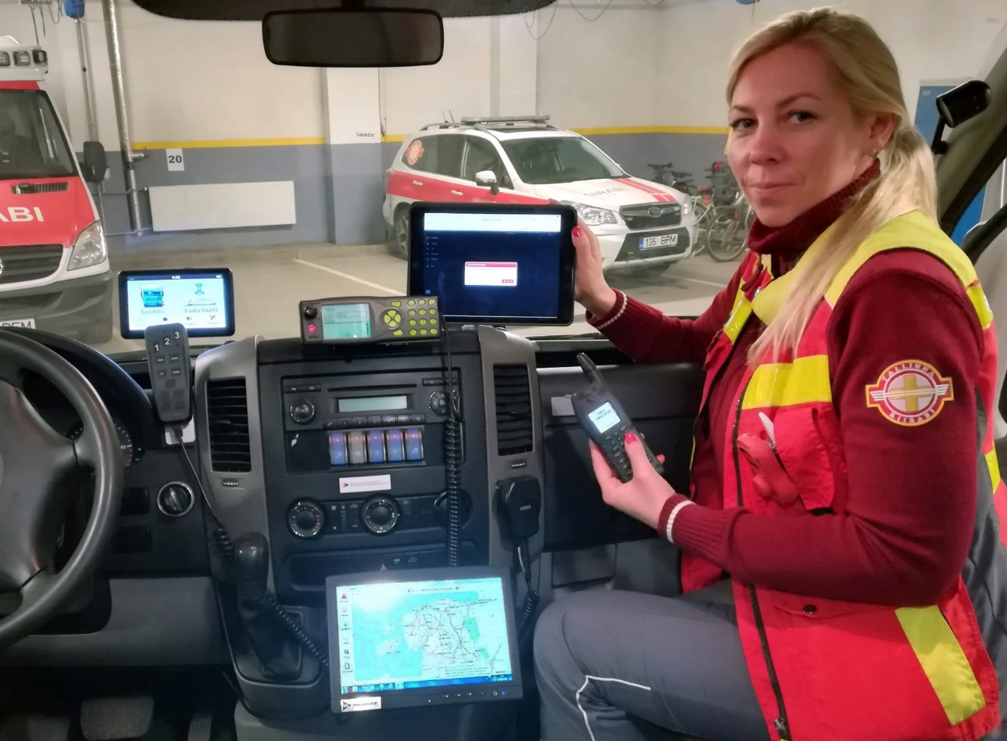
eAmbulance
Receiving dispatch and incident information.
Access to the patient’s previous health data.
Documentation of the patient’s condition, medical staff actions, and administered medications.
Reviewing ambulance operation guidelines.
Data transmission to the Health Information System.
Collection and analysis of quality and statistical data.

Slide 4
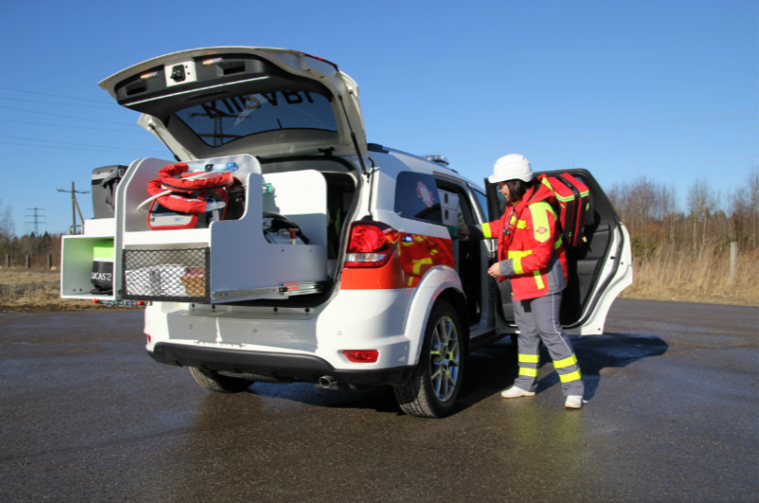
Not enough
Background Challenges:
Aging Population
More chronically ill individuals
Fewer healthcare workers and resources
Rising Healthcare Costs
Key Challenges
Understaffed and overburdened services
Inadequate primary care access

Slide 5
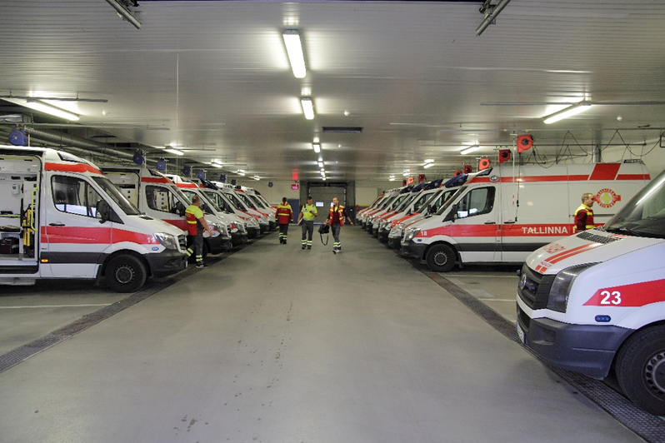
From Reactive to Proactive
Weather & Environment:
Use forecasts to plan resources proactively
Pre-deploy crews based on conditions
Mobile Data:
Factor in crowd movement and seasonal migration
Position ambulances where people actually are
Regional Health Profiles:
Combine current and historical data Predict emergency demand with date/time accuracy
Position resources accordingly

Slide 6
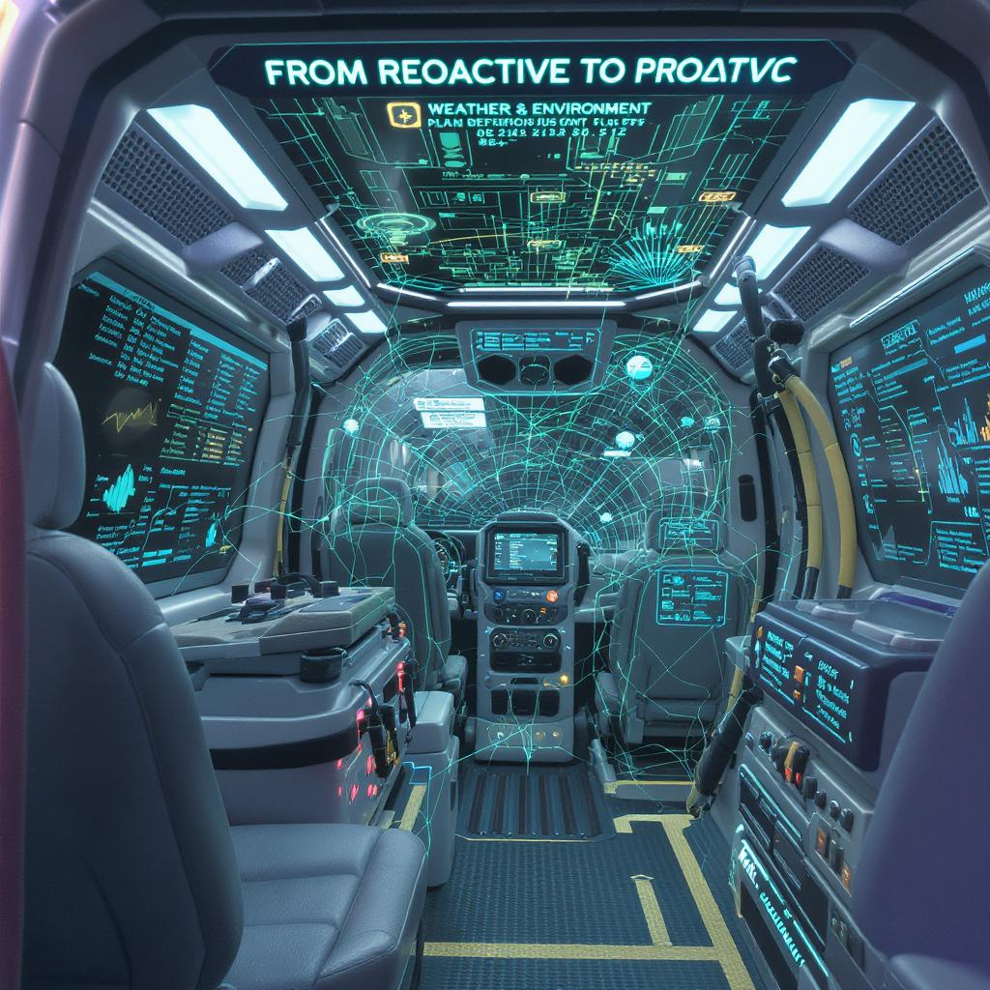

Slide 7
Tänan!
birgit.lao@terviseamet.ee

