Slide 1
Virtual Emergency Department and Ambulance Victoria Care Collaboration
Dr. Amanda Burnside MBBS, BSci(MedSci), FRACGP, AFRACMA
General Practitioner (Deputy Director Quality and Safety) Victorian Virtual Emergency Department
Primary Care Medical Advisor, Ambulance Victoria
Teaching Associate Monash University, Department of Paramedicine
Affiliate Senior Clinical Lecturer Deakin University, School of Medicine
amanda.burnside@nh.org.au
+61 431 479 363

Slide 2
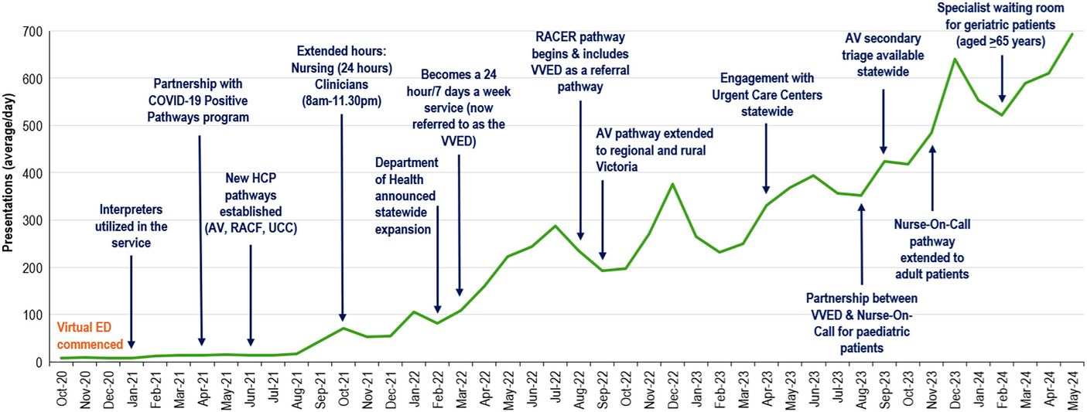
The Journey
Jason Talevski, Adam I. Semciw, James H. Boyd, Rebecca L. Jessup, Suzanne M. Miller, Jennie Hutton, Joanna Lawrence, Loren Sher,
From concept to reality: A comprehensive exploration into the development and evolution of a virtual emergency department,
ACEP Open,Volume 5, Issue 4,2024,
Over 500,000 patients seen since 2020
Notes:
This makes us, by far the busiest emergency department in the state
We are now reaching 1000 per day with an equal split between children, adults and +65

Slide 3
The clinical staff – VVED
Nurses
Nurse Practitioners
Emergency Physicians
General Practitioners
Paediatric Emergency Physicians
Paediatricians
Geriatricians
Physiotherapists
Pharmacists

Slide 4
The clinical staff – Ambulance Victoria
Advanced life support paramedics
Mobile intensive care ambulance paramedics (road and flight)
Triage practitioners (nurses and paramedics)
Nonemergency transport officers
Ambulance community officers
Notes:
AHPRA registered – under the direction of the office of the medical director – use of CPGs
Each has a different scope of practice
Paramedic practitioners – will have prescribing rights

Slide 5
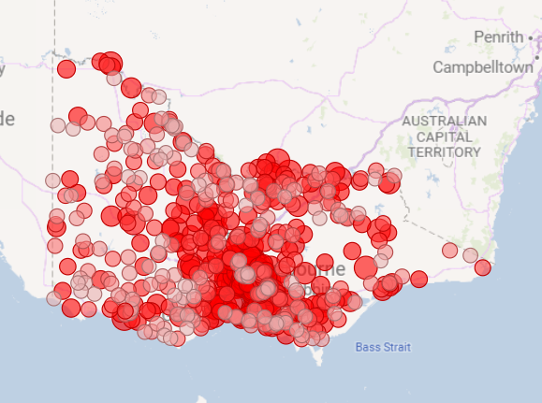
The services
Acute management
Reviews
Referral to appropriate in person care
Specialist's clinics
Observation wards
Co-ordination for direct admission to hospital
Co-ordination with Adult Retrieval Victoria and Ambulance Victoria
COST TO PATIENT: FREE to anyone physically located in Victoria
Notes:
Cost per patient is 250-300 – 170 euro
Cost for patient in ED is about $750 - 426 euro
Border towns

Slide 6
VVED additional services
Virtual Observation Ward (VOW)
K-VOW
A-VOW
Rapid Access Clinic (RAC)
Victorian Virtual Specialist Clinics (VVSC)
Advanced Practice Physiotherapists
Diabetes Nurse Practitioners
Aged Care Nurse Practitioners
Palliative Care Nurse Practitioners

Slide 7
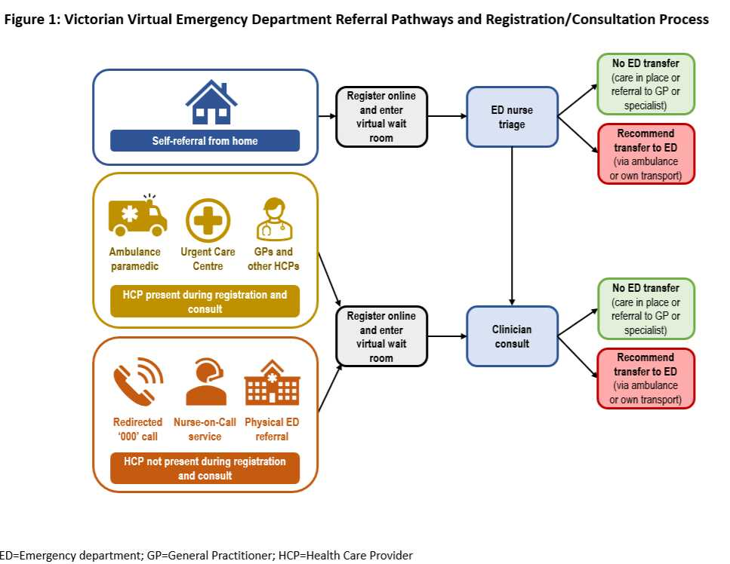
The referral pathways

Slide 8
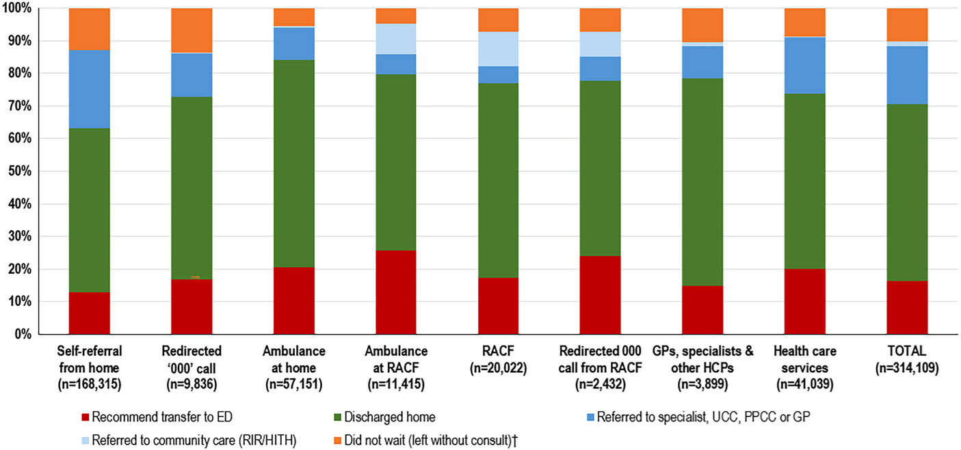
The numbers …
FIGURE 3. Key Victorian Virtual Emergency Department (VVED) milestones and monthly patient presentations from October 2020 to May 2024 (average/day). AV, ambulance Victoria; ED, emergency department; HCP, health care provider; RACER, residential aged care enhanced response; RACF, residential aged care facility.
Jason Talevski, Adam I. Semciw, James H. Boyd, Rebecca L. Jessup, Suzanne M. Miller, Jennie Hutton, Joanna Lawrence, Loren Sher,
From concept to reality: A comprehensive exploration into the development and evolution of a virtual emergency department,
ACEP Open,Volume 5, Issue 4,2024,

Slide 9
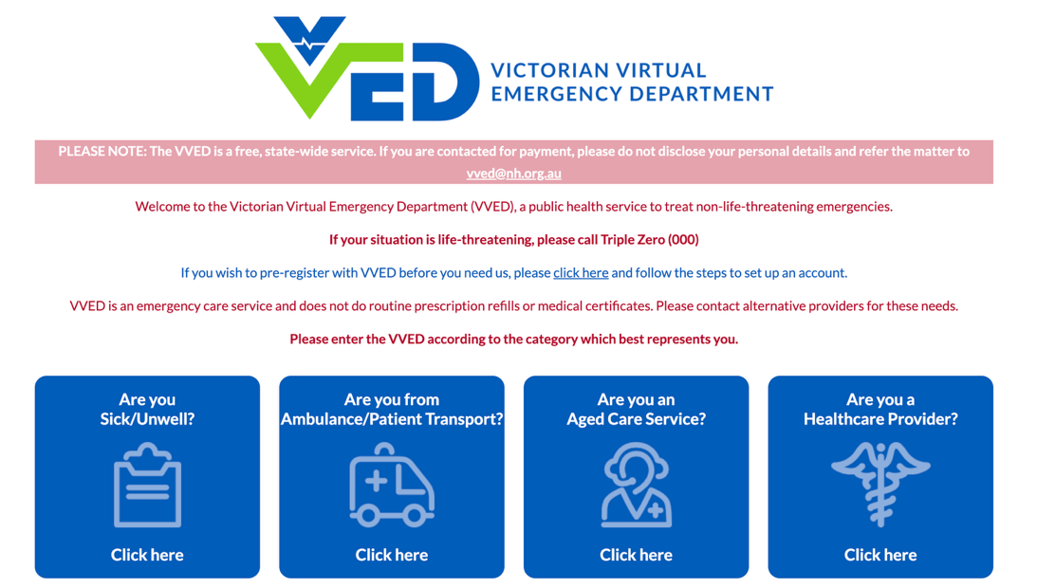
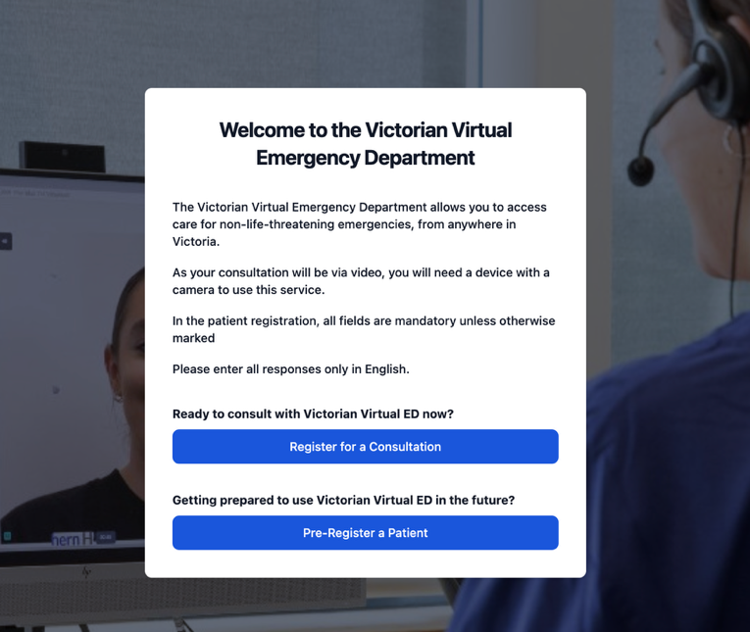
How it works …
Notes:
Interpreter services available

Slide 10
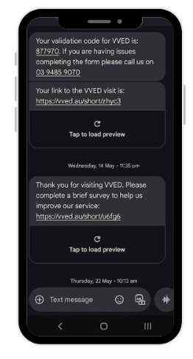
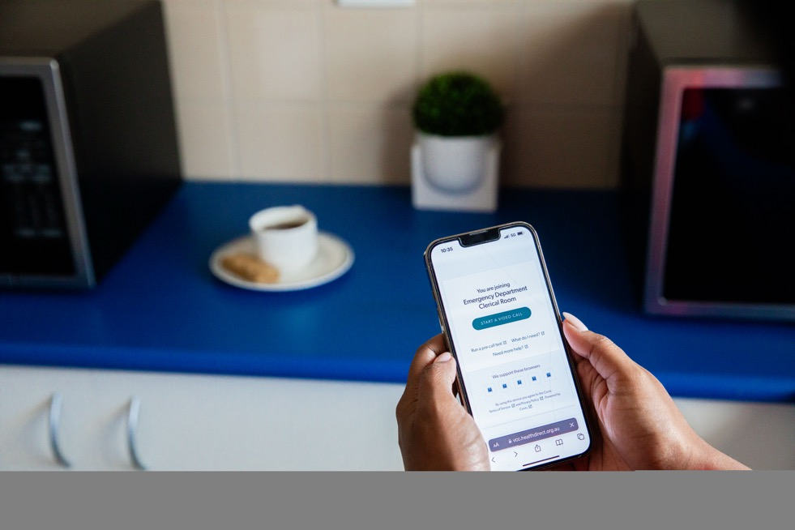
How it works …
Notes:
AV paramedics all have their own ipads

Slide 11
How it works …
Notes:
Our doctors work from all different locations

Slide 12
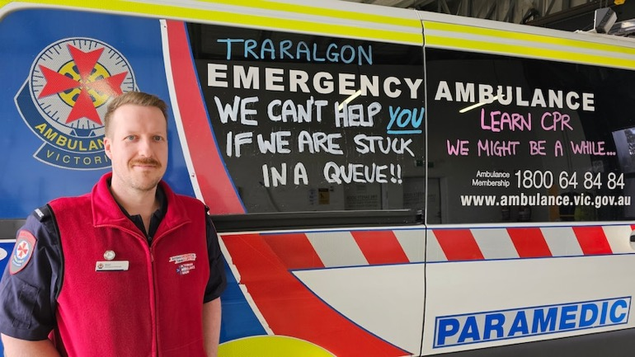
Referral Streams from Ambulance Victoria (AV)
In-field referrals
Approximately 70 per day
Wait time, average 9 minutes
80% kept at home
5-10% deemed to be ok for private transport
Ambulance Victoria Secondary Triage
Approximately 40 patients per day
88% diversion away from Emergency Ambulance
79% diversion from Emergency department
https://www.abc.net.au/news/2024-09-09/ambulance-ramping-leaves-victorians-without-paramedics/104289358
Notes:
Average ramping rimes

Slide 13
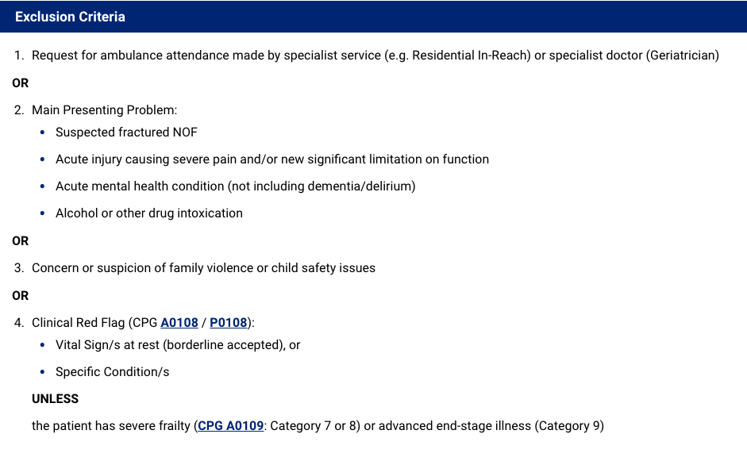
The presentations from AV…

Slide 14
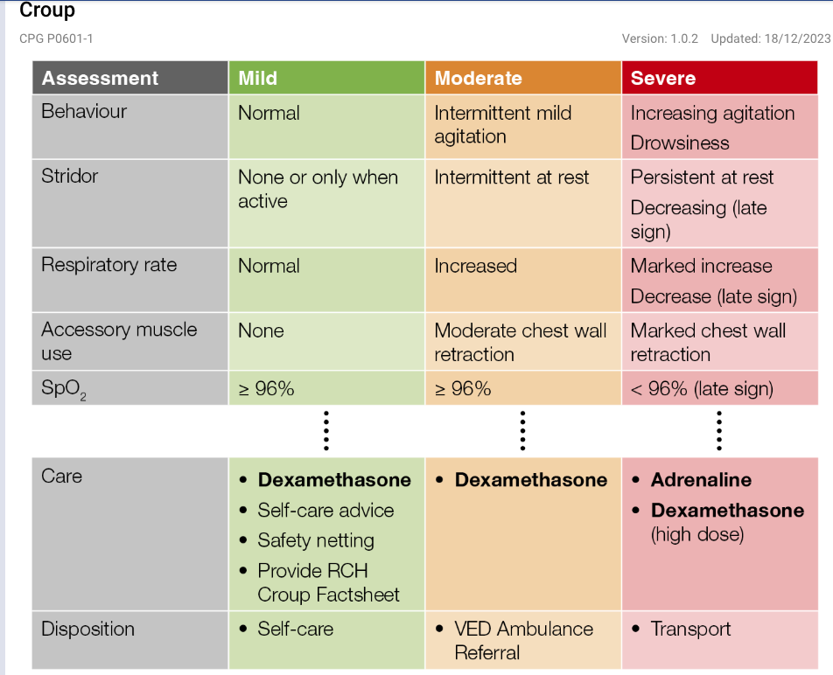
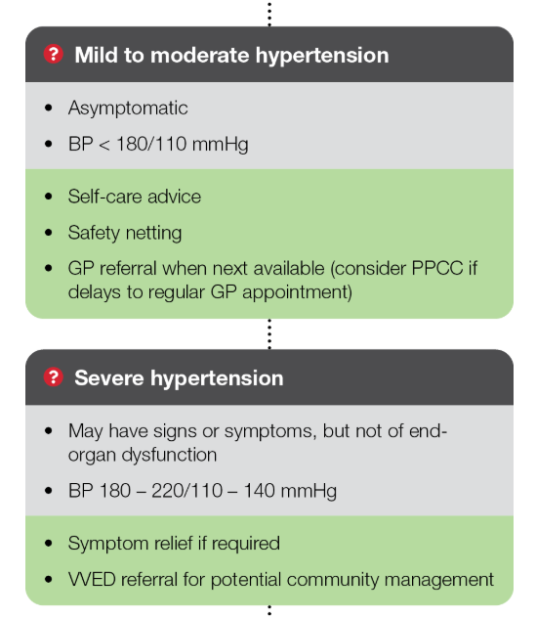
The presentations from AV…
Notes:
Decreased transport of croup from 93% to 23%

Slide 15
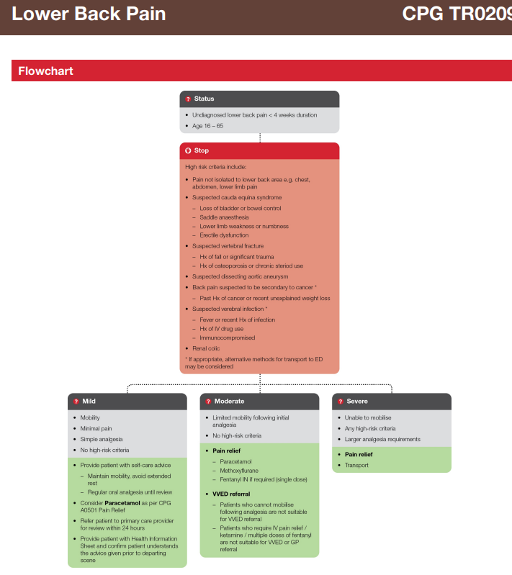
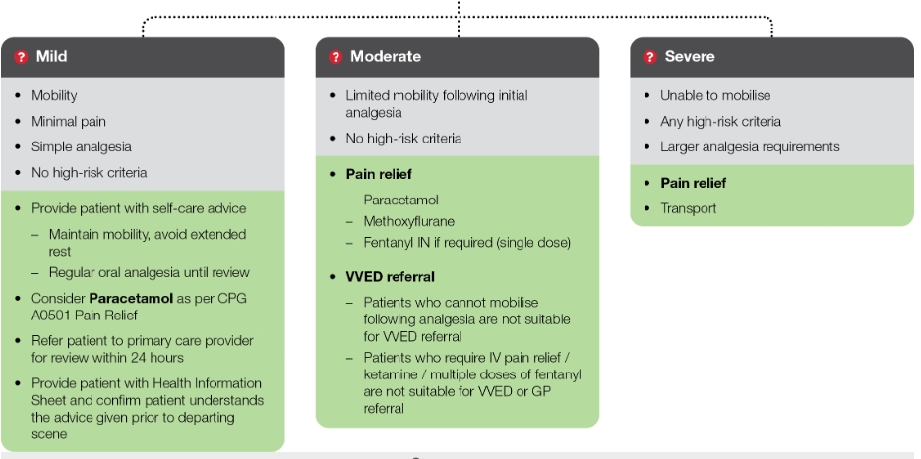
The presentations from AV…

Slide 16
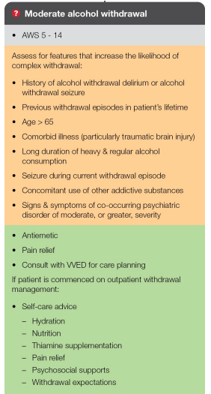
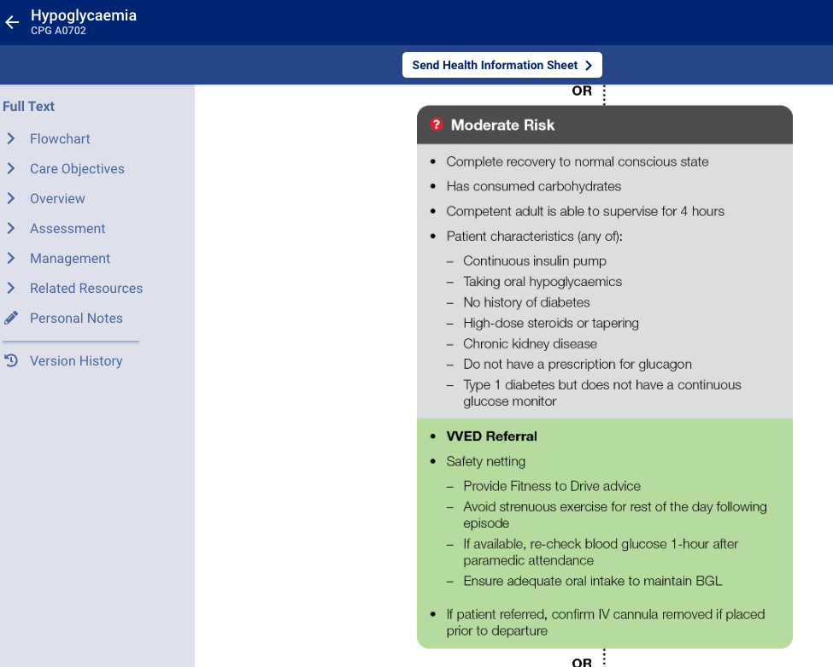
The presentations from AV…

Slide 17
The presentations from AV…
Notes:
All < 28 have to be seen by VVED if they are deemed safe to be left at home

Slide 18
The presentations from AV…
Falls
Capacity assessments
AV at Aged Care Facility
Infections
End of life care
Advice when diagnosis unclear
The list goes on!

Slide 19
Regulation and Governance
Memorandum of understanding
Data sharing in line with health privacy acts
Shared clinical reviews and shared attendance at morbidity and mortality meetings
Monthly meetings to discuss quality and processes
Shared clinical practice guideline review and development
Notes:
There is a memorandum of understanding between AV and NH (VVED), this is reviewed yearly.
For shared case reviews VVED work closely with the AV patient review team
So far we have had no serious adverse patient events
CPG design is a codesign process between the 2 services
IT is very fast paced
We have had 1 ISR 2 incidents

Slide 20
To the future …
Low risk chest pain trial
Community paramedics and paramedic practitioners
Enhanced use of technology and monitoring

Slide 21
Questions
?

