Slide 1
Regulation of Ambulance Care - England
Laura English, Policy Manager. CQC
EPSO Conference, Jersey, 17th June 2025

Slide 2
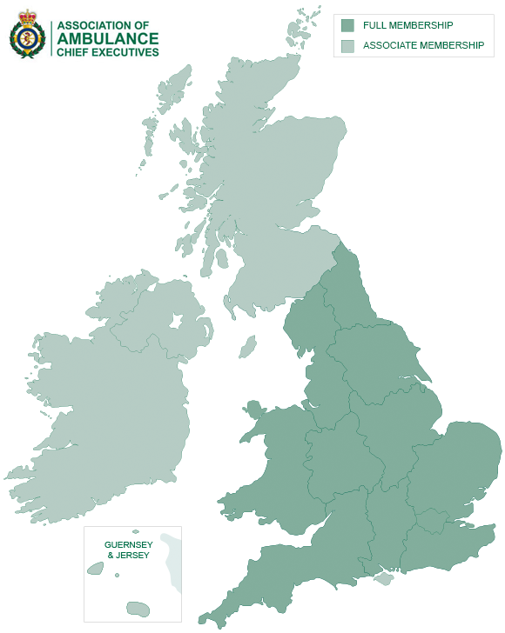
Ambulance provision in England
10 NHS National Ambulance Trusts, plus Isle of Wight
Independent Ambulance provision – approx. 300 locations
Specialist Ambulance provision
Air Ambulance (12 locations over 9 providers
Secure Patient Transport
HART (Hazardous Area Response Team with NHS Ambulance Trusts)
Notes:
National Ambulance Trusts (Isle of Wight NHS Trust provide ambulance service on the island as part of the integrated trust.):
Provide emergency ambulance service, the emergency operations centre (the call handling and dispatch function) and many also provide a patient transport service (PTS).
Very variable geographical spread and population coverage. The map shows the geographical patch of the full and associate members of the Association of Ambulance Chief Executives . AACE provides the statutory ambulance services with an organisation that can support them in the implementation of nationally agreed policy. The darker green areas show the geographical spread of the 10 English ambulance services who are full members of AACE (along with Wales – not regulated by CQC). Other areas of the UK are associate members.
Whilst London has the smallest geographical patch, it serves the largest population – approx. 8.6million. Aside from the Isle of Wight, the North East Ambulance Trust serves the smallest population - 2.6 million but over a much larger geography. So - they have different challenges.
Independent ambulance provision:
Many provide additional capacity for the emergency service by subcontracting from the NHS Ambulance Trusts
Some only provide patient transport services
England has a relatively lower reliance on IH provision than in many other countries.
Specialist provision:
Air ambulances only need to register with CQC if they employ clinical staff who provide a regulated activity. A small number (for example London Air Ambulance) are not CQC registered as they only provide the flight operations, and it is local acute NHS Trusts, or the local NHS Ambulance Trust, who provide the clinical staff and are responsible for the clinical care / regulated activity.
Secure patient transport service – for patients detained under the Mental Health Act. This is private / independent provision.
Hazardous Area Response Teams are specialist teams within NHS Trusts, attending certain call outs including Mass Casualties and Chemical, Biological, Radiological or Nuclear (CBRN). They are protected in terms of resource.

Slide 3
What is in scope for CQC regulation?
Typically, a service providing an emergency response will need to be registered for:
Transport services, triage and medical advice provided remotely
Treatment of Disease, Disorder or Injury
Most NHS Ambulance Trusts, and Air Ambulances will also be registered for Surgical Procedures
For providers who only have a patient transport service (PTS), it is only the transport regulated activity that will be relevant.
Notes:
Like any provider, it is the Regulated Activities that determine whether a provider needs to register with CQC. Typically, a service providing an emergency response will need to be registered for:
Transport services, triage and medical advice provided remotely
Treatment of Disease, Disorder or Injury
Most NHS Ambulance Trusts, and Air Ambulances will also be registered for Surgical Procedures
For providers who only have a patient transport service, it is only the transport regulated activity that will be relevant.

Slide 4
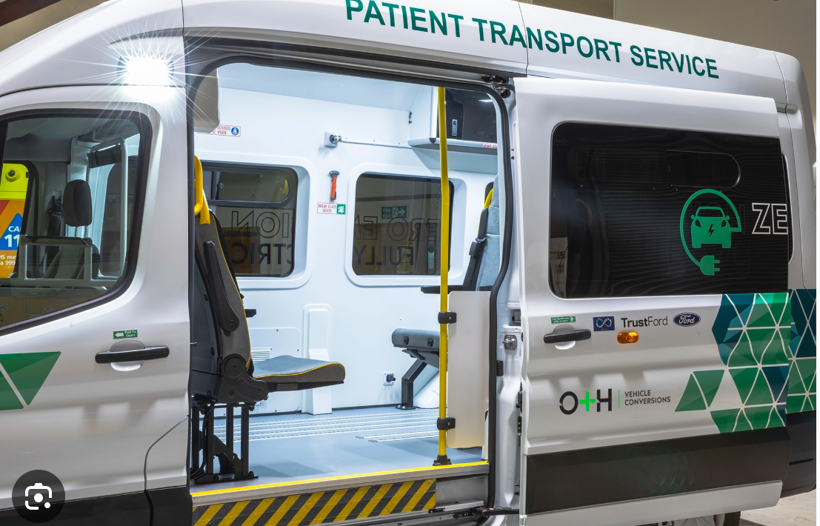
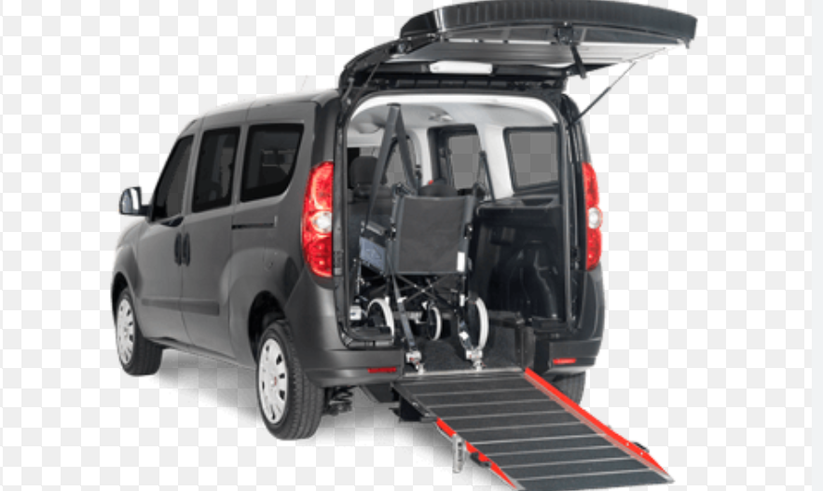
Regulatory complexities
Consistency of what is in scope:
Transport regulation based on design of vehicle
Medical Repatriation
Event Medical Services
Provision of services across borders in UK
Dual registration with other regulators
Difficult to apply some aspects of the assessment framework to some ambulance functions
Notes:
Note to Becky: The second half of this report is useful in explaining the challenges of what is in and out scope: https://www.cqc.org.uk/sites/default/files/20190304%20The%20state%20of%20care%20in%20independent%20ambulance%20services%20FINAL.pdf
What is in scope
The transport regulation is based on the design of the vehicle which states it ”includes services that involve a vehicle that was designed for the primary purpose of transporting people who need treatment”. This means that providers using taxis, volunteers in private cars, or mortuary vehicles do not need to be registered with CQC, unless the vehicles have been modified to be made suitable for transporting patients. It is up to providers to establish whether any of their vehicles would meet this definition, which has led to the following inconsistencies:
1. Some providers have tried to gain CQC registration to give themselves a greater advantage when tendering for contracts. For example, some contracts and tenders require CQC registration, even when they are not actually commissioning for a regulated activity, but rather a pure transport service. Commissioners understanding of what is a Regulated Activity can be poor and they look to CQC as a Quality Mark rather than a Regulator.
2. Other providers have used the wording of the regulated activity to ensure that they are out of scope by using vehicles that do not meet the scope of registration. As a result, there are potentially vulnerable people accessing unsafe services, without fully understanding who is caring for them, and with no regulatory oversight of these providers.
Top picture – clearly within scope
Bottom picture – what do you think? This type of vehicle can be owned privately.
Medical repatriation is largely out of scope due to a general exemption that applies to all Regulated Activties and excludes services provided under travel insurance (which most medical repatriation is). However, if it were funded privately, then legally that is a regulated activity.
Many medical repatriation services don’t know how a particular journey is being funded
Even where it is regulated, CCQ’s remit is for England only…and there is no such thing as English Airspace (only UK airspace)….so, where does the regulated activity begin?
There is an exemption for both transport and TDDI for any medical event services provided within an event site:
Defining what an event is can be complex
If they convey a patient off an event site to hospital that is regulated, so sometimes if they have done that once in a year, we are regulating based on a single journey
More importantly, there are significant risks within the event medical services and CQC have often been notified of concerns by people who think they are within our remit. As a result of the Manchester Arena Bombing Inquiry, a recommendation was made to bring this sector within CQC’s regulation – something we have been calling for, for some time. We expect this to happen shortly.
Provision of services across borders in UK
Anectodal evidence of independent providers setting up headquarters in Wales or Scotland to avoid registration in England despite operating in England. No regulation of IH ambulance sector in Wales.
Dual registration with other regulators:
For example, we have an MoU with the Civil Aviation Authority for Air Ambulances (because they regulate all the flight operations)
Difficult to apply some aspects of the assessment framework to some areas of the provision:
For example, what does IPC mean when it is an emergency operation centre (i.e. the call handling and dispatch function) where there are no physical patients?

Slide 5
Regulatory complexities
Inspection logistics
Resourcing
Training
Involving patients
Making judgements
Many issues beyond control of the emergency ambulance service
Not meeting targets – risk generally around response time
I
Notes:
Inspection logistics
Resourcing - Inspection teams may need to go to multiple sites – consider staffing, station, resources, provision of ambulances, ride out, plus visit to local ED to talk to patients’ experience about ambulances
Training – overall it’s a reasonably small sector in terms of registered providers and this means inconsistencies in judgements can be more obvious, especially across the 10 NHS Ambulance Trusts. There are also training challenges for niche services such as air ambulances.
Involving patients – will visit the ED to speak to patients who have been conveyed by ambulance. But if they have been conveyed by an independent provider who is subcontracting from the NHS Ambulance Trust, the patient may well not even realise this – they won’t necessarily know which provider they are talking about and will presume it was an NHS ambulance. It is possible to ask the service if they can ask patients for permission to share their details with the inspection team to speak at a later time, but this has to be done in compliance with data protection laws.
Making judgements
Many issues are beyond the control of an ambulance service. They bear the brunt of flow issues – if there is not enough capacity to get people out of hospital into social care beds, then wards are too full to transfer ED patients into them. The ED becomes a holding area, and ambulances are made to wait outside with long handover waits, with the rationale that patients are safer given the ambulance crew can look after them. But this has a knock-on effect on response rates to patients in the community who face lengthy waits. This is a big safety issue – the patient outside ED might be safer, but the patient in the community waiting for an ambulance isn’t. The limitations of provider-based regulation seem really apparent in this sector.
How do you bring context into the judgements – if all 10 Trusts are not meeting the response times, do you still recognise that some are doing better than others?

Slide 6
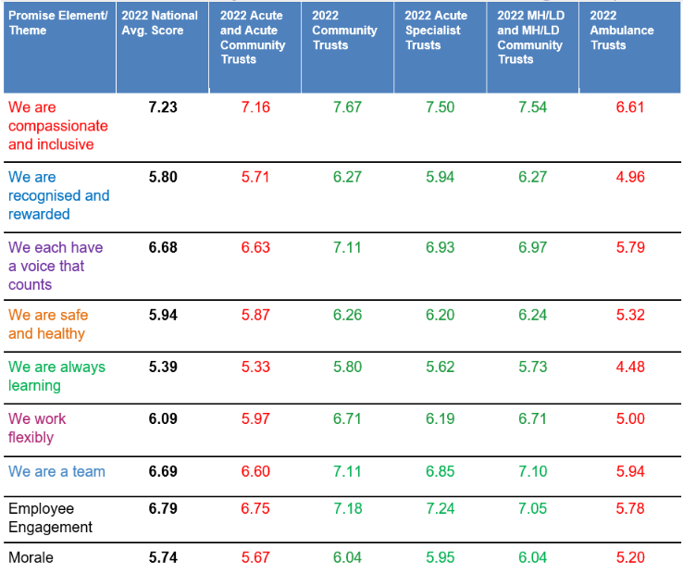
Quality of provision – NHS ambulance services
Generally good…
…..but some issues with culture
National Guardian’s Office report
NHS Staff Survey shows the ambulance sector is below the NHS national average score on all seven of the People Promise elements
Notes:
The NHS Ambulance sector is largely good, although there are some issues around culture that seem to affect this sector. This may be because the workforce is dispersed and this limits support to frontline workers. It may also because the sector has tended to come from a more command and control, military type background.
The National Guardian’s Office carried out a speak out review for the sector and the ‘speaking up culture’ box is a quote from that report. The sector along performs poorly on the ‘People Promise’ elements of the National Safety survey, scoring worse than the national NHS average on every element.
CQC have used its enforcement powers in regards to this issue. In 2020 we referred The East of England Ambulance Service to the Equality and Human Rights Commission for failing to address serious incidents of sexual abuse against both patients and staff, which resulted in them signing a legally binding agreement. Its worth noting that across all services, both NHS and independent, we have had concerns about sexual safety of patients. Ambulance staff are in a privileged position, uniformed, and able to see patients, who will be in a very vulnerable state, in a closed environment in the back of ambulance. This is something to be aware of.
Combined, these prompted a 2024 Culture review of ambulance trusts from NHS England. The review highlighted 6 key recommendations:
Balance operational performance with people performance at all levels.
Focus on leadership and management culture and develop the ambulance workforce.
Improve the operational environment, line management and undergraduate training.
Translate the NHS equality, diversity, and inclusion improvement plan into a bespoke plan for the sector.
Target bullying and harassment, including sexual harassment and enable freedom to speak up.
Prioritise, support and develop human resources and organisational development functions.

Slide 7
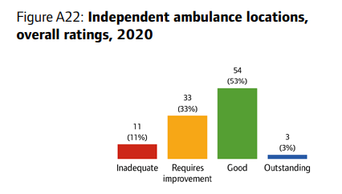
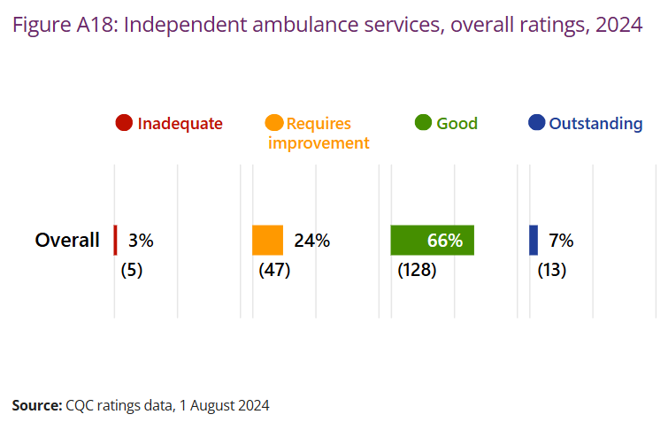
Quality of provision – independent services
Initial inspections very concerning:
Poor recruitment, training & safeguarding processes
Inadequate or poorly maintained vehicles and equipment
Medicines management
Inappropriate use of restraint
But signs of improvement:
Notes:
Note to Becky: The first half of this report is useful in explaining the types of issues we initially came across in the sector https://www.cqc.org.uk/sites/default/files/20190304%20The%20state%20of%20care%20in%20independent%20ambulance%20services%20FINAL.pdf
We had significant concerns about how safely and effectively independent ambulance services cared for their patients. We found ongoing issues with poor recruitment, training and safeguarding processes, with evidence of incidents of serious harm to people from staff that had not been properly recruited and vetted. Patients were put at risk from inadequate or poorly maintained vehicles and equipment, and the inappropriate use of restraining equipment. We had concerns about medicines management, including how providers manage controlled drugs, with some providers not holding the required Home Office licence. Findings from our inspections show that many providers do not understand what it means to be a regulated organisation, and the requirements they must meet.
A comprehensive inspection programme was put in place to inspect all independent ambulance services. The Chef Inspectors of Hospitals wrote to all services outlining his concerns and more rigorous registration processes were implemented in the sector. This has started to have an impact, as the improvements in the ratings profiles between 2020 and 2024 illustrate – although please note that the 2024 ratings include a number of air ambulances, which skews the figures. The air ambulance providers are an outstanding sector. Every single location is rated as outstanding overall, with 11/12 rated outstanding for safety (and the 12th rated good). It may be that there is learning from the aviation side of the business – its widely acknowledged that aviation has a much more mature approach to safety management than healthcare. This is something we are exploring within our safety portfolio.

Slide 8
Some closing thoughts
The ambulances services are a great source of information about the health and social care sector as a whole.
They see the whole system and have great insight into the capacity pressures, and where blockages in flow are.
They also tend to innovate.
I
Notes:
This side is just a closing thought.
We found the insight of the ambulance sector invaluable during COVID. A national ambulance control centre is stood at to deal with high profile incidents, and COVID was an example of this. They had real-time insight into handover waits at every ED, for example, as well as how many calls were waiting at each ambulance service. They are very data driven and tend to innovate – for example introducing Hospital Ambulance Liaison Officers into EDs to help with the flow of patients.

Slide 9
Any questions?

