Slide 1
Regulation With a Broader Focus – The Singapore Journey
Mr Dharmendran Gopal
Deputy-Director, Hospital and Ambulatory Care Regulations, MOH

Slide 2
Health Regulation Mission
To safeguard and improve the safety and welfare of the public in our evolving healthcare landscape, through an effective and efficient regulatory regime

Slide 3
We have or are in the process of making qualitative shifts to regulate more effectively and with a broader focus
Premise
Service
Preventive care and wellbeing
Disease
Reactive
Proactive
Process
Outcome

Slide 4
The Healthcare Services Act (HCSA) replaced the Private Hospitals and Medical Clinics Act (PHMCA) to allow a more flexible and future-proof regulatory regime focused on services
HCSA took effect in Jan 2020; amended in 2023
Background:
PHMCA was enacted in 1980. Since then, new care models have emerged, and healthcare services are increasingly delivered through different modes, such as mobile and online channels.
Key Objectives:
Better safeguard patient safety and well-being;
Enable the development of new and innovative healthcare services.

Slide 5
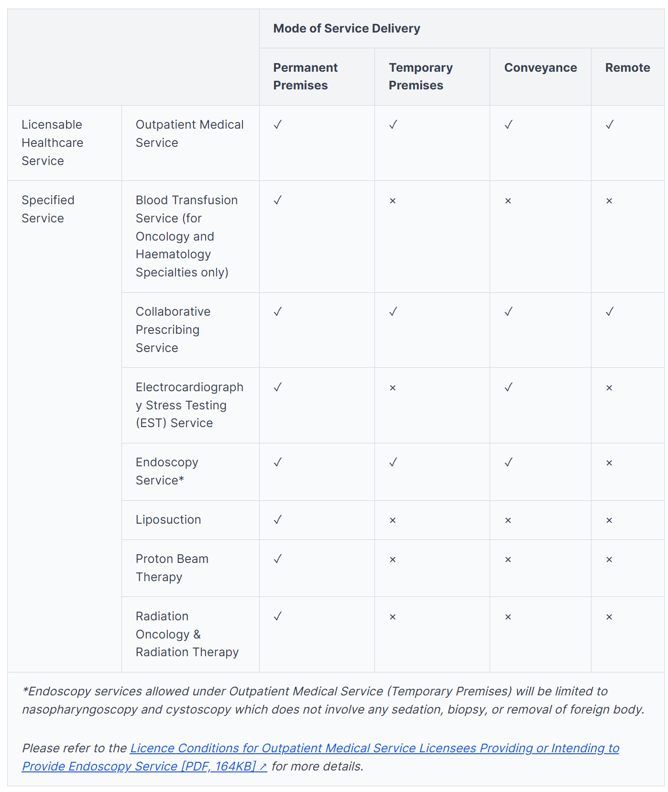
The Licensing Framework under HCSA comprises of Licensable Healthcare Services, Specified Services, and Modes of Service Delivery
Licensable Healthcare Service (LHS) MOH adopts a risk-based regulatory approach to determine the types of licensable services under HCSA. There are 17 LHSes, split into 3 categories (inpatient, outpatient and clinical support services).
Specified Services (SS) Some LHS have Specified Services (SSes). SSes generally involve complex or higher risk procedures provided in a LHS and have distinct requirements for patient safety.
Modes of Service Delivery (MOSD) To better cater for emerging models of care and to future-proof HCSA, four different modes of service delivery were also introduced.
Example: SS and MOSD for Outpatient Medical Service
Notes:
At present, HCSA licensees are only required to notify MOH before providing any specialised services - these are higher risk services which are related to the underlying LHS but have distinct requirements. This implicitly assumes that the licensee can safely deliver all specialised services within the underlying LHS. While there are broad requirements common across the various specialised services, it is noted that there may be differing requirements across some. An approval regime would allow MOH to better determine the licensee’s ability to provide any specialised service upfront. Examples include laboratory disciplines or specified tests such as immunology under the Clinical Laboratory Service, or liposuction under the Medical Service.
For example, the equipment and personnel requirements to safely perform x-rays and Magnetic Resonance Imaging differ, although a licence for Radiological Services would be applicable to both imaging modalities.

Slide 6
The HCSA was implemented in 3 Phases over 2022 – 2023 involving over 5,000 licensees and over 10,000 licences across 17 Licensable Healthcare Services
HCSA Phase 1
(3 Jan 2022)
HCSA Phase 2
(26 Jun 2023)
HCSA Phase 3
(18 Dec 2023)
General Regulations
Advertisement Regulations
Fees Regulations
Clinical Support LHSes
Clinical Laboratory Service
Radiological Service
Blood Banking Service
Cord Blood Banking Service
Emergency Ambulance Service
Medical Transport Service
Inpatient LHSes
Acute Hospital Service
Community Hospital Service
Contingency Care Service
Outpatient LHSes
Outpatient Medical Service
Outpatient Dental Service
Ambulatory Surgical Centre Service
Outpatient Renal Dialysis Service
Assisted Reproduction Service
Clinical Support LHSes
Human Tissue Banking Service
Nuclear Medicine Service
Inpatient LHSes
Nursing Home Service

Slide 7
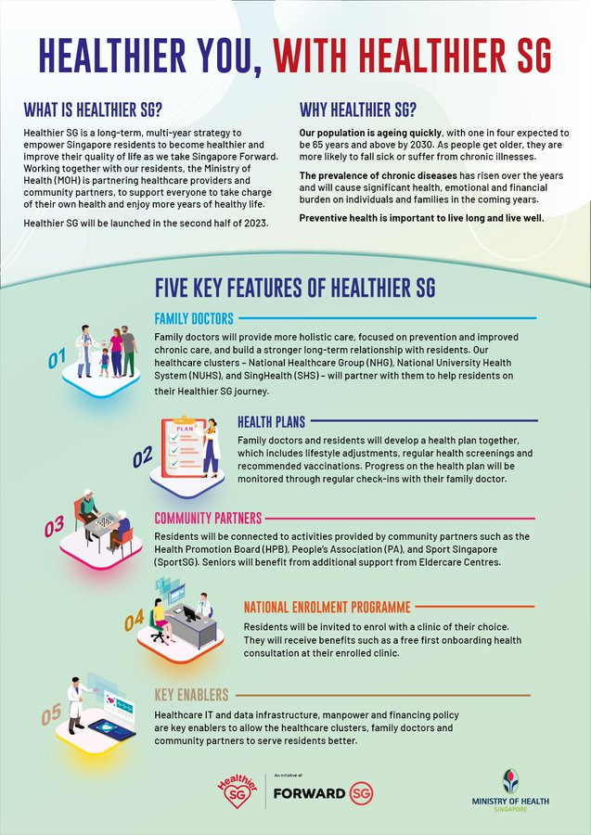
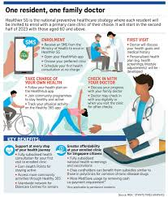
Healthcare is moving upstream, with a greater focus on preventive health
Healthier SG is a national initiative to help all Singaporeans take steps towards better health and quality of life, by focusing on:
Preventive care,
Enrolling with a family doctor
Personalized Health Plan
Connecting to a wide range of healthy lifestyle activities
Insert HSG pic

Slide 8
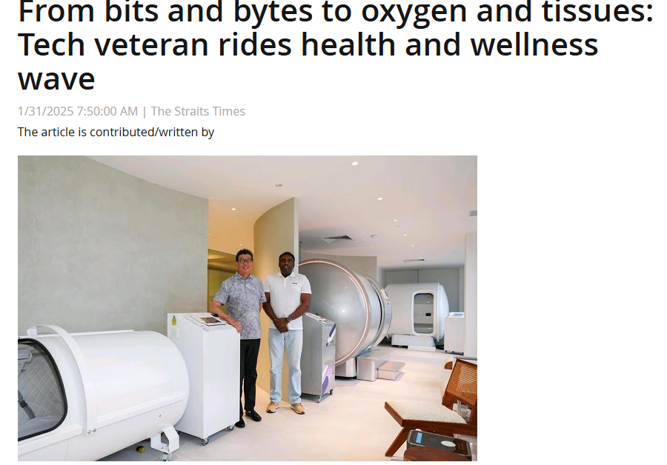
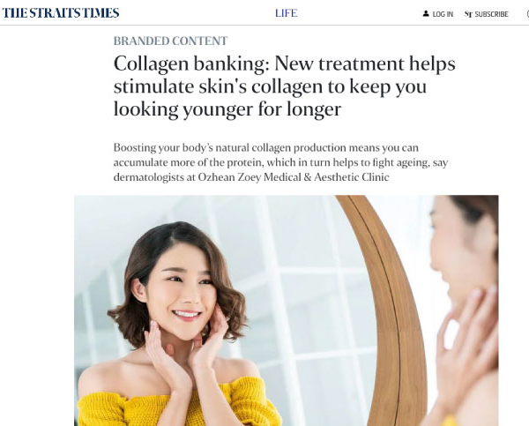
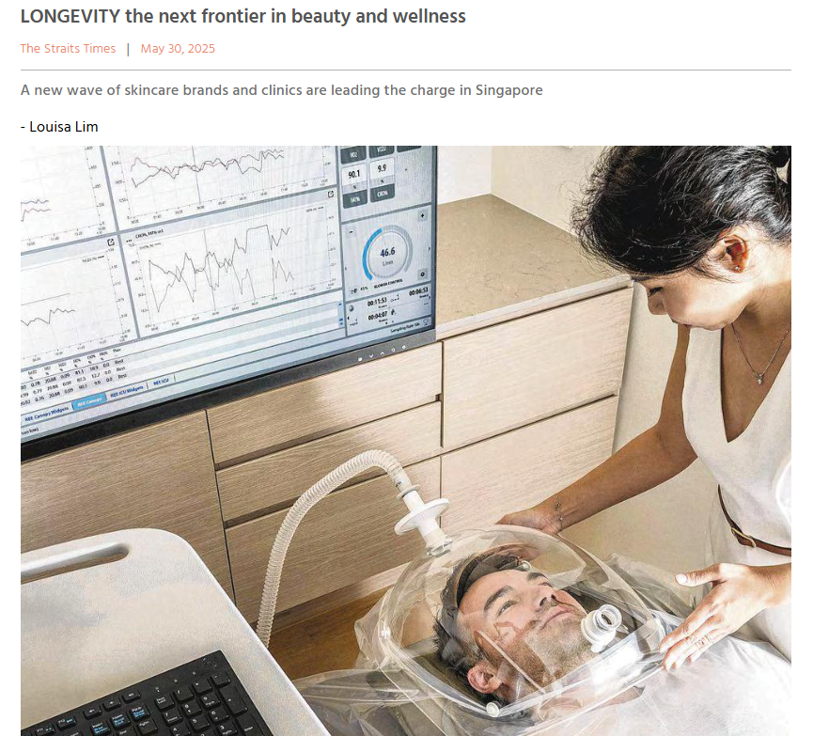
Evolving healthcare landscape has also resulted in emergence of healthcare services beyond traditional disease diagnosis and treatment
Longevity and wellness services are more common, and we need to review our regulatory approach to balance patient safety with pro-enterprise considerations. We similarly need to review aesthetic procedures and guidelines.

Slide 9
We are proactive in our regulatory approach, by keeping abreast of changes in healthcare practice, using data, engagement and horizon scans
Analytics
Risk-based approach to inspection, where inspection frequency is based on past compliance history, and the risk profile of the licensee.
Horizon scanning
Identify emerging healthcare services and regulatory areas of concern (telemedicine, AI, etc.)
Engagement and sensing
Regular engagement with professional boards, healthcare professionals, licensees and other organisations and international regulators

Slide 10
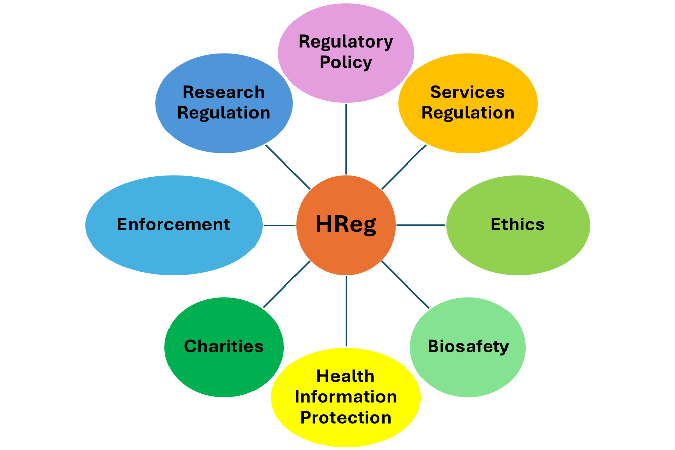
We work with multiple parties given the cross-cutting nature of regulatory work
Whole Of Government (WOG)
Professional practice
Professional Boards, Academy of Medicine, Singapore Medical Association, College of Family Physicians
Ageing-related care models
Ageing Planning Office (APO)
Agency for Integrated Care (AIC)
Pro-enterprise environment
Ministry of Trade and Industry
New technologies & care models in public sector
Health Services Group (HSG)
MOH – Office of Healthcare Transformation (MOHT)
Legislation
Attorney-General’s Chambers
Legal Office
MinLaw
Financing schemes
Healthcare Finance
Quality and safety
Agency for Care Effectiveness (ACE)
Health Services Group (HSG)
Cyber and data-related work
InfoComm Technology and Data Group (ITDG)
Cyber Security Agency (CSA)
Personal Data Protection Commission (PDPC)
Synapxe
Clinical research work
National Medical Research Council (NMRC)
Health Sciences Authority (HSA) – Clinical Trials Branch
Licences & regulations
MHA – Protected Place
MOM – Pressure Vessels
NEA – Radiation Safety
SCDF – Fire Safety
SFA – Food Handling
HSA – Health Products
MCCY – Health Charities
Private sector commissioning
Finance Partnerships & Governance Division
Incident escalation
Integrated Operations Hub

Slide 11
We also learn from other organisations and international regulators
Examples:
HReg’s Regulatory Advisory Panel (RAP)
European Partnership of Supervisory Organisations in Healthcare Services and Social Care (EPSO)
Panel of international & local experts to guide on regulatory policy and management of new innovative care models
Regular meetings with health services regulators across UK and Europe.
HReg & Duke-NUS Centre of Regulatory Excellence (CoRE) Collaboration
Healthcare Cybersecurity Advisory Panel (HCAP)
Collaborate with academia for research on international best practices and horizon scanning
Panel of international and local experts on cybersecurity from various sectors.
Notes:
We have established a Regulatory Advisory Panel, or RAP, comprises a distinguished group of international and local experts who will provide us with invaluable insights and guidance on regulatory policy, and assist in risk evaluation and management of new and innovative care models.
Similarly, we have the Healthcare Cybersecurity Advisory Panel, or HCAP, to advise us especially in the realm of cybersecurity.
In terms of international regulators, we engage in regular conversations with health regulators in the UK and Europe through the European Partnership of Supervisory Organisations in Healthcare Services and Social Care (EPSO).
Apart from other regulators, we also collaborate closely with academia and industry via our collaboration with the Duke-NUS Centre of Regulatory Excellence, CoRE. CoRE helped us conduct research for international best practices, and also horizon scanning to stay ahead of the curve in regulating new health services.

Slide 12
Our Regulatory Ethos has evolved from:
Processes → Outcomes | from ‘Referee’ → ‘Coach’
Streamline and improve existing core regulatory operations; enhancing risk-based framework to inform priorities
Sharpen efforts on patient safety outcomes in the licensing, audit and inspection journey
Empowered with key features to raise standards for patient safety, welfare, and continuity of care
Ensure fidelity of implementation and ensuring the regulations are outcomes-based
Engage stakeholders to identify and assess emerging healthcare service models and technologies
Review of governance for emerging actors and care models in the healthcare landscape
Strengthen and develop policies/guidelines for digital health (e.g. HIB, Cyber, AI, etc)
Core Inspection & Enforcement Operations
Rolling out
Healthcare Services Act (HCSA)
New Regulatory Areas
Notes:
Taken together, Hreg has been dedicated to not just improving our existing operations, but also laying the groundwork for the future. Our regulatory ethos has undergone a transformative shift, moving from a process-oriented approach to one that's focused on outcomes. To licensees, we are not referees to find fault with them, but rather coaches to seek improvement together with them in patient safety and welfare.
Over the past five years, our strategy has been centered on three main pillars:
To streamline and enhance our core regulatory operations. (By adopting a risk-based framework, we've been able to better inform our priorities and sharpen our focus on patient safety outcomes throughout the licensing, audit, and inspection journey.)
While, successfully implemented the Healthcare Services Act. (which is equipped with key features designed to elevate standards for patient safety, welfare, and continuity of care. )
Meanwhile, we are also proactively strengthening and developing policies for emerging regulatory areas.
OBR allows for simpler, less detailed rules. This potentially leads to swifter regulatory assessments, which could in turn reduce regulators’
Workloads. However, while OBR may be cheaper to develop, they can be costlier to enforce if standards are not clearly defined. Furthermore, in order for OBR to be effective, regulators will need to garner additional expertise — whether in-house or outsourced — in order to properly assess and enforce outcomes.
The three themes with the highest proportion of outcomes-based content were: Premises and Equipment (42%), Infection Control (18%), and Safety and Efficacy of Services (14%).

Slide 13
We are restructuring to develop a “one-stop” future ready centre of regulatory excellence
Regulatory transformation to enhance synergies in regulatory activities across health services, products, information and professionals;
Our Stakeholders
Streamline stakeholder journeys with a single regulatory touch point for our stakeholders (e.g. licensees, registrants, citizens)
Our Partners
Single touchpoint for our partners (i.e. other government agencies & statutory boards) for all health regulatory matters.
Our People
Greater opportunities to take on new roles, develop new skills and access a wider range of resources for professional growth and career progression as regulatory specialists and leaders.
Greater ease of collaboration and cooperation across regulatory domains to tackle complex regulatory issues holistically
“One-Stop”
Health Regulatory
Hub
Health Services
Health Products
Health Professionals
Enforcement
Health Data Protection

Slide 14
We Need a Collective Approach Towards Transforming Regulation
There is no one-size-fits-all solution to regulating healthcare
Always be agile and be prepared for change as the healthcare landscape will continue to evolve at a rapid pace
It is important to continue engaging and collaborating with various stakeholders to co-create policies, regulations and tools while safeguarding patient safety and welfare

Slide 15
Q&A

Slide 16
Thank You

Slide 17
The HCSA enables regulations, licence conditions and codes of practices to be promulgated and enforced
The Act
Sets out the powers, broad requirements and obligations
Regulations
Sets out requirements to be met when providing licensable healthcare services.
General Regulations
Advertisement Regulations
Sets out the general requirements applicable to all licensees.
Fees Regulations
Appeals Regulations
Sets out the requirements unique to each licensable healthcare service (LHS).
Service Specific Regulations
Licence Conditions
Sets out specific technical requirements for each LHS
Code of Practice (COP)
(e.g. COP for Key Office Holders)
Sets out governance related requirements for all or specific LHS.
Guidance/FAQs*
Provides guidance to licensees on minimum standards.
*FAQs/Guidance carry illustrations of good practices to help licensees interpret and meet the requirements in the Regulations and LCs, and are not enforceable.

Slide 18
Enhanced safeguards and strengthened regulatory ability under HCSA
Strengthened Governance over Licensees through measures such as mandatory appointments of Quality Assurance teams, Service Review Committees, and Clinical Ethics Committees, alongside stricter oversight of key office holders.
Measures to safeguard patient safety and welfare through record-keeping requirements, employment restrictions in high-risk settings, and regulations on healthcare advertising.
Enhanced price transparency such as mandating the display of common charges, and financial counselling requirements for prescribed licensees.
Enhanced regulatory power including ‘step-in’ powers to allow MOH to temporarily take over residential providers who are failing, stop orders for inappropriate/risky services and a broader range of regulatory sanctions.

