Slide 1
Regulation with a broader focus
The Netherlands
EPSO conference June 16-17, 2025 Jersey
Martin de Bree
This presentation is based on:
Bree, M.A. de, Dees, M., Vries, F. de. (2025). Toezichthouders als lerende Schakel in een lerende overheid, Toezine: https://www.toezine.nl/toezicht-als-stimulerende-schakel-in-een-lerende-overheid/

Slide 2
agenda
complexity and rules
regulation in the Netherlands
problems
call to be(come) a switch in a learning government
small examples

Slide 3
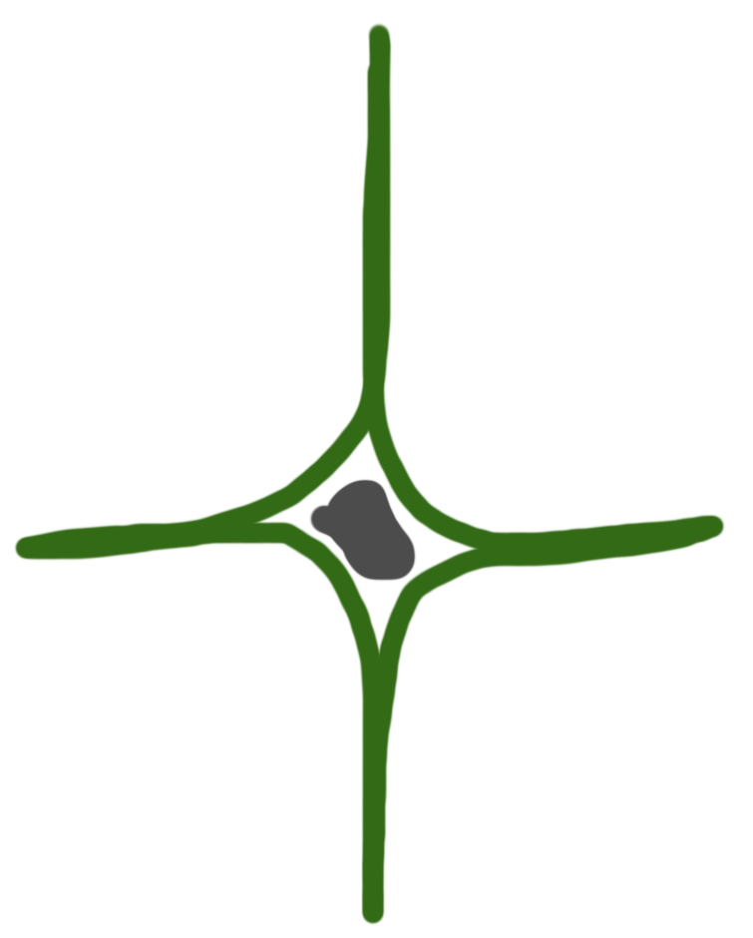
COMPLEXITy and rules
No one knows yet how to solve the problem. So: experimentation and learning by doing
Only experts know how to solve a problem. So: engage expertise
complex
complicated
chaos
simple
No one can know how to solve a problem. So: get in control fast to prevent damage
Everybody knows how to solve the problem. So: efficiënt execution
Snowden 2007

Slide 4
Regulation in the netherlands
health care
mining
environment
construction
food safety
product safety
Policy making
Policy making
Policy making
Policy making
Policy making
Policy making
Strict separation between ministries and inspections
Rule making
Rule making
Rule making
Rule making
Rule making
Rule making
Inspection & enforcement
Inspection & enforcement
Inspection & enforcement
Inspection & enforcement
Inspection & enforcement
Inspection & enforcement

Slide 5
Effective rules?
Sparrow, 2020; Kasdorp, 2022

Slide 6
problems
Narrow scope whilst many problems are wicked e.g. environmental pollution and health care
Ex ante: practical knowledge of inspectorates is poorly used to design effective policies and rules
Ex post: poor learning after implementation of policies and rules

Slide 7
Call to be(come) a switch for learning
Critical Role in Policy Learning: Without a proactive stance, the government risks overlooking policy shortcomings, widening the gap with society.
Proactive & Reflective Approach: Regulators are uniquely positioned to identify emerging challenges and opportunities early.
Strengthening Reflective Oversight: Public regulators must evolve from strict rule enforcement to safeguarding broader societal goals.
Accelerating Change: Oversight agencies are increasingly held accountable for tangible results across sectors like environment, health, education, and safety.
Identifying Gaps: Regulators see where laws fail to align with real-world societal impacts and flag new challenges, like AI-driven ethical concerns.

Slide 8
Examples of proactive regulators
Reporting gaps by regulators between policy goals and actual outcomes. The Netherlands Authority for Consumers and Markets advises on outdated regulations to ease bureaucratic burdens.
Labor migration debate: In 2024, the Inspector-General of the Dutch Labour Inspectorate raised concerns about labor migration after findings of exploitation and poor housing for migrant workers.
Legislative shortcomings: Since the financial crisis, the Authority for Financial Markets and De Nederlandsche Bank have annually advised the Finance Minister on societal risks and legal effectiveness, proposing improvements.
Facilitating dialogue: Dutch agencies struggle to combat unsafe product imports due to poor compliance with EU regulations, leading to discussions with the minister for a joint approach.
Innovative oversight: In 2016, the AFM and a major mortgage provider experimented on ways to encourage customers to repay interest-only mortgages.
Knowledge-sharing: Regulatory bodies exchange best practices at the annual Toezichtfestival, fostering collaboration across sectors.

Slide 9
Resuming …
Our society is complex and rapidly evolving, requiring a government that can anticipate and adapt.
In this environment, regulators play a crucial role as independent actors who connect various stakeholders and contribute to a flexible, autonomous, and engaged government.
To be effective, they must identify regulatory gaps, operate independently, remain critical—including of their own effectiveness—and always prioritize the fundamental goals of policies and legislation.

Slide 10
Thank you!

