Slide 1

Supervisory arrangements & contigency factors: designing suitable supervision for integrated care networks
Provisonal findings of the EISON research program focused on supervising integrated care in the Netherlands
Dr. Sander Merkus
In co-creation with Prof.Dr. Mirella Minkman
June 17, 2025

Slide 2




External and Internal Supervision Methods and Modalities for Organizational Networks Addressing Complex Societal Issues (EISON)
Patrick Kenis, Jörg Raab (Tilburg University), Mirella Minkman (TIAS)
Melanie Ehren, Cor van Montfort (VU Amsterdam), Sander Merkus (Vilans/Tilburg University)
Notes:
Naam PK Vakgebied OD
Vooral nieuwe vormen interesseren mij en laatste jaren bezig geweest met het ON: prevalentie, effectiviteit, governance, …
Eerst vooral de werkvloer: recent interesseren zich Bestuurders, RvC, Inspecties hiervoor en daaruit leidt ik fa dat het echt belangrijk aan het worden is.
Recent twee onderzoeksprojecten ingediend:
NWO National Wtenschapsagenda ‘Vernieuwing van Toezicht’ (ook AW en VTW bij betrokken)
Toezocht in het domein Sociaal Wonen ()(BZK, VTW en Aede en eventuel VWS)

Slide 3
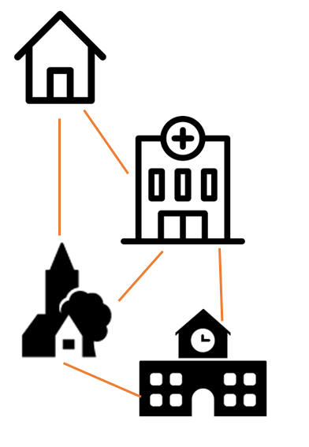
EISON: External & Internal Supervision on Organisational Networks
Complex Societal Challenges
Organizational Networks
Internal supervision (eg. Board of Supervisors)
Supervisory Arrangements
External supervision
(Inspectorate, Regulator)
Research Question
How can external inspectorates and internal supervisory boards enhance organizational networks as well as mitigate the risks of these networks?
Which methods and modalities are fit for this purpose, under what conditions and why?
How can innovative ‘building blocks’ for supervision be arranged into coherent supervisory arrangements that align with the purpose and context of specific networks?

Slide 4
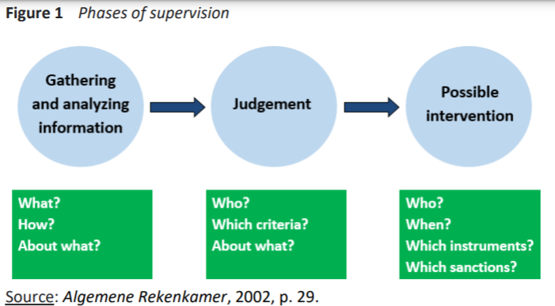

‘Supervision can be understood as parties explaining and justifying their conduct, answering other parties that pose questions, pass judgement, and potentially intervene.’ (Tran 2021: 10)
Notes:
Juist in situaties waarin verantwoordelijkheden, geldstromen en taken gedeeld en verdeeld worden over veel partijen is de vraag naar rekenschap en transparantie, en daarmee naar toezicht extra aan de orde.
Rijksinspecties zijn in essentie nog steeds gericht op ‘stand alone’ organisaties in hun eigen sector en onvoldoende toegerust voor toezicht op sectoroverstijgende organisatienetwerken.
Veel onderzoek naar succes- en faalfactoren van samenwerkingsverbanden, nog weinig naar de rol van (intern en extern) toezicht.

Slide 5
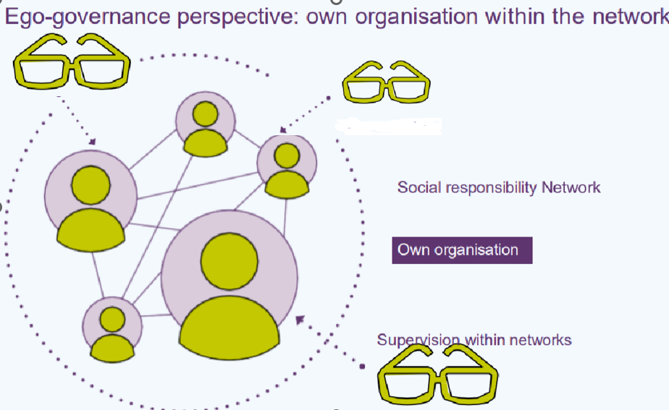

Slide 6
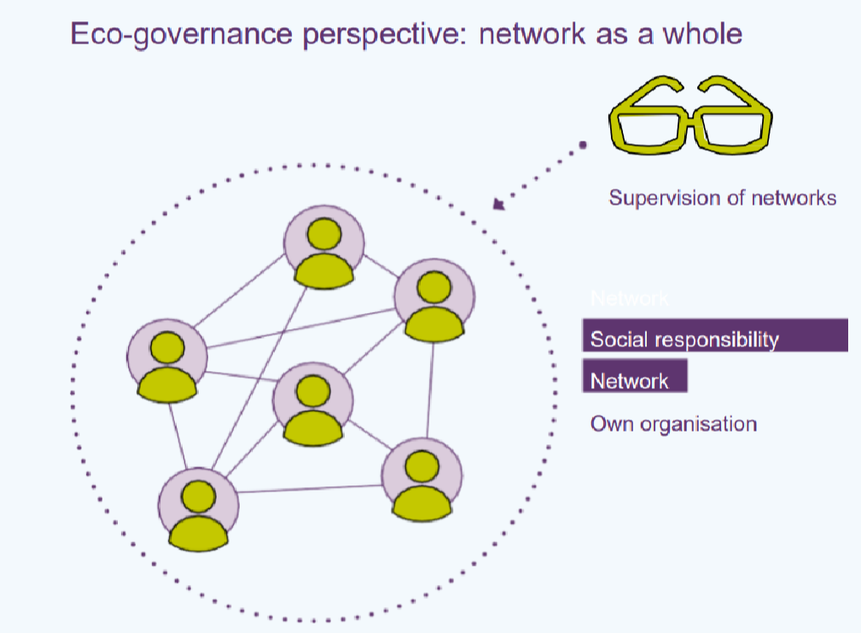

Slide 7
Object of supervision/regulation
Organization
Network
1. Does participation in the network add value for the own organization? “What is in it for me?” Supervision focuses on the added value and risks of participating in the network for the own organization. | 2. Does participation in the network align with the strategy/interests of the own organization? Supervision focuses on the appropriateness of participation in the network within the own strategy.
3. Does the organization contribute to the functioning and performance of the network? Supervision focuses on the contribution of the own organization to the network’s objectives | 4. Does the network deliver results? Does it help solve the societal problem? Supervision focuses on evaluating the network and the organization only secondarily
Ego-centric
Perspective
Eco-centric
Perspective

Slide 8
Purpose of the research
Co-creation of ‘supervisory arrangements’ for the integral care networks – beyond compliance towards co-operation.
Experiments together with in- and external supervisors and the networks in a co-creative fashion.
Creating more understanding about which supervisory arrangements are appropriate for which kind of networks

Slide 9
Progress of research program
2023: researching the functioning and existing supervision of networks
2024: Focus groups and developing potential innovative building blocks for network supervision
2025: defining ‘design challenges’ of networks and designing supervisory arrangements for experimentation
2025/2026: Experimenting with innovative buidling blocks and arrangements and evaluating outcome

Slide 10
Potential building blocks for supervisory arrangements
Supervisors/inspectorates and participating network organizations co-designing a definition of the societal challenge for integrated care and a common framework to monitor progress
Distributing monitoring reports of effect and impact of the network in equal form and at the same moment towards internal supervisors in participating organizations and external supervisors/regulators
Joint inspection by multidisciplinary inspection teams, including representatives from major inspectorates
Annual Meeting of supervisory boards of the organizations participating in the network (and potentially also external inspectorates/regulators)
Evaluative supervision – organizing an (external) evaluation or visitation of the network (with specific obligations)
Conseile locale – council of citizens elected by random ballot, supervizing the progress of solving the societal challenge

Slide 11
Provisional contingency factors for suitable supervisory arrangements
Purpose & expected result of supervision
Stimulating learning/monitoring expenditure/monitoring progress social challenge/…
Size of the network (# participants)
Few/average/many
Diversity of the network (different domains)
One sector or specialism/several domains/many domains
Mode of instigation of the network
Mandated/strong financial incentive/voluntary
Developmental phase of the network
initiative/ execution / expansion / consolidation
Political/societal pressure on network
Low urgency or political risk / high urgency or risk
Modality of network governance

Slide 12
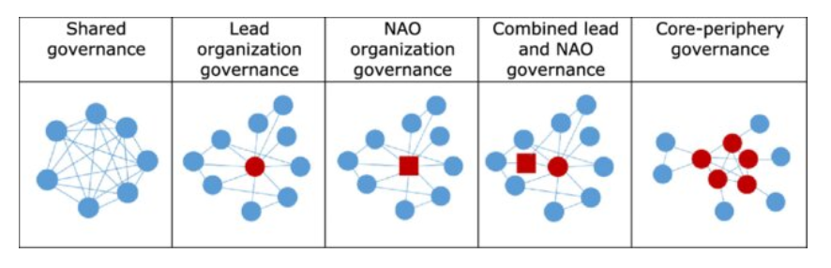
Modality of network governance
(Bron: Provan en Kenis 2008)

Slide 13
Two general pre-conditions for supervisors and regulators of integrated networks
Public Intrest or societal challenge is of primary concern
  Oriented at development, no snapshot inspection but continuous proces
Descretionary room for action for internal and external supervisors is needed.
  Possibility for custom made solutions, but no arbitrary random actions. (Principle-based inspection or ‘compy or explain’)
Supervision on networks might be formative, harnessing network identity and increasing the opportunity that members invest in the network and do not fall back on their own organization.

