Slide 1
Health Regions Integrated Service Delivery

Slide 2
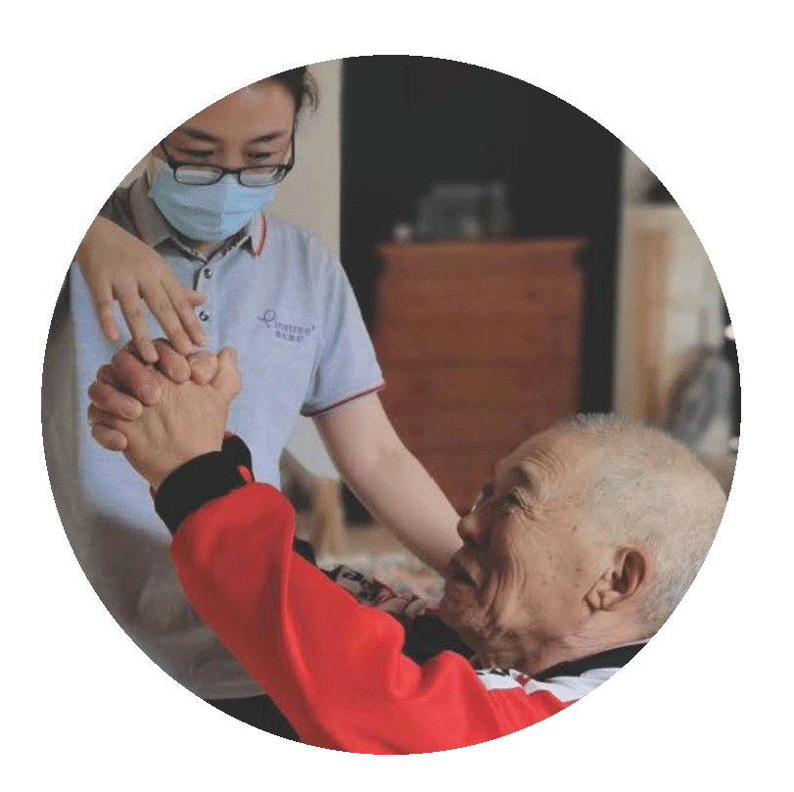
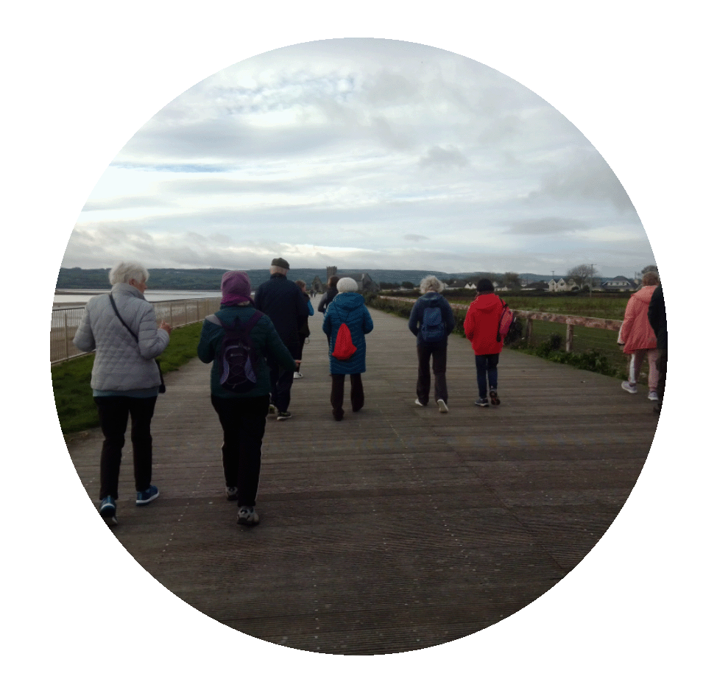
Health Regions Vision
To deliver person-centred health and social care services that are informed by the needs of the people and communities in each region, better serving people at all stages throughout their lives
To align hospital- and community-based services in each region so that they can work together better and deliver joined-up, co-ordinated care closer to home
To balance national standards of care and direction with local decision-making to ensure people can access the same quality of care no matter where they live
To improve the health and well-being of people in each region by ensuring that services are planned around local needs, people are well-informed and supported when accessing services, and resources are fairly allocated and accounted for

Slide 3
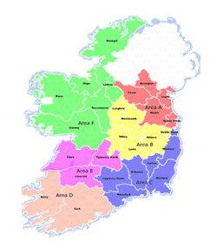
Health Regions Strategic Objectives
2. Clarify and strengthen corporate and clinical governance and accountability at all levels
1. Align and integrate hospital-based and community-based services to deliver joined-up, integrated care closer to home
3. Support a population-based approach to service planning and delivery which aims to address health inequalities
4. Improve equitable regional investment and balance national consistency with appropriate local autonomy to maintain consistent quality of care across the country
5. Run an efficient, highly productive, and transparent health and social care service with aligned incentives to provide people with timely access to safe, high-quality and integrated care.
Source: RHA Strategic Objectives

Slide 4
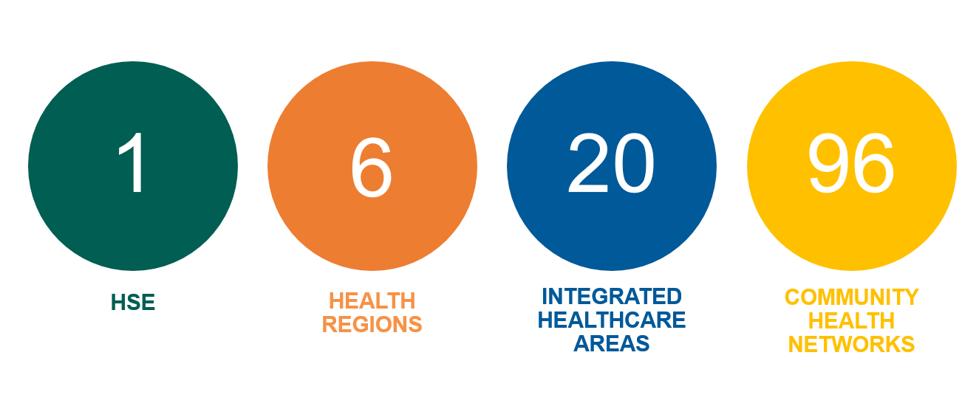
HSE Geographical Sub-structures

Slide 5
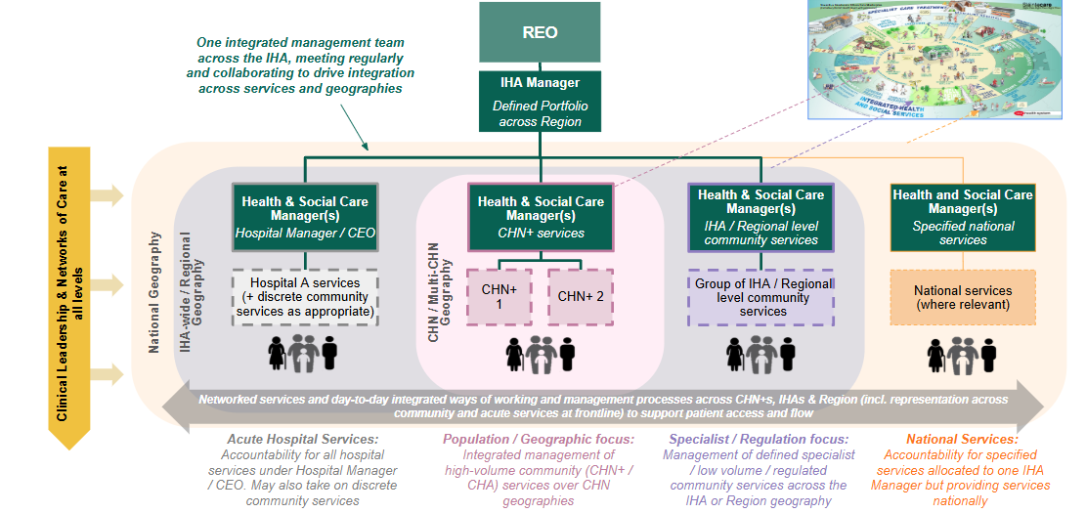
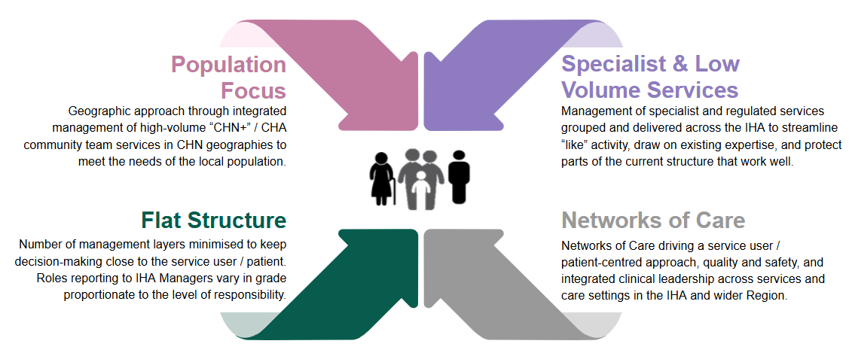
Future State Integrated Service Delivery Model
Overview of Integrated Healthcare Area (IHA) Design
Requirement for consistent IHA design to align with key features of approved ISD model in all regions
Geographic population focused model driving Integrated Service Delivery for patients and service users, in line with Sláintecare. Within the ISD Model the term Community Healthcare Area (CHA) refers to the integrated management and organisation of a range of health and social care services at the level of a CHN geography
Flat integrated structure ensuring IHA managers are operationally focused - Hospital Managers / CEOs, Community Heads of Services & General Managers reporting directly to IHA Manager
Appropriate management of specialist and / lower volume services across the IHA / Region
Networks of Care driving standardisation, quality and safety across the IHAs and Regions
Structure will be filled within existing staffing levels
Each Region / IHA will adopt the principle of equitable distribution of services across Health & Social Care Managers. Key criteria will include scale, population demographics, complexity of services, etc.

Slide 6
Standard Integrated Healthcare Area (IHA) Design
Approved by Health Regions Governance Group
Managers / teams within Section 38s will report into the relevant organisation / board, with a working relationship to the IHA Manager
Role Titles TBC
Voluntary Hospital Board
(for illustration)
IHA Manager
(& Defined Lead role across Region)
Health & Social Care Manager
Hospital Manager / CEO
(& Defined Lead role across IHA)
Health & Social Care Manager General Manager
CHA Services
(& Defined Lead role across IHA)
Health & Social Care Manager
Head of Service
Specialist Services
(& Defined Lead role across IHA)
Clinical representation on IHA Management Team (e.g. ECD, Clinical Directors, GP Lead, Nursing & HSCP Representation)
Dedicated IHA QPS Role
(Proposal – TBC)
Dedicated partnering and support from Corporate / Enabling services
Networks of Care driving integration across patient & service-user pathways at all levels across the IHA and Region
Patient & Public Partnership
Operational accountability for all services delivered within the Hospital
Specific proposals will be progressed in Regions to drive integration between acute and community services
Operational accountability for majority of Community Services in the CHN geography, including:
High-volume teams (CHN, CDNTs, Home Support, CAMHS, Adult MH)
Some residential, respite and day services (in line with appropriate GM span of control)
Operational accountability for specialist / higher complexity services that serve a wider geography including Community Specialist Teams and some regulated services (e.g. Mental Health Inpatient)
Regulatory oversight role as ‘Registered Provider Representative / Proprietor’ for designated services
Portfolio responsibility for specific care group(s) and for driving Networks of Care
Additional defined accountabilities as determined by REO
Core service configuration will be applied consistently across Regions, some variation will be required between IHAs / Regions based on local context / current service delivery models, e.g. Social Inclusion, Specialist Palliative Care

