Slide 1
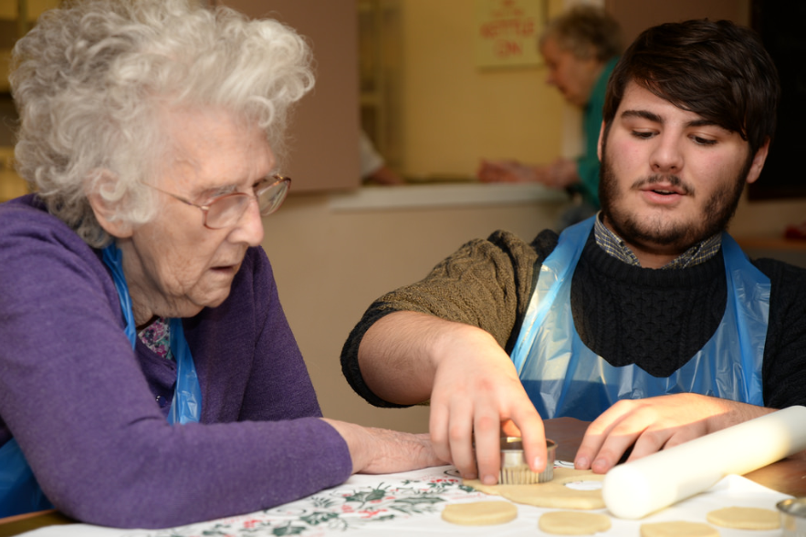
Regulatory impact for integration
CQC
Becky Hodson
Deputy Director of Strategic Priorities
EPSO Conference, 17.06.25

Slide 2


Our role and purpose
The Care Quality Commission is the independent regulator of health and adult social care in England.
We make sure health and social care services provide people with safe, effective, compassionate, high-quality care and we encourage care services to improve.
Notes:
Our core purpose is to make sure health and social care services provide people with safe, effective, compassionate, high-quality care and we encourage care services to improve. But problems when implementing our new assessment approach and issues with our new technology mean we are unable to fully deliver that purpose.

Slide 3


Our unique oversight of care
29,733 Adult social care services
136 NHS acute hospital trusts
10 NHS ambulance trusts
268 Independent Ambulance providers
212 Hospices
49 NHS mental health trusts
274 Independent mental health locations
11,632 Dental practices
6,383 GP practices
1,515 Independent acute locations
255 NHS or independent community health providers
273 Out of hours and urgent care
29 Slimming clinics
149 Prison healthcare locations
Is it safe?
Is it effective?
Is it caring?
Is it responsive?
Is it well-led?
Notes:
Numbers produced and verified by Performance Team - Katie Kemplen <katie.kemplen@cqc.org.uk> on 22 October 2024

Slide 4

Our responsibilities
  The Health and Care Act gives CQC
  a role in reviewing integrated care systems
  It also gives CQC a duty to assess how local
  authorities are meeting their social care duties
  under part 1 of the Care Act
These will allow us to look more effectively at how care provided in a local system is improving outcomes and reducing inequalities
We’ve engaged extensively on how we’ll do this. We want to bring together a view of quality across a local area and put people at the centre of driving improvement in care
Notes:
The final version of the Act:
Gives CQC a duty to independently review and assess how Local Authorities are delivering their Care Act functions under Part 1.
Creates new powers for CQC to have oversight of Integrated Care Systems (ICSs), putting three key themes for assessment on the face of the Bill – Leadership, integration and quality and safety.
Introduces a requirement for all health and social care providers who carry out regulated activities to ensure that their staff receive specific training appropriate to their role on learning disabilities and autism. The Secretary of State (SofS) is also required to produce a Code of Practice with regards to training on learning disability and autism.
Creates a duty for CQC to enforce the NHS food and drink standards. The Bill imposes requirements on NHS hospitals in connection with food or drink provided or made available to any person on hospital premises in England that are used in connection with the carrying on of a regulated activity. Further regulations will be made which will specify the nutritional standards or requirements which are to be complied with.
New responsibilities –
We now have new powers to oversee local authorities and integrated care systems under the Health and Care Bill.
These will support us to deliver the objectives in our strategy by allowing us to look more effectively at how the care provided in a local system is improving outcomes for people and reducing inequalities in their care.
We’ve engaged extensively over the last year on how we’ll do this, including two large workshops with around 400 representatives from across the country and establishing an expert advisory group to provide dedicated input.
This will be transformative in how we bring together a view of quality across a local area, put people at the centre and help drive improvement in care.

Slide 5
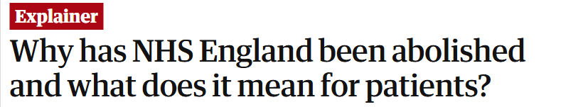
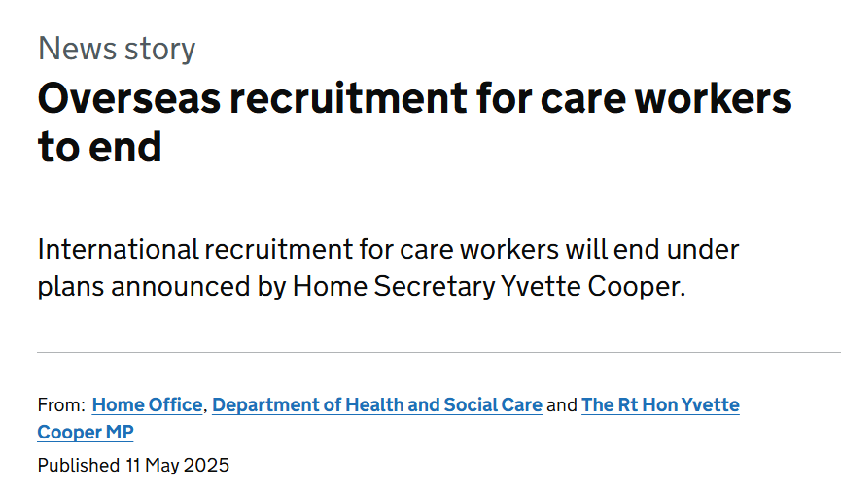

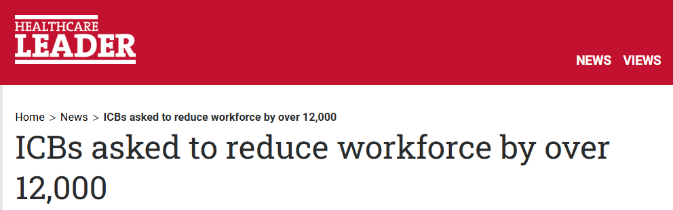
Current context
Significant amount of change
Oversight landscape is shifting
Workforce, funding and cuts
10 Year Plan

Slide 6
Regulatory impact: integration
System partners
Integrated Care Systems
Hard levers
(Formal mechanisms)
Assessment and inspection
Action and recommendations
Ratings
Legislative responsibility to escalate concerns
Assessment
(Currently paused)
Soft levers
Relationships
Collaboration and convening
Advice and guidance
Highlight practice and learning
Notes:
*Local authorities - If we find that a local authority is failing to perform its functions under the Care Act to an acceptable standard, we must inform the Secretary of State for Health and Social Care. This duty is under section 50 of The Health and Social Care Act 2008.
The duty is triggered where any quality statement receives a score of 1. This applies to all quality statements except those under the ‘Leadership’ theme. These do not directly map to Part 1 of the Care Act.
When this happens, the Chief Inspector of Adult Social Care and Integrated Care will write separately to:
the Secretary of State to explain how we made our decision
the Chief Executive and Director of Adult Social Services at the local authority to inform them that a section 50 notification has been made.

Slide 7
Insights into integration
Relationships
“Healthcare professionals commented that they were very impressed with the positive, and initiative-taking way the service worked with them, by providing thorough, up to date, and appropriate information to keep people safe with their consent.
Domiciliary Care Agency - Outstanding
“We saw the practice worked inconsistently in partnership with other services... We saw limited examples of how the practice had… for example, [built] relationships with community groups to promote the take up of screening programmes. Staff were unable to provide examples of established mechanisms for engaging with the community healthcare provider. The practice told us they attended primary care network meetings; however, we did not see evidence of these meetings and actions.”
GP Practice - Inadequate

Slide 8
Insights into integration
Systems and information
“As a result of partnership arrangements, there was an effective recording system which allowed social care staff to view the health details of a person and some clinical information such as medication and diagnoses from health systems. Health partners could also view who the allocated worker was and any safeguarding concerns.”
Local Authority - Outstanding
“There were processes that provided smooth information sharing, and enabled people to receive the care and support they required in a co-ordinated, flexible way that understood the diverse health and social care needs of the local community.”
Domiciliary Care Agency - Outstanding
“Access to records between health and social work colleagues, however, relied on staff proactively contacting workers and could not be accessed via a shared record.”
Local authority - Good

Slide 9
Insights into integration
Workforce and skills
“A visiting health professional we spoke with told us, “There are plenty of staff, I can always find a staff member and I am always supported by a staff member on my visits to people. They are really supportive and know people so well. The care plans are brilliant and are always updated with our guidance.”
Care home - Outstanding
“A healthcare professional commented, “The communication…has been excellent. The team…ensure that their staff are trained and safe to work with the client.””
Domicillary Care Agency - Outstanding

Slide 10
Insights into integration
Understanding & working with local populations
“The local authority had convened a health and care citizens’ assembly to contribute to the health and well-being strategy (2022 to 2030).
The local authority used VCSE partnerships to meet diverse needs in communities and reduce inequalities using tools such as family group conferencing and helping to connect people with networks, community groups and agencies. Partners told us the local authority did reach out to the VCSE to seek current knowledge of the community landscape and were inquisitive to the needs of the community.”
Local authority - Outstanding
“There were significant shortfalls in how the service understood the diverse health and care needs of people and their local communities, so care was not joined-up, flexible or supportive of choice and continuity. We found no evidence to demonstrate the outcome of the national patient survey had been reviewed and used to make improvement.”
GP Practice - Inadequate
“An example of exceptional care provision was the services relationship and work with a charitable organisation that provides support and a safe space to people who are homeless... All care was provided on site at the charity and offered to anyone who visited the charity during the regular and well publicised clinic times. Homeless people who used the service had also been supported to make their voices heard, and able to influence the care provided. This was because the provider asked for their feedback which was reviewed and considered.”
GP Practice - Good

Slide 11
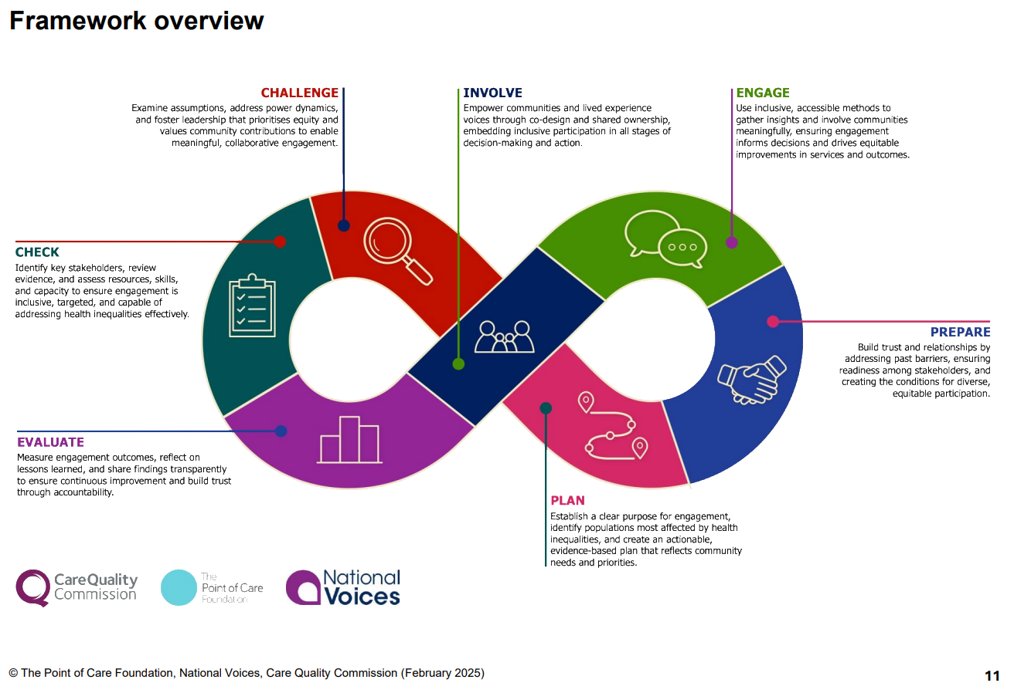
Opportunities for CQC
Understanding and working with local populations
Lever: guidance and tools for improvement
Addressing health inequalities through engagement with people and communities: A self-assessment and improvement framework for integrated care systems
Developed in partnership with The Point of Care Foundation and National Voices
With funding from the Regulators’ Pioneer Fund

Slide 12

Opportunities for CQC
Systems
Lever: working with partners
Supporting the Digitising Social Care Programme

Slide 13

Opportunities for CQC
Workforce and skills
Lever: using our independent voice
Dementia strategy: a review of the experiences of people with dementia in England and how health and care services are responding

Slide 14
A note on challenges
Coordination of inspection activity across a pathway
Wide variation in system partners’ capacity and capability for improvement
Context and interdependencies
“…CQC assessment activity needs to incorporate a systems perspective and demonstrate that it is understanding performance and outcomes through this lens. In practice, this means ensuring CQC continue to build an approach that recognises (and reflect in assessment scoring and reports) the importance of context to outcomes, considering the upstream factors that affect particular outcomes, which sometimes may be quite distant from the outcome of interest, and acknowledging that outcomes often result from the work of multiple organisations interacting. CQC should also ensure the wider context around LA/ICS operating constraints is considered and reflected in the assessment process.”

Slide 15
Thank you

