Slide 1
Involving Citizens in Regulation: capturing the experience of service users
Hester van de Bovenkamp, Erasmus University Rotterdam, vandebovenkamp@eshpm.eur.nl

Slide 2
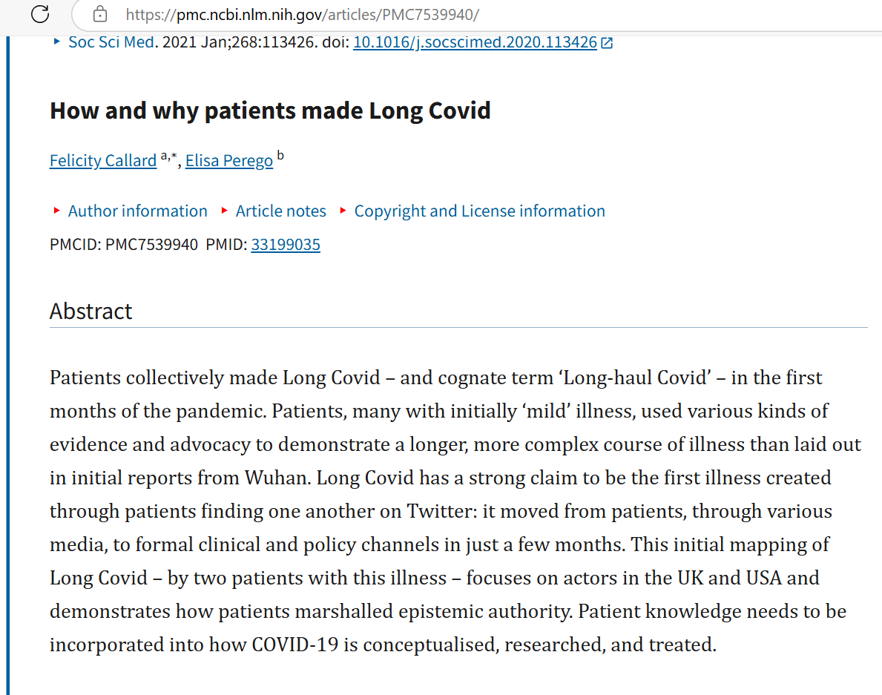
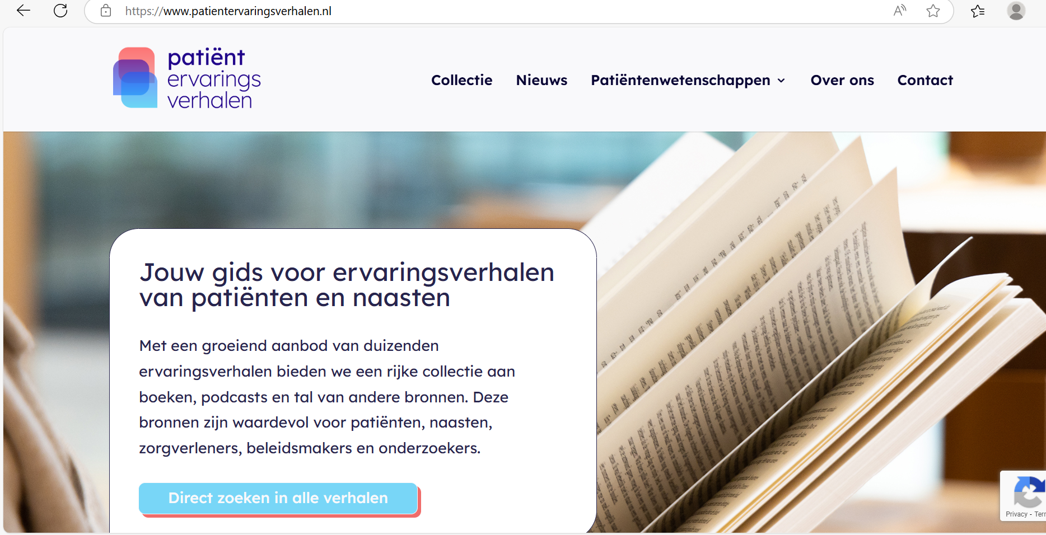
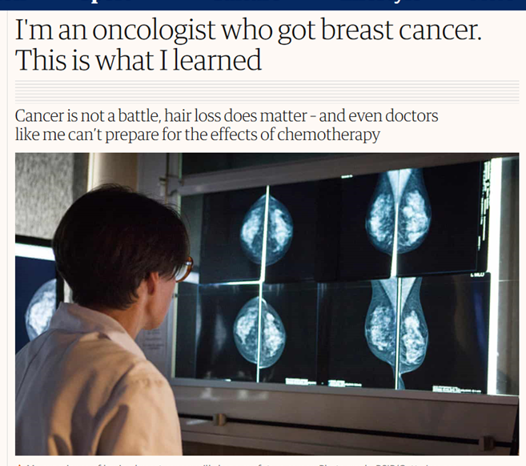
Focus on patient stories and how they can be used for healthcare decision-making
Telling stories of illness is the attempt, instigated by the body’s disease, to give a voice to an experience that medicine cannot describe (Frank 2013, p.18)

Slide 3
Patient involvement on the collective level
Much involvement of patient (representatives) on the collective level
Why: other perspective and democratize decision-making
At the same time proves difficult to put into practice
Also attention for involvement in regulation

Slide 4
Involvement in regulation in the Netherlands
Added value of different perspective on quality of care and legitimizing regulation
Also part of political debate: participation as a countervailing power

Slide 5
Theory on responsive regulation and tripartism (Ayres & Braithwaite, 1991; Braithwaite, 2011)
Arguments in favor of bringing in third parties in regulation:
Avoid capture
Intertwined with the argument of adding a new perspective, especially where it concerns ‘weaker forms’ of capture
Broader literature on involvement shows its intricacies
Question: how does this work out in practice?

Slide 6
Case studies

Slide 7
Involvement and capture
Participation increased the transparency of the inspection process for the citizens involved
Compliance with rules and inspection criteria not on citizens’ top of mind, focus on improving quality of care
Risk of information capture of citizens by the regulators

Slide 8
Involvement and adding new perspectives
Youth care: different values upfront, clash with regulatory frameworks
Mystery guests: more positive in their judgement
Experts by experience: training to be a neutral bystander limits different perspective
Incident investigations: different perspective but also here clashes with method of incident analysis
Results used for further reflection on how to include citizens’ perspectives

Slide 9
Concluding reflections
Including citizens’ perspectives can help avoid capture of dominant frames
Opens possibility for reflection on ‘good’ public services and by consequence regulation, e.g. RUN study
Requires thinking about the timing of involvement
Requires reflection on the fact that patient involvement is political in nature: part of the struggle on ideas, interests and power
How to do involvement well requires continuous experimentation

Slide 10
Further reading
Kok, J., Palimetaki F., Akrouh, N. et al. (2025) - Involving Service Users in Care Regulation: A Scoping Review of Empirical Literature International Journal of Health Policy and Management, 14 (1), 1-13
de Graaff, B., Rutz, S., Stoopendaal, A. & van de Bovenkamp, H., (2025)Involving citizens in regulation: A comparative qualitative study of four experimentalist cases of participatory regulation in Dutch health care Regulation & Governance. 18, 4, p. 1411-1425
Kok, J., de Kam, D., Leistikow, I., Grit, K., & Bal, R. (2022). Epistemic Injustice in Incident Investigations: A Qualitative Study. Health Care Analysis, 30(3-4), 254-274.
Wiig S, Rutz S, et al. (2020). What methods are used to promote patient and family involvement in healthcare regulation? A multiple case study across four countries. BMC Health Serv Res. 2020 Jul 6;20(1):616.
Cribb A, O'Hara JK, Waring J. Improving responses to safety incidents: we need to talk about justice. BMJ Qual Saf. 2022 Apr;31(4):327-330.

