Slide 1
Involving Lived Experience in Quality Reviews
Hannah Lucas-Motley
Head of Quality and Accreditation, RCPsych

Slide 2
The Royal College of Psychiatrists (RCPsych)
“We work to secure the best outcomes for people with mental illness, learning difficulties and developmental disorders by promoting excellent mental health services, training outstanding psychiatrists, promoting quality and research, setting standards and being the voice of psychiatry”
Notes:
Membership organization, central offices in London with other offices in devolved nations and divisionally across England

Slide 3
The ‘Working Together’ Model – why?
25+ years of involvement
Developed in organic, siloed way
Consultation vs true coproduction
WTM introduced to:
Reduce variation in experience
Provide additional support
Implement robust recruitment procedures
Provide clarity around roles and expectations
Ensure involvement is meaningful and recognised

Slide 4
The ‘Working Together’ Model – how?
Design
Oversight group established
CEO
Staff leads for HR/ Finance/ safeguarding
Clinical lead for involvement
Patient and carer rep
Met every two months
Discussed best practice for experience and engagement
Preparation
Consultation with staff and wider pool of patients and carers
Training and drop-in sessions for all staff teams
Nature and number of roles
Identifying contacts
Key changes
Policy refresh
Implementation
Recruitment plans put in place
Inductions developed
College-wide
HR
Project-specific
Shadowing
Ongoing Oversight meetings
Regular staff drop-in sessions
Notes:
Advert - College and external websites
Similar process to College staff
Values-based questions
DBS checks

Slide 5
The College Centre for Quality Improvement (CCQI)
Work with every mental health trust in England and increasingly in the devolved nations and internationally
29 quality networks, 3 national audits, 2 feedback tools and the Invited Review Service
80+ staff and two Clinical and Strategic directors
Our 2024 events and conferences were attended by over 2,500 people
670 services reviewed in 2024
Work closely with 100 patient and carer representatives

Slide 6
Quality networks and accreditation
Home to 29 quality networks and accreditation programmes with ~1,600 member services which employ over 50,000 staff
Model of self- and peer review with emphasis on support, sharing learning and solutions
Underpinned by core standards for inpatient and community services
Continuous improvement embedded in regular standard review
Complements regulatory bodies and prepares services for inspections
Positioned to evolve - standards, services and mode of engagement with members e.g., COVID 19 complete virtual migration
Multidisciplinary, cross sector and cross setting
Standards
Self review
Peer review
Accreditation
Learning from the reviews

Slide 7
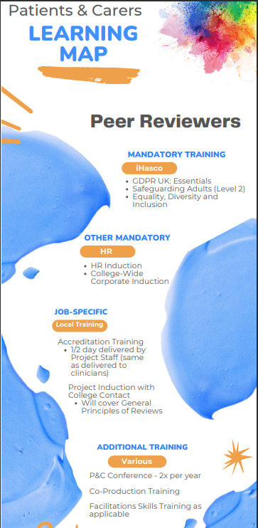
Patients and Carer Reps Quality and Accreditation Networks
People with lived experience of the specialism
Number determined by size of the network
Comprehensive induction & training plan
Expectation of ≥8 days of work p/a
Reviews as core activity, plus additional opportunities
Advisory Group
Accreditation Committee
Standards/questionnaire development
Event development/facilitation

Slide 8
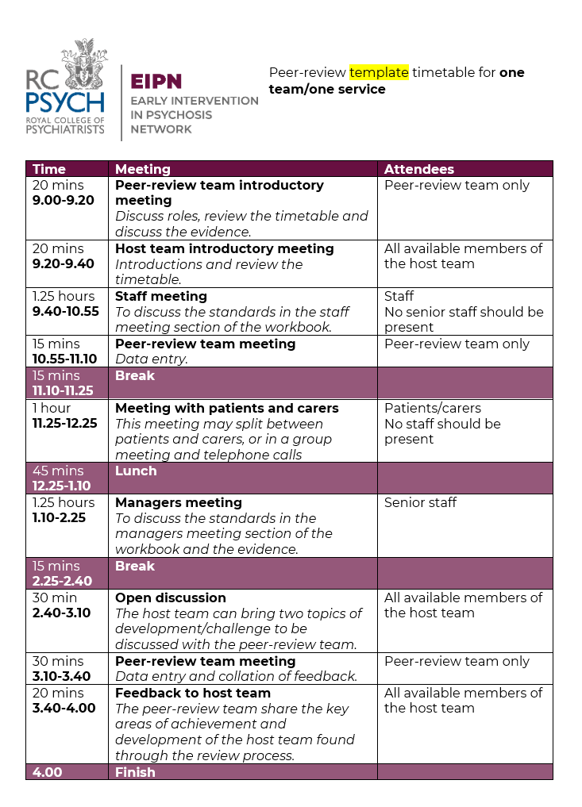
Patients and Carer Reps Quality Reviews
Usually 1 day; some online, some in person
‘Developmental’ vs accreditation
Combination of interviews and discussions
Reps lead on patient/carer meetings
Review key documentation
Professionals
Patient/carer Representative
Network Rep
Host Service
Notes:
Network reps have been trained in facilitation to ensure patients and carers are brought into conversations without putting people on the spot

Slide 9
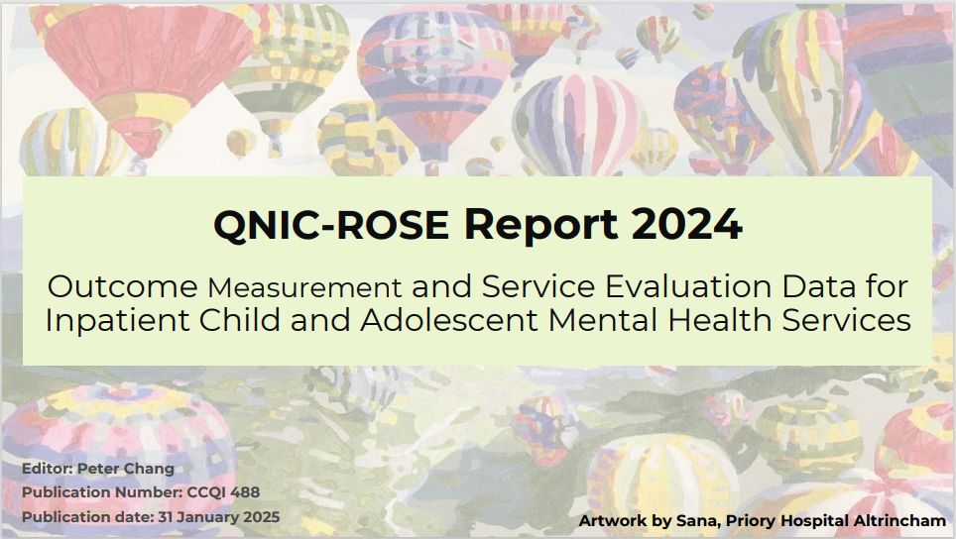
Patients and Carer Reps Quality and Accreditation Networks

Slide 10
Patients and Carer Reps Support
College contact
Debriefs following reviews
Rep catch-ups
Employee Assistance Programme
Biannual Patient & Carer Conferences
Annual Patient & Carer Survey

Slide 11
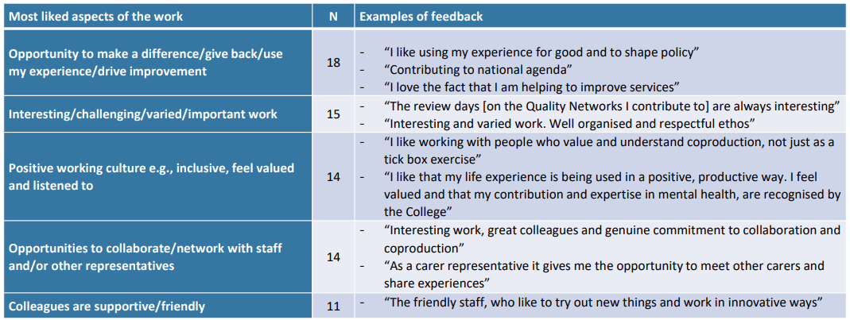
What works well? Patient/carer perspective
RCPsych Patient and Carer Representatives Survey (2024)
Notes:
N=60 out of total 145 reps (41% response rate)

Slide 12
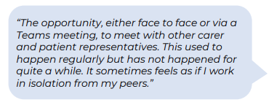
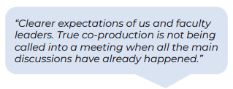
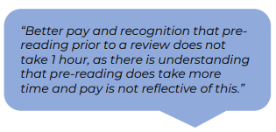
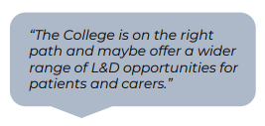
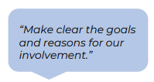
What could be improved? Patient/carer perspective
RCPsych Patient and Carer Representatives Survey (2024)

Slide 13
Next Steps for RCPsych
True coproduction is an ongoing learning curve!
Coproduction training for all staff
Coproduction vs co-design vs engagement
WTM being revised (5 years on)
Oversight group
College contacts
Pool of representatives
Action planning
Next survey
Next conference

Slide 14
How to get started?
Seek advice from the experts
Tap into local groups (example: QNCC & Young Minds)
Focus groups/panels to discuss meaningful involvement
Develop shared aims
Involvement from staff
Clear roles and expectations
Both internal and external
Establish support mechanisms
Review
Won’t get it right first time!
Best practice constantly evolving

Slide 15
Thank you
www.rcpsych.ac.uk/improving-care/ccqi

