Slide 1
Responding to Regulatory Challenges
Rory Gribbell
Director of Strategy and Engagement at Ofsted

Slide 2
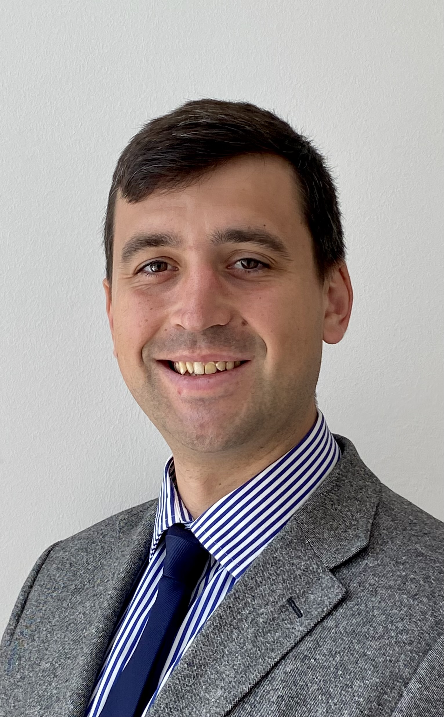
Agenda: Dealing with a crisis of legitimacy
Introduction to Ofsted
Crisis of confidence
Reform strategy
Where are we now?
Biography
From 2016-24, Rory Gribbell worked as an education adviser to Prime Ministers, Secretaries of State and Ministers in England.
Since January 2024, he has worked as Director of Strategy and Engagement at Ofsted, supporting the design and delivery of Ofsted’s reform strategy in response to the tragic death of Ruth Perry.
Prior to working in government, Rory was a maths teacher, having qualified through the Teach First programme.
Notes:
90% g/o gone.

Slide 3
Introduction: Ofsted works across education and care
State-Funded
Schools
Independent
Schools
Further Education
and Skills
Teacher Development
Area SEND
Social Care
Early Years
21,900 schools*
52 non-maintained special schools
1,140 non-association independent schools
Online education providers (new)
160 GFE colleges
44 sixth-form colleges
140 adult community education providers
1,270 independent learning providers
70 16-19 academies
110 HEIs
13 specialist FE colleges
130 independent specialist colleges
120 prisons
179 accredited initial teacher training providers (from September)
9 ECF/NPQ providers
153 local area partnerships
153 local authorities
3,480 children’s homes
13 secure children’s homes
2 secure training centres
200 boarding settings
98 residential family centres
400 adoption agencies
12 residential holiday schemes
Supported accommodation (new)
27,100 nurseries
34,700 childminders
6 childminder agencies, with 1,240 childminders on roll
In 2024-2025, the total budget to deliver our work was £205m.
3
*44% of primary have nursery/2YO provision and 60% of secondary have sixth form.

Slide 4
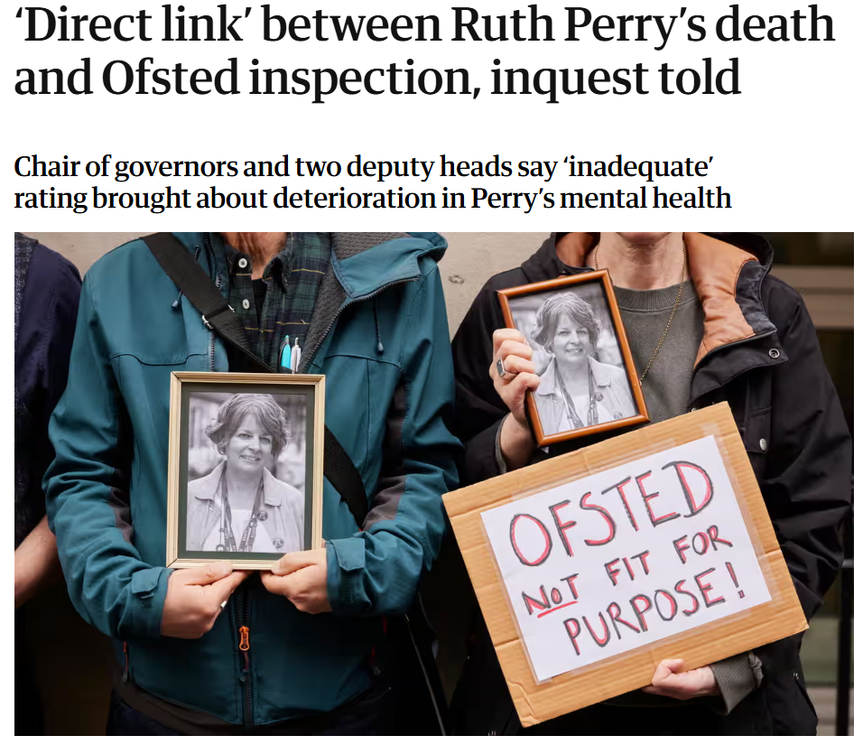
Crisis of confidence: Tragic death of Ruth Perry in 2023
Timeline of events
November 2022: Inspection of Caversham Primary School results in an ‘inadequate’ judgement due to safeguarding failures.
January 2023: Ruth Perry, Head Teacher of Caversham Primary, passes.
Autumn 2023: Coronial inquest into the circumstance of death.
December 2023: Regulation 28 Report to Prevent Deaths issued, identifying a risk to life unless changes were made by Ofsted.
4

Slide 5
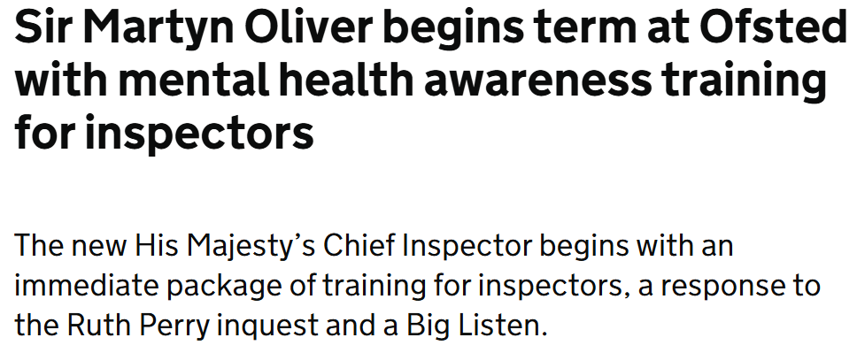
Reform strategy part 1: Control through pace
Timeline of events
January 2024: Sir Martyn Oliver takes over at Ofsted, immediately announcing mental health training and a determination to work more closely with the profession.
January 2024: Ofsted formally responds to the Preventing Future Deaths report, accepting all recommendations.
March 2024: Big Listen consultation launched.
July 2024: General election results in a landslide Labour victory, with promises of removing the overall effectiveness grade.
September 2024: Ofsted formally responds to the Big Listen consultation, announcing (with DfE Secretary of State) the removal of the overall effectiveness grade.
5

Slide 6
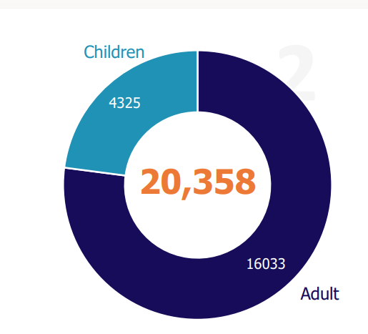
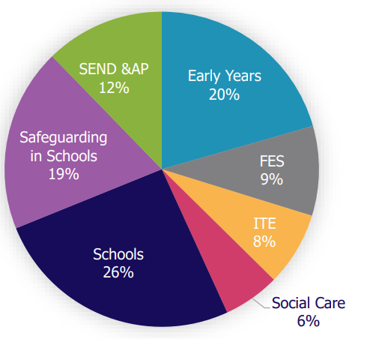
The Big Listen: Listening following calls for change
The Big Listen, which aimed to hear feedback, accept criticism and make improvements, had four strands:
A public consultation, launched at the beginning of March 2024, has received 20,358 responses.
A children’s survey reaching 4,325 children and young people, alongside focus groups with children in care and care leavers.
Externally commissioned polling and focus groups reaching 7,000 professionals from across our remits, 4,000 parents and carers, and over 4,000 members of the public.
Hundreds of events with stakeholders led by HMCI and other leads at Ofsted.
The public consultation reached over 20k people, including 4.3k children.
The public consultation received responses across all of Ofsted’s remits.
6

Slide 7
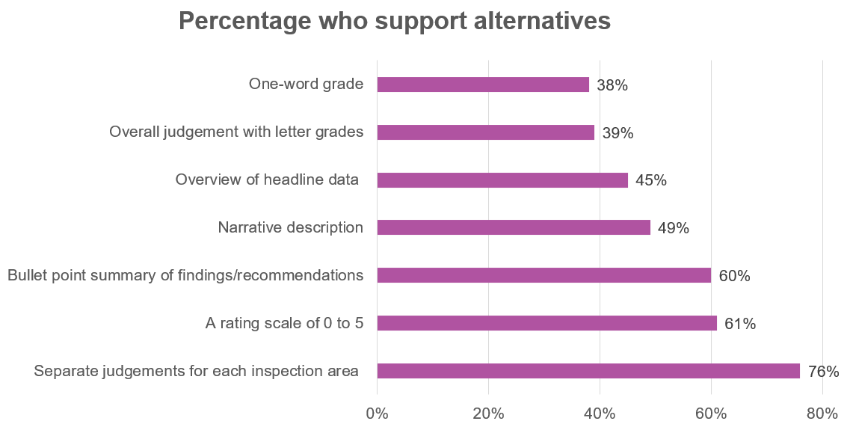
The Big Listen: What did we hear?
Parents largely support Ofsted but want an alternative to one-word judgements
Professionals had strikingly similar views
“Act in the best interest of children” – 54% agreed, 13% disagreed
“Help improve standards of education” – 52% agreed, 31% disagreed
Are “a valuable source of information” – 55% agreed, 12% disagreed
Providers want more advice on how to improve and consistency between inspections.
Their views on alternatives to the one-word judgements had significant overlap:
7

Slide 8
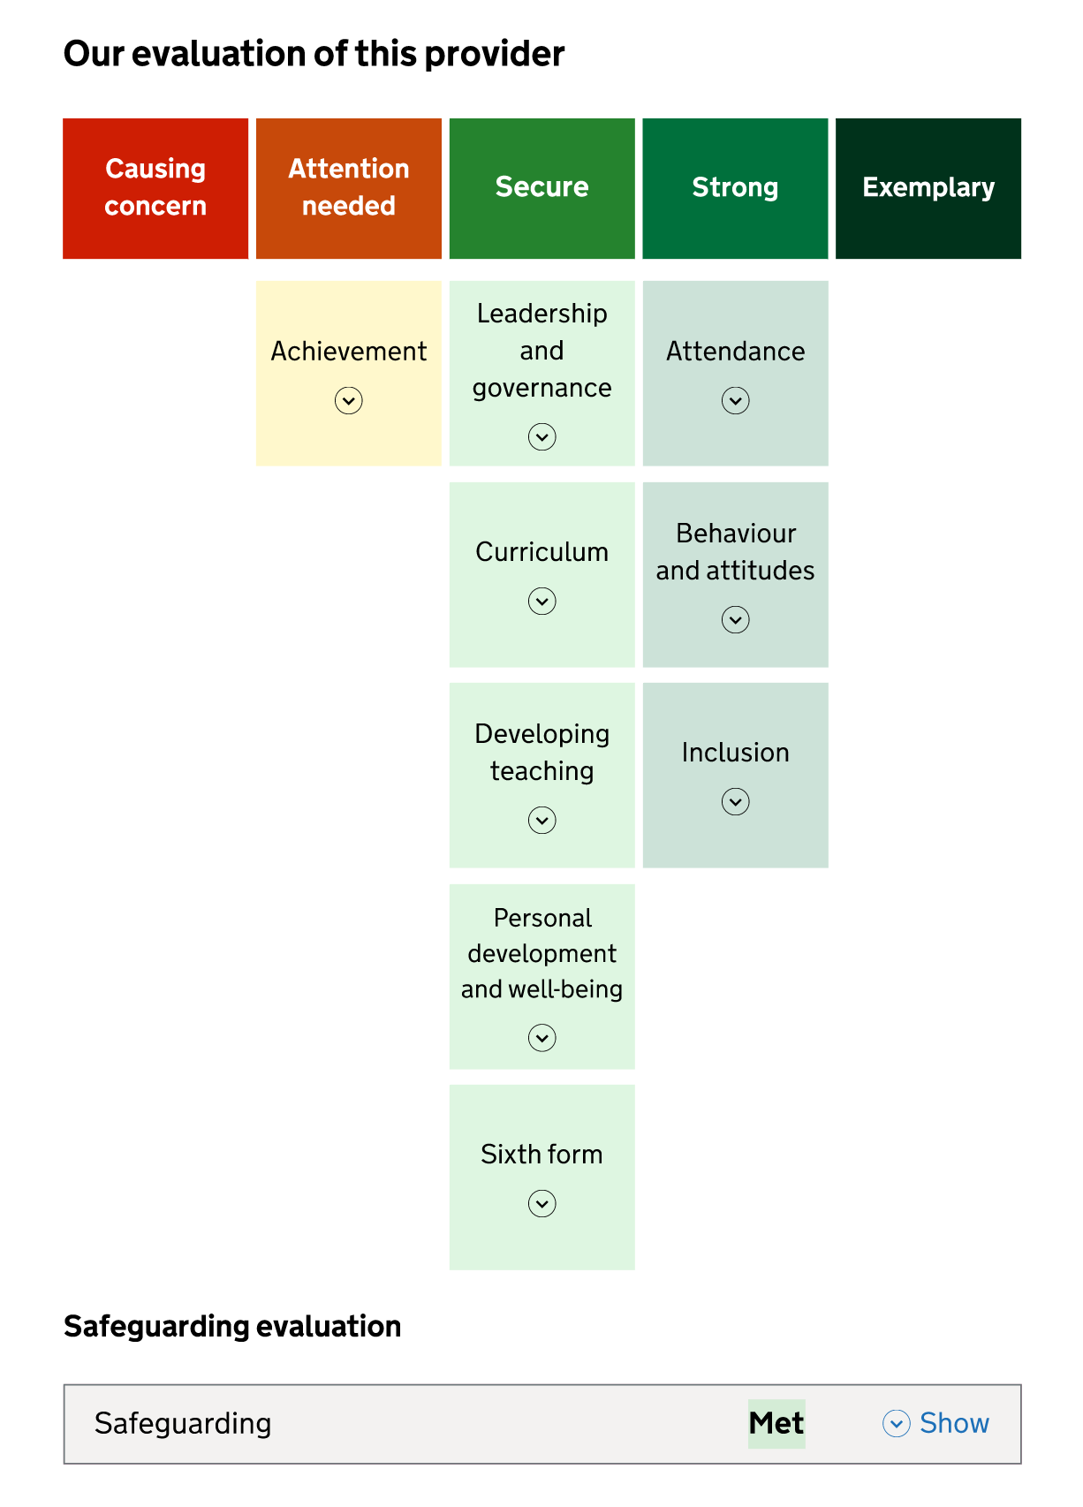
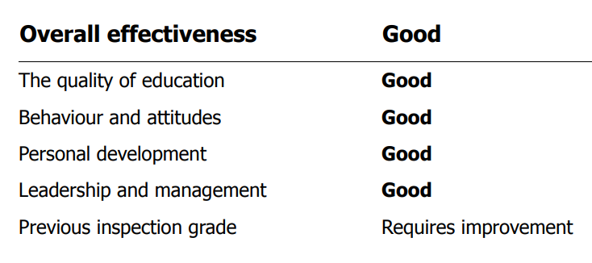
Reform strategy part 2: Working for parents and professionals
Notes:
The new framework and report card will look different. And they will feel different. They begin as a diagnostic assessment to help schools improve – schools should be able to see what they need to do to do things well. This is a different relationship to now. But where schools are not good enough there is still a hard edge – high standards and accountability.
We will reset our relations with the system through a reformed model of inspection, reporting and through the insights we gather across education, children's services and skills. Our aim is to: *provide high quality, informative reports to parents *give education providers a diagnostic toolkit which will enable self-improvement and support Regions Group to ensure opportunity for all *develop insights which inform parliament and supports targeted and evidence-based policy decisions from the DfE We will have courageous conversations on behalf of children, holding the system to account where standards are unacceptable - including where schools are 'stuck'.

Slide 9
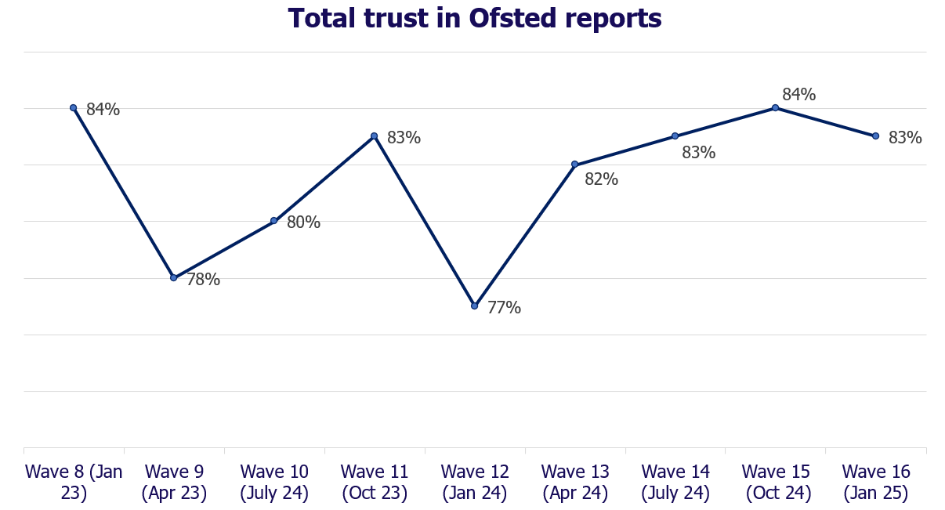
Reform strategy part 2: Maintain public/parental confidence
Balancing sector and parents
Ofsted’s strategic strength stems almost entirely from the faith parents put in us to hold providers to account for standards and safety.
The 2023 crisis of confidence needed arresting, but it was essential not to lose sight of why we exist.
Understanding our strategic strengths allowed for much needed changes, as well as a narrative pivot to focus on children once again.
9

Slide 10
Ofsted on the web and social media
www.gov.uk/ofsted
https://reports.ofsted.gov.uk
www.linkedin.com/company/ofsted
www.youtube.com/ofstednews
www.slideshare.net/ofstednews
www.twitter.com/ofstednews
10

